Slide 1
PROF.HANAN HABIB & PROF A.M.KAMBAL DEPRTMENT OF PATHOLOGY,MICROBIOLOGY UNIT KSU
TUBERCULOSIS
Respiratory Block

Slide 2
Introduction
Tuberculosis (TB) is an ancient ,chronic disease affects humans, caused by Mycobacterium tuberculosis complex.
A major cause of death worldwide.
Usually affects the lungs, other organs can be affected in one third of cases.
If properly treated is curable, but fatal if untreated in most cases.

Slide 3
Epidemiology
TB affects 1/3 of human race ( 2 billions) as a latent dormant tuberculosis.
Incidence: a world wide disease , more common in developing countries.
Affects all age groups who are subject to get the infection.

Slide 4
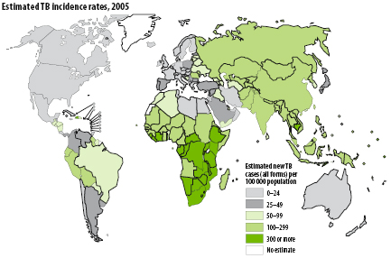

Slide 5
Epidemiology
The WHO estimated 8.9 million new cases in 2004 & 2 - 4 million death.
Incidence :
in KSA : 32-64 cases /100,000
in USA : 5.2 cases/100,000
in South Ease Africa : 290 cases /10,000 due to coupling with HIV infection.

Slide 6
Epidemiology
Transmission mainly through inhalation of airborne droplet nuclei ( < 5 μm) in pulmonary diseases case , rarely through GIT & skin
Reservoir: patients with open TB.
Age: young children & adults
People at risk : lab. technicians, workers in mines, doctors ,nurses. HIV pts., diabetics end stage renal failure, contacts with index case.

Slide 7
Characteristics of the genus Mycobacteria
Slim, rod shaped, non-motile, do not form spores.
Do not stain by Gram stain . Why ?
Contain high lipid conc. ( Mycolic acid ) in the cell wall which resist staining . It is called Acid- alcohol fast (AFB), Why ? it
resists decolorization with up to 3% HCL, 5%
ethanol or both.

Slide 8
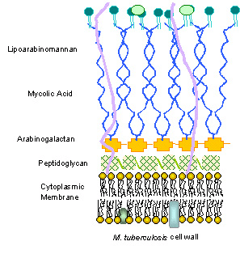

Slide 9
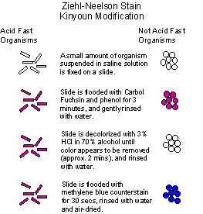

Slide 10
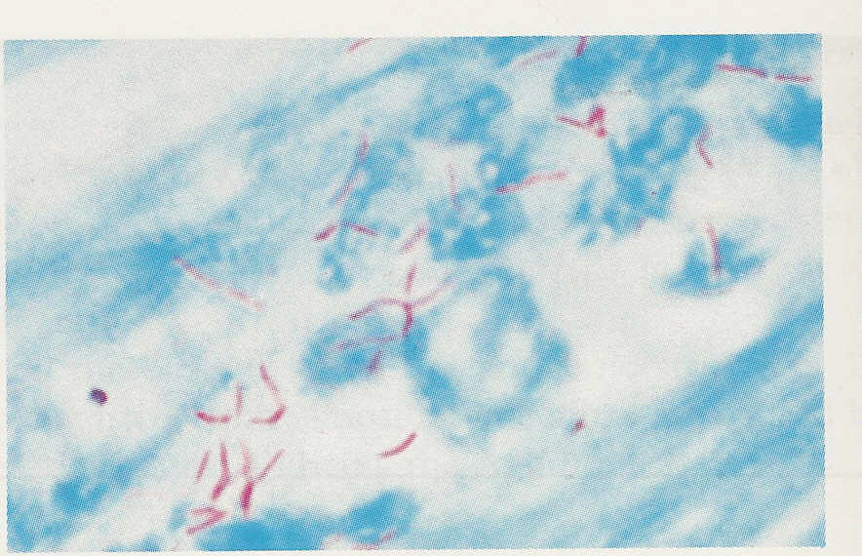
Mycobacterium tuberculosis (approx. x 1000)

Slide 11
Acid-Fast Bacilli (AFB)
Stain used : Ziehl-Neelsen stain (ZN stain)
Strict aerobe
Multiply intracellularily
Delayed hypersensitivity reaction type of immune response
Slowly growing ( 2 - 8 wks.)

Slide 12
Mycobacterium tuberculosis complex
1- M.tuberculosis (Human type)
2- M. bovis (Bovine type)
3- M. Africanum
4- BCG strains
All are called Mycobacterium tuberculosis Complex and cause tuberculosis ( TB) .

Slide 13
Pathogenesis of Tuberculosis
Mycobacteria acquired by airborne droplet reaches the alveolar macrophages , able to survive their ( the main virulence factor).
This starts cell mediated immune response which controls the multiplication of the organism but does not kill it.
Granuloma formed , organism lives in dormant state ( latent tuberculosis infection)

Slide 14
Pathogenesis of Tuberculosis
Patient show evidence of delayed cell mediated immunity ( CMI ).
Disease results due to destructive effect of CMI .
Clinically the disease is divided into primary or secondary .

Slide 15
Pathogenesis of Tuberculosis
Primary Tuberculosis
Occurs in patients not previously infected.
Inhalation of bacilli Phagocytosis lymph nodes calcify to produce GHON focus (or Primary Complex) at the periphery of mid zone of lung.

Slide 16
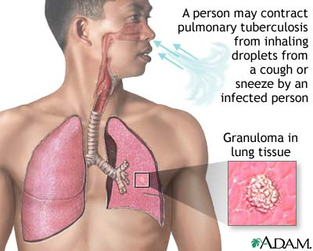
Pathogenesis of TB

Slide 17
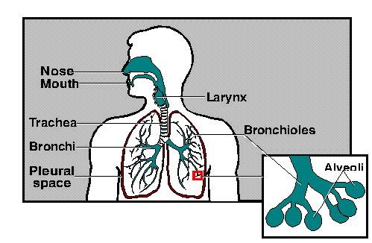

Slide 18
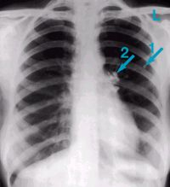

Slide 19
Tuberculosis: (a) Chest X-ray of a patient with tuberculosis bronchopneumonia. (b) Chest X-ray of the same patient 10 months after antituberculous therapy. (Courtesy of Dr. R.S.Kennedy)

Slide 20
Primary Tuberculosis
Microscopy of lesion shows Granuloma.
Clinically: primary TB usually asymptomatic or / minor illness.
Non-pulmonary TB: may spreads from pulmonary infections to other organs eg.:
TB of lymph nodes ( cervical, mesenteric).
TB meningitis
TB bone & joint

Slide 21
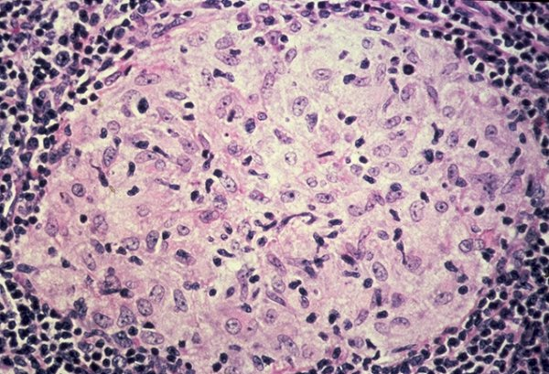

Slide 22
Primary Tuberculosis
Genitourinary TB
Miliary TB (blood and other organs)
Soft tissue (cold abscess): lack of inflammation with caseation.
Caseation: due to delayed hypersensitivity reaction. Contains many bacilli ,enzymes, O₂,N₂ intermediates, necrotic centre of granuloma cheezy material.

Slide 23
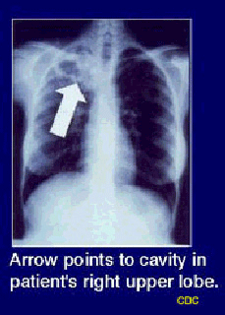
Secondary TB (reactivation)
Occurs later in life
Lung more common site
Immunocompromised patients.
Lesion localized in apices
Infectious & symptomatic
Microscopy: many bacilli, large area of caseous necrosis cavity (open TB) with granuloma and caseation.

Slide 24
Secondary TB
Clinically: fever, cough, hemoptysis ,weight loss & weakness.
Source of secondary TB :
- Endogenous (reactivation of an old TB) or
- Exogenous (re-infection in a previously sensitized patient who has previous infection with the organism).

Slide 25
Immunity to Tuberculosis
Cell-mediated immunity associated with delayed hypersensitivity reaction.
Detected by tuberculin skin test.
Tuberculin test takes 2-10 weeks to react to tuberculin and becomes positive.

Slide 26
Tuberculin Skin Test
Uses purified protein derivative (PPD).
Activity expressed by Tuberculin unit .
Activates synthesized lymphocytes to produce CMI which appear as skin induration.
May not distinguish between active and past infection except in an individual with recent contact with infected case.
Low level activity induced by environmental mycobacteria & previous vaccination.

Slide 27
Methods of Tuberculin Skin Test
Intradermal inoculation of 0.1 ml of PPD , 5TU.
Read after 48-72hrs.
Methods of tuberculin skin test
1- Mantoux test.
2- Heaf test (screening).

Slide 28
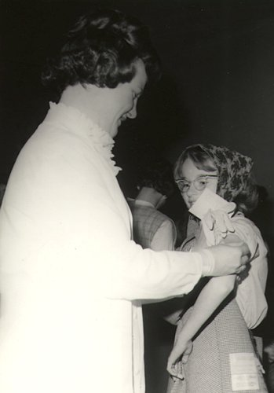
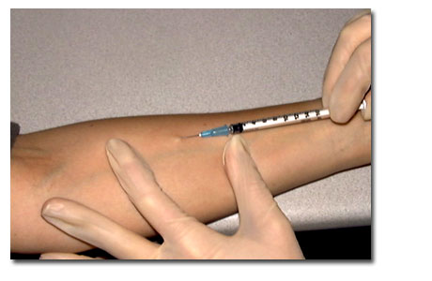

Slide 29
Positive Tuberculin Skin Test
1- >5mm induration positive in :
Recent contact with active TB.
HIV or high risk for HIV
Chest X-ray consistent with healed TB.
2- > 10mm induration positive in:
IV drugs user, HIV seronegative patient.
Medical conditions eg. diabetes , malignancy.

Slide 30
Positive Tuberculin Test
Residents & employee at high risk
Patients from country with high incidence.
Children < 4yrs or exposed to adult high risk group.
Mycobacteriology lab. personnel.
3- >15 mm induration positive in :
any persons including those with no risk factors for TB.

Slide 31
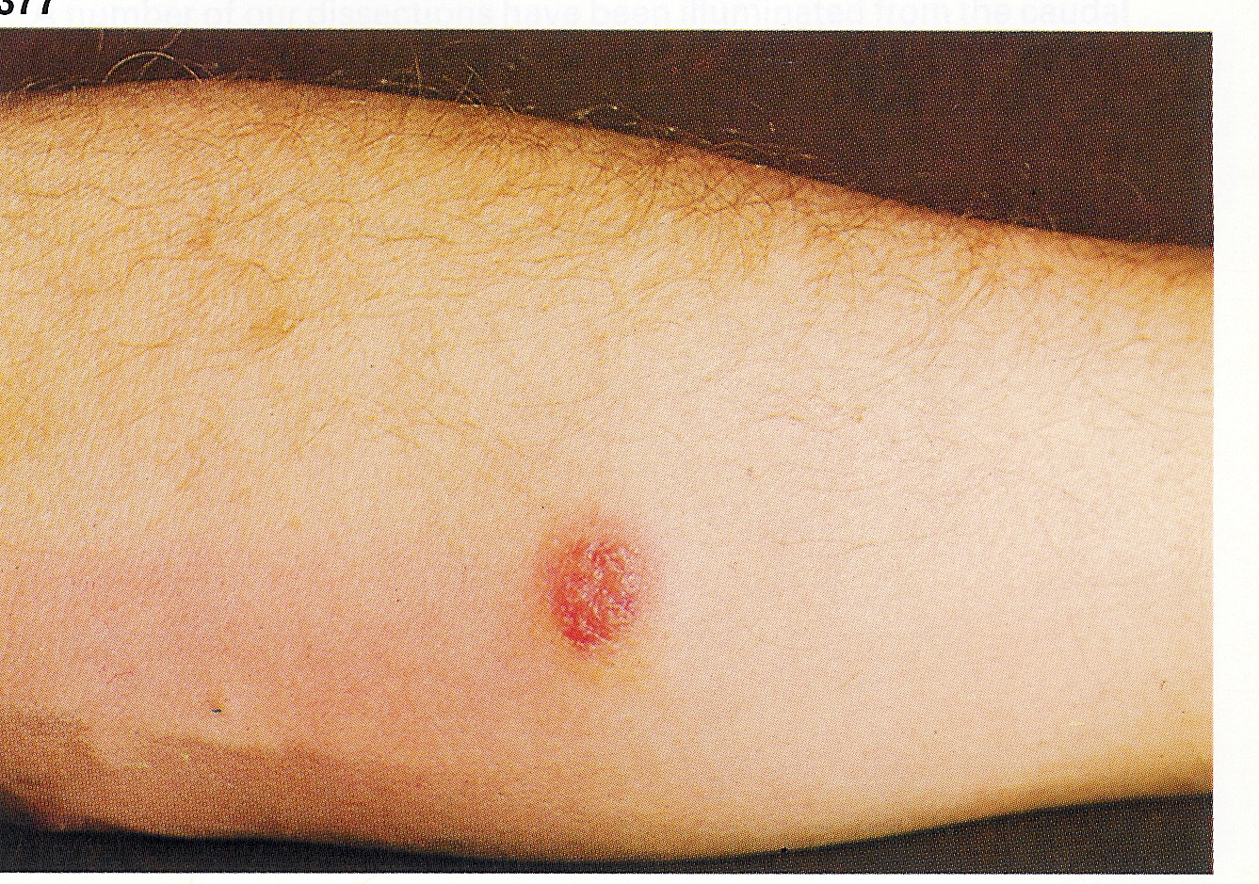
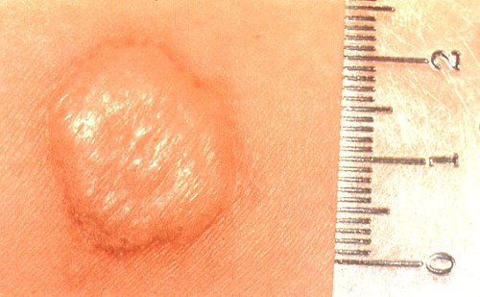

Slide 32
Negative Tuberculin Skin Test
No induration , either due to:
No previous infection
Pre-hypersensitivity stage
Lost TB sensitivity with loss of Ag.
AIDS patients are anergic and susceptible to infection.

Slide 33
Laboratory Diagnosis of TB
1- Specimens:
Pulmonary TB: 3 early morning sputum samples ( or induced cough),or bronchial lavage, or gastric washing (infants) ,…etc.
Cerebrospinal fluid ( CSF) ( TB meningitis)
3 early morning urine
Bone , joint aspirate
Lymph nodes, pus or tissues NOT swab.
Repeat sample .

Slide 34
Laboratory Diagnosis of TB
2- Direct microscopy of specimen :
Z-N or (Auramine ) stain.
3- Culture: the gold standard test for identification and sensitivity.
Media used: Lowenstein-Jensen media (L J).
Media contains: eggs, asparagin, glycerol, pyruvate/ malachite green.

Slide 35
Laboratory Diagnosis of TB
Colonies appear in LJ media after 2-8 weeks as eugenic, raised,buff,adherent growth enhanced by glycerol (MTB) or by pyruvate (M.bovis).
Other media plus LJ media may be used:
Fluid media (middle Brook)
MGIT ( mycobacteria growth indicator test )
Automated methods :- eg. Bactec MGIT.
Measurement of interferon –gamma ( IF-γ) secreted from sensitized lymphocytes challenged by the same mycobacterial proteins in a patient previously exposed to disease, will produce interferon gamma. Has a specific significance than tuberculin skin test.
PCR: molecular test directly from specimen (CSF).

Slide 36
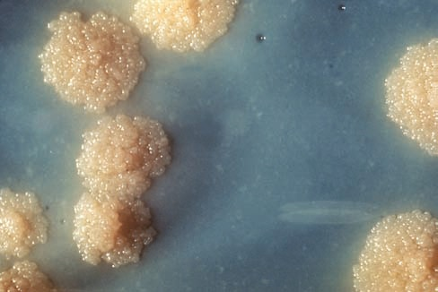

Slide 37
Identification
Morphology , growth at 37C + 5 -10 % CO₂
Biochemical tests : Niacin production & Nitrate test.
Sensitivity testing
Guinea pig inoculation: rarely done.

Slide 38
Management of a TB case
1- Isolation for 10-14 days ( for smear positive cases i.e. > 1000 organisms / ml of sputum considered infectious case ).
Triple regimen of therapy .Why ?
To prevent resistant mutants
To cover strains located at different sites of the lung .
To prevent relapse
2- Treatment must be guided by sensitivity testing.

Slide 39
First Line Treatment
Isoniazide (INH)
Rifampicin (RIF)
Ethmbutol (E)
Pyrazinamide (P)
Streptomycin (S)
INH+ RIF +P for 2 months then continue with INH+RIF for 4-6 months. Multidrug resistant TB is resistance to INH & RIF.
Directly Observed Therapy (DOT).

Slide 40
Second Line
Used if the bacteria was resistant to first line drugs. More toxic than the first line drugs.
PASA ( Para-Amino Salicylic acid)
Ethionamide
Cycloserine,
Kanamycin,
Fluroquiolones

Slide 41
Prevention of TB
Tuberculin testing of herds.
Slaughter of infected animals.
Pasteurization of milk to prevent bovine TB
Recognition of new cases.
Prophylaxis with INH of contacts.
Follow up cases .
Immunization with BCG to all new borne.

