Slide 1
Pneumonia
Community acquired pneumonia
Dr fawzia Alotaibi

Slide 2
Introduction
inflammation of the parenchyma of the lung (the alveoli)
Common in winter months
It is the sixth leading cause of death in USA
over 3 million people develop pneumonia each year and 600,000 hospitalized in United States
Morbidity and mortality of pneumonia are high especially in old people
Almost 1 million annual episodes of CAP in adults > 65 yrs in the US
Histologic spectrum vary
fibrinopurulent alveolar exudate (acute bacterial)
interstitial infiltrates (viral and other atypical pneumonias)
granulomas and cavitation (chronic pneumonias)

Slide 3
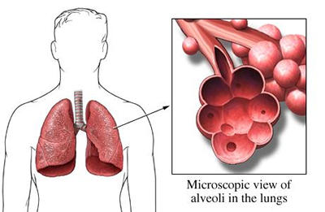
Definition
• Acute infection of the parenchyma of the lung alveoli (consolidation and exudation) caused by:
bacteria, fungi, virus, parasite.
Acute, fulminant
Chronic
• Pneumonia may also be caused by other factors chemical, allergen

Slide 4
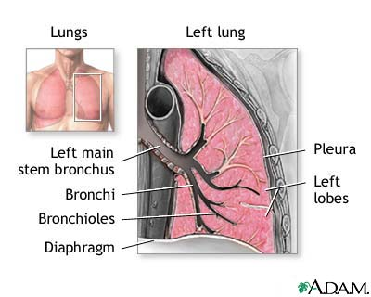
Lung Anatomy

Slide 5
Epidemiology
Risk factors
Age < 2 yrs, > 65 yrs
prior influenza
HIV
alcoholism
smoking
Asthma
Immunosuppression
Chronic lung and heart (S.pneumoniae)
Risk factors
institutionalization
Recent hotel : Legionella
Travel,
occupational exposures-
birds (C- psittaci )
Aspiration
COPD
dementia

Slide 7
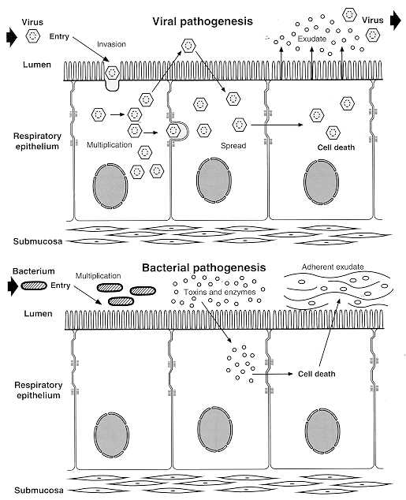
Pathogenesis
Two factors involved in the formation of pneumonia
pathogens
host defenses.

Slide 9
Pathophysiology :
Inhalation or aspiration of pulmonary pathogenic organisms into a lung segment or lobe.
Secondary bacteraemia from a distant source, Escherichia coli urinary tract infection and/or bacteraemia (Less common)

Slide 10
Classification
Anatomy
Lobar: entire lobe
Bronchopneumonia
Interstitial
Pathogen
Gram-positive :Streptococcus pneumoniae , Staphylococcus aureus, Group A hemolytic streptococci
Gram-negative :Klebsiella pneumoniae, Hemophilus influenzae, Moraxella catarrhal and Escherichia coli
Atypical Bacteria :Mycoplasma pneumoniae, chlamydophila pneumoniae and legionella. Anaerobic bacteria
Viral and fungal
Acquired environment: community ,hospital ,nursing home acquired and immunocompromised host

Slide 11
Lobar pneumonia
Bronchopneumonia
Interstitial pneumonia

Slide 12
Pathogens l
Bacterial pneumonia
Typical
Gram-positive bacteria as
Streptococcus pneumoniae
Staphylococcus aureus
Group A hemolytic streptococci
(2) Gram-negative bacteria
- Klebsiella pneumoniae
- Hemophilus influenzae
- Moraxella catarrhal
- Escherichia coli
(3) Anaerobic bacteria

Slide 13
Atypical pneumonia
Legionnaies pneumonia
Mycoplasmal pneumonia
Chlamydia pneumonia
Rickettsias
Fungal pneumonia
Candida
Aspergilosis
Pneumocystis carnii
Viral pneumonia
the most common cause of pneumonia in children < than 5 years
- Adenoviruses
- Respiratory syncytial virus
- Influenza virus
- Cytomegalovirus
- Herpes simplex virus
Pneumonia caused by other pathogen
Parasites
- protozoa

Slide 14
CAP
CAP : pneumonia acquired outside of hospitals or extended-care facilities for > 14 days before onset of symptoms.
Streptococcus pneumoniae (most common)
Drug resistance streptococcus pneumoniae(DRSP) is a major concern.

Slide 15
What is the most common cause of community-acquired pneumonia?
Children
Viral
Respiratory syncetial virus
Parainfluenza virus
Human metapneumovirus
Bacterial
S.pneumoniae
H.influenza type B
Group B streptococci in neonate
Adult
S.pneumoniae
Mycoplasma pneumoniae, chlamydophila pneumoniae
respiratory viruses depending on the season
Special conditions
Chronic lung diseases
S.pneumoniae
H.influenza
Recently hospitalized
Gram negative, legionella
Recent inflenza
S.pneumoniae
S.aureus

Slide 16
What is the difference between typical and atypical community-acquired pneumonia?
Variable | Typical | Atypical
Etiology | S.pneumoniae, H.influenza | Mycoplasma pneumoniae, chlamydophila pneumoniae , legionella, TB, viral or fungal
Clinical presentation | Sudden onset of fever, chill, productive cough, shortness of breath and chest pain | Gradual onset headache, sore throat and body ache
Diagnosis Gram Stain | Useful | Useless (no cell wall)
Radiography | Lobar infiltrate | Dramatic changes: patchy or interstitial
Treatment with penicillin | Sensitive | Resistant

Slide 17
Clinical manifestation lobar pneumonia
The onset is acute
Prior viral upper respiratory infection
Respiratory symptoms
Fever
shaking chills
cough with sputum production (rusty-sputum)
Chest pain- or pleurisy
Shortness of breath

Slide 18
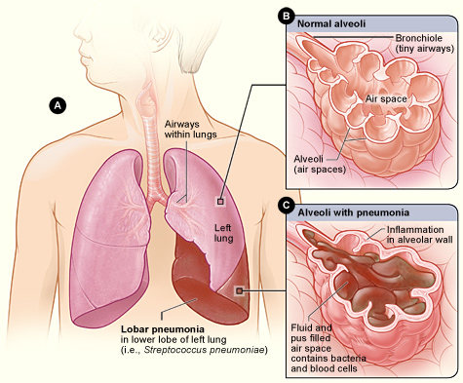
Lobar pneumonia

Slide 19
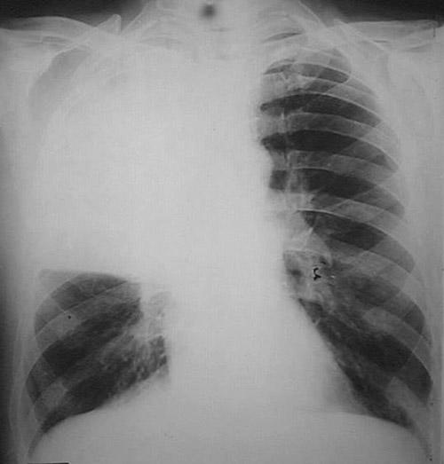
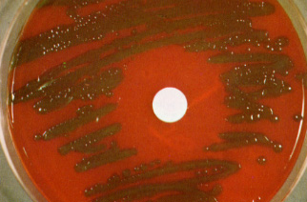
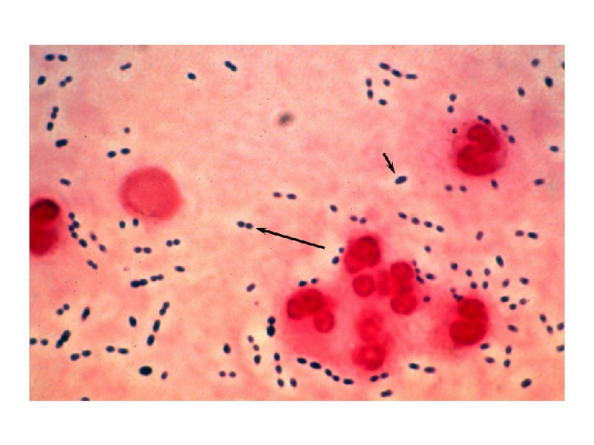
Diagnosis
Clinical
History & physical
X-ray examination
Laboratory
CBC- leukocytosis
Sputum Gram stain- 15%
Blood culture- 5-14%
Pleural effusion culture
Pneumococcal pneumonia

Slide 20
Drug Resistant Strep Pneumoniae
40% of U.S. Strep pneumo CAP has some antibiotic resistance:
PCN, cephalosporins, macrolides, tetracyclines, clinda, bactrim, quinolones
All MDR strains are sensitive to vancomycin or linezolid; most are sensitive to respiratory quinolones
β-lactam resistance – Not for meningitis (CSF drug levels)
PCN is effective against pneumococcal Pneumonia at concentrations that would fail for meningitis or otitis media
For Pneumonia, pneumococcal resistance to β-lactams is relative and can usually be overcome by increasing β-lactam doses (not for meningitis!)

Slide 21
 | PCN Minimum Inhibitory Concentration (MIC) mcg/mL to Streptococcus Pneumonmoniae:
 | Susceptible | Intermediate | Resistant
2008 | MIC ≤ 2 | MIC = 4 | MIC > 8
2007 CAP Guidelines | MIC <2 | --- | MIC > 2
Meningitis | MIC <0.06 | --- | MIC >0.12
Pneumococcal CAP: Be cautious if using PCN if MIC >4. Avoid using PCN if MIC >8.
Remember that if MIC <1, pneumococcus is PCN-sensitive in sputum or blood (but need MIC <0.06 for PCN-sensitivity in CSF).
MIC Interpretive Standards for S. pneumoniae. Clinical Laboratory Standards Institute (CLSI) 2008; 28:123.

Slide 22
Mycoplasma pneumonia
Eaton agent (1944)
No cell wall
Mortality rate 1.4%
Rare in children and in > 65
Associated with M.I. in some literature
Myocarditis
Mycoplasma pneumonia.
common
people younger than 40.
crowded places like schools, homeless shelters, prisons.
usually mild and responds well to antibiotics.
can be very serious
may be associated with a skin rash and hemolysis

Slide 23
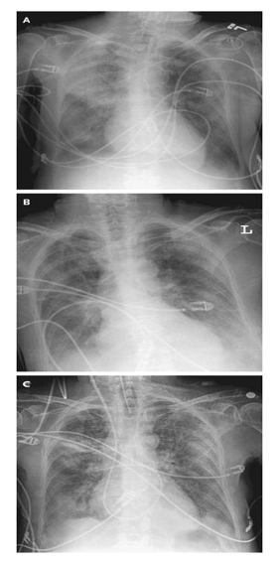
Symptoms
Insidious onset
Mild URTI to severe pneumonia
Headache
Malaise
Fever
dry cough
Arthralgia / myalgia
Signs
Minimal
Few crackles
Rhonchi
Exhaustion
Low grade fever

Slide 24
Legionella pneumophila
Legionnaire's disease.
has caused serious outbreaks.
Outbreaks have been linked to exposure to cooling towers
ICU admissions.

Slide 25
Diagnosis & Treatment of atypical pneumonia
Mild elevation WBC
U&Es
Low serum Na (Legionalla)
Deranged LFTS
↑ ALT
↑ Alk Phos
Cold agglutinins (Mycoplasma)
Serology
DNA detection
Macrolide
Rifampicicn
Quinolones
Treat for 10-14 days

Slide 26
Importance of history taking in patient with community-Acquired pneumonia
History
Solid organ transplant | Any pathogen Bacterial , viral, fungal,or parasitic
HIV | Pneumocystis jeroveci
Travel to some area in USA | Endemic Mycosis
Exposure to air-conditioning, cooling towers, hot tub, hotel stay, grocery sore mist machine | Legionella pneumophilla
Exposure to Turkeys, chickens, ducks or parrots | Chlamydia psittaci
Exposure to contaminated bat caves | Histoplasma capsulatum
Exposure tosheep, goat or cattle | Coxiella burnetii
Exposure to rabbits | Francisella tularensis
Occupation | Mycobacterium tuberculosis, HIV

Slide 27
Evaluate the severity & degree of pneumonia
Is the patient will require hospital admission?
patient characteristics
comorbid illness
physical examinations
basic laboratory findings

Slide 28
Diagnosis
Physical examination
Respiratory signs on consolidation
Other systems
Chest x-ray examination
Laboratory
CBC- leukocytosis
Electrolytes (↓Na in legionella)
Urea, creatinine, LFT

Slide 29
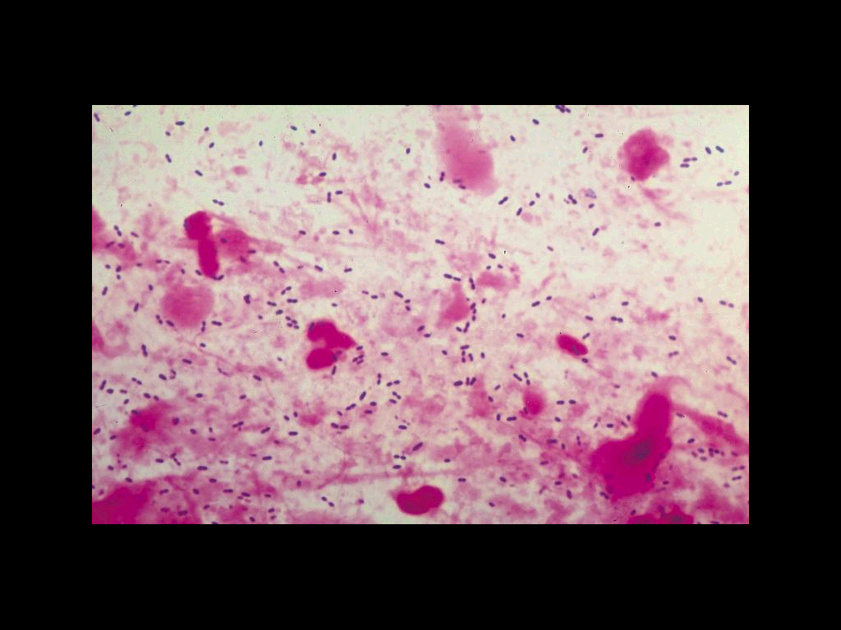
Diagnosis
Sputum Gram stain- 15%
Sputum culture
Bronchoscopic specimens
Blood culture 6-10%
NP swab for respiratory viruses
Legionella urine antigen
Serology for M.pneumoniae, C.pneumoniae
Cold agglutination M.pneumoniae
More Invasive procedure in sick patient

Slide 30
Management
Outpatient or inpatient (hypotension, confusion and oxygenation) and age
Previous treatment in the past 3 months
Resistance patterns in the community

Slide 31
Antibiotics selection
 | Macrolide (Azithromycin or clathromycin) | Fluoroquinolone(FQ) | Ceftriaxone (βlactam)
Outpatient | √
Outpatient with comorbidity and or macrolides treatnet |  | √ | √ + macrolide
Inpatient Non ICU |  | √ | √+ macrolide
Inpatient ICU |  |  | √ +macrolide or FQ

Slide 32
Other Concerns
Organisms | Antibiotics
Pseudomonas | Macrolide + ceftazime or FQs
MRSA | Vancomycin or linazolid
Chlamydophila psittaci | Macrolide or tetracycline
Coxiella burnetti | Macrolide or tetracycline
Legionella | Erythromycin

Slide 33
The diagnostic standard of sever pneumonia
Altered mental status
Pa02<60mmHg. PaO2/FiO2<300, needing MV
Respiratory rate>30/min
Blood pressure<90/60mmHg
Chest X-ray shows that bilateral infiltration, multilobar infiltration and the infiltrations enlarge more than 50% within 48h.
Renal function: U<20ml/h, and <80ml/4h

Slide 34
Complications
Death 10% , 40% (ICU) within 5 days
Mainly old age with sever pneumonia
Respiratory and cardiac failure
Empyema 10%

Slide 35
Prevention
Vaccination
Influenza
S.pneumoniae
Prevention of Aspiration
Head Position
Teeth cleaning

