Slide 1
Health Care Associated Pneumonia Respiratory Block
BY PROF .A.M.KAMBAL and
PROF .HANAN HABIB
Department of Pathology, KSU

Slide 2
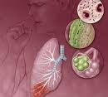
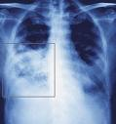
Health Care Associated Pneumonia
Definition of Pneumonia:
Infection of the pulmonary Parenchyma

Slide 3
PNEUMONIA can be :
A-Community acquired Pneumonia acquired in the community, by community acquired organism, eg. Streptococcus pneumoniae usually susceptible to antibiotic.
B-Health care associated pneumonia acquired 48-72 hours after admission to health care institutions eg. pneumonia caused by organisms in hospital which are usually resistant to antibiotics-eg. Pseudomonas aeruginosa

Slide 4
Definition
Nosocomial pneumonia: is defined as hospital associated pneumonia (HAP) or health care associated pneumonia (HCAP).
Occurring at least 48 -72 hours after admission and not incubating at the time of hospitalization.

Slide 5
Health care associated Pneumonia
A- Hospital Acquired Pneumonia(HAP)
B- Ventilator Associated Pneumonia (VAP) in patients with assisted respiration for a period of 48 hours.

Slide 6
Introduction
Nosocomial pneumonia is the 2nd most common hospital-acquired infections after urinary tract infection. Accounting for 31 % of all nosocomial infections.
Nosocomial pneumonia is the leading cause of death from hospital-acquired infections.
The incidence of nosocomial pneumonia is highest in ICU (intensive care unit) patients.

Slide 7
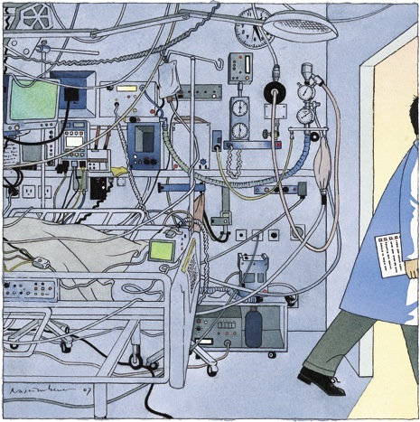
ICU

Slide 8
Introduction
The incidence of nosocomial pneumonia in ventilated patients was 10-fold higher than non-ventilated patients
The reported crude mortality for HAP is 30% to greater than 70%.
--- Medical Clinics of North America
Therapy of Nosocomial pneumonia 2001 vol.85 1583-94

Slide 9
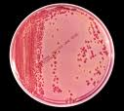
Pathogenesis

Slide 10
Pathogenesis
For pneumonia to occur, at least one of the following three conditions must occur:
1. Significant impairment of host defenses
2. Introduction of a sufficient-size inoculum to overwhelm the host's lower respiratory tract defenses
3. The introduction of highly virulent organisms into the lower respiratory tract
Most common is microaspiration of oropharyngeal secretions colonized with pathogenic bacteria.

Slide 11
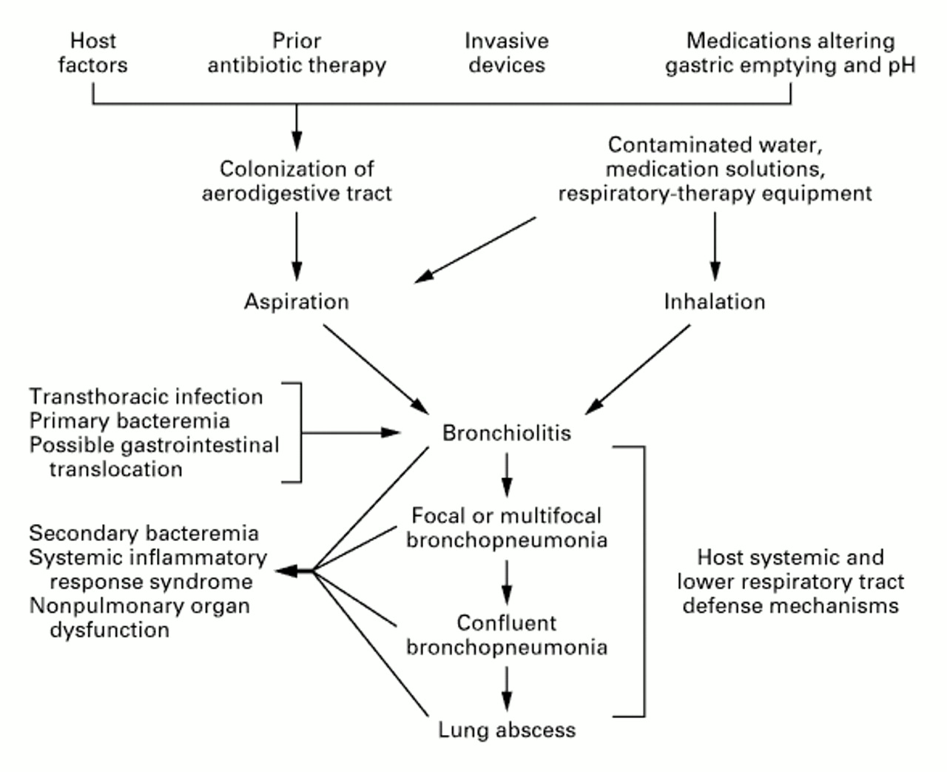
Pathogenesis
--- The Prevention of Ventilator-Associated Pneumonia Vol.340 Feb 25, 1999 NEJM

Slide 12
Classification
Early-onset nosocomial pneumonia:
Occurs during the first 4 days of admission.
Usually is due to S. pneumoniae, MSSA (Methicillin sensitive S.aureus ), H. Influenza, or anaerobes.
Late-onset nosocomial pneumonia:
occurs more than 4 days of admission.
More commonly by Gram negative organisms, especially: P. aeruginosa, Acinetobacter, Enterobacteriaceae (Klebsiella, Enterobacter, Serratia) or MRSA.

Slide 13
Causative Agent
Enteric Gram negative bacilli are isolated most frequently particularly in patients with late-onset disease and in patients with serious underlying disease often already on broad-spectrum antibiotics.
Prior use of broad-spectrum antibiotics and an immunocompromised state make resistant Gram-negative organisms more likely.

Slide 14
Causative Agents
P. aeruginosa and Acinetobacter are common causes of late-onset pneumonia, particularly in the ventilated patients.

Slide 15
Causative Agents
S. aureus is isolated in about 20~40% of cases and is particularly common in :
1. Ventilated patients after head trauma, neurosurgery, and wound infection
2. In patients who had received prior antibiotics or
Prolonged care in ICU
MRSA(methicillin resistant S.aureus) is seen more commonly in patients who:
Received corticosteroids
Undergone mechanical ventilation >5 days
Presented with chronic lung disease
Had prior antibiotics therapy

Slide 16
Causative Agents
Anaerobes are common in patients predisposed to aspiration .
Ventilator associated pneumonia (VAP ) with anaerobes occurred more often with oropharyngeal intubation than nasopharyngeal intubation.

Slide 17
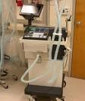
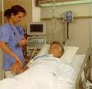
Ventilator-associated Pneumonia (VAP)

Slide 18
Ventilator-associated Pneumonia (VAP)
Definition:
Nosocomial pneumonia that has developed in patient who are receiving mechanical ventilation.
Classification:
Early-onset: within 48-72 hours after tracheal intubation, which complicates the intubation process
Late-onset: after 72 hours

Slide 19
Pathogenesis
Requires 2 important processes:
1. Bacterial colonization of the aerodigestive tract
2. Aspiration of contaminated secretion into the
Lower airway
Prevents mechanical clearance by cough and the mucociliary escalator.

Slide 20
Prevention for VAP
The oral regimen (topical Gentamicin, Colistin, Vancomycin cream given every 6hours for 3 weeks) treating oropharyngeal colonization could prevent VAP.
--- Prevention of VAP by oral decontamination
American journal of respiratory critical care medicine2001 164:382-8

Slide 21
Preventions for VAP
Non-pharmacologic strategies
Effective hand washing and use of protective gowns and gloves
Semirecumbent positioning
Avoidance of large gastric volume
Oral (non-nasal) intubation
Continuous subglottic suctioning
Humidification with heat and moisture exchanger
Posture change
--- The Prevention of Ventilator-Associated Pneumonia Vol.340 Feb 25, 1999 NEJM

Slide 22
Preventions for VAP
Pharmacologic strategies
Stress-ulcer prophylaxis
Combination antibiotic therapy
Prophylactic antibiotic therapy
Chlorhexidine oral rinse
Prophylactic treatment of neutropenic patients
Vaccines
--- The Prevention of Ventilator-Associated Pneumonia Vol.340 Feb 25, 1999 NEJM

Slide 23
Treatment
Most initial therapy is empiric because no pathogen is identified or results are not available when antimicrobial decisions are made in most patients.

Slide 24
Treatment
Initially be treated with a broad-spectrum antibiotic regimen aimed at covering all likely bacterial pathogen
This regimen should subsequently be narrowed, according to the result of culture

Slide 25
Treatment
The pathogen may be influenced by coexisting illnesses, prior treatment, and length of hospitalization.
The frequency of ICU-acquired P. aeruginosa carriage or colonization/infection was 23.4% at 7 days and 57.8% at 14 days.
---- Current opinion in infectious disease 2002, 15:387-94, copyright LWW

Slide 26
Treatment
The mortality can be reduced with early appropriate empiric therapy.
(Form 30 % with appropriate therapy to more than 90 % with inappropriate therapy) .
----

Slide 27
Treatment
Guidelines by American Thoracic Society has divided patients into three groups, each with a set of probable pathogens.
Group 1: mild to moderate HAP with no risk factor
Group 2: mild to moderate HAP with risk factor
Group 3a: severe HAP, early-onset with no risk factor
Group 3b: severe HAP, late-onset or with risk factor

Slide 28
Treatment
For mild-to-moderate HAP, monotherapy has been shown to be effective.
For severe HAP in which infection with resistant organisms is likely, combination therapy probably should be instituted until culture result are available.

Slide 29
Treatment
Patients with S. aureus infection, agents against this organism are necessary, including Vancomycin if MRSA is suspected.
Linezolid is comparable with Vancomycin.
The advantage of Linezolid is less possible nephrotoxicity.
---- current opinion in infectious disease 2002, 15:387-94, copyright LWW

Slide 30
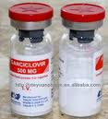
Treatment
Combination of antipseudomonal drugs is controversial:
Traditional:
antipseudomonal Beta-lactam with an Aminoglycoside. Synergy but potential nephrotoxicity.
2. Another approach:
antipseudomonal Beta-lactam with a Fluoroquinolone. No benefit of synergy but reduce concern of nephrotoxicity, and quinolone gets into the lungs at higher concentrations.

Slide 31
Response to Therapy
If no clinical response is noted or deterioration occurs, we need to consider:
1. Infectious causes:
Resistant pathogen
Superinfection
Unusual pathogens
Lung abscess
Extrapulmonary infection
2. Noninfectious events:
Heart: congestive heart failure (CHF)
Lung: fibroproliferative acute respiratory distress syndrome (ARDS), pulmonary emboli, Atelectesis.

