Slide 1

Lecture Title:
Respiratory Fungal infections II
(Respiratory Block, Microbiology)
Lecturer name: Dr. Ahmed M. Al-Barrag
Lecture Date: 18-2-2012

Slide 2

Lecture Objectives..
Students at the end of the lecture will be able to:
Acquire the basic knowledge about fungal infections of the respiratory system
know the main fungi that affects the respiratory system
Identify the clinical settings of such infections
Know the laboratory diagnosis, and treatment of these infections.

Slide 3
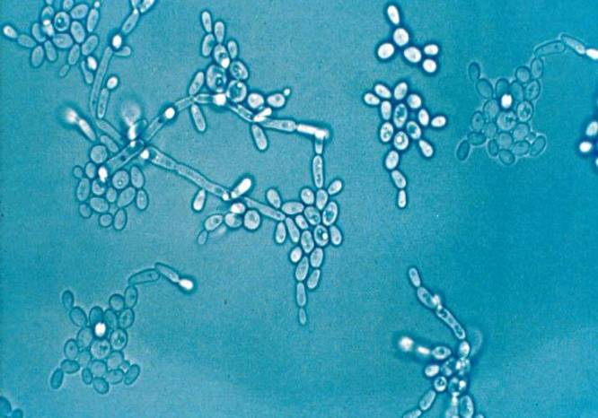
Candidiasis
Candidiasis refer to infection caused by any of the > 160 species of the genus Candida
Candida : Yeasts
  Pseudohyphae
Candida albicans is the most common species causing candidiasis.
  Other species include:
      Candida glabrata,
      Candida tropicalis,
      Candida parapsilosis,
      Candida krusei

Slide 4
Candida
Part of the endogenous flora
  Skin
  Gut
  Mucosal surfaces
Most infections are due to person’s own flora
Portal of entry:
  Breach in skin or mucosa by catheters, trauma, surgery
Endogenous source for majority of Candida infections
Exogenous transmission?

Slide 5
Candidiasis
High-risk patients
  AIDS
  Surgery
  Malignancy
  Leukopenia
  Burns
  Premature infants
Exposures
    ICU >7 days
    CVCs
    Antibiotics
    TPN

Slide 6
Candidiasis
Disease spectrum
  Infections of the skin and nail
  Gastrointestinal infections (oral cavity, esophagus)
  Infection of genitalia (female)
  Urinary tract infection (lower and upper UTIs)
  Ocular infections (Keratitis, endophthalmitis)
  Candidemia
  CNS infection
  Deep organ Candidiasis
  Pneumonia
  Endocarditis
  Bone and joint infections
  Chronic mucocutaneous candisiasis (CMC) (congenital, immunological defect)

Slide 7
Candidiasis
Mucocutaneous & Cutaneous infections
Oral thrush:
White or grey Pseudomembranous patches on oral surfaces especially tongue with underlying erythema.
Common in neonates, infants, children, elderly,
compromised host, AIDS.
Esophagitis
Diaper rash

Slide 8
Pulmonary Candidiasis
Primary pneumonia is less common and could be a result of Aspiration
Secondary pneumonia commonly seen with hematogenous candisiasis
Immunocompromised patients
Isolation of Candida from sputum, BAL is not always significant
  Clinical features
  Radiology,
Other yeast causing Pulmonary infections
  Trichosporon
  Geotrichum

Slide 9
Candidemia
  Increased colonization (endogenous or exogenous factors)
  Damage in host barriers by catheters, trauma, surgery
  Immunosuppression
  Central venous catheters (CVC)
Disseminated candidiasis (envolment of any organ)
Septic shock
Meningitis
Ocular involvement (retinitis)
Fever could be the only clinical manifestation

Slide 10
Candida- Nosocomial Bloodstream Infection
Candida is the fourth in causing nosocomial bloodstream infections (BSI)
Wisplinghoff H, et al. Clin Infect Dis. 2004;39:309-317.

Slide 11
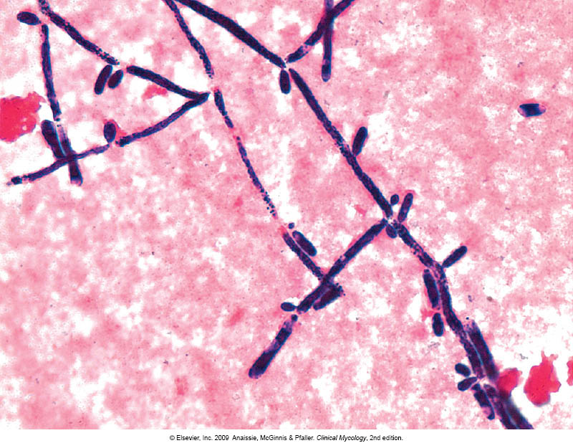
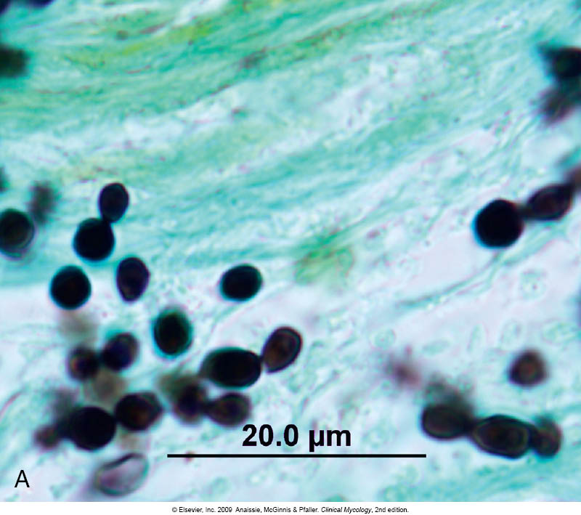
Candidiasis - diagnosis
Laboratory Diagnosis:
Specimen depend on site of infection.
Swabs, Urine, Blood, Respiratory specimens, CSF, Blood for serology
Direct microscopy :
Gram stain, KOH, Giemsa, GMS, or PAS stained smears.
Budding yeast cells and pseudohyphae will be seen in stained smear or KOH.

Slide 12
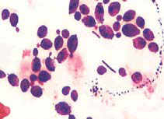
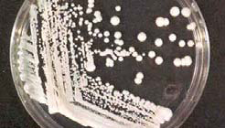
Candidiasis - diagnosis
Culture:
on SDA & Blood agar at 37ºC,
creamy moist colonies in 24 - 48 hours.
Blood culture

Slide 13
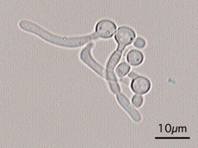
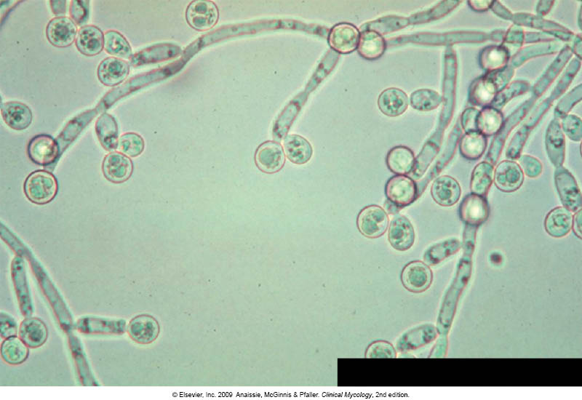
Candidiasis - diagnosis
Because C. albicans is the most common species to cause infection
We use do the follwoing tests to identify C. albicans
  1. Germ tube test
  Formation of germ tube when cultured in serum at 37ᵒC
  Chlamydospore production in corn meal Agar
  3. Resistance to 500 μg/ml Cycloheximide
If these 3 are positive yeast is C.albicans,
If negative, then it could be any other yeast,
  Use Carbohydrate assimilations and fermentation.
  Commercial kits available for this like: API 20C, API 32C
Culture on Chromogenic Media (CHROMagar™ Candida)
Germ tube test
Chlamydospores of C. albicans in CMA

Slide 14
Candidiasis - diagnosis
Serology:
Patient serum
  Test for Antigen , e.g. Mannan antigen using ELISA
  Test for Antibodies
PCR

Slide 15
Treatment of Candidiasis
Oropharyngeal:
Topical Nystatin suspension, Clotrimazole troches ,Miconazole, Fluconazole suspension.
Vaginitis:
Miconazole, Clotrimazole
Systemic treatment of Candidiasis:
Fluconazole
  Voriconazole
  Caspofungin
  Amphotericin
  In candidemia :
  Treat for 14 days after last positive culture and resolution of signs and symptoms
  Remove intravascular catheters, if possible

Slide 16
In Vitro Susceptibility of Candida spp.
  Antifungal susceptibility testing in not done routinely in the microbiology lab.
  It is done in the following cases:
    For fungi isolated from sterile samples
    If the patient is not responding to treatment
    In case of recurrent infections
  Points to consider:
  C. glabrata can be less susceptible or resistant to fluconazole
  C. krusei is resistant to fluconazole

Slide 17
Pulmonary Cryptococcosis
Causative agent
Cryptococcus neoformans
C. gattii
  A typical yeast with a thick capsule
Source of infection
Pigeon or birds droppings & contaminated soil
Pathogenesis
  Human infection by inhalation
  infections could be asymptomatic
  May develop pneumonia, disseminate to CNS causing
  meningitis (immunological status of the host)
  Pulmonary disesae can be seen in immunocompetent host (rare)
  Meningitis and disseminated disease in immunocompromised hosts

Slide 18
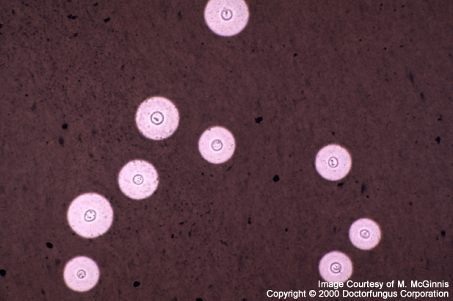
Cryptococcosis
Lab Diagnosis
Samples :
  Respiratory sample
  If meningitis developed, collect a CSF sample
1. Direct microscopy
  Giemsa stain and GMS stain
  If CSF sample, do India Ink preparation
If positive: Yeast cell with a thick capsule
2. Culture on SDA
Identify using API 20C , Urease +ve
Phenol oxidase +ve

Slide 19
Cryptococcosis
Treatment
Systemic fungal agents
Amphotericin B
Combination of Amphotericin B & flucytosine

Slide 20
Pneumocystosis (PCP)
Opportunistic fungal pneumonia
It is interstitial pneumonia of the alveolar area.
Affect compromised host
Especially common in AIDS patients.
Etiology:
Pneumocystis jiroveci
Previously thought to be a protozoan parasite, but later it has been proven to be a fungus
Does not grow in laboratory media e.g. SDA
Naturally found in rodents (rats), other animals (goats, horses), Humans may contract it during childhood

Slide 21
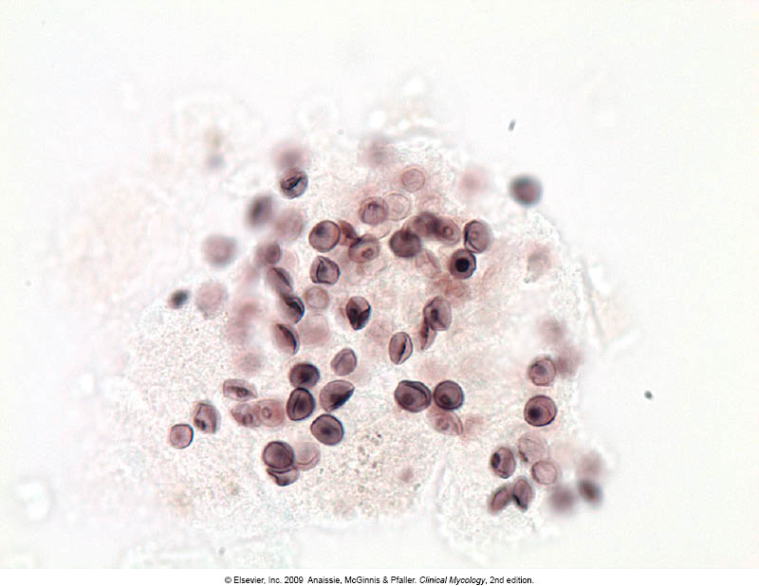
Pneumocystosis
Laboratory Diagnosis:
Patient specimen: Bronchoscopic specimens (B.A.L.), Sputum, Lung biopsy tissue.
Histological sections or smears stained by GMS stain.
Immunuofluorescence (better sensitivity)
  If positive will see cysts of hat-shape,
  cup shape, crescent
Treatment:
Trimethoprim – sulfamethoxazole
Dapsone

Slide 22
Thank You ☺
(Respiratory Block, Microbiology)
Dr. Ahmed M. Al-Barrag
18-2-2012

