Slide 1
Respiratory Tract Infection
DR MONA BADR
Assistant Professor & Consultant Virologist College of Medicine & KKUH

Slide 2
Respiratory Tract Infections
Are the commonest of human infection and cause a large amount of morbidity and loss of time at work (sick leave).
Are common in both children and adults.
Mostly caused by viruses.
Mostly are mild and confined to the upper respiratory tract (URT).
Mostly are self-limiting disease.
URT-infection may spread to other organs causing more severe infection and death.

Slide 3
Viral Infection of Respiratory Tract
Influenza virus Orthomyxoviridae
Rhinovirus Picornaviridae family
Coronavirus Coronaviridae family
Para influenza viruses Paramyxoviridae family
Respiratory Synctial viruses Paramyxoviridae
Adenovirus Adenoviridae family.

Slide 4
Orthomyxoviridae Family Orthomyxoviruses Influenza Virus
1) Single, Stranded negative sense RNA with 8 helical segments
2) Helical capsid symmetry
3) Enveloped viruses which contains 2 projecting glycoprotein spikes.
Heamagglutinin HA attachment.
Antibodies to the HA is responsible for immunity.
Neuroamindase NA an enzyme help in releasing progeny virus formation from infected cell.

Slide 5
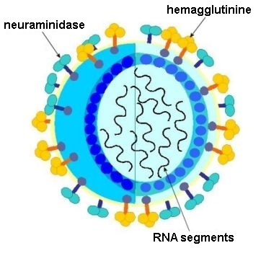

Slide 6
Influenza Virus
Epidemiology:
Winter months mostly
Influenza A can cause epidemic and pandemic which is usually associated with Antigenic shift, while Influenza B can cause outbreaks & epidemic which associated only with Antigenic drift.
.

Slide 7
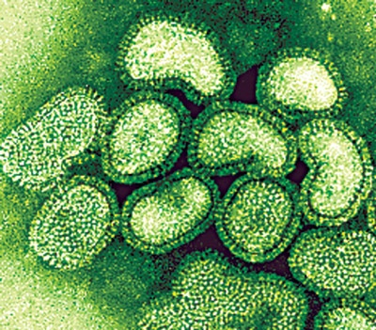

Slide 8
Types of Influenza Viruses
Influenza A
Influenza B
Influenza C
Infect human and
animals.
Infect human
Infect human only
Cause outbreaks&epidemc
Cause mild illness
Can cause epidemic
and pandemic in man
epizootic.
Antigenic drift
Antigenic drift only
antigenic shift.

Slide 9
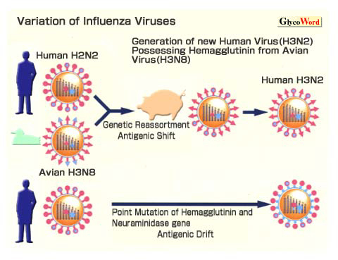

Slide 10
Pathogenesis and Immunity:
Influenza virus establish a local upper respiratory tract infection.
According to the immunity of the host, it can cause localized infection or spread to the lower respiratory tract infection.
Vireamia usually occurs(fever) .
Influenza infection is self limiting condition.

Slide 11
Clinical Syndrome:
Transmission inhalation of respiratory secretion
Incubation period 1 - 4 days
Seasonal variation usually in winter
Symptoms: Sudden onset of fever
Malaise – Headache
Sneezing – sore throat - It takes 3 days.
Non-productive cough

Slide 12
Complication of Influenza:
Primary Influenza Pneumonia.
2nd bacterial pneuomonia Strep. pneumoniae, H.influenzae
Myositis(inflammation of the muscle).
Post influenza encephalitis.
Bronchial Asthma.
Sinusitis.
.

Slide 13
Laboratory Diagnosis:
Specimen: Nasopharyngeal aspirate, nasal washing.
Rapid and direct detection of influenza A or B from nasopharyngeal aspirate by immunofluorescence &ELISA. This is the most common laboratory diagnosis.
PCR (Nucleic acid testing)

Slide 14
Treatment:
Amantadine: Is only effective against influenza A virus.
inhibiting the un coating step of influenza A virus.
It has both therapeutic and prophylactic .
It significantly reduced the duration of fever and
illness is given to high risk group of patients who are
not vaccinated because they have allergy from egg.

Slide 15
Tamiflu (Oseltamivir)
It is Neuraminidase inhibitor that act by blocking the viral enzyme neuraminidase which help the influenza virus invade respiratory tract cells is effective against Influenza A&B.
It has to be given within the first 48 hours after the exposure of cases or appearance of symptoms.
Recommended dose is 75 mg twice daily for 5 days.

Slide 16
INFLUANZA VACCINE
Tow types of vaccine ,both contain the current influenza A & B .
Vaccine should be given in October or November ,before the influenza season begins.
Yearly booster dose recommended.

Slide 17
1-The Flu shot vaccine
Inactivated (Killed vaccine),
Given to people older than 6 months, including healthy people as well as high risk groups (elderly, patients with chronic pulmonary or cardiac diseases).

Slide 18
2-The Nasal spray flue vaccine(Flu mist)
This is a live attenuated vaccine.
Approved for use in healthy people only between 5- 49 years age.

Slide 19
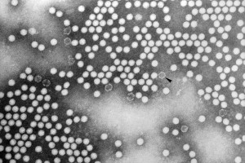
2- Rhinovirus
Family: Picornaviridae.
Non-enveloped virus with + polarity ssRNA genome, more than 100 serotypes available.
Transmission: Inhalation of infectious aerosol droplets.
Clinical symptoms: The 1st cause of common cold. The main symptoms of common cold are sneezing, clear watery nasal discharge with mild sore throat and cough.
Lab diagnosis: Direct detection of the Ag from NPA by direct I.F.
Treatment and prevention: Usually self-limiting disease, no specific treatment, and no vaccine available.

Slide 20
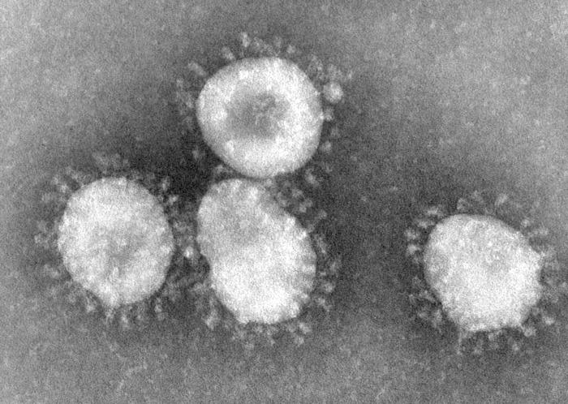
3-Coronaviruses
The name Coronavirus means Crown
(when viewed with an electron microscope).
ssRNA enveloped with positive polarity.
Coronavirus are 2nd cause of common cold .

Slide 21
Clinical presentation of common cold:
Symptoms runny nose, sneezing and nasal obstruction, mild sore throat, headache and malaise that last for one week.
Complication: Usually due to secondary bacterial infection
Acute sinusitis 2) Acute otitis media.
3) Exacerbation of chronic bronchitis ,bronchial asthma.
Laboratory Diagnosis:
Usually no need.
Treatment and Prevention:
No specific treatment.
No vaccine available.

Slide 22
Coronavirus
* Severe Acute Respiratory Syndrome (SARS)
In winter of 2002, a new respiratory disease known as (SARS) emerged in China.
A new mutation of coronavirus, a zoonotic disease, the animal reservoir may be cat, and cause atypical pneumonia with difficulty in breathing.
Treatment and prevention: No specific treatment or vaccine available.

Slide 23
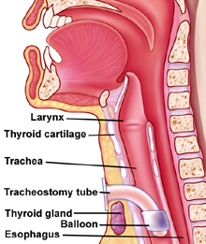
4- Parainfluenza Virus
Family: Paramyxoviridae.
Structural features: Enveloped virus with negative polarity ssRNA genome, with 5 serotypes.
Transmission: Inhalation of infectious aerosol droplets mainly in winter.
Clinical syndrome:
Croup or acute laryngotracheobronchitis. P.I. Type I, II mainly in infants and young children. Fever, harsh cough, difficult inspiration can lead to airway obstruction need hospitalization to do tracheostomy.
Bronchiolitis and Pneumonia: P.I. Type III in young children.

Slide 24
Continued.. Parainfluenza Virus
Lab diagnosis: Direct detection from N.P.A by direct I.F.
Treatment and prevention: Supportive treatment, No specific treatment or vaccine available.

Slide 25
5-Respiratory Syncytial Virus (RSV)
One of the paramyxoviridae family.
Enveloped ,ss RNA .
The virus transmitted by respiratory droplets, virus is very
contagious with( I.P. 3-6 days) infection mainly in winter.
The importance of RSV lies in its tendency to invade the lower respiratory tract of infant <6 months
Bronchiolitis & pneumonia ,,

Slide 26
Clinical Syndromes:
RSV can cause any respiratory tract illness from common cold pneumonia
In old children and adult can cause common cold .
Bronchiolitis an important and life –threatening disease in infant especially under 6 months of life, started with fever, nasal discharge, rapid breathing, respiratory distress and cyanosis, it may be fatal in premature infant or infant with underlying disease or immunocompromised infant, also can lead to chronic lung disease in later life.
Pneumonia: also an important and life threatening disease in infant with case fatality rate of 2-5% .

Slide 27
Laboratory Diagnosis:
Isolation of the virus from nasopharyngeal aspirate OR mouth wash in cell culture will appear as multinucleated giant cell (syncitia).
ELISA and immunofluorescent for direct detection from
nasopharyngeal aspirate.

Slide 28
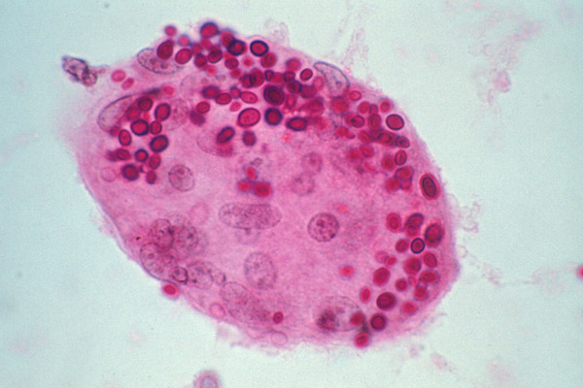
Syncitia multinucleated giant cell

Slide 29
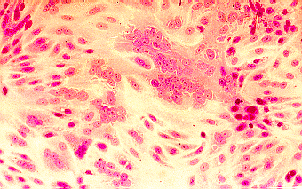
Isolation in cell culture
(multinucleated giant cells or syncytia)

Slide 30
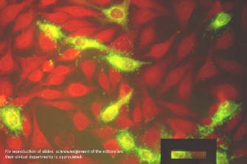
Immunoflurescence on smears of respiratory secretions

Slide 31
Treatment and Prevention:
Infant will be hypoxic and need hospitalization
(oxygen inhalation).
Ribavirin given by inhalation to treat severe
Bronchiolitis and pneumonia.
Passive immunization with anti-RSV immunoglobulin is
available for premature infant.
Hospital staff caring for these isolated infants have to follow
control measure as hand washing, wearing of gowns, goggles and
mask.
No vaccine is available.

Slide 32
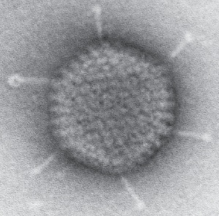
Adenovirus
Structural features: Non-enveloped virus with ds-DNA genome.
Pathogenesis: Adenovirus infects epithelial cell lining respiratory tract, conjunctiva, urinary tract, gastrointestinal tract and genital tract, Adenovirus has the tendency to be
Latent in lymphoid tissue.
Clinical syndrome:
Phrayngitis and tonsilitis.
Pharyngioconjunctivitis
Keratoconjunctivitis.
Pneumonia: in preschool children.
Gastroenteritis.
Acute hemorrhagic cystitis.
Cervicitis and urethritis.
TTT &prevention: No specific treatment or vaccine.

Slide 33
Good luck

