Slide 1
Respiratory Fungal Infections
Dr. Ahmed Al-Barrag
Asst. Professor of Medical Mycology
School of Medicine and the University Hospitals
King Saud University

Slide 2
Respiratory fungal ifections
Respiratory System
Rout of infection?
Oral Cavity, any role?
Respiratory fungal infections are less common than viral and bacterial infections.
Are opportunistic infections
  Diseases in immunocompromised mainly , rarely in healthy hosts
Have significant difficulties in diagnosis and treatment.

Slide 3
Risk factors
  AIDS
  Bone marrow/ organ transplantation
  Cancer: Leukemia, lymphoma etc
  Drugs: Cytotoxic drugs, steroids etc
  Endocrine related: Diabetes
  Failure of organs
  Other factors
  Increased survival of premature neonates
  More elderly pts.
  Long Stay in hospital/ ICU
  Surgery
  Devices

Slide 4
Respiratory fungal infection - Etiology
YEAST
  Candidiasis (Candida and other yeast)
  Cryptococcosis (Cryptococcus neoformans, C. gattii)
Pneumocystosis (Pneumocystis jiroveci)
Opportunistic
Mould fungi
  Aspergillosis (Aspergillus species)
  Zygomycosis (Zygomycetes, e.g. Rhizopus, Mucor)
  Other mould
Dimorphic fungi
  Histoplasma capsulatum
  Blastomyces dermatitidis
  Paracoccidioides brasiliensis
  Coccidioides immitis
Primary infections

Slide 5
Primary Systemic Mycoses
  Infections of the respiratory system
  Dissemination seen in immunocompromised hosts
  Common in North America and to a lesser extent South America. Not common in other parts of the World.
  Etiologies are dimorphic fungi.
  In nature found in soil of restricted habitats.
  Primary pathogens
  Some are highly infectious
  They include:
  Blastomycosis,
  Histoplasmosis,
  Coccidioidomycosis,
  Paracoccidioidomycosis

Slide 6
Aspergillosis
Aspergillosis is a spectrum of diseases of humans and animals caused by members of the genus Aspergillus.
These include
(1) mycotoxicosis
(2) Allergy
(3) Colonization (without invasion and extension ) in preformed cavities
(4) Invasive, inflammatory, granulomatous, necrotizing disease of lungs
(5) systemic and disseminated disease.
The type of disease and severity depends upon the physiologic state of the host and the species of Aspergillus causing the disease.
Aetiological Agents: Aspergillus species,
common species are A. fumigatus, A. flavus, A. niger, A. terreus and A. nidulans.

Slide 7
CLASSIFICATION OF ASPERGILLOSIS
Invasive aspergillosis
Airways/nasal exposure to airborne Aspergillus
Chronic aspergillosis (>3 months)
Chronic cavitary pulmonary
Aspergilloma of lung
Maxillary (sinus) aspergilloma
Persistence
without disease
colonisation of
the airways or nose/sinuses
Allergic
Allergic bronchopulmonary (ABPA)
Allergic Aspergillus sinusitis

Slide 8
Aspergillosis
Chronic Aspergillosis (Colonizing aspergillosis)
(Aspergilloma OR Aspergillus fungus ball)
    Signs include: Cough, hemoptysis, variable fever
    Radiology will show mass in the lung , radiolucent crescent
Invasive pulmonary Aspergillosis
    Signs: Cough , hemoptysis, Fever, Pneumonia, Leukocytosis
    Radiology will show lesions with halo sign

Slide 9
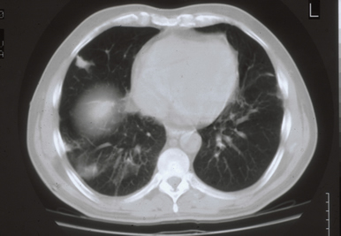
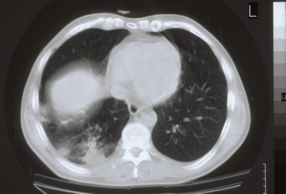
Invasive pulmonary aspergillosis in AIDS
Note the Halo sign

Slide 10
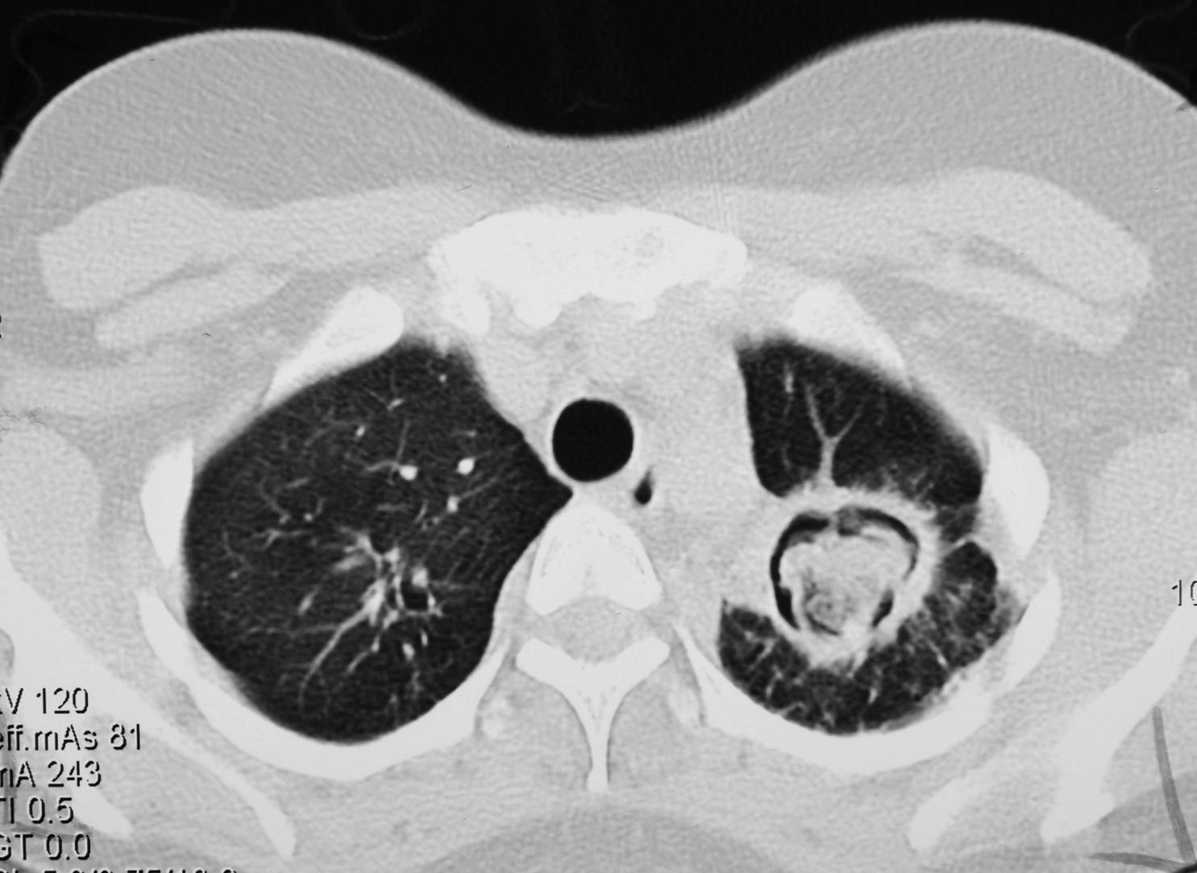
Simple (single) aspergilloma
Note the Air crescent

Slide 11
Allergic bronchopulmonary (ABPA)
Hx Asthma
Bronchial obstruction
Fever, malaise
Eosinophilia
Wheezing +/-
Also:
Skin test reactivity to Aspergillus
Serum antibodies to Aspergillus
Serum IgE > 1000 ng/ml
Pulmonary infiltrates

Slide 12
A link between airborne fungi and severe asthma?

Slide 13
Common airborne Fungi
Aspergillus niger
Aspergillus fumigatus

Slide 14
Other important airborne fungi
Rhizopus

Slide 15
Skin test
  Allergy to fungi

Slide 16
AIR QUALITY
  Nosocomial pulmonary Aspergillosis
  > 500 cases of POST-OPARATIVE ASPERGILLOSIS

Slide 17
Fungal sinusitis

Slide 18
Fungal Sinusitis
Clinical:
Nasal polyps – and other symptoms of sinusitis
Could disseminate to – eye craneum (Rhinocerebral)
The most common cause in KSA is Aspergillus flavus
In addition to Aspergillus, there are other fungi that can cause fungal sinusitis
Aspergillus sinusitis has the same spectrum of Aspergillus disease in the lung
Diagnosis
  Clinical and Radiology
  Histology of mucosa and mucous is important to determining disease classification and management
  Culture
  Precipitating antibodies useful in diagnosis
  Measurement of IgE level, RAST test
Treatment :
depends on the type and severity of the disease and the immunological status of the patient

Slide 19
Diagnosis

Slide 20
Diagnosis
Specimen:
  Respiratory specimens: Sputum, BAL, Lung biopsy,
  Other samples:
  Blood, etc.
Lab. Investigations:
  Direct Microscopy:
  Periodic Acid Schiff (P.A.S); KOH, Giemsa, Grecott methenamine silver stain (GMS)
  will show fungal septate hyphae with Dichotomous branching
  Culture on SDA
  Serology: Primarily test for Antibody using Aspergillus polyvalent Ag, Aspergillys terreus Ag, Aspergillus nidulans Ag.
  Using I.D (Immunodiffusion)and/or C.I.
  EELISA test for galactomannan Antigen is available with better sensitivity

Slide 21
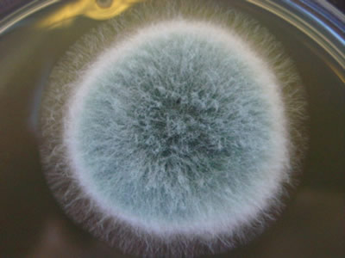
Cultures for Aspergillus from sputum and BAL
Yield in IA from BAL and sputum is not satisfactory
Bacteriological media inferior to fungal media

Slide 22
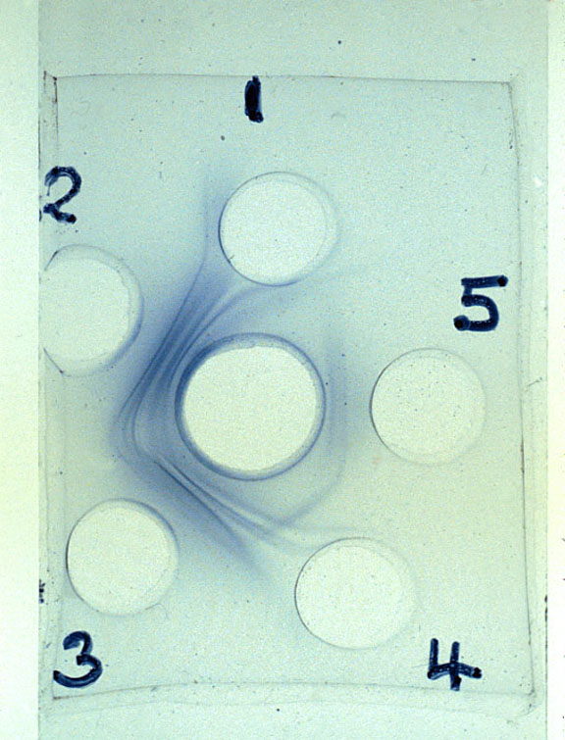
Diagnosis
Serology:

Slide 23
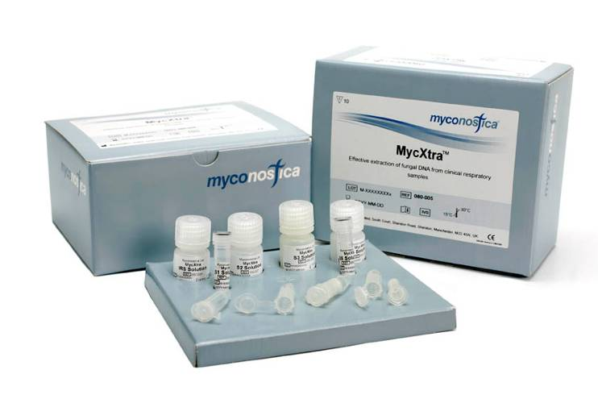
Diagnosis- PCR
MycAssay™: Aspergillus

Slide 24
Management of acute invasive Aspergillus sinusitis
Requires both biopsy for direct microscopy and culture for diagnosis
– differential diagnosis :
Mucormycosis, Scedopsporium /Fusarium infection
Requires systemic antifungal therapy to minimize tissue destruction, and spread to face, eye, mouth, brain and cure
? Requires surgical removal

Slide 25
Choice of antifungal for aspergillosis
Voriconazole (unless drug interaction)
Amphotericin B (if not ‘nephro-critical’)
OR
Posaconazole (oral only, if no drug interactions)
Itraconazole

Slide 26
Zygomycosis
Pulmonary zygomycosis
Rhinocerebral zygomycosis
Risk factors
Diabetic ketoacidosis
Granulocytopenia
Corticosteroid therapy
Malignancy
HSCT
AIDS
Many others

Slide 27
Zygomycosis
Etiology:
Zygomycetes
Non-septate hyphae
e.g. Rhizopus, Mucur, Absidia
Angioinvasion, Thrombotic invasion of blood vessels
Pulmonary infractions and hemorrhage
Rapid evolving clinical course
High mortality

Slide 28
Pulmonary Zygomycosis
Acute
Fever, pulmonary infiltrates refractory to antibacterial therapy.
Consolidation , nodules, cavitation, pleural effusion, hemoptysis
Infection may extend to chest wall, diaphragm, pericardium.
Early recognition and intervention are critical

Slide 29
Diagnosis
Specimen:
  Respiratory specimens: Sputum, BAL, Lung biopsy,
  Other samples
Lab. Investigations:
  Direct Microscopy:
    Periodic Acid Schiff (P.A.S); KOH,
    Giemsa, Grecott methenamine silver stain (GMS)
    will show broad non- septate fungal hyphaeCulture on SDA (no cycloheximide)
Serology: Not available
Treatment:
  Amphotericin B
  Surgery

Slide 30
Thank you

