Slide 1
RESPIRATORY BLOCK PATHOLOGY L1
Pathology of bronchial asthma
Dr. Maha Arafah

Slide 2
At the end of this lecture, the student should be capable of:
Understanding asthma as an episodic, reversible bronchoconstriction caused by increased responsiveness of the tracheobronchial tree to various stimuli.
Knowing that asthma is divided into two basic types: extrinsic or atopic allergic and intrinsic asthma.
Understanding the morphological changes seen in the lungs in cases of severe asthma
Listing clinical presentation in cases of asthma
Listing the complications of asthma: superimposed infection, chronic bronchitis and pulmonary emphysema
Definition and manifestations of status asthmaticus

Slide 3
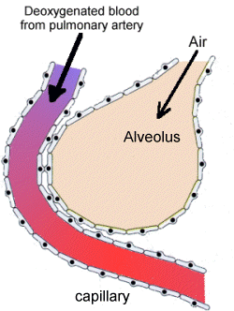
Introduction: Anatomy

Slide 4
Chronic Obstructive Pulmonary Disease
Bronchiectasis
Emphysema
Chronic Obstructive Pulmonary Disease
Chronic Bronchitis
Asthma

Slide 5
Chronic obstructive pulmonary diseases
Bronchial asthma
Chronic relapsing inflammatory disorder characterized by:
Hyperactive airways leading to episodic, reversible bronchoconstriction
Due to increased responsiveness of the tracheobronchial tree to various stimuli.

Slide 6
bronchial asthma animation
http://link.brightcove.com/services/player/bcpid236059233?bctid=347806802

Slide 7
Primarily targets:
the bronchi and terminal bronchioles
Most common chronic respiratory disease in children
More common in children than adults
Majority (50-80%) develop symptoms before 5 years of age
Two types

Slide 8
Extrinsic Asthma 70%
CLASSIFICATION OF ASTHMA
Intrinsic Asthma 30%
Initiated by type 1 hypersensivity reaction induced by exposure to extrinsic antigen.
Subtypes include:
a. atopic (allergic) asthma.
b. occupational asthma.
c. allergic bronchopulmonary aspergillosis.
Personal or family history of allergic reaction
Develop early in life
Initiated by diverse, non-immune mechanisms, including ingestion of aspirin, pulmonary infections, cold, inhaled irritant, stress and exercise.
No personal or family history of allergic reaction.
Develop later in life

Slide 9
Extrinsic Asthma
Atopic (allergic) asthma is the most common form, begins in childhood
Other allergic manifestation: allergic rhinitis, urticaria, eczema.
Other family member is also affected
Skin test with antigen result in an immediate wheel and flare reaction

Slide 10
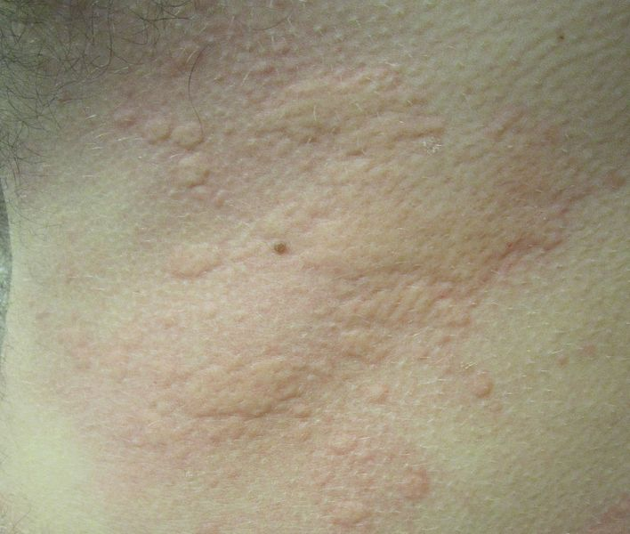
wheel and flare reaction

Slide 11
Pathogenesis of Bronchial Asthma
EXAGGERATED BROCHOCONTRICTION
Two components:
1. Chronic airway inflammation.
2. Bronchial hyperresponsiveness.
The mechanisms have been best studied in atopic asthma.

Slide 12
Pathogenesis of Atopic Asthma
A classic example of type 1 IgE-mediated hypersensitivity reaction.
In the airway – initial sensitization to antigen (allergen) with stimulation of TH2 type T cells and production of cytokines (IL-4, IL- 5, and IL-13).
Cytokines promote:
1. IgE production by B cell (IL4)
2. Growth of mast cells (IgE)
3. Growth and activation of eosinophils (IL5)
4. mucous secretion (IL13)

Slide 13
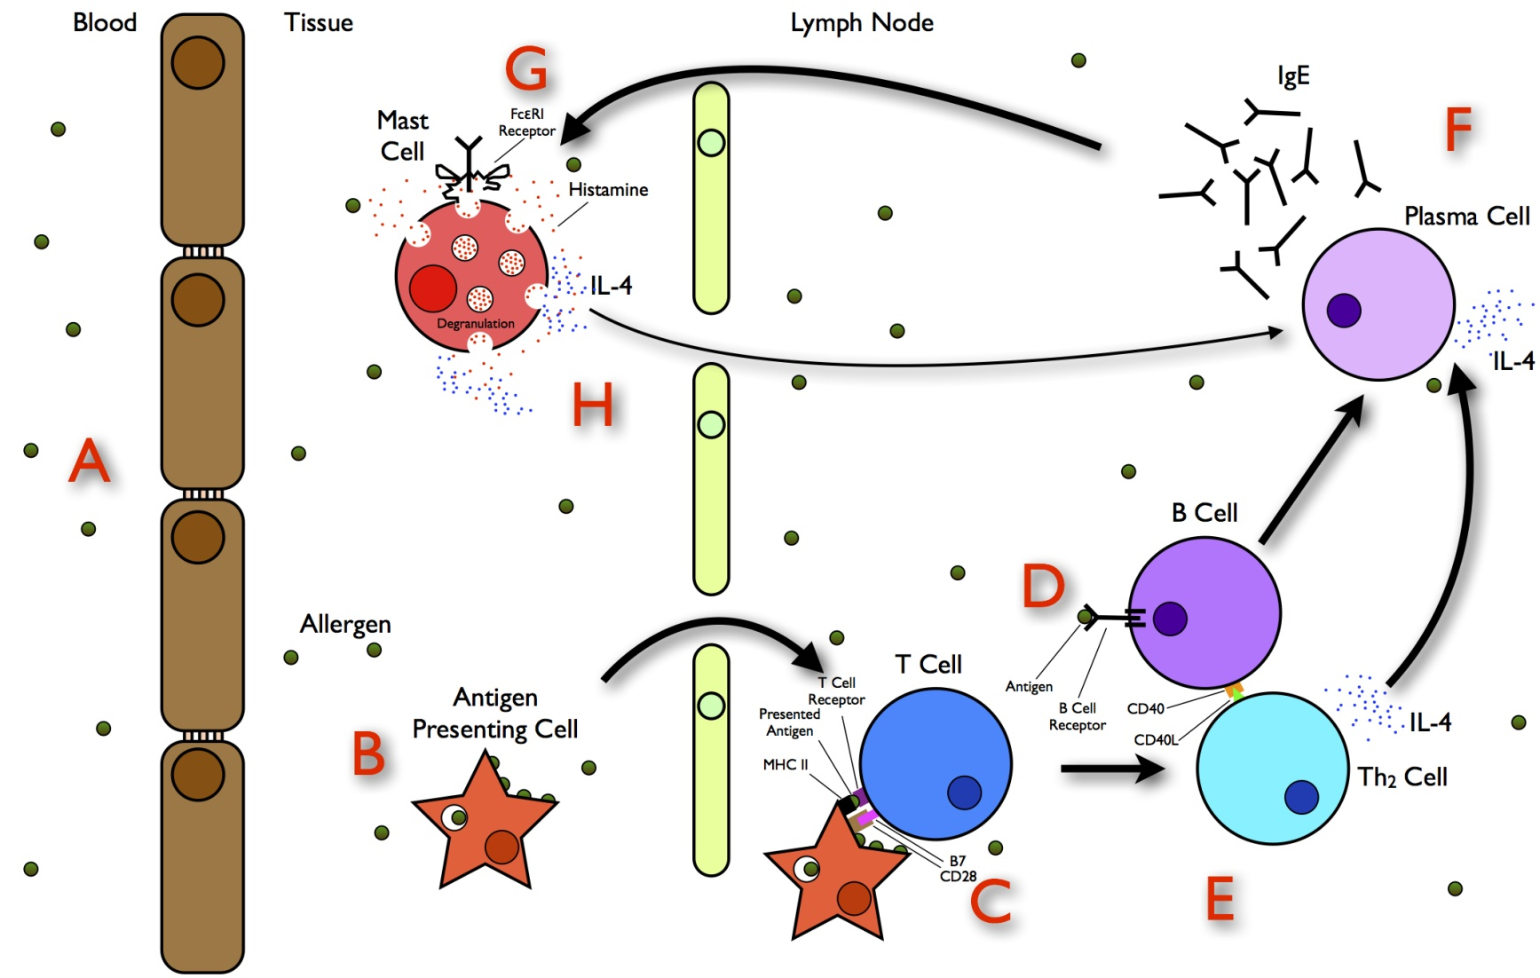
Extrinsic Asthma
Serum IgE and eosinophil are increased
immune related, TH2 subset of CD4+ T cells

Slide 14
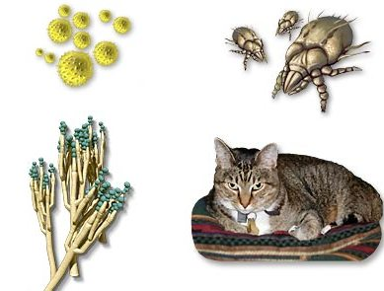
Inhaled Allergens
Pollen
House Dust Mites
Mold
Animal Hair and Dander

Slide 15
Pathogenesis of Atopic Asthma
IgE-mediated reaction to inhaled allergens elicits:
1. acute response (within minutes)
2. a late phase reaction (after 4-8 hours)

Slide 16
Pathogenesis of Atopic Asthma
Acute-phase response
Begin 30 to 60 minutes after inhalation of antigen.
Mast cells on the mucosal surface are activated.
Mediator produced are :
Leukotrienes C4, D4 & E4 (induce bronchospasm, vascular permeability & mucous production)
Prostaglandins D2, E2, F2 (induce bronchospasm and vasodilatation)
Histamine ( induce bronchospasm and increased vascular permeability)
Platelet-activating factor (cause aggregation of platelets and release of histamine)
Mast cell tryptase (inactivate normal bronchodilator).
Mediators induce bronchospasm, vascular permeability & mucous production.

Slide 17
Pathogenesis of Atopic Asthma
Late phase reaction
Recruitment of leukocytes mediated by product of mast cells including:
1. Eosinophil and neutophil chemotactic factors
2 . IL-4 & IL-5 and induceTH2 subset ofCD4+ T cells
3. Platelet-activating factor
4. Tumor necrosis factor.
Other cell types are involved: activated epithelial cells, macrophages and smooth muscle.

Slide 18
Pathogenesis of Atopic Asthma
Late phase reaction:
The arrival of leukocytes at the site of mast cell degranulation lead to:
1. Release of more mediators to activate more mast cells
2. Cause epithelial cell damage
Eosinophils produce major basic protein, eosinophilic cationic protein and eosinophil peroxidase ( toxic to epithelial cells).
These amplify and sustains injury without additional antigen.

Slide 20
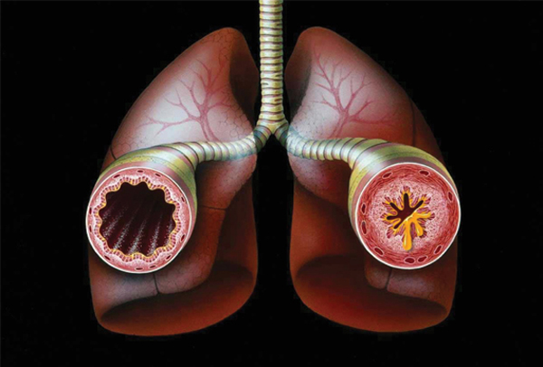

Slide 21
Summary of Pathogenesis
Type I hypersensitivity reaction with exposure to extrinsic allergens
Typically develops in children with an atopic family history to allergies
(1) Initial sensitization to an inhaled allergen
(a) Stimulate induction of subset 2 helper T cells (CD4 T_{H}2) that release interleukin (IL) 4 and IL-5
(b) IL-4 stimulates isotype switching to IgE production.
(c) IL-5 stimulates production and activation of eosinophils.
(2) Inhaled antigens cross-link IgE antibodies on mast cells on mucosal surfaces.
(a) Release of histamine and other preformed mediators
(b) Functions of mediators:
Stimulate bronchoconstriction, mucus production, influx of leukocytes

Slide 22
Summary of Pathogenesis
(3) Late phase reaction (4-8 hours later)
(a) Eotaxin is produced.
Chemotactic for eosinophils and activates eosinophils
(b) Eosinophils release major basic protein and cationic protein.
Damage epithelial cells and produce airway constriction
Other mediators involved
(1) LTC-D-E₄ causes prolonged bronchoconstriction.
(2) Acetylcholine causes airway muscle contraction.

Slide 24
Non-Atopic Asthma
Non immune
Positive family history is uncommon.
Serum IgE – normal.
No other associated allergies.
Skin test – negative.
Hyperirritability of bronchial tree (Stress, exercise, cigarette smoke)
Triggered by respiratory tract infection including
viruses (Examples-rhinovirus, parainfluenza virus, respiratory syncytial virus)
inhaled air pollutants (e.g. sulfur dioxide, ozone)
Subtypes:
1. Drug-induced asthma (Aspirin or nonsteroidal drug sensitivity)
2. Occupational asthma ( fumes, dusts, gases)

Slide 25
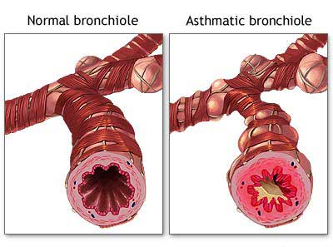
Morphology of Asthma
Grossly
lung over distended (over inflation)
occlusion of bronchi and bronchioles by thick mucous.

Slide 26
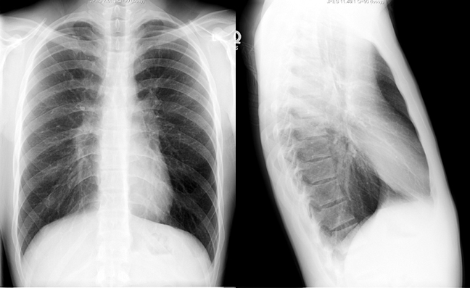
Hyperinflated lung

Slide 27
Morphology of Asthma
AIRWAY REMODELING
Histologic finding:
Thick BM.
Edema and inflammatory infiltrate in bronchial wall.
Submucosal glands increased.
Hypertrophy of the bronchial wall muscle.
Mucous contain Curschmann spirals, eosinophil and Charcot-Leyden crystals.

Slide 28
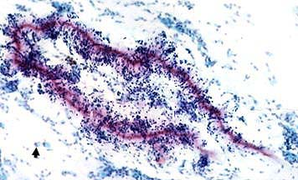
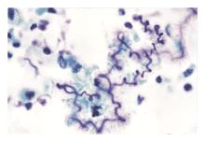
Curschmann spirals
Coiled, basophilic plugs of mucus formed in the lower airways and found in sputum and tracheal washings

Slide 29
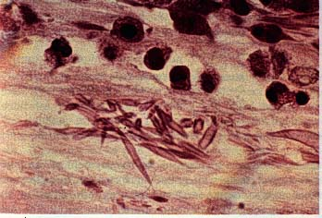
Charcot-Leyden crystals.
Eosinophilic needle-shaped crystalline structures from eosinophil proteins

Slide 30
Clinical findings
(1) Episodic expiratory wheezing (inspiratory as well when severe)
(2) Nocturnal cough
(3) Increased anteroposterior diameter
Due to air trapping and increase in residual volume
http://www.youtube.com/watch?v=YG0-ukhU1xE&feature=related

Slide 31
Clinical Coarse
Classic asthmatic attack – dyspnea, cough, difficult expiration, progressive hyperinflation of lung and mucous plug in bronchi. This may resolve spontaneously or with Rx
May progress to emphysema or chronic bronchitis
Superimposed bacterial infection may occur

Slide 32
Laboratory findings
(1) Initially develop respiratory alkalosis
(a) Patients work hard at expelling air through inflamed airways.
(b) May progress into respiratory acidosis if bronchospasm is not relieved
Normal pH or respiratory acidosis is an indication for intubation and mechanical ventilation.
(2) Eosinophilia, positive skin tests for allergens

Slide 33
Status asthmaticus
Severe cyanosis and persistent dyspnea for days and weeks
Does not respond to therapy
Hypercapnia, acidosis, sever hypoxia
May be fatal

