Slide 1
RESPIRATORY BLOCK
PATHOLOGY L2
Introduction to COPD including bronchiectasis , chronic bronchitis & emphysema
Dr. Maha Arafah

Slide 2
Objectives
At the end of this lecture, the students should be able to:
A] Understand that obstructive disorders are characterized by an increase in resistance to airflow, owing to partial or complete obstruction at any level of the bronchial/bronchiolar.
B] Know that the major obstructive disorders are chronic bronchitis, emphysema, asthma and bronchiectasis.
C] Is aware that the symptom common to all these disorders is "dyspnea" (difficulty in breathing) but each have their own clinical and anatomical characteristics.
D] Chronic bronchitis and emphysema almost always coexists

Slide 3
Contents
1] Chronic bronchitis: definition, clinical presentation, role of cigarette smoking and air pollution, pathological changes and complications with special emphasis on cor pulmonale.
2] Emphysema: definition and clinical characteristics. Types of emphysema including centrilobular emphysema, panacinar emphysema (deficiency of alpha one antitrypsin), paraseptal and irregular emphysema.
3] Complications of emphysema with special emphasis on interstitial emphysema and pneumothorax.
4] Bronchiectasis: definition, predisposing factors, kartagener's syndrome (primary ciliary dyskinesia) and pathological features of bronchiectasis.

Slide 5
Obstructive and Restrictive Pulmonary Diseases
Diffuse pulmonary diseases are divided into:
1. Obstructive disease:
characterized by limitation of airflow owing to partial or complete obstruction at any
level from trachea to respiratory bronchioles.
Pulmonary function test:
limitation of maximal
airflow rate during forced expiration (FEVI).
2. Restrictive disease: characterized by reduced expansion of lung parenchyma with decreased total lung capacity while the expiratory flow rate is near normal.
Occur in:
1. Chest wall disorder.
2. Acute or chronic, interstitial and infiltrative diseases,
e.g. ARDS and pneumoconiosis.

Slide 6
Chronic Obstructive Pulmonary Disease (COPD)
Share a major symptom: dyspnea with chronic or recurrent obstruction to airflow within the lung.
The incidence of COPD has increased dramatically in the past few decades.

Slide 7
Chronic Obstructive Pulmonary Disease
Bronchiectasis
Emphysema
Chronic Obstructive Pulmonary Disease
Chronic Bronchitis
Asthma
A group of conditions characterized by limitation of airflow
Emphysema and chronic bronchitis often co-exist.

Slide 8
Emphysema
http://www.youtube.com/watch?v=5b6f1LH9WH8&feature=related

Slide 9
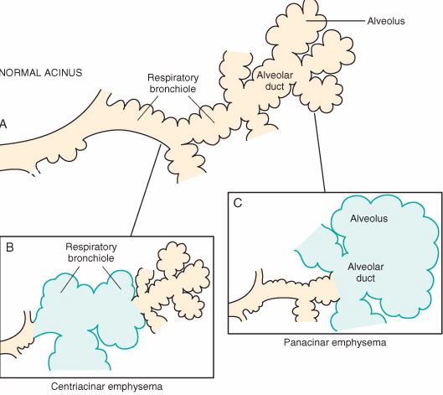
Emphysema
Is characterized by permanent enlargement of the airspaces distal to the terminal bronchioles accompanied by destruction of their walls, without obvious fibrosis.
Over inflation.
Types of emphysema:
1. Centriacinar (20x)
2. Panacinar
3. Distal acinar
4. Irregular

Slide 11
Emphysema
Incidence
Emphysema is present in approximately 50% of adults who come to autopsy.
Pulmonary disease was considered to be responsible for death in 6.5% of these patients.

Slide 12
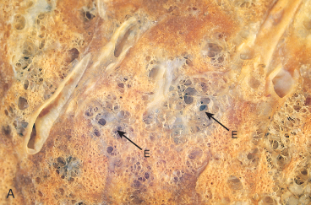
Centriacinar (centrilobular) emphysema
Occur in heavy smoker in association with chronic bronchitis
The central or proximal parts of the acini are affected, while distal alveoli are spared
More common and severe in upper lobes (apical segments)
The walls of the emphysematous
space contain black pigment.
Inflammation around bronchi & bronchioles.

Slide 13
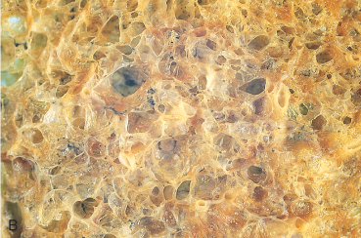
Panacinar (panlobular) emphysema
Occurs in α₁-anti-trypsin deficiency.
Acini are uniformly enlarged from the level of the respiratory bronchiole to the terminal blind alveoli.
More commonly in the lower lung zones.

Slide 14
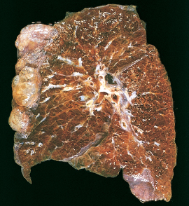
Distal acinar (paraseptal) emphysema
The proximal portion of the acinus is normal but the distal part is dominantly involved.
Occurs adjacent to areas of fibrosis, scarring or atelectasis.
More severe in the upper half of the lungs.
Sometimes forming multiple cyst-like structures with spontaneous pneumothorax.

Slide 15
Irregular Emphysema
The acinus is irregularly involved, associated with scarring.
Most common form found in autopsy.
Asymptomatic.
usually a complication of various inflammatory processes including chronic pulmonary tuberculosis.

Slide 16
Pathogenesis of Emphysema
Is not completely understood.
Alveolar wall destruction and airspace enlargement invokes excess protease or elastase activity unopposed by appropriate antiprotease regulation (protease-antiprotease hypothesis)
2 key mechanisms:
1. excess cellular proteases with low antiprotease level
2. excess ROS from inflammation
Element of ch. Bronchitis coexists

Slide 17
Pathogenesis of Emphysema
Protease-antiprotease imbalance occur in 1% of emphysema
α₁-antitrypsin, normally present in serum, tissue fluids and macrophages, is a major inhibitor of proteases secreted by neutrophils during inflammation.
Encoded by codominantly expressed genes on the proteinase inhibitor (Pi) locus on chromosome 14.
Pi locus is extremely pleomorphic (M , Z)
Any stimulus that increase neutrophil or macrophages in the lung with release of protease lead to elastic tissue damage.

Slide 18
Pathogenesis of Emphysema
The protease-antiprotease hypothesis explains the effect of cigarette smoking in the production of centriacinar emphysema.
-Smokers have accumulation of neutrophils in their alveoli.
-Smoking stimulates release of elastase.
-Smoking enhances elastase activity in macrophages, macrophage elastase is not inhibited by α₁-antitrypsin.
-Tobaco smoke contains reactive oxygen species with inactivation of proteases.

Slide 19
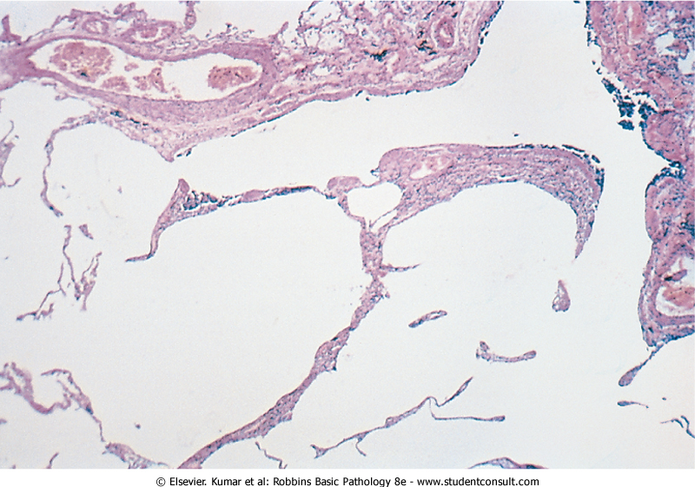
Emphysema
Morphology
The diagnosis depend largely on the macroscopic appearance of the lung.
The lungs are pale, voluminous.
Histologically, thinning and destruction of alveolar walls creating large airspaces.
Loss of elastic tissue.
Reduced radial traction on the small airways.
Alveolar capillaries is diminished.
Fibrosis of respiratory bronchioles.
Accompanying bronchitis and bronchiolitis.

Slide 20
Emphysema: Clinical course
Cough and wheezing.
Weight loss.
Pulmonary function tests reveal reduced FEV1.

Slide 21
Complications
(a) Emphysema is often complicated by or coexistent with chronic bronchitis.
(b) Interstitial emphysema, in which air spaces may enter into the interstitial tissues of the chest from a tear in the airways may sometimes occur.
(c) Other complications of emphysema may include rupture of a surface bleb (markedly dilated and emphysematous alveolus) with resultant pneumothorax.

Slide 22
Death from emphysema is related to:
Pulmonary failure with respiratory acidosis, hypoxia and coma.
Right-sided heart failure.

Slide 23
Chronic Obstructive Pulmonary Disease
Bronchiectasis
Emphysema
Chronic Obstructive Pulmonary Disease
Chronic Bronchitis
Asthma

Slide 24
http://www.youtube.com/watch?v=o7mgL-xupRQ&feature=related

Slide 25
Chronic Bronchitis
Common among cigarette smokers and urban dwellers, age 40 to 65
The diagnosis of chronic bronchitis is made on clinical grounds.
Persistent productive cough for at least 3 consecutive months in at least 2 consecutive years.
Can occur in several forms:
1. Simple chronic bronchitis.
2. Chronic mucopurulent bronchitis.
3. Chronic asthmatic bronchitis.
4. Chronic obstructive bronchitis.

Slide 26
Chronic bronchitis
Pathogenesis
Hypersecretion of mucus that starts in the large airways.
Causative factor are cigarette smoking and pollutants.
Morphology
Enlargement of the mucus-secreting glands, increased number of goblet cells, loss of ciliated epithelial cells, squamous metaplasia, dysplastic changes and bronchogenic carcinoma.
Inflammation, fibrosis and resultant narrowing of bronchioles.
Coexistent emphysema.

Slide 27
Reid Index > 0.4

Slide 28
Chronic bronchitis
Clinical Course
Prominent cough and the production of sputum.
COPD with hypercapnia, hypoxemia and cyanosis.
Cardiac failure.

Slide 29
Chronic bronchitis vs. Emphysema

Slide 31
Emphysema and Chronic Bronchitis
 | Predominant Bronchitis | Predominant Emphysema
Appearance Age Dyspnea Cough Infection Respiratory Insufficiency Cor pulmonale Airway resistance Elastic recoil Chest radiography | “Blue bloaters” 40-45 Mild, late Early, copious sputum Common Repeated Common Increased Normal Prominent vessels, large heart | “Pink Puffers” 50-75 Severe, early Late, scanty sputum Occasional Terminal Rare, terminal Normal or slightly increased Low Hyperinflation, small heart
http://www.youtube.com/watch?v=9EqCq_8J8vg&feature=related

Slide 32
Bronchiectasis
http://www.youtube.com/watch?v=vxoA8FddG7k

Slide 33
Chronic Obstructive Pulmonary Disease
Bronchiectasis
Emphysema
Chronic Obstructive Pulmonary Disease
Chronic Bronchitis
Asthma

Slide 34
Bronchiectasis
Chronic necrotizing infection of the bronchi and bronchioles leading to or associated with abnormal dilatation of these airways.
Bronchial dilatation should be permanent.

Slide 35
Conditions associated with Bronchiectasis
1. Bronchial obstruction
Localized:
- tumor, foreign bodies or mucous impaction
Generalized:
- bronchial asthma
- chronic bronchitis
Congenital or hereditary conditions:
- Congenital bronchiactasis
- Cystic fibrosis.
- Intralobar sequestration of the lung.
- Immunodeficiency status.yndrome.
Necrotizing pneumonia.
Localized:
- tumor, foreign bodies or mucous impaction
Generalized:
- bronchial asthma
- chronic bronchitis
- Congenital bronchiactasis
- Cystic fibrosis.
- Intralobar sequestration of the lung.
- Immunodeficiency status.
- Immotile cilia and kartagner syndrome.
Caused by TB, staphylococci or mixed infection.

Slide 36
Kartagener Syndrome
Inherited as autosomal recessive trait.
Patient develop bronchiactasis, sinusitis and situs invertus.
Defect in ciliary motility due to absent or irregular dynein arms.
Lack of ciliary activity interferers with bronchial clearance.
Males have infertility.

Slide 37
Bronchiectasis
Etiology and pathogenesis
Obstruction and infection.
Bronchial obstruction (athelectasis of airway distal to obstruction) – bronchial wall inflammation.
These changes become irreversible:
1. If obstruction persist.
2. If there is added infection.

Slide 38
Morphology of Bronchiectasis
Usually affects lower lobes bilaterally (vertical airways).
Dilated airways up to four times of normal, reaching the pleura.
Tube-like enlargement (cylindroid) or fusiform (saccular).
Acute and chronic inflammation, extensive ulceration of lining epithelium with fibrosis.

Slide 39
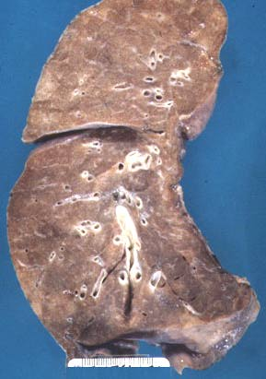
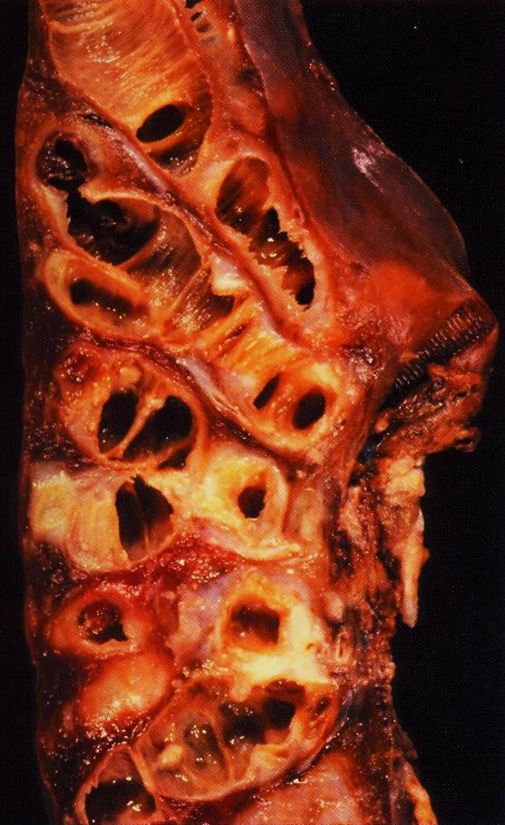

Slide 40
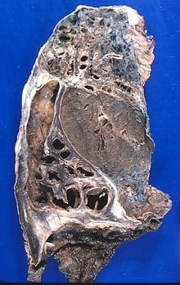
Bronchiectasis

Slide 41
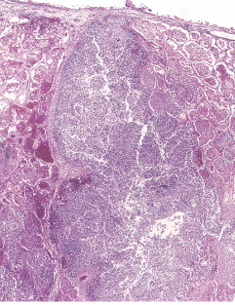

Slide 42
Bronchiectasis
Clinical course:
Sever persistent cough with sputum (mucopurulent, fetid sputum) sometime with with blood.
Clubbing of fingers.
If sever, obstructive pulmonary function develop.
Rare complications: metastatic brain abscess and amyloidosis.

Slide 43
Summary
Chronic Obstructive Pulmonary Disease
Asthma
Emphysema
Types
Pathogenesis
Pathology
Clinical features
Definition
Causes
Pathogenesis
classification
Clinical Features
Chronic Obstructive Pulmonary Disease
Bronchiectasis
Chronic Bronchitis
Definition
Causes
Pathogenesis
Pathology
Clinical Features
Definition
Causes
Pathogenesis
Pathology
Clinical Features

Slide 44
Emphysema:
Dilated air spaces beyond respiratory arteriols
Types
Centriacinar: Smoking
Clinical features
Cough and wheezing. Respiratory acidosis
Complications
Pneumothorax
Panacinar: deficiency of α1 AT
Paraseptal
Irregular: scar
Weight loss.
Pulmonary function tests reveal reduced FEV1.
Pulmonary failure with respiratory acidosis, hypoxia and coma.
Right-sided heart failure ( Cor pulmnale)
Death from emphysema is related to:

Slide 45
Chronic Bronchitis:
Persistent productive cough for at least 3 consecutive months in at least 2 consecutive years, smoking related
forms:
1. Simple chronic bronchitis.
Morphology
Enlargement of the mucus glands, increased number of goblet cells, loss of ciliated epithelial cells, squamous metaplasia, dysplastic changes and bronchogenic carcinoma.
Clinical features
Prominent cough and the production of sputum.
2. Chronic mucopurulent bronchitis.
3. Chronic asthmatic bronchitis.
4. Chronic obstructive bronchitis.
Inflammation, fibrosis and resultant narrowing of bronchioles.
Coexistent emphysema
COPD with hypercapnia, hypoxemia and cyanosis.
Cardiac failure

Slide 46
Asthma: Dyspnea and wheezing
Asthma
Types
1. Extrinsic asthma: Type 1 Hypersensitivity reaction, IgE, childhood, family Hx of allergy.
Morphology
Hypertrophy of bronchial smooth muscle & hyperplasia of goblet cells e eosinophils
Mucous plug e Curschmann spirals & Charcot-Leyden crystals.
Complication
Superimposed infection
2. Intrinsic asthma: associated e bronchial asthma, aspirin, exercise, cold induced. No Hx of allergy
Chronic bronchitis
Pulmonary emphysema
Status asthmaticus

Slide 47
Bronchiectasis:
Chronic necrotizing infection of the bronchi
and bronchioles leading to permenant dilatation of these airways
Causes
Infection
Congenital (Cystic fibrosis, Kartagener’s Syndrome)
Clinical features
Sever persistent cough with sputum (mucopurulent sputum) sometime with blood.
complications
Rare complications: metastatic brain abscess and amyloidosis.
Obstruction
Clubbing of fingers.
Lung Abscess
If sever, obstructive pulmonary function develop.

Slide 48
Pneumothorax
http://www.youtube.com/watch?v=qVmy5s7AFe0&feature=related
Athelectasis
http://www.youtube.com/watch?v=VQRggeFb_J0&feature=related

