Slide 1
Restrictive lung diseases
RESPIRATORY BLOCK
Pathology L2
Dr. Maha Arafah

Slide 2
OBJECTIVES
At the end of this lecture, the student should be able to:
Understand the structure and constituents of the lung interstitium as well as the restrictive changes which occur in these diseases and lead to the development of symptoms of progressive breathlessness and cough in affected patients.
Appreciate the pathogenesis of interstitial lung diseases regardless of their type. This pathogenesis include the influx of inflammatory cells into the alveoli and alveolar walls, distortion of the normal structure of alveoli, release of chemical mediators and promotion of fibrosis (honey-comb lung).
Become aware of the classification of interstitial lung diseases.

Slide 3
CONTENTS
Definition and causes of restrictive pulmonary diseases.
Pathogenesis of restrictive pulmonary diseases which include abnormalities in the chest wall or neuromuscular diseases that restrict lung expansion or conditions leading to interstitial accumulations of cells or non-cellular substances.
Brief account on the clinicopathological features of:
Adult and neonatal respiratory distress syndromes.
Anthracosis and coal worker's pneumoconiosis.
Silicosis and asbestosis.
Hypersensitivity pneumonitis (extrinsic allergic alveolitis).
Goodpasture syndrome.
Eosinophilic granuloma.
Idiopathic pulmonary fibrosis.
Sarcoidosis.

Slide 4
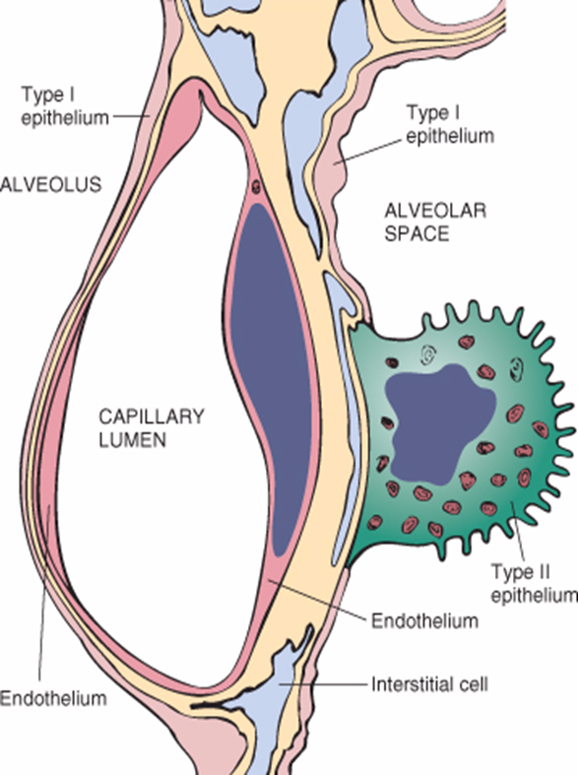
Lung Interstitium

Slide 5
Restrictive lung disease Definition
Restrictive pulmonary disease is a group of disorders characterized by reduced expansion of the lung and reduction in total lung capacity.
Stiff Lung
Examples include:
abnormalities of the chest wall from bony abnormalities or neuromuscular disease that restrict lung expansion
Primary interstitial lung disease

Slide 6
Restrictive lung diseases
Characterized by reduced compliance of the lung.
Important signs and symptoms:
- Dyspnea.
- Hypoxia.
- With progressive severe hypoxia, respiratory failure and cor pulmonale.
It can be:
- Acute.
- Chronic.

Slide 7
Acute restrictive lung diseases
Adult respiratory distress syndromes
Neonatal respiratory distress syndromes

Slide 8
Adult respiratory distress syndromes (ARDS)
Progressove respiratory failure:
Acute onset of dyspnea
Decreased arterial oxygen pressure
Bilateral pulmonary infiltrate (edema)
Absence of evidence of left sided heart failure
Most common cause of non- cardiogenic pulmonary edema

Slide 9
Adult respiratory distress syndromes (ARDS)
Can be caused by many conditions:
Direct injury to lung:
Pneumonia, aspiration, pulmonary contusion (trauma), fat embolism, near drowning, inhalation injury irritants such as chlorine, oxygen toxicity, post lung transplant
Indirect injury to lung:
Sepsis, sever trauma with shock, cardiopulmonary bypass, acute pancreatitis, transfusion, uremia , overdose with street drugs such as heroin, therapeutic drugs such as bleomycin.

Slide 10
Adult respiratory distress syndromes (ARDS)
ARDS is produced by diffuse alveolar damage with resultant increase in alveolar capillary permeability, causing leakage of protein-rich fluid into alveoli.

Slide 11
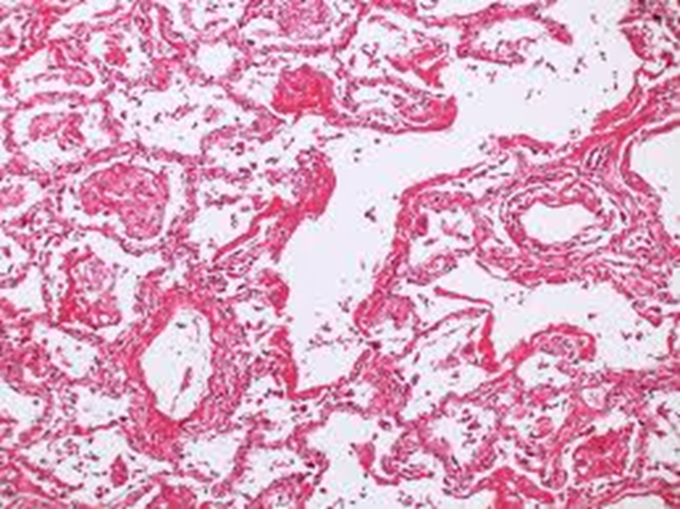
Adult respiratory distress syndromes
Characteristics include the formation of an intra-alveolar hyaline membrane composed of fibrin and cellular debris.

Slide 12
Adult respiratory distress syndromes
ARDS can be a manifestation of the severe acute respiratory syndrome (SARS). The SARS virus is a coronavirus that destroys the type II pneumocytes and causes diffuse alveolar damage.

Slide 13
Adult respiratory distress syndromes
ARDS is initiated by damage to alveolar capillary endothelium and alveolar epithelium and is influenced by the following pathogenetic factors:
(a) Neutrophils release substances toxic to the alveolar wall.
(b) Activation of the coagulation cascade is suggested by the presence of microemboli.
(c) Oxygen toxicity is mediated by the formation of oxygen-derived free radicals.

Slide 14
Adult respiratory distress syndromes
Clinical
Mortality was 100%
Now 30 -40% with good ICU support
Poor prognosis: old age, multisystem failure, high level of IL-1

Slide 16
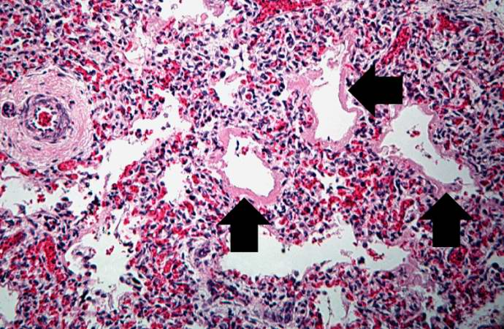
Neonatal respiratory distress syndromes (HYALINE MEMBRANE DISEASE)
the most common cause of respiratory failure in the newborn and is the most common cause of death in premature infants.

Slide 17
Neonatal respiratory distress syndromes (HYALINE MEMBRANE DISEASE)
This syndrome is marked by dyspnea, cyanosis and tachypnea shortly after birth.
Results from a deficiency of surfactant, most often as a result of immaturity.

Slide 18
Neonatal respiratory distress syndromes (HYALINE MEMBRANE DISEASE)
Predisposing factors:
Prematurity.
Maternal diabetes mellitus and delivery by cesarean section.

Slide 19
Chronic restrictive lung disease Definition
Are a heterogenous group with little uniformity regarding terminology and classification.
Many entities are of unknown cause and pathogenesis.
Similar clinical signs, symptoms, radiographic alterations and pathophysiologic changes.
Account for about 15% of non-infectious lung diseases.
End-stage: diffuse interstitial pulmonary fibrosis

Slide 20
Chronic restrictive lung disease
Major Categories of Chronic Interstitial Lung Disease
- Occupational: Pneumoconiosis
- Fibrosing:
Usual interstitial pneumonia (idiopathic pulmonary fibrosis)
- Immune diseases: Sarcoidosis, Goodpasture syndrome
Hypersensitibity pneumonitis, systemic lupus erythematosus, systemic sclerosis (scleroderma), Wegener granulomatosis
- Drug: Chemotherapy, methotrexate, bleomyxin toxicity
- Radiation Reactions
- Others: Eosinophilic granuloma
Smoking related: Desquamative interstitial pneumonia
Respiratory bronchiolitis-associated interstitial lung disease

Slide 21
Pathogenesis of interstitial lung diseases
Influx of inflammatory cells into the alveoli and alveolar walls
Distortion of the normal structure of alveoli
Release of chemical mediators
Promotion of fibrosis

Slide 22
Pneumoconiosis
Non-neoplastic lung reaction to inhalation of mineral dusts.
Most common dusts are coal dust, silica, asbestos and beryllium.
The development of pneumoconiosis is dependent on:
- The amount of dust retained in the lung and airways.
a. Concentration of the dust in the ambient air.
b. Duration of the exposure.
c. Effectiveness of the clearance mechanisms.
- The size (1-5μ) shape.
- Their solubility and physiochemical activity.
- The possible additional effects of other irritants, tobacco
smoking.
The particles are impacted at alveolar duct macrophage, accumulate inflammatory response fibrosis.

Slide 23
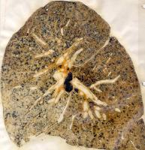
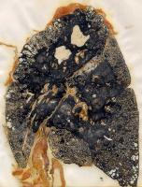
Coal worker’s pneumoconiosis (CWP)
The simple form
The complicated form
Focal aggregations of coal dust-laden macrophages (coal macules)
Patients have slight cough and blackish sputum.
Occurs after many years of underground mine work.
fibrous scarring appears (complicated CWP) also callled progressive massive fibrosis PMF

Slide 24
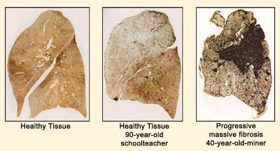

Slide 25
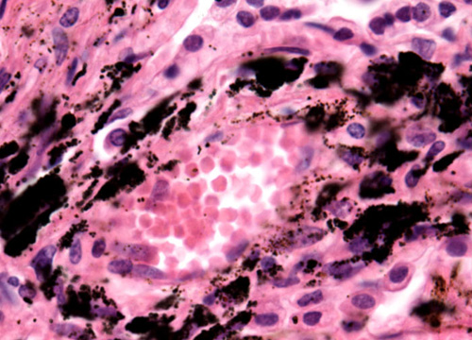
Coal worker pneumoconiosis
Morphology:
Simple CWP:
- Focal black pigmentations (macules), 1-2 mm up to 5 mm are scattered through the lung.
- Mostly in the upper zones of the lower and upper lobes of the lungs.
- Macules are composed of aggregations of coal dust-filled
macrophages in close proximity to alveolar ducts.

Slide 26
Coal worker pneumoconiosis
Morphology
Complicated CWP:
- Black scars exceed 2 cm in diameter some times up to 10 cm
- It consists of dense collagen and carbon pigments.
- Cor pulmonale.
- Miners who have rheumatoid arthritis and PMF are called Caplan’s syndrome.

Slide 27
Silicosis
Long exposure to silica particles.
Encountered in industries: mining of gold, tin, copper and coal, sandblasting, metal grinding, ceramic manufacturing.
Silicosis predispose to lung cancer.
Pathogenesis:
Crystalline silica is highly fibrogenic.
Scattered lymphocytes and macrophages are drawn rapidly with fibrosis.
Some particles are transported to lymph nodes.

Slide 28
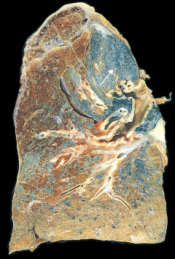
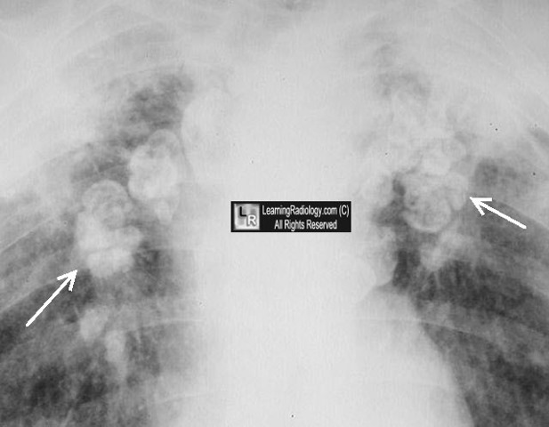
Morphology of Silicosis
Tiny collagenous nodules that enlarge forming stony-hard large fibrous scars usually in the upper lobes.
The lung parenchyma between the scars may be compressed or emphysematous.
Calcifications may appear (eggshell calcification) .
Similar collagenous nodules within the lymph nodes.
Fibrous pleural plaques may develop.

Slide 29
Morphology of Silicosis
Micro:
-Hyalinized collagen fiber surround an amorphous center (fibrous nodules).
- Scarring progress to PMF.
-Scarring extending and encroching the pulmonary arteries.
-Cor pulmonale.

Slide 30
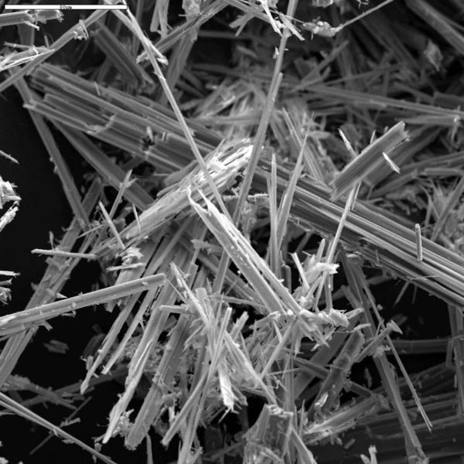
Asbestosis
All types of asbestos (crocidolite and amosite) are fibrogenic
but the crocidolite is the most carcinogenic.
Asbestosis occurs decades after exposure has ended.
Characterized by scarring containing asbestos bodies.

Slide 31
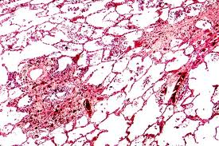
scarring containing asbestos bodies.

Slide 32
Asbestosis
Inhalation of asbestos leads to:
- Asbestos pneumoconiosis.
Characterized by scarring containing asbestos bodies.
- Pleural effusion.
- Pleural adhesions.
- Parietal pleural fibrocalcific plaques.
- Increased incidence of mesothelioma, bronchogenic carcinoma, other cancer.

Slide 33
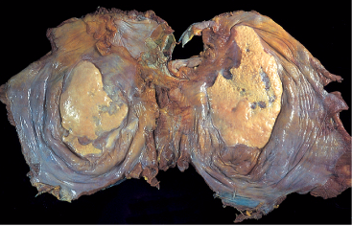

Slide 34
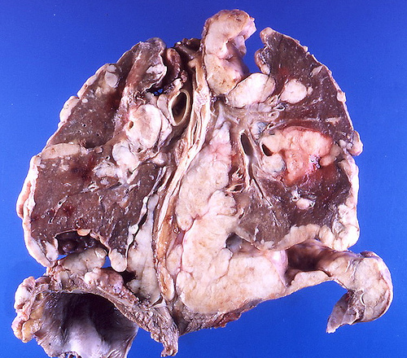
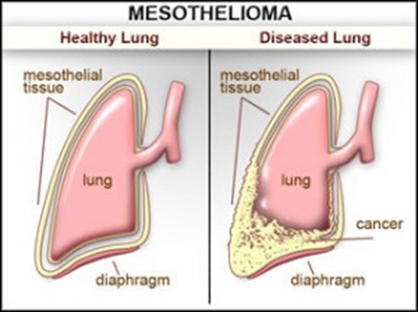
Asbestosis
Both bronchogenic carcinoma and mesothelioma develop in workers exposed to asbestos.
The risk of bronchogenic carcinoma is fivefold and for mesothelioma is 1000 fold greater

Slide 35
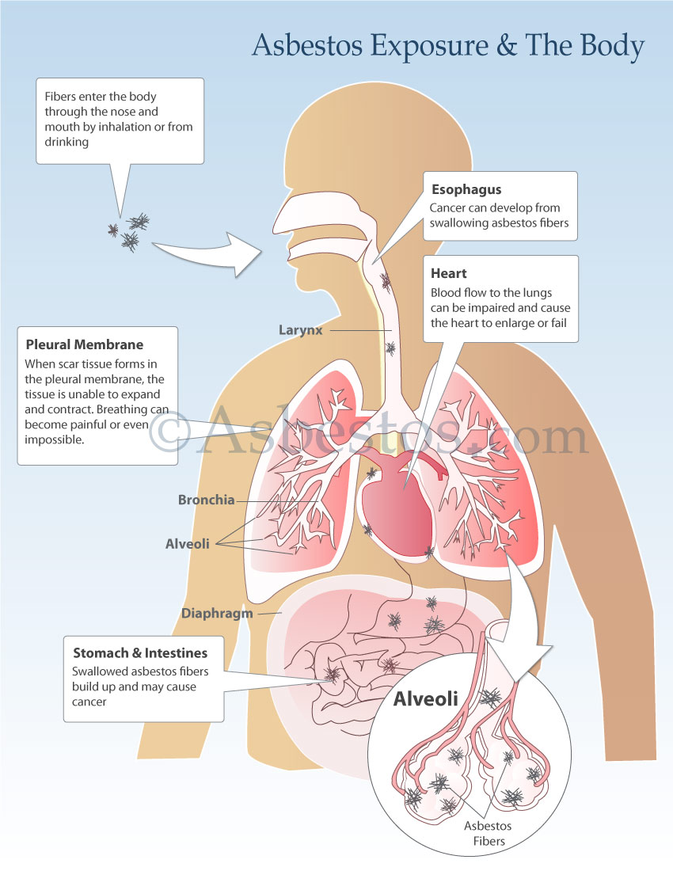
Asbestosis
In asbestosis, pt. develop progressively worsened dyspnea with cough and sputum progressing to cor pulmonale and death.

Slide 36
Hypersensitivity pneumonitis
An immunologically mediated inflammatory lung disease ( type III and IV)
primarily affects the alveoli and is therefore often called allergic alveolitis.
Hypersensitivity to inhaled antigens in the form of organic such as moldy hay, e.g. farmer’s lung, humidified lung or pigeon breeder’s lung.
Occupational disease
Restrictive disease

Slide 37
Hypersensitivity pneumonitis
May present either as an acute reaction with fever, cough, dypsnea and constitutional complains 4 to 8 hours after exposure
or as
a chronic disease with insidious onset of cough, dyspnea, malaise and weight loss.

Slide 38
Hypersensitivity pneumonitis Causes
by inhalation of :
Fungal /bacterial
Humidifier lung: spores of thermophilic actinomycetes
farmer’s lung: from moldy hay (micropolyspora)
Animal products: pigeon breeder’s lung
Chemicals

Slide 39
Morphology of hypersensitivity pneumonitis
Mononuclear cell infiltrates in the alveoli and alveolar walls and around terminal bronchioles.
Interstitial non-caseating granulomas reflecting type IV hypersensitivity reaction are present in more than two thirds of cases.
Diffuse interstitial fibrosis.

Slide 40
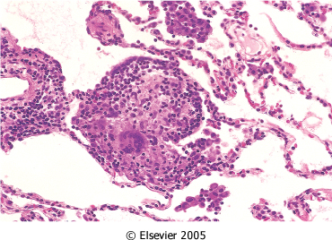

Slide 41
Hypersensitivity pneumonitis
Clinical course is variable.

Slide 42
Goodpasture syndrome
Rare disease characterized by intra-alveolar hemorrhage and glomerulonephritis.
A cytotoxic antibody against glomerular and alveolar basement membrane is responsible for the injury: damage to glomerular and alveolar basement membrane.
Male sex
Age: 20 to 30 years or 60 to 70 years

Slide 43
Goodpasture syndrome
Clinical Features
Pulmonary complaints consist of hemoptysis and dyspnea.
Hematuria, proteinuria, red cell casts and renal failure are results of glomerulonephritis.
Antiglomerular basement membrane antibody can be detected in serum.

Slide 44
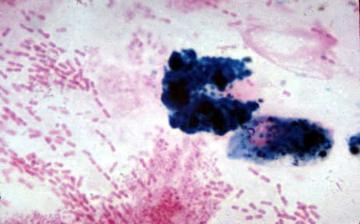
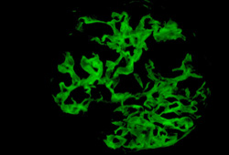
Goodpasture syndrome
Iron stain in sputum
Immunofluorescence of renal biopsy staining for IgG in a linear pattern in patient with anti-glomerular basement membrane (anti-GBM) disease

Slide 45
Pulmonary Langerhans cell histiocytosis (PLCH)
clonal proliferation of Langerhans cells.
is a unique form of LCH in that it occurs almost exclusively in cigarette smokers. It is now considered a form of smoking-related interstitial lung disease.
Some patients recover completely after they stop smoking, but others develop long-term complications such as pulmonary fibrosis and pulmonary hypertension

Slide 46
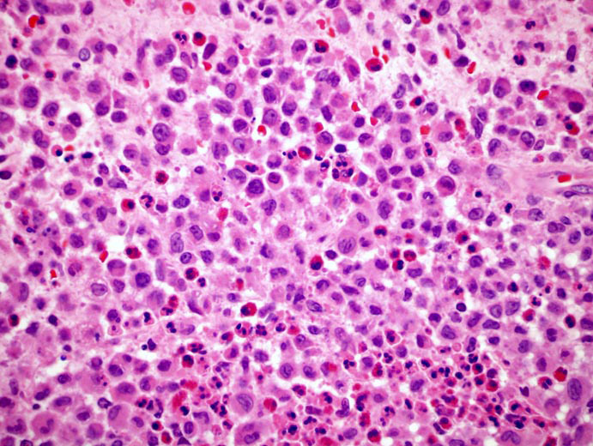
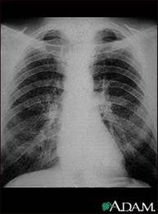
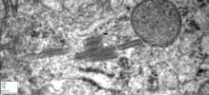
Eosinophilic granuloma Langerhan's Cell Histiocytosis

Slide 47
Idiopathic pulmonary fibrosis ( Usual interstitial pneumonia UIP) (cryptogenic fibrosing alveolitis)
A clinicopathologic syndrome with characteristic radiologic, pathologic and clinical features:
Unknown atiology
diffuse interstitial fibrosis and inflammation.
Sever hypoxemia
M>F
Dx by exclusion

Slide 48
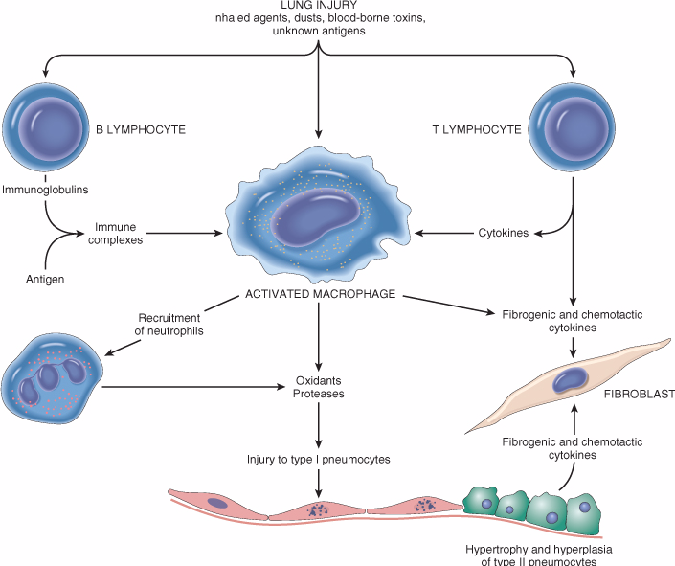
Pathogenesis
Some form of alveolar wall injury result in interstitial edema and alveolitis.
Type I pneumocyte is more susceptible to injury.
Type II pneumocyte hyperplasia (regenerate).
Fibroblast proliferation with progressive fibrosis of intra-alveolar exudate and interalveolar septa.
IgG deposits are seen in alveolar wall.
FGF, TGF-β, PDGF
IL-8 leukotriens

Slide 50
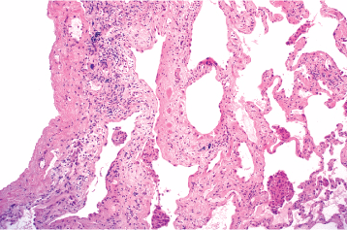
Morphology of IPF
Gross -The lungs are firm.
-Pulmonary edema.
The morphologic changes vary according to the stage of the disease.
Early cases:
-Intraalveolar exudate.
-Hyaline membranes.
-Infiltration of the alveolar
septa with mononuclear
cells.
-Hyperplasia of type II
pneumocytes
-

Slide 51
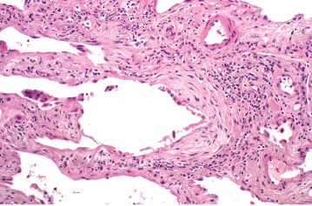
Morphology of IPF
Advancing disease:
-Organization of the intraalveolar exudates by fibrous tissue.
-Thickening of the alveolar septa owing to fibrosis and variable amounts of inflammation.
-Alternating areas of fibrosis and normal tissue.
- Geographic variation
- Temporal variation
In the end, the lung consists of spaces lined by cuboidal or columnar
epithelium separated by inflammatory fibrous tissue (honeycomb lung).

Slide 53
Clinical features of IPF
Males are affected more often than females.
Most patients are between 40 &70 years old.
Gradual onset of dyspnea with respiratory difficulty.
Hypoxemia and cyanosis.
Cor pulmonale and cardiac failure may result.
The progression in individual cases is unpredictable.
The median survival is about 3 to 5 years.

Slide 54
Sarcoidosis
An inflammatory condition of the tissues, most noted for originating in the lymph nodes or the lungs
affecting all races
affecting both sexes equally
Non- casaeting granuloma

Slide 55
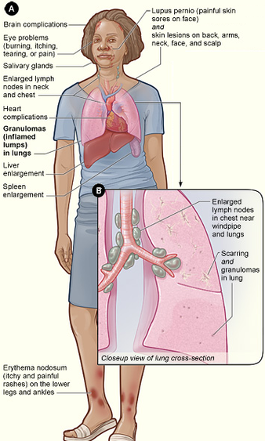
Sarcoidosis
Bilaterl hilar LN
Lung nodules
Other organs

Slide 56
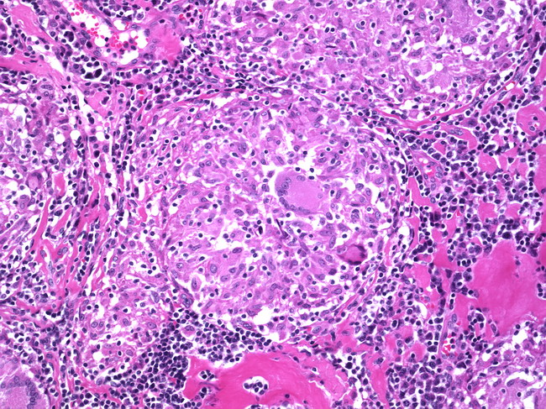
Sarcoidosis

Slide 58
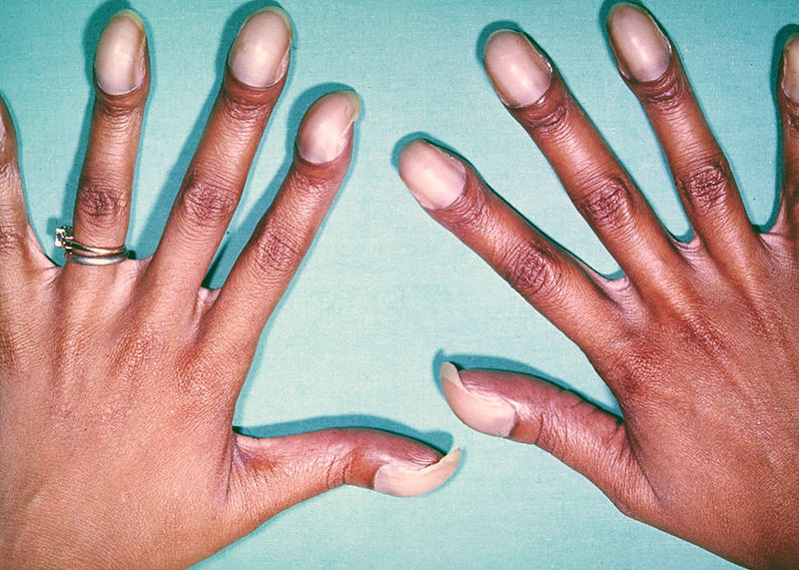
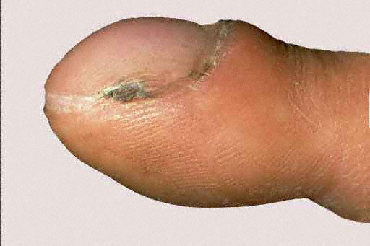
Clubbing Finger

