Slide 1
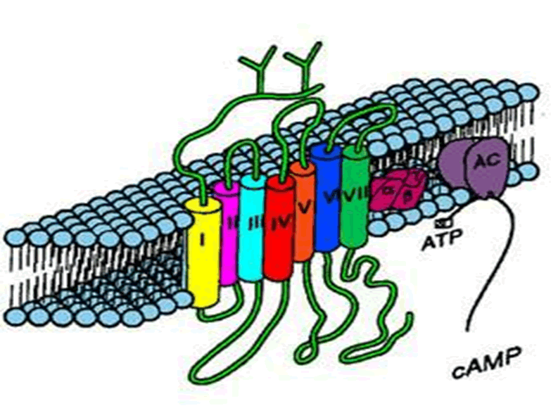
PREREQUISITE
Sympathetic Nervous System
PHYSIOLOGY
Needed for studying SNS PHARMACOLOGY

Slide 2
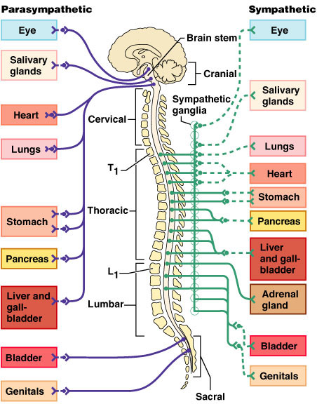
Differ in:
Site of ganglia
Length of pre & postganglionic fiber
Mediators of postganglionic fiber
Ramifies adrenal medulla and its mediator circulate in blood

Slide 3
Transmitter is
Mainly norepinephrine [NE]
Rarely Ach  M₂
or Dopamine  D₁
Transmitter is
Mainly epinephrine [E ]  circulates and acts α₁, α₂, β₁ , β₂
Gland cells

Slide 4
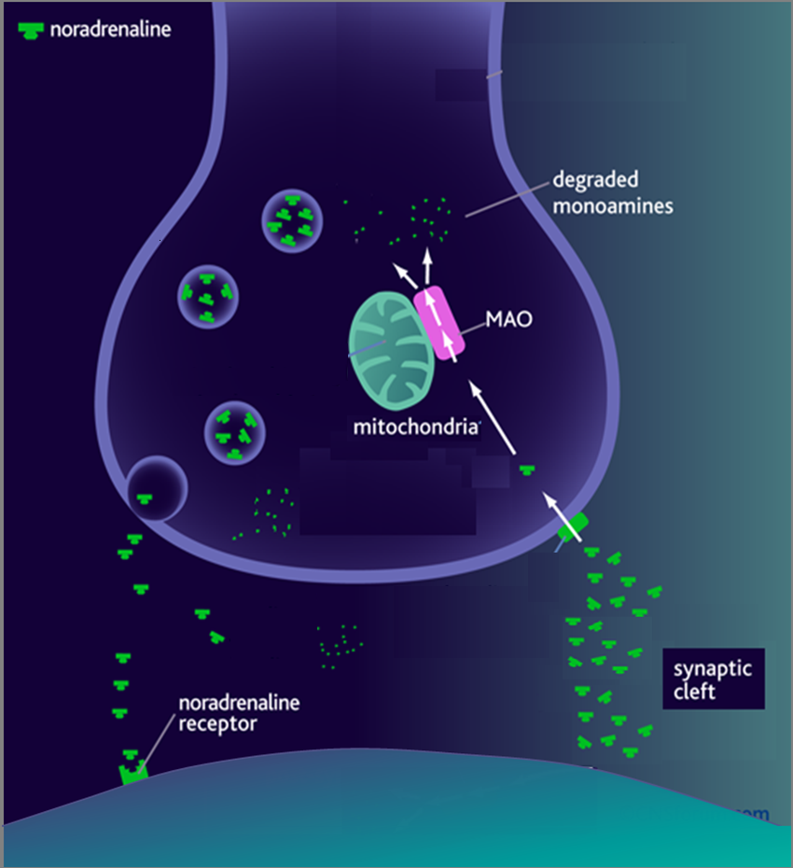
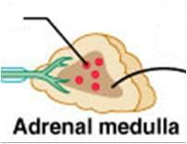
Na
POSTGANGLIONIC SYMPATHETIC NERVE ENDING
Norepinephrine (NE)
Tyrosine
Dopa
Tyrosine
SYNTHESIS
DA
STORAGE
NE
RELEASE
Ca
ACTION
REUPTAKE
NET
DEGRADE
Dopamine (DA)
NE  E
E
ADRENAL MEDULLA
COMT

Slide 5
SYMPATHETIC ACTIONS
Fight & Flight
α receptors
β₁ receptors
β₂ receptors
EYE: Contract
Dilator Pupilli
EYE: Relax
Ciliary m.
SALIVARY GLANDS
◉ Salivation
BLOOD VESSELS
Vasoconstriction
HEART
 Force Inotropic
HR Chronotropic
AV conduction
Dromotropic
VESSELS
Vasodilatation
BRONCHUS
Bronchodilatation
GIT
Contraction of sphincters
GIT & G. Bladder
Motility
PANCREAS
◉ Insulin secretion
LIVER
 Glucose
KIDNEY
Renin from Juxta-glomerular cells
URINARY BLADDER
Contraction of sphincters
BLADDER
Detrusal m.:Relax
PENIS
Ejaculation
UTERUS
Relax :Tocolysis

Slide 6
D₁

Slide 7
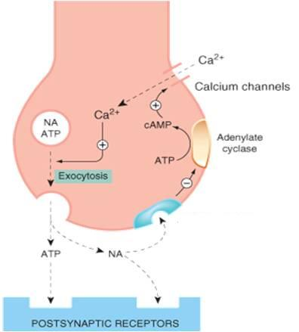
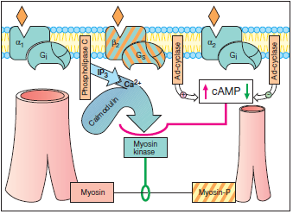
SYMPATHETIC NERVE ENDING
SNS actions at α_{1&2} and β₂ receptors in smooth m.
SYMPATHETIC SUPPLY TO SMOOTH MUSCLES
α ₂
Gq
Presynaptic action of NE
at α₂ receptor
CONTRACTION
RELAXATION
CONTRACTION

Slide 8
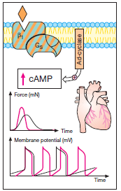
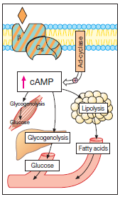
SNS actions at β₁ receptors in heart
SNS actions at β receptors in organs controlling metabolism

Slide 9
Sum up of physiological actions of Epinephrine (adrenaline)
Acts on all ADR; β =/> α
Heart  inotropic, chronotropic, dromotropic & lusiotropic (excitability)(β₁)
BP  systolic (β₁) / diastolic   low dose (β₂) &  high dose (α₁)
Vascular SMC; constrict skin + peripheral (α₁) / dilate coronary+skeletal (β₂)
Non vascular SMC;
Lung  bronchiodilatation (β₂)
GIT  motility (β₂) / contract sphincter (α₁)
Bladder   detrusor m. (β₂) / contract trigone & sphincter (α₁)
Pregnant uterus  tocolytic (β₂)
Eye  mydriasis (α₁)
 no sig. change; accommodation & intraocular pressure(IOP) ???
Metabolism insulin (α₂) , glucagon (β₂),  liver glycogenolysis + sk. m. glycolysis (β₂) /   adipose lipolysis (β₃ /β₂)
CNS little, headache, tremors & restlessness

Slide 10
Eye
Mydriasis
Accomodation
Mydriasis
Paralysis of constrictor pupilli (M)
Contraction of dilator pupilli (α)

Slide 11
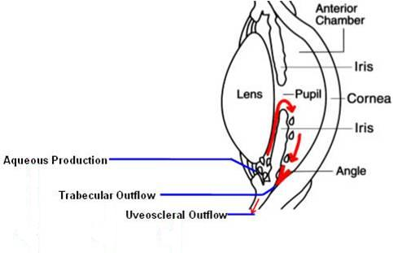
Glaucoma Treatment-An Evolving Paradigm
Intra-Ocular Pressure [IOP]
Kept by a balance between formation & drainage
If balance disturbed by increasing formation or decreasing drainage  IOP glaucoma
SNS; No or slightly increase formation !!!
No or slightly increase drainage !!!
SNS; So collectively hardly an effect on IOP

Slide 12
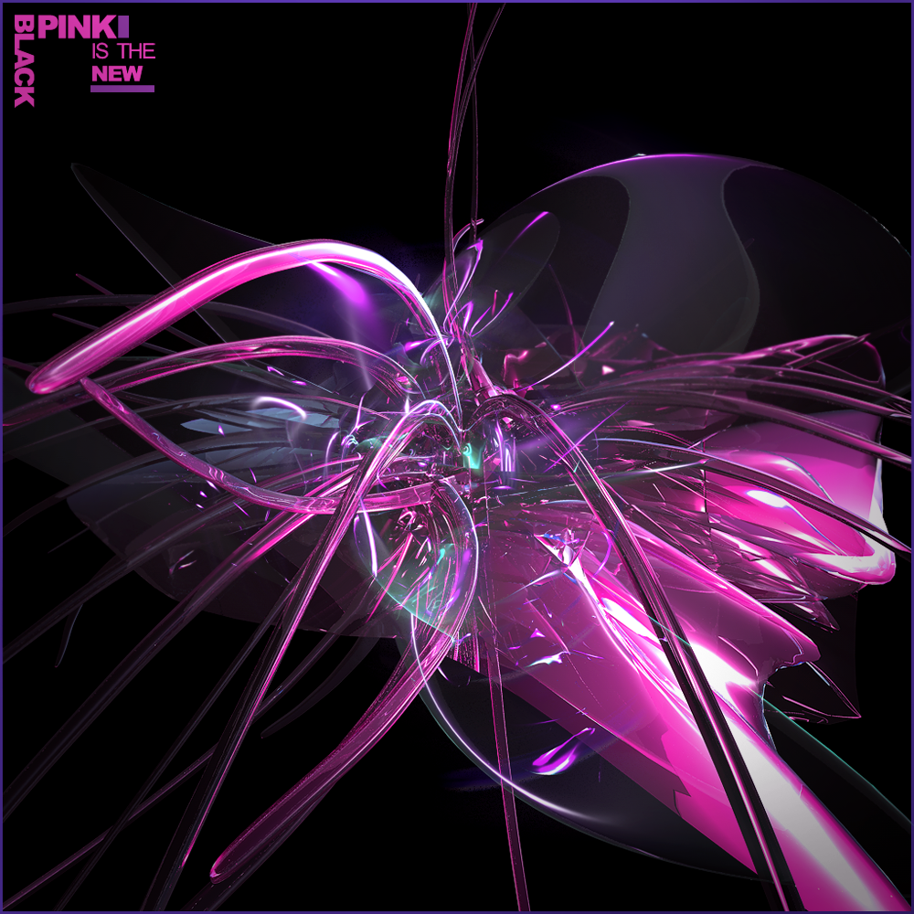
GOOD LUCK

Slide 15
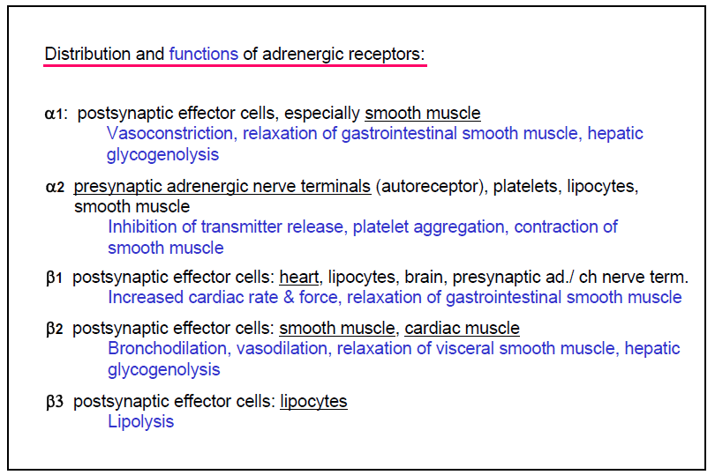

Slide 16
