Slide 1
Treatment of asthma
By
Prof. Hanan Hagar

Slide 2
Disorders of Respiratory Function
Classification
Main disorders of the respiratory system are :
1. Bronchial asthma
2. Cough
3. Allergic rhinitis
4. Chronic obstructive pulmonary disease
(COPD, also called emphysema)

Slide 3
Asthma
Asthma is a chronic inflammatory disorder of bronchial airways that result in airway obstruction in response to external stimuli

Slide 4
Airways of the asthmatic patients are characterized by:
Airway hyper-reactivity: abnormal sensitivity of the airways to wide range of external stimuli as pollen, cold air and tobacco smoke.
Inflammation
Swelling
Thick mucus production.

Slide 5
Bronchospasm
constriction of the muscles around the airways, causing the airways to become narrow.

Slide 6
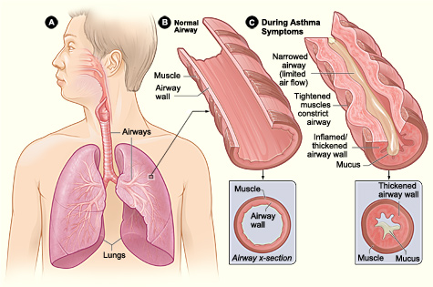
http://link.brightcove.com/services/player/bcpid236059233?bctid=347806802

Slide 7
Symptoms of asthma
Asthma produces recurrent episodic attack of
Acute bronchoconstriction (immediate)
Shortness of breath
Chest tightness
Wheezing
Rapid respiration
Cough
Symptoms can happen each time the airways are irritated by inhaled irritants or allergens.

Slide 8
Causes
Infection
Emotional conditions
Stress
Exercise
Pets
Seasonal changes
Some drugs as aspirin-β bockers

Slide 9
Airways Innervations
Efferent nerves
Parasympathetic supply
M3 receptors in smooth muscles and glands.
No sympathetic supply
B2 receptors located in smooth muscles and glands

Slide 10
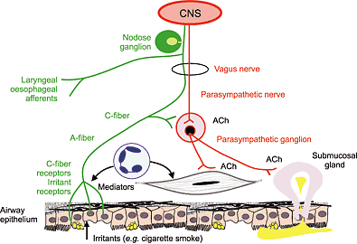

Slide 11
Afferent nerves
Irritant receptors (vagal fibers) in upper airways.
C-fiber receptors (sensory nerve fibers) in lower airways.
Stimulated by :
Exogenous chemicals
Physical stimuli (cold air)
Endogenous inflammatory mediators

Slide 12
Anti asthmatic drugs
AIMS
To relieve acute episodic attacks of asthma (bronchoconstriction).
To reduce the frequency of attacks, and
nocturnal awakenings.
To prevent future exacerbations.

Slide 13
Anti asthmatic drugs
Bronchodilators
(Quick relief medications)
Used to treat acute episodic attack of asthma
Short acting β2-agonists
Antimuscarinics
Xanthine preparations
Anti-inflammatory Agents
(control medications or prophylactic therapy)
Used to reduce the frequency of attacks
Corticosteroids
Mast cell stabilizers
Leukotrienes antagonists
Anti-IgE monoclonal antibody
Long acting ß2-agonists

Slide 14
Anti asthmathic drugs
I. Bronchodilators : (Quick relief medications)
are used to relieve acute attack of bronchoconstriction
1. β2 - adrenoreceptor agonists
2. Antimuscarinics
3. Xanthine preparations

Slide 15
II- Anti - inflammatory Agents :
reduce the number of inflammatory cells in the airways and prevent blood vessels from leaking fluid into the airway tissues. By reducing inflammation, they reduce the spasm of the airway muscle

Slide 16
Anti - inflammatory Agents
(control medications / prophylactic therapy)
Are used as prophylactic therapy
Mast cell stabilizers.
Glucocorticoids.
Anti-IgE monoclonal antibody
(omalizumab
4. Leukotrienes antagonists:
5-Lipoxygenase inhibitors
Leukotriene–receptor inhibitors

Slide 17
Sympathomimetics
β- adrenoceptor agonists
Mechanism of Action
1- direct β2 stimulation ⎯→ stimulate adenyl cyclase ⎯→ Increase cAMP ⎯→ bronchodilation
2- Inhibit mediators release from mast cells.
3- Increase mucus clearance by ( increasing
ciliary activity).

Slide 18
Classification
Non selective β agonists.
Epinephrine - Isoprenaline
Selective β2 - agonists.
Salbutamol (albuterol)
Terbutaline
Salmeterol
Formeterol

Slide 19
Non selective β-agonists.
Epinephrine
Potent bronchodilator
rapid action (maximum effect within 15 min).
S.C. or by inhalation by (aerosol or nebulizer).
Duration of action 60-90 min
Drug of choice for acute anaphylaxis (hypersensitivity reactions).

Slide 20
Disadvantages
Not effective orally.
Hyperglycemia # in Diabetes.
CVS side effects : Tachycardia, arrhythmia, hypertension # angina
Skeletal muscle tremor

Slide 21
Selective β2 –agonists
are drugs of choice for acute attack of bronchospasm
Are mainly given by inhalation (metered dose inhaler or nebulizer).
Can be given orally, parenterally.

Slide 22
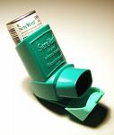
Nebulizer Inhaler

Slide 23
Selective β2 –agonists are classified into
Short acting ß2 agonists
Salbutamol (albuterol)
Terbutaline
Long acting ß2 agonists
Salmeterol
Formeterol

Slide 24
Short acting ß2 agonists
Salbutamol (albuterol) (inhalation, orally, I.V.)
Terbutaline ( inhalation, orally, S.C., )
Have rapid onset of action (15-30 min).
Duration of action (4-6 hr)
used for symptomatic treatment of
bronchospasm (acute episodic attack of
asthma)
Terbutaline & salbutamol are also used as
tocolytics for premature labor.

Slide 25
Long acting selective ß2 agonists
Salmeterol & formoterol:
Long acting bronchodilators (12 hours)
are given by inhalation
high lipid solubility (creates a depot effect)
Salmeterol has slow onset of action
are not used to relieve acute episodes
used for nocturnal asthma (prophylaxis)
combined with inhaled corticosteroids to control asthma (decreases the number and severity of asthma attacks).

Slide 26
Advantages of ß2 agonists
Minimal CVS side effects
Suitable for asthmatic patients with
hypertension or heart failure.
Disadvantages of ß2 agonists
Skeletal muscle tremors.
Nervousness
Tolerance (B-receptors down regulation).
Tachycardia over dose (B1-stimulation).

Slide 27
Muscarinic antagonists
Ipratropium – Tiotropium
Non selective muscarinic antagonists.
Inhibit bronchoconstriction and mucus secretion
Kinetics
Quaternary derivatives of atropine
Given by aerosol inhalation
Does not diffuse into the blood
Do not enter CNS
Delayed onset of action.
Duration of action 3-5 hr

Slide 28
Pharmacodynamics
a short-acting bronchodilator.
Less effective than β2-agonists.
No anti-inflammatory action
Minimal systemic side effects.

Slide 29
Uses
Chronic obstructive pulmonary diseases (COPD).
In acute severe asthma combined with
β2-agonists & steroids.
Tiotropium
Given by inhalation
Longer duration of action (24 h)
Used for COPD

Slide 30
Methylxanthines
Theophylline
(orally – sustained release preparation-
parenterally)
Aminophylline
(theophylline + ethylene diamine)
(orally – parenterally).

Slide 31
Mechanism of Action
are phosphodiestrase inhibitors
↑ cAMP → bronchodilation
Adenosine receptors antagonists (A1)
Increase diaphragmatic contraction
Stabilization of mast cell membrane

Slide 32
ATP
B-agonists
Bronchodilation
Adenyl cyclase
cAMP
Bronchial tree
Phosphodiesterase
Theophylline
Adenosine
Bronchoconstriction
3,5,AMP

Slide 33
Pharmacological Effects :
1- relaxation of bronchial smooth muscles
2- CNS stimulation
* stimulant effect on respiratory center.
* decrease fatigue & elevate mood.
* tremors, nervousness, insomnia,
convulsion

Slide 34
Skeletal muscles : ↑contraction of diaphragm → improve ventilation
CVS:
+ ve Inotropic ( ↑ heart contractility)
+ ve chronotropic (↑ heart rate)
GIT: Increase gastric acid secretions
Kidney: weak diuretic action (↑renal blood flow)

Slide 35
Pharmacokinetics
Metabolized in the liver by Cyt P450 enzymes
( t ½ = 8 h )
T ½ is decreased by
Enzyme inducers (phenobarbitone-rifampicin)
T½ is increased by
Enzyme inhibitor (cimetidine, erythromycin)

Slide 36
Uses
1. second line drug in asthma (theophylline)
For status asthmatics (aminophylline is given as slow infusion ).
COPD

Slide 37
Side Effects
Low therapeutic index narrow safety margin
monitoring of theophylline blood level is necessary.
CNS side effects: seizures
CVS effects: hypotension, arrhythmia.
GIT effects: Nausea & vomiting

Slide 38
II- Anti - inflammatory Agents :
reduce the number of inflammatory cells in the airways and prevent blood vessels from leaking fluid into the airway tissues. By reducing inflammation, they reduce the spasm of the airway muscle & bronchial hyper-reactivity

Slide 39
II- Anti - inflammatory Agents
by reducing inflammation in airways, they reduce the spasm of the airways & bronchial hyper-reactivity

Slide 40
II- Anti - inflammatory Agents
Glucocorticoids.
Mast cell stabilizers.
Leukotrienes antagonists.

Slide 41
Glucocorticoids
Mechanism of action
Inhibition of phospholipase A2 decrease synthesis of arachidonic acid & prostaglandin and leukotrienes
Decrease inflammatory cells in airways e.g. macrophages, eosinophils

Slide 42
Mast cell stabilization decrease histamine release
decrease capillary permeability and mucosal edema.
Inhibition of antigen-antibody reaction.

Slide 43
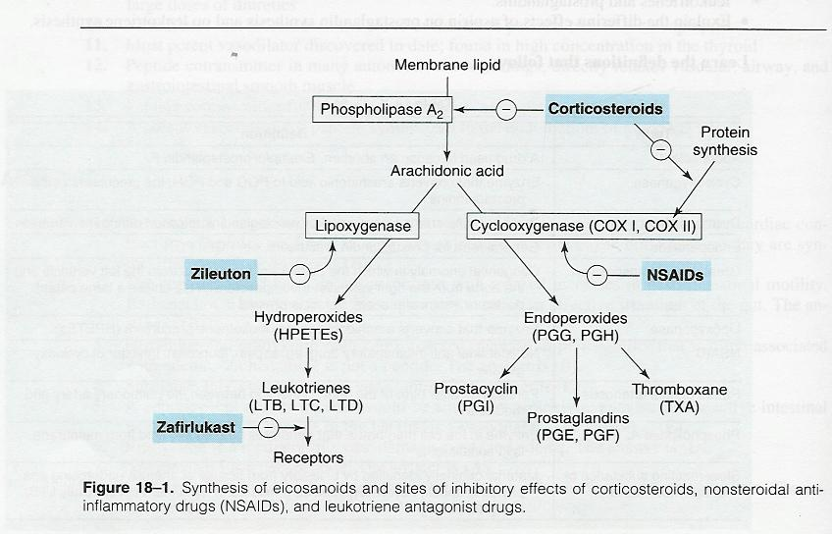

Slide 44
Routes of administration
Inhalation (metered-dose inhaler):
Beclomethasone
Fluticasone (high first pass effect in liver & low bioavailability).
Orally: Prednisone
Injection: Hydrocortisone
Methyl prednisolone

Slide 45
Pharmacodynamics
Not bronchodilators
Reduce bronchial inflammation
Reduce bronchial hyper-reactivity to stimuli
Have delayed onset of action (effect usually attained after 2-4 weeks).
Maximum action at 9-12 months.

Slide 46
Given as prophylactic medications (as prophylactic therapy to reduce frequency of asthma attacks).
Effective in allergic, exercise, antigen and irritant-induced asthma.

Slide 47
Abrupt stop of corticosteroids should be avoided and dose should be tapered (adrenal insufficiency syndrome).

Slide 48
Uses
Inhalation
relatively safe
As a prophylactic therapy to control moderate to severe asthma in children and adults alone or in combination with beta-agonists.
Upregulate β2 receptors (have additive effect to B2 agonists).

Slide 49
Systemic corticosteroids are reserved for:
management of acutely ill patients
Status asthmaticus (i.v.).

Slide 50
Side effects due to systemic corticosteroids
(prolonged use of oral/parenteral corticosteroids)
Adrenal suppression
Growth retardation in children
Osteoporosis
Fat distribution
Hypertension
Hyperglycemia
Fluid retention

Slide 51
Weight gain
Susceptibility to infections
Cataract
Glaucoma
Wasting of the muscles
Psychosis

Slide 52
Inhalation has very less side effects:
Oropharyngeal candidiasis (thrush).
Dysphonia (voice hoarseness).

Slide 53
Mast cell stabilizers
Cromolyn (Sodium cromoglycate)
Nedocromil
act partially by stabilization of mast cell membrane.

Slide 54
Pharmacokinetics
Inhalation (aerosol, microfine powder,
nebulizer).
Poor oral absorption (10%)
half life is 90 minutes.

Slide 55
Pharmacodynamics
Not direct bronchodilators
Not effective in acute attack of asthma.
Prophylactic anti-inflammatory drug
Reduce bronchial hyper-reactivity.
Effective in exercise, antigen and
irritant-induced asthma.
Children respond better than adults

Slide 56
Uses
Prophylaxis in asthma especially in children.
Allergic rhinitis.
Conjunctivitis

Slide 57
Side Effects
Bitter taste
minor upper respiratory tract irritation (burning sensation, nasal congestion)

Slide 58
Leukotrienes antagonists
5-Lipoxygenase inhibitors.
Leukotriene-receptor antagonists.

Slide 61
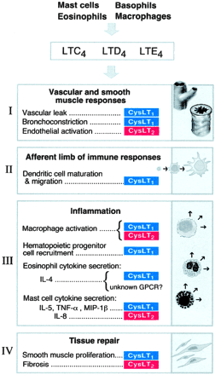

Slide 62
Leukotrienes
Synthesized by inflammatory cells found in the airways (eosinophils, macrophages, mast cells)
Products of 5-lipo-oxygenase on arachidonic acid
Leukotriene B4:
chemotaxis of neutrophils

Slide 63
Cysteinyl leukotrienes C4, D4 & E4:
bronchoconstriction
increase bronchial hyper-reactivity
mucosal edema
mucus hyper-secretion

Slide 64
5-Lipoxygenase inhibitors
Zileuton
is a selective inhibitor of 5-lipo-oxygenase
inhibits synthesis of leukotrienes (LTB4 , LTC4, LTD4 & LTE4).
Given orally
Short duration of action.
Is given (3-4 times/ day).

Slide 65
Leukotriene receptor antagonists
Zafirlukast
are selective, reversible inhibitors of cysteinyl leukotriene receptors (LTD4)
Taken orally.

Slide 67
Antileukotriene drugs
Are bronchodilators
Have anti-inflammatory action
less effective than inhaled corticosteroids
Potentiate corticosteroid actions (has corticosteroid sparing effect low dose of corticosteroid can be given).

Slide 68
Uses of antileukotriene drugs
Prophylaxis of mild to moderate asthma.
Aspirin-induced asthma
Antigen and exercise-induced asthma
Are not effective to relieve acute attack of asthma.

Slide 69
Side effects of Leukotriene antagonists
Elevation of liver enzymes.
Headache
Dyspepsia.
Rare: Churg-Strauss syndrome (eosinophilic vasculitis).

Slide 70
Omalizumab
is a monoclonal antibody directed against human IgE
prevents IgE binding with its receptors on mast cells & basophiles.
Decrease release of allergic mediators.
Used to treat allergic asthma.
Expensive-not first line therapy.

Slide 72
Treatment of COPD
Chronic irreversible airflow obstruction
Smoking is a high risk factor
Inhaled bronchodilators
Inhaled antimuscarinics (main drug)
Short acting bronchodilators
these drugs can be used either alone or combined

Slide 73
Examples
salbutamol + ipratropium
Salmeterol + Tiotropium (long acting-less dose frequency)
For severe COPD
Bronchodilators
Inhaled glucocorticoids
Oxygen therapy
Antibiotics

Slide 74
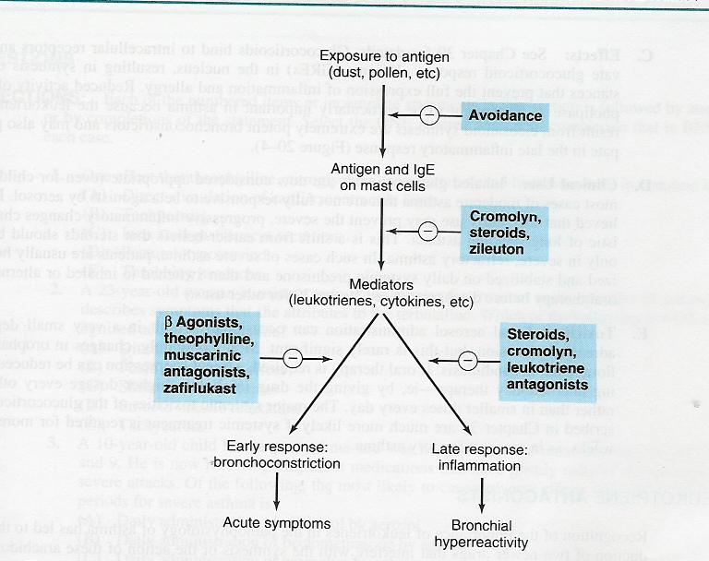
Summary for treatment of asthma

Slide 75
Bronchodilators (relievers for bronchospasm)
 |  | Drugs
Adenyl cyclase cAMP | Short acting main choice in acute attack of asthma Inhalation | B2 agonists Salbutamol, terbutaline
 | Long acting, Prophylaxis Nocturnal asthma | Salmeterol, formoterol
Blocks M receprtors | Main drugs For COPD Inhalation | Antimuscarinics Ipratropium (Short) Tiotropium (long)
Inhibits phosphodiesterase↑ cAMP | (orally) (parenterally) | Xanthine derivatives Theophylline Aminophylline

Slide 76
Anti-inflammatory drugs (prophylactic)
Inhibits phospholipase A2 inhalation | Corticosteroids Dexamethasone, Fluticasone
Orally | prednisolone
parenterally | Hydrocortisone
Inhalation Prophylaxis in children | Mast stabilizers Cromoglycate (Cromolyn) Nedocromil
(orally) (orally) | Cysteinyl antagonists Zileuton (5 lipooxygenase inhibitor) Zafirlukast (D4 blocker)
Injection SC Anti IgE antibody | Omalizumab

