Slide 1
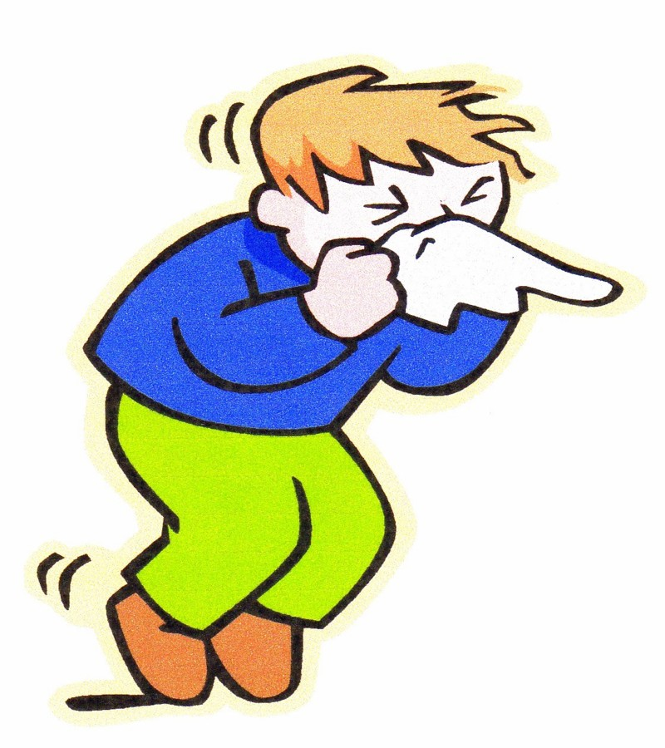
Pharmacological treatment of acute & chronic Rhinitis + Cough
By: Dr Alia AlShanawani
Dep of Medical Pharmacology, KSU
Feb 2012

Slide 2
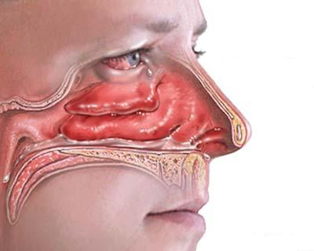
RHINITIS
Inflammation & swelling of mucous membrane of nose
Eyes, ears, sinuses, & throat can also be involved.

Slide 3
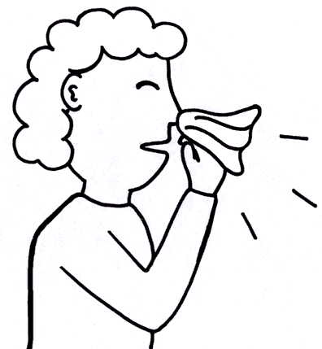
Types of Rhinitis
Acute Rhinitis (7- 14 days)
Short lived; results from viral infections + other causes (allergies)
This will lead to mast cell & basophiles degranulation & the local release of inflammatory mediators.
Symptoms: nasal itching, rhinorrhea, sneezing, congestion, transient nasal blockage, cough & low grade fever.

Slide 4
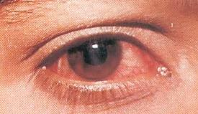
ii) Chronic Rhinitis
Long- standing (> 6 weeks)
Usually occur with chronic sinusitis (chronic rhinosinusitis)
Chronic rhinitis is usually an extension of rhinitis caused by inflammation or an infection.

Slide 5
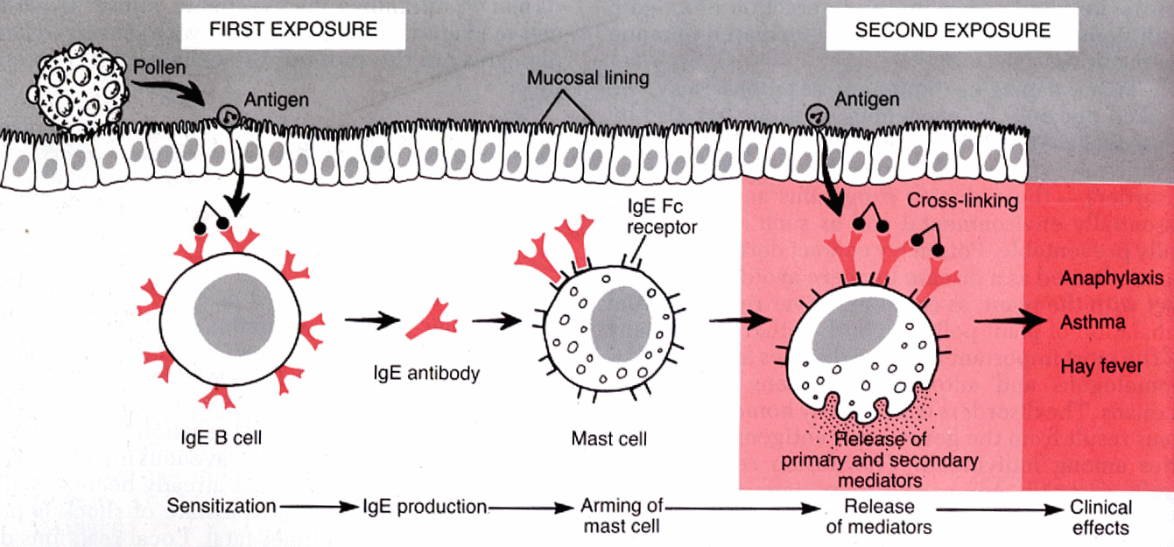
Pathogenesis of Allergic Rhinitis

Slide 6
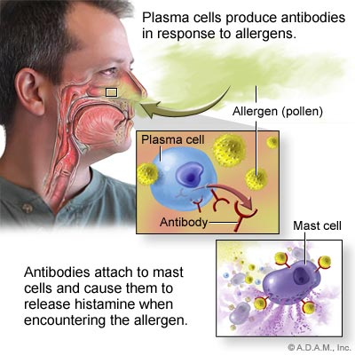

Slide 7
Treatment of Rhinitis
Non-pharmacological therapy
Avoidance of irritants/ allergen
Dusting/vacuuming; washing of bed sheets
Intake of fluids
Rest

Slide 8
Pharmacological therapy
1- Antihistamines (H1 receptor antagonists)
2- α-Adrenergic agonists
3- Corticosteroids
4- Cromolyn
5-Leukotriene receptor antagonists e.g. (Montelukast); new adjunct therapy for chronic allergic rhinitis .

Slide 9
Antihistamines
Agents block the actions of histamine
Classical antihistamines = H1 receptor antagonists
Histamine
Biologically active amine functions as neurotransmitter; Synthesized from histidine
Distributed in mast cells, basophiles, neurons of brain, cells of stomach.

Slide 10
The different Histamine receptors
 | Location | Type of receptor | Effect | Treatment
H1 | Throughout the body, specifically in smooth muscles, vascular endothelial cells, heart & CNS | G-protein coupled, linked to intercellular Gq, which activates phospholipase C | Mediate an increase in vascular permeability at sites of inflammation induced by histamine | Allergies, nausea, sleep disorders
H2 | Mainly in gastric parietal cells, low level can be found in vascular smooth muscle, mast cells, neutrophils, CNS, heart, & uterus | G-protein coupled, linked to intercellular Gs | Increases the release of gastric acid | Stomach ulcers
H3 | Found mostly presynaptically in the CNS, with a high level in the thalamus, caudate nucleus & cortex, also a low level in small intestine, testis & prostate. | G-protein coupled, possibly linked to intercellular Gi | Neural presynaptic receptor, may function to release histamine | Unknown
H4 | They were discovered in 2000. They are widely expressed in components of the immune system such as the spleen, thymus & leukocytes. | Unknown, most likely also G-protein coupled | Unknown | In addition to benefiting allergic conditions, research in the H4 receptor may lead to the treatment of autoimmune diseases. (rheumatoid arthritis )
Notes:
, caudate nucleus within the basal ganglia in the brain. for learning & memory

Slide 11
Effects of histamine
CVS
Dilatation of arterioles, capillaries & venules B.P
Histamine (H1) increase the permeability of capillary vessels, passage of fluid & protein into the extracellular space & edema.
Direct +ve inotropic & chronotropic effects on the heart thru stimulation of H2 receptors.

Slide 12
GIT
(stimulation of H2) Acid production ↑ +↑intestinal secretion
Contraction of sm muscles (H1 receptor stimulation)
Respiratory tract
Bronchoconstriction (H1 receptors)
CNS
H1: maintenance of wakeful states.
H1 & H2: Regulation of body temp., effect CVS system & sexual arousal, causes pain & itching by stimulation of peripheral nerve endings.

Slide 13
Effects of histamine
Intra dermal injection of histamine causes:
Red spot
Edema
Flare & itching.
Toxicity: flushing, hypotension, tachycardia, headache, bronchoconstr. & G I upset.

Slide 14
Classification of Antihistamines:
A- First generation drugs
Ethanolamine
e.g., Diphenhydramine, dimenhydrinate & doxylamine
ii) Piperazine derivatives e.g., Cyclizine, meclizine
iii) Alkylamines e.g., Chlorpheniramine
iv) Phenothiazine derivatives
e.g., Promethazine
v) Miscellaneous (other drugs)
e.g., Cyproheptadine.

Slide 15
B- Second generation antihistamines
1-Piperidine
e.g. fexofenadine
2-Miscellaneous
e.g., Loratadine= Claritin® (longer acting), Cetirizine

Slide 16
Treatment of Rhinitis 1- Antihistamines
MOA
1st & 2nd generation antihistamines are competitive inhibitors of H1- receptor mediated responses.
Many of the 1st generation drugs have effects that are not mediated by H1- receptors.
Such as antimuscarinic activity, alpha adrenoceptors blocking, serotonin receptors antagonism & local anesthetic receptor sites.
Some of these actions are of therapeutic value & some are undesirable.

Slide 17
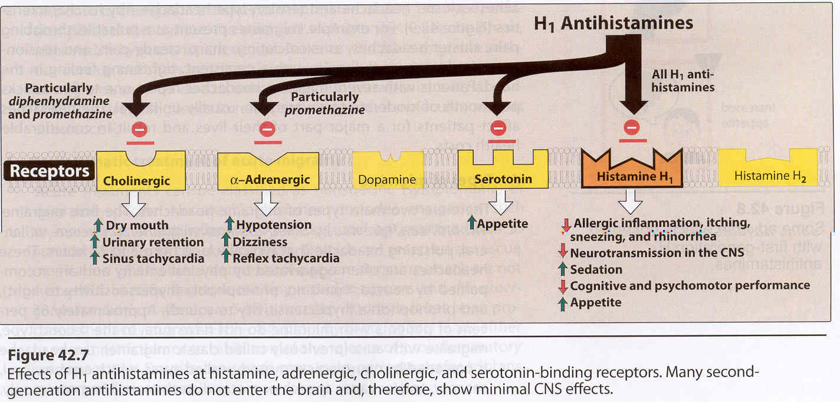
Motion sickness

Slide 18
Properties of Antihistamines
*Used locally/ orally.
1st generation drugs = lipid soluble , easily cross into brain, produce sedation & drowsiness
2nd generation drugs = less lipid soluble, not significantly pass into brain, do not cause sedation & drowsiness.

Slide 19
Pharmacokinetics
Rapidly absorb----after oral administration, with peak blood levels occurring within 1-3 hr.
Wide distribution
Some extensively metabolized by microsomal systems in liver (CYP3A4 system)—important drug interaction with Ketoconazole
Duration of action:
4-6 hours (most drugs)
12-24 hr Meclizine & 2nd generation drugs.

Slide 20
Pharmacological actions
1- Sedation
1st generation drugs
Common effect; Varies with drugs & with patients
Useful as OTC “sleep aid” medication & unsuitable for daytime use. E.g. promethazine, diphenhydramine, doxylamine & pyrilamine.
At ordinary dose= children---excitation;
at toxic dose=marked stimulation, agitation, convulsion & coma.
2nd generation drugs= little or no sedating effect.

Slide 21
2- Antinausea & Antiemetic actions
Some 1st generation drugs (due to their antimuscarinic action) are effective antiemetic agents
& significantly prevent motion sickness & vertigo e.g., promethazine, meclizine, cyclizine, doxylamine, dimenhydrinate & diphenhydramine
MOA: limit stimulation of the vomiting center from the vestibular system (which is rich in histamine & acetylcholine).
3- Antiparkinsonism effects:
Some H₁ antagonists (esp diphenhydramine) =suppressant effect on extrapyramidal symptoms associated with antipsychotic drugs (due to their antimuscarinic action).

Slide 22
4- Anticholinoceptor actions
Many 1st generations agents (diphenhydramine, promethazine, Triprolidine & dimenhydrinate)= atropine like effect ---beneficial for non-allergic rhinorrhea (may cause urinary retention & blurred vision).
5- Alpha- adrenoceptor blocking actions
Phenothiazine sub group= cause orthostatic hypotension.

Slide 23
6-Serotonin blocking actions
E.g., Cyproheptadine—antiserotonin agent
7- Local anesthesia
Several 1st generation agents have local anesthetic effects (by blocking Na⁺ channels in excitable membranes) e.g., diphenhydramine & promethazine
8- Other actions
Some H1 antagonist (e.g.cetirizine) inhibit mast cell release of histamine + some other mediators of inflammation → treatment of allergies.

Slide 24
Clinical Uses of antihistamines
1- Allergic reaction
The most common use of H1- receptor antagonists is Urticaria , allergic conjunctivitis & allergic rhinitis (histamine primary mediator)
Reduce production of secretion (inhibit mast cell degranulation)
Reduce pruritus & sneezing
Reduce dermatitis & hay fever
do not significantly improve congestion

Slide 25
2- Nausea & vomiting
3-Motion sickness & vestibular disturbances (meniere’s syndrome)
4-Sleep aid.

Slide 26
Adverse Effects for 1st gerneration antihistamines
Antimuscarinic effects
dryness of mouth, blurring of vision, retention of urine, constipation & ↓sweating
Alph Antagonist effects
blocking of α-receptors on blood vessels = postural hypotension
CNS
sedation but may cause mental agitation & convulsion (toxic doses)
Tolerance to certain antihistamines may develop after prolonged administration.

Slide 27
Treatment of Rhinitis,,,, Cont’ 2- Alpha Adrenergic agonists (Decongestants: po/ topical)
A- Short acting α-adrenergic agonist
(nasal decongestants e.g., pseudoephedrine) → constrict dilated arterioles in nasal mucosa, suppress swelling & ↓airway resistance
B- Longer acting: oxymetazoline
C- Alpha agonists + antihistamine (loratadine or fexofenadine + pseudophedrine)
Alpha agonists should not be used for longer time bec of rebound nasal congestion.

Slide 28
3-Corticosteroids
Used to treat allergic nasal obstruction & chronic rhinitis (reduce: sneezing, itching, rhinorrhea & congestion).
Topical steroid sprays
e.g., beclomethasone, budesonide, & fluticasone.
Corticosteroids have anti-inflammatory action by inhibiting leukotrienes & prostaglandins formation.
Histamine, platelet-activating-factor, kinins, & substance P are affected indirectly by the inhibitory effects of the corticosteroids on inflammatory cells.

Slide 29
Corticosteroids Cont’
Local corticosteroids are more effective compared to systemic antihistamines for allergic & non allergic rhinitis.
Side effects:
Localized to intranasal (nasal irritation, nose bleed, sore throat, candidiasis) Due to the anti-inflammatory & immunosuppressive effect of steroids .

Slide 30
4- Cromolyn Na (nasal & ophthalmic)
Antiinflammatory drug & Mast cell stabilizer (prevent release of histamine & other mediators from mast cells)
Intranasal cromolyn= useful particularly as prophylactic when given before (1 to 2 weeks) contact with allergen
Multiple daily dosing of cromolyn is required.
Effects:
Reduces allergic rhinitis & conjunctivitis
Reduces nasal pruritus, sneezing, rhinorrhea & congestion.

Slide 31
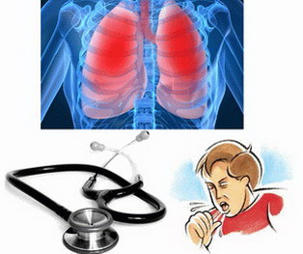

Slide 32
Cough
Physiological Cough (Productive Cough)
Is a protective reflex mechanism that removes foreign materials & secretions from the bronchi & bronchioles.
Unproductive Cough (dry cough)
occurs due to exposure to irritant vapors or gases or due to pathological conditions as chronic bronchitis.

Slide 33
Coughing can be provoked by:
Common cold
Pneumonia & pulmonary embolism
Asthma
Smoking
Gastroesophageal reflux
ACE inhibitors
Bronchitis.

Slide 34
A productive cough should not be suppressed except in special circumstances (eg, when it exhausts the patient or prevents rest & sleep) & generally not until the cause has been identified.
An acute infection such as pneumonia may require antibiotics, an asthma-induced cough may be treated with the use of bronchodilators, or an antihistamine may be administered in the case of an allergy.

Slide 35
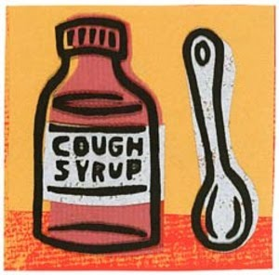
Coughs can be either acute (typically not lasting longer than 2 -3 weeks) or
chronic (lasting longer than 4 weeks).
Cough medicines
cough suppressants (for a dry cough) or
expectorants (for a wet, productive cough that brings up mucous) are available OTC & by prescription.

Slide 36
Antitussives
1. Peripheral antitussives : e.g. Benzonatate
2. Central antitussives.
a. Narcotic analgesics
Morphine
Codeine
b. Synthetic narcotic analgesics
c. Antihistaminics ( H1-Blockers )

Slide 37
Narcotic analgesics
Are drugs used to suppress dry cough, used in doses below those required for pain relief.
Codeine (methyl-morphine)
opiate with less addiction liability.
Potent antitussive
Weak analgesic.

Slide 38
MOA
Suppress cough by inhibiting release of excitatory neuropeptides thru stimulation of µ receptors.
Side Effects
1- Constipation
2- Drowsiness & mild respiratory depression
3- Inhibition of mucociliary clearance (thick sputum)
4- Decrease secretions in the bronchioles
5- Dependence
6- Dry mouth.

Slide 39
Synthetic narcotic analgesics
dextromethorphan – levo-propoxyphene.
Dextromethorphan
1- As potent as codeine.
2- No drowsiness.
3- Less constipating effect.
4- No respiratory depression.
5- No inhibition of mucociliary clearance.
6- No addiction.

Slide 40
NOTES
Antitussives are used for dry cough.
Contraindicated in
chronic bronchitis
cough associated with asthma
( harmful sputum thickening & retention).

Slide 41
Antihistaminics (H1-Blockers )
Diphenhydramine
Triprolidine.
Side Effects
Anticholinergic actions
Sedation
Drowsiness.

Slide 42
Peripherally Acting Antitussives Demulcents, Local Anesthetics, and Humidifying Aerosols & Steam Inhalations
Act on either the afferent or efferent side of the cough reflex.
Demulcents are (agents that form a soothing film (protective coating) over the irritated pharyngeal mucous membrane, relieving minor pain & inflammation of the membrane).
Useful for coughs originating above the larynx
They are usually given as syrups or lozenges & include acacia, licorice, glycerin, honey, & wild cherry syrups.

Slide 43
Peripherally Acting Antitussives
Benzonatate,
is a local anesthetic; its antitussive effect may
be due to a combination of local anesthesia &
depression/decrease sensitivity of pulmonary stretch receptors.
Humidifying aerosols and steam inhalations exert an antitussive effect by acting as a demulcent & by decreasing the viscosity of bronchial secretions
Inhaling water as an aerosol or as steam, with or without medicaments (sodium chloride, compound benzoin tincture, eucalyptol), is the most common method of humidification.
Notes:
Stretch receptors are mechanoreceptors responsive to distention of the thorax, which are neurologically linked to the medulla via efferent nerve cells, joining them to the expiratory cells present there. Stretch receptors are also found in other organs and muscles, such as bowel wall.

Slide 44
Expectorants: Definition
Drugs that aid in the expectoration (removal) of mucus & exudates from the respiratory passages by cough
Reduce the viscosity of secretions
Disintegrate & thin secretions.
By loosening and thinning sputum and bronchial secretions, the tendency to cough is indirectly diminished.

Slide 45
Expectorants: Mechanisms of Action
Reflex stimulation
Guaifenesin
An expectorant drug used to thin mucus and sputum
It also stimulates the flow of respiratory tract secretions, allowing ciliary movement to carry the loosened secretions upward toward the pharynx.
Direct stimulation
The secretory glands are stimulated directly to increase their production of respiratory tract fluids
Examples: iodine-containing products such as iodinated glycerol & potassium iodide. Final result: thinner mucus that is easier to remove.

Slide 46
Classification of Expectorants
1. Sedative Expectorants
They increase the fluidity of sputum & its expulsion by cough.
These drugs are used in chronic inflammation of respiratory mucosa
(chronic bronchitis).

Slide 47
e.g. of sedative expectorants:
Ammonium chloride
Na & K iodide.
Guaifenesin.

Slide 48
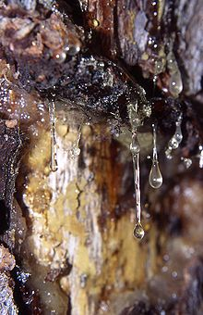
2- Stimulant expectorants
These drugs are used in chronic inflammation of respiratory mucosa
(chronic bronchitis).
Stimulating reflex expectorants in which person vomit thus ejecting the mucus & phlegm. They promote healing & repair of mucosal tissues.
thins the mucus which helps the body to cough it up.
e.g. terpene hydrate.

Slide 49
Mucolytics
Acts by reducing the viscosity of sputum.
Acetyl cysteine (interfering with disulphide bonds in mucus).
Bromohexine (destroy muco-polysaccharride structure of mucus).
Steam inhalation
Uses
Acute & chronic bronchitis
Asthma.

