Slide 1
Treatment of Respiratory Tract infections

Slide 2
Prof.
Azza EL-Medany

Slide 3
Objectives of the lecture
At the end of lecture , the students should be able to understand the following:
Types of respiratory tract infections
Antibiotics commonly used to treat
respiratory tract infections and their
side effects.
Understand the mechanism of action, pharmacokinetics of individual drugs.

Slide 4
Classification of respiratory tract infections
Upper respiratory tract infections (URTI’s)
Lower respiratory tract infections (LRTI’s)

Slide 5
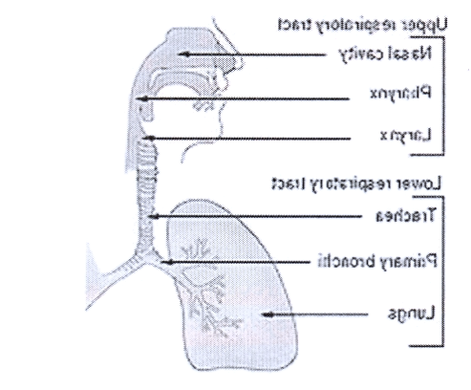

Slide 6
LRTI’s | URTI’s
Bronchitis Acute, Chronic, Acute exacerbation of chronic bronchitis Pneumonia Community -acquired Hospital-acquired | Rhinitis Sinus infection Pharyngitis/tonsilitis Laryngitis
Bacteria mainly: S. pneumonia H. influenza M. catarrhalis | Viruses Bacteria , mainly Group A streptococcus & H. influenzae | Causes
Broad- spectrum penicillins Amoxicillin, Ampicillin Cephalosporins Macrolides Flouroquinolones | Antibiotics ( Bacteria) Decongestants,eg:pseudoephedrine Alternative medicine,eg:Vit c, Plenty of fluids, analgesics | Treatment

Slide 7
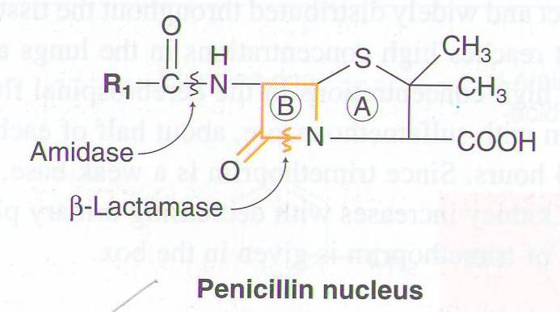
Penicillins

Slide 8
Mechanism of action of penicillins
Inhibits bacterial cell wall synthesis
Bactericidal

Slide 9
Broad spectrum penicillins
Amoxicillin
Ampicillin
Acts on both gram –positive & gram- negative microorganisms
Sensitive to β-lactamase enzyme

Slide 10
Pharmacokinetics
Given orally or parentrally
Not metabolized in human.
Relatively lipid insoluble.
Excreted mostly unchanged in
urine.
Half-life 30-60 min ( increased
in renal failure).

Slide 12
Therapeutic uses
Upper respiratory tract infections, especially those produced by Group A gram positive beta-hemolytic streptococci.
Lower respiratory tract infections

Slide 13
β-Lactamase inhibitors
Clavulanic acid
Sulbactam
Themselves have no antibacterial activity.
They inactivate β-lactamase enzyme
e.g. Amoxicillin/clavulanic acid (augmentin)
Ampicillin/ sulbactam

Slide 14
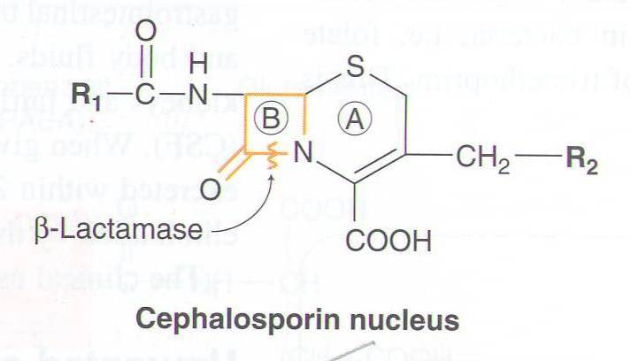
Cephalosprins

Slide 15
Mechanism of action of Cephalosporins
Inhibit bacterial cell wall synthesis
Bactericidal

Slide 16
2nd Generation Cephalosporins
Cefuroxime axetil, cefaclor
Effective mainly against Gram-negative bacteria.
Well absorbed orally
Active against β-lactamase –producing bacteria

Slide 17
3rd Generation Cephalosporins
Ceftriaxone / Cefotaxime
Have enhanced activity against gram-negative bacilli
Given by intravenous route
Effective treatment in pneumonia produced by β-lactamase producing bacteria

Slide 18
Pharmacokinetics of cephalosporins
Given parenterally or orally
Relatively lipid insoluble
Excreted Mostly unchanged in the urine.
Half-life 30-90 min (increased in renal failure)

Slide 19
Adverse effects of cephalosporins

Slide 22
Mechanism of action
Inhibit protein synthesis by binding to 50 S subunit of the bacterial ribosomes
Bacteriostatic
Bacteriocidal at high concentration

Slide 23
Clarithromycin
More effective on G+ bacteria.
Stable at gastric acidity
Inhibits cytochrome P450 system
Metabolized to active metabolite
Excreted in urine 20-40% unchanged or metabolite
Bile approx. 60%
Half-life 4-5 hours

Slide 24
Azithromycin
More effective on G- bacteria.
Stable at gastric acidity
Undergo some hepatic metabolism ( inactive metabolite )
Biliary route is the major route of elimination
Only 10-15% excreted unchanged in the urine
Half- life ( 3 days)
Once daily dosing
No effect on cytochrome P- 450

Slide 25
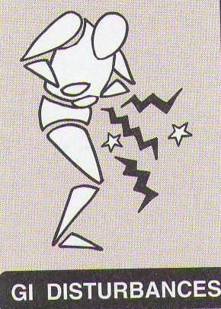
Adverse effects

Slide 26
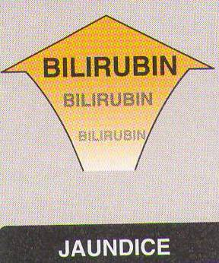

Slide 28
Mechanism of action
Inhibit DNA synthesis by inhibiting DNA Gyrase enzyme

Slide 29
CIPROFLOXACIN
Antibacterial spectrum
Mainly effective against G – bacteria

Slide 30
Pharmacokinetics
Well absorbed orally ( available i.v )
Di & tri- valent cations interfere with its absorption
Concentrates in many tissues, esp. kidney, prostate, lung & bones/ joints
Does not cross BBB
Excreted mainly through the kidney
Half-life 3.3 hrs

Slide 31
Adverse effects of fluoroquinolones
Nausea , vomiting & diarrhea
CNS effects ( confusion, insomnia,
headache, dizziness & anxiety).
Damage growing cartilage (arthropathy)
Phototoxicity

Slide 32
Contraindications
Is preferably avoided in adolescents (under 18 years because of arthropathy)
Pregnancy/lactation

Slide 33
Clinical Uses

Slide 34
THANK YOU

