Slide 1
Anticholinergic drugs
Prof. Alhaider
1433 H

Slide 2
Anticholinergic drugs
Are drugs that block cholinergic receptors.

Slide 3
Anticholinergic drugs
Antimuscarinics
(Parasympatholytics)
Antinicotinics
Ganglionic
blockers
Neuromuscular blockers
Naturally occurring alkaloids
synthetic atropine substitutes

Slide 4
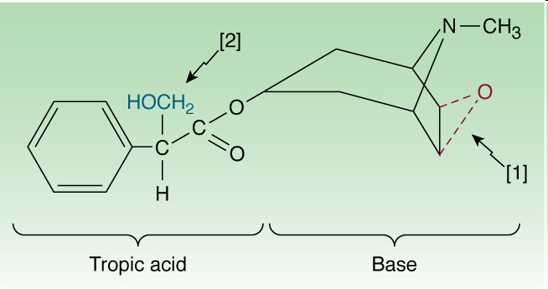
Muscarinic antagonists (Parasympatholetics)
Natural alkaloids
Atropine (Hyoscyamine)
Hyoscine (Scopolamine)
Esters of tropic acid and tertiary amines
Lipid soluble Why?
Good oral absorption Why?
Good distribution
Cross blood brain barrier (have CNS actions) Why?

Slide 5
Chemistry and PK:
What are the differences between Atropine (Hyosyamine) and
Scopolamine (Hyosine)? See the last slide
What are the differences between tertiary and quaternary
compounds in Clinical uses and PK (absorption and distribution)?
At which medications the anti-cholinergic effects could be found?
Mechanism of Action:
Simply, they are competitive and reversible blockers of muscarinic receptors?
Some of them like atropine could not distinguish between the
subtypes of muscarinic receptors. So What?

Slide 6
Pharmacological Effects of Antimuscarinics
(Atropine is a prototype)
Note: Simply it is the opposite of the cholinergic actions
1) Effect on Eye:
Blocks muscarenic innervations on the circular
muscles (Mydriasis) and relaxes cilairy muscles (Cycloplegia)
Increases intra ocular pressure thus worsens glaucoma
.
↓ Lacrimal secretion → sandy eye
What are the clinical consequences of such Pharm. effects?

Slide 7
Effects on CVS:
Mainly, tachycardia due to antagonism of the vagal affect..
No significant effects on atria and ventricles and blood pressure.
What is the clinical significant of such effects?
Effects on CNS
a. At normal doses: Atropine stimulates modularly centers, while scopolamine produces drowsiness and amnesia. However, at higher doses both of them produce excitement, agitation, hallucinations and coma.
b. Anti motion sickness effect (Scopolamine) why not Atropine?
c. Anti-tremor activity (Benztropin; Trihexyphenidyl)
Actions on the respiratory system
a. Decreases bronchial secretion (used as preanesthetic Med; COPD)
b. Dilates bronchioles (used for Rx. Asthma)

Slide 8
Gastrointestinal Effects:
Relaxation of smooth muscles (constipatin).
↓ GIT motility → Antispasmodic effect (Buscopan and Propanthelin).
↑ Sphincter contraction
Urinary Tract
Relaxation of smooth muscles of ureters.
Increases Sphincter contraction. Thus leads to Urinary retention
Therefore, they are contraindicated for prostate hypertrophy patients.

Slide 9
Effects on Secretion
A. ↓ Salivary secretion (Dry mouth
↓ gastric Acid (used for Peptic Ulcer )
↓ Sweating → Dry skin → Fever in infants and children.
↓ Bronchial Secretion (used for COPD)

Slide 10
Anticholinergic actions | Cholinergic actions
relaxation of circular muscles (Mydriasis) relaxation of ciliary muscles (Cycloplegia) loss of accomodation | Eye Contraction of circular muscle of iris (miosis) 2. Contraction of ciliary muscles for near vision
Tachycardia ( heart rate) | Heart bradycardia ( heart rate)
Relaxation of muscles contraction of sphincter Urinary retention | Urinary bladder Contraction of muscles Relaxation of sphincter

Slide 11
Anticholinergic drugs | Cholinergic drugs
Decrease all secretion | Exocrine glands Increase of sweat, saliva, lacrimal, bronchial, intestinal secretions
peristalsis secretion Contraction of sphincter constipation | GIT peristalsis secretion relaxation of sphincter
1. Bronchodilatation 2. Decrease secretion | Lung Bronchoconstriction 2. bronchial secretion

Slide 12
Adverse effects
Eye: Blurred vision – Mydriasis
CVS: Tachycardia - Atropine flush
GUT: Urinary retention
GIT: Constipation, paralytic ileus
Secretions: Dryness of mouth , Sandy eye
Increased body temperature.
CNS: sedation, hallucination, excitation (Toxic dose).
Treatment of Atropine-like Txicity
Gastric lavage.
Anticonvulsant.
Cooling blanket.
Antidote: Physostigmine ( IV slowly).

Slide 13
Contraindications
Glaucoma (angle closure glaucoma)
Tachycardia
Prostate hypertrophy in old patients.
Constipation, paralytic ileus, intestinal obstruction.
Children in case of atropine

Slide 14
Therapeutic applications: a. Central Nervous System Disorders 1. Parkinson’s disease (Benztropine) 2. Motion Sickness (Scopolamine) B. Opthalmological Disorders: e.g: Homatropine,tropicamide 1. Accurate measurement of refractive error in uncooperative patients (e,g: children) (Ciliary paralysus) 2. Examination of retina (Mydriasis)

Slide 15
C. Respiratory Disorders:
History: Inhalation of smoke from burning
leaves of Datura stramonium as remedy of
B. Asthma.
Thus, Ipratropium as inhalation (or Tiotropium)
are commonly used for Asthma and COPD.
Why not Atropine?
D. CVS (Atropine) for cardiac arrest How?
E. GIT:
1. Peptic Ulcer: Pirenzepine (selective M1)
2. As antispasmotic Buscopan; Propantheline (IBS)
F. Urinary Disorders**: To Rx incontinence
(Imipramine; Oxybutynin)

Slide 16
What is difference between atropine and hyoscine?
Hyoscine (SCOPOLAMINE) has
Shorter duration of action
More CNS depressant action
Antiemetics action in motion sickness
Can produce amnesia.
Less CVS effect
Notes:
16

Slide 17
Good Luck
Any Questions
Mobile: (0505281200)
Or
aqahaider@hotmail.com
qalhaider@ksu.edu.sa

