Slide 1
Drugs for Bronchial Asthma & COPD
By
Prof. Alhaider 1433 H

Slide 2
Disorders of Respiratory Function
Classification
Main disorders of the respiratory system are :
1. Bronchial asthma
2. Allergic rhinitis
3. Chronic obstructive pulmonary disease
(COPD, also called emphysema and chronic bronchitis)

Slide 3
Type of Drugs used in Respiratory System:
1) Bronchodilators
2) Anti-inflammatory drugs
3) Drugs for Cough
4) Antibiotics

Slide 4
Drugs Used for Asthma:
Definition of Asthma: Simply it is inflammation or hyper-reactivity of bronchial airways that result in airway obstruction .
Symptoms:
Coughing; shortness of Breath (dyspnea) and
chest tightness and wheezing.

Slide 5
Pahtophysiology of Asthma:
(it is the key to understand Rx).
1. Immunological model for immediate hypersensitivity (extrinsic asthma (see Figure 56-5)

Slide 6
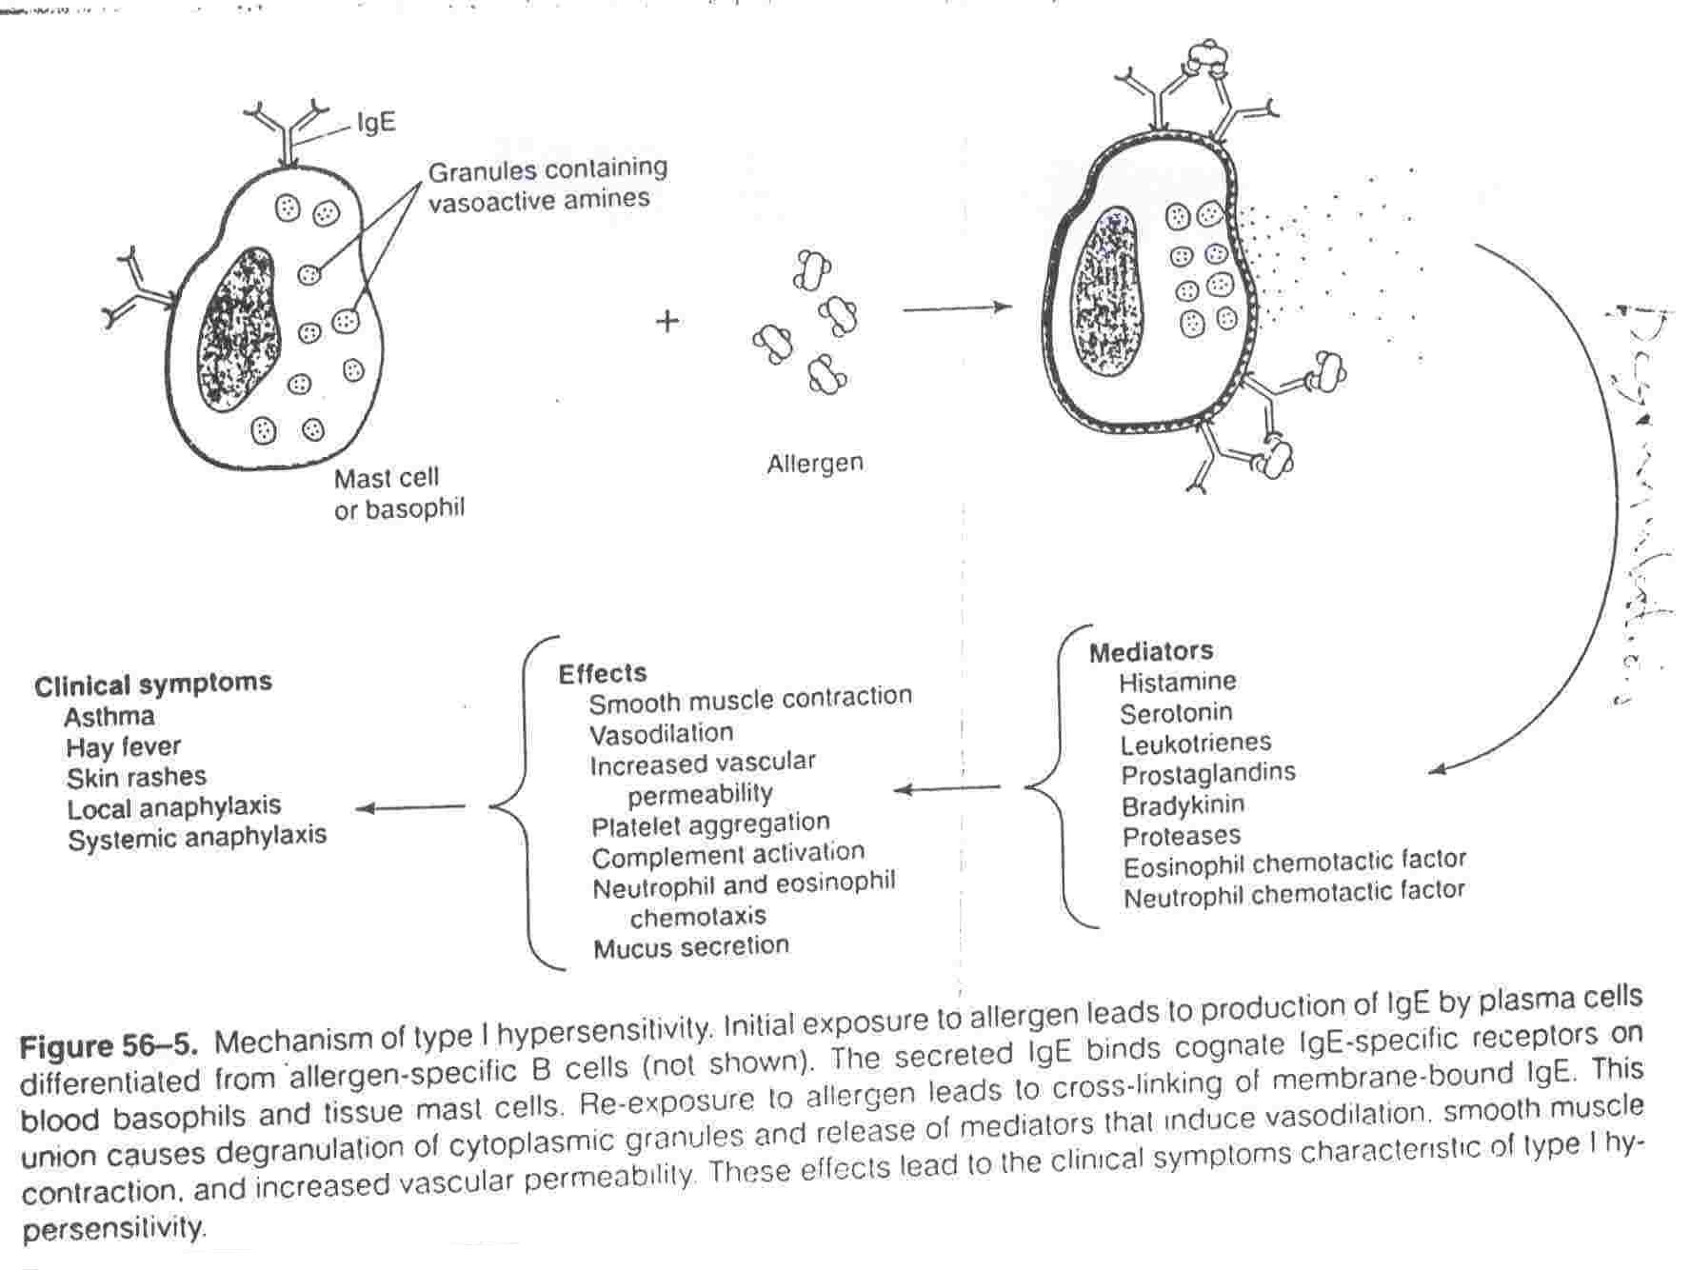

Slide 7
http://link.brightcove.com/services/player/bcpid236059233?bctid=347806802

Slide 8
Control of bronchial smooth muscle
Factor Constriction Dilatation
Neurogenic(ANS)
Parasympathetic +
Sympathetic +
Autonomic receptors
Cholinergic(muscarinic) +
Adrenergic alpha +
beta 2 +
Humoral
Histamine +
Serotonin (5-HT) +
Bradykinin +
SRS-A +
Prostaglandins + (PGF2 alpha) + (PGE2)

Slide 9
2. Non-specific hyperreactivity (Intrinsic asthma) (see Table)
Classification of Drugs Used for Asthma:
1. Bronchodilators
a. β2-adrenergic agonists
b. Methylxanthines
c. Muscarinic-receptor antagonists
2. Anti-inflammatory Drugs
a. Cromolyn or nedocromil
b. Corticosteriods
c. Leukotrienes antagonists
d. Anti-immunoglobulin E (monoclonal antibody)

Slide 10
Anti asthmatic drugs
AIMS
To relieve acute episodic attacks of asthma (bronchoconstriction).
To reduce the frequency of attacks, and
nocturnal awakenings.
To prevent future exacerbations.

Slide 11
Anti asthmatic drugs
Bronchodilators
(Quick relief medications)
Used to treat acute episodic attack of asthma
Short acting β2-agonists
Antimuscarinics
Xanthine preparations
Anti-inflammatory Agents
(control medications or prophylactic therapy)
Used to reduce the frequency of attacks
Corticosteroids
Mast cell stabilizers
Leukotrienes antagonists
Anti-IgE monoclonal antibody
Long acting ß2-agonists

Slide 12
1. Bronchodilators
Α. β2-adrenergic agonists
MOA: Stim. β2-adrenoceptors leading to smooth muscle relaxation via c-AMP (see Figure 20-1). Also, may prevent activation of mast cells.
CLASSIFICATION:
1. Non selective β agonists. E.G: Epinephrine

Slide 13
Why not Norepinephrine
Potent bronchodilator
rapid action (maximum effect within 15 min).
S.C. or by inhalation by (aerosol or nebulizer).
Duration of action 60-90 min
Drug of choice for acute anaphylaxis (hypersensitivity reactions).
Why not Epinephrine is not commonly used for Asthma?

Slide 14
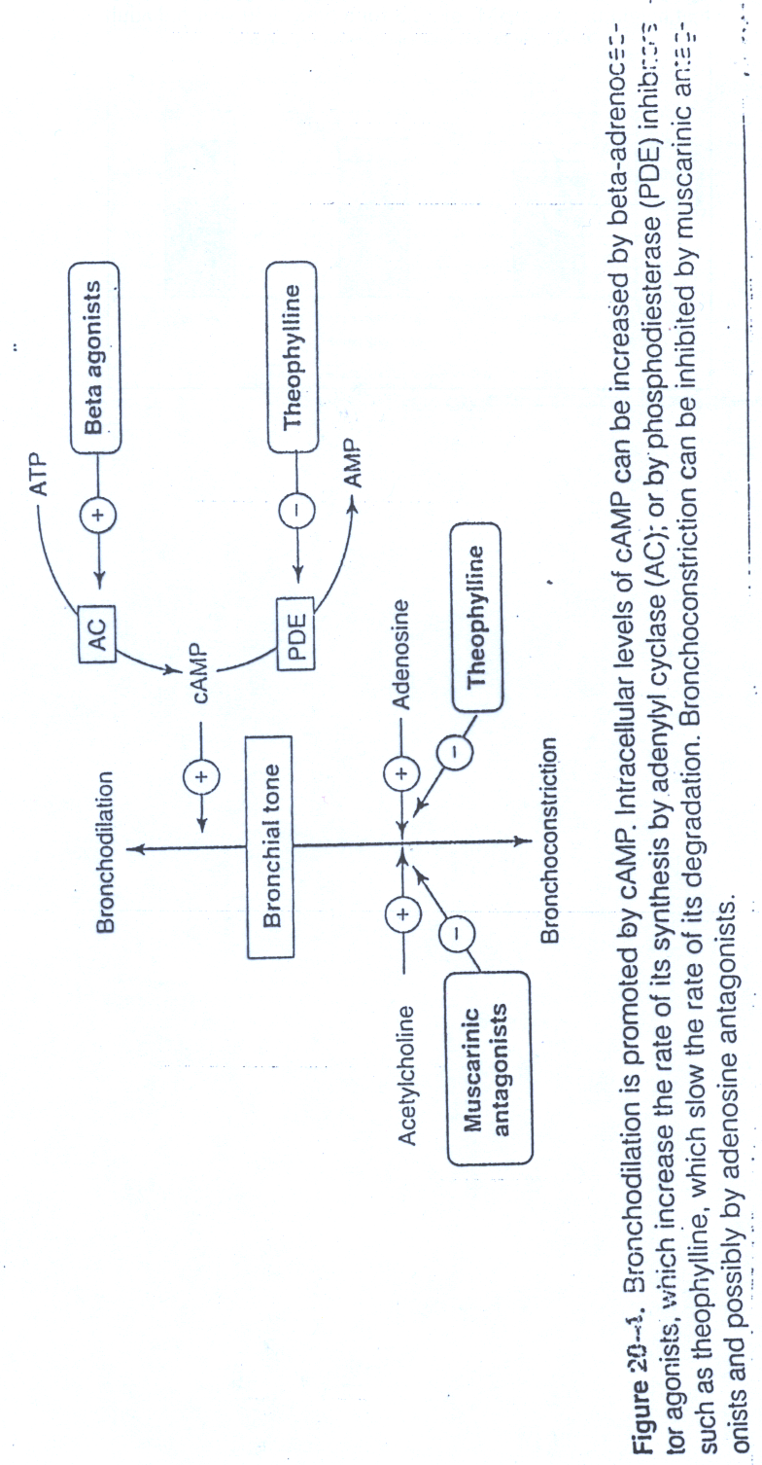

Slide 15
2. Selective B2-agonists:
e.g.; Salbutamol; terbutaline (Short Acting, t1/2 4 hrs)Salmetrol; formetrol (Long Acting, t1/2 8hrs)
PK:
Available as injections or oral but inhaled or nebulizer forms are more common. WHY?
Side Effects: Tachycardia and remors at high dose; Tolerance.
How can tolerance be overcome?
When Long Acting like Salmetrol is preferred?

Slide 16
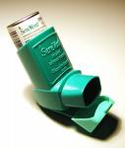
Nebulizer Inhaler

Slide 17
B. Methyxanthins
e.g.: Theophyline (orally);
Aminophyline = Theophyline + ethylene diamine (orally and parentrally )
MOA:
1. Bronchodilation by increasing the level of c-AMP via
inhibtion of phosphodieasterase.
2. Theophyline is an universal antagonist at
adenosine receptors ??, thus causing bronchial
smooth muscle relaxation.

Slide 18
PK: Available in oral (e.g.: Sustained release) or injectable forms (Aminphyline).
What is aminophyline?
Side Effects: Low therapeutic index; GI upset; CNS stimulation; CVS as tachycardia and cardiac output; renal diuresis.
Why do theophyline not commonly used nowadays?

Slide 19
C. Antimuscarinic Drugs:
History:
e.g.: Ipratropium; Tiotropium (long Acting)
MOA:
PK: Only to be given by inhalation or by nebulizer ; with slow onset and longer duration as compared to salbutamol.
Why Ipratropium or Tiotropium are good choices for patients with COPD? (see figure)

Slide 20
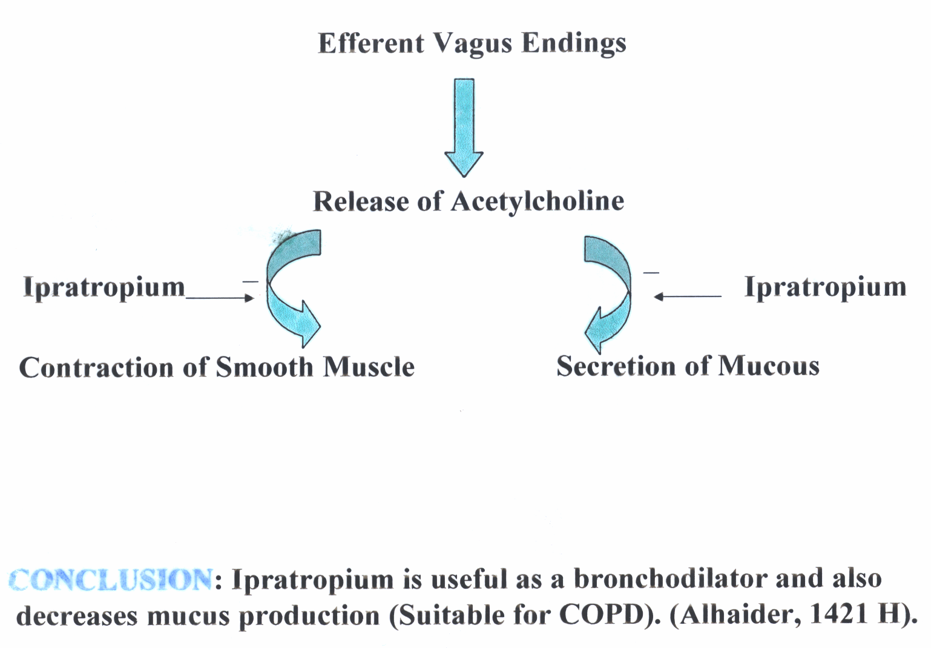

Slide 21
2. Anti-inflammatory Drugs:
Since airway hypersensitivity is related the degree of inflammation; anti-inflammatory drugs are considered one of the most effective drugs in the treatment of chronic and acute types of asthma?
Act by reducing the number of inflammatory cells
in the airways and prevent blood vessels from leaking fluid into the airway tissues. And also by reducing inflammation, they reduce the spasm of the airway muscle & bronchial hyper-reactivity

Slide 22
Notes:
These agents are not direct bronchodilators.
Some of them are not effective to overcome the signs and symptoms of existing attack of asthma (But should be used as they act after the attack).

Slide 23
Classification of Anti-inflammatory Drugs
a. Mast cell stabilizers
e.g.: Sodium cromoglycate (Intal^{R}) QID; Nedocromil (Tilade^{R}) BID.
How do these drugs work? See Figure 26-5

Slide 24
PK: Available as inhaled aerosol or nebulizer solution.
Side Effects: Not significant
Disadvantage: Less effective in many
asthmatics but better response in children.

Slide 25
b. Corticosteriods:
e.g. Beclomethasone; Fluticasone etc (seeTable 3)
MOA: Deacresephospholipase A2 and thus Inhibit the synthesis of arachidonic acid; decrease leukocyte migration, phagolytic activity and inflammation) (See Figure); Also, they upregulate b-adrenoceptors. So What?)

Slide 26
PK: These drugs are available as: ;
Oral and injectable (for severe asthma) but inhalation forms are proffered to avoid side effects).
Examples:
Injection: e.g.; Hydrocortisone
Oral: prednisolone (Why it is the preferred
oral form?).
Inhalation:
Beclomethasone (as MDI);

Slide 28
Synthesis of eicosanoids and sites of inhibitory effects of anti-inflammatory drugs
Membrane lipid
Corticosteroids
Arachidonic acid
NSAIDs
Hydroperoxides Endoperoxides
(HPETES) (PGG, PGH)
Leukotrienes Prostacyclin Thromoxane
(LTB, LTC ,LTD, LTE) (PGI) (TXA)
Prostaglandins
(PGE, PGF)
Phospholipase A2
-
Cycloxygenase
Lipoxygenase
-

Slide 29
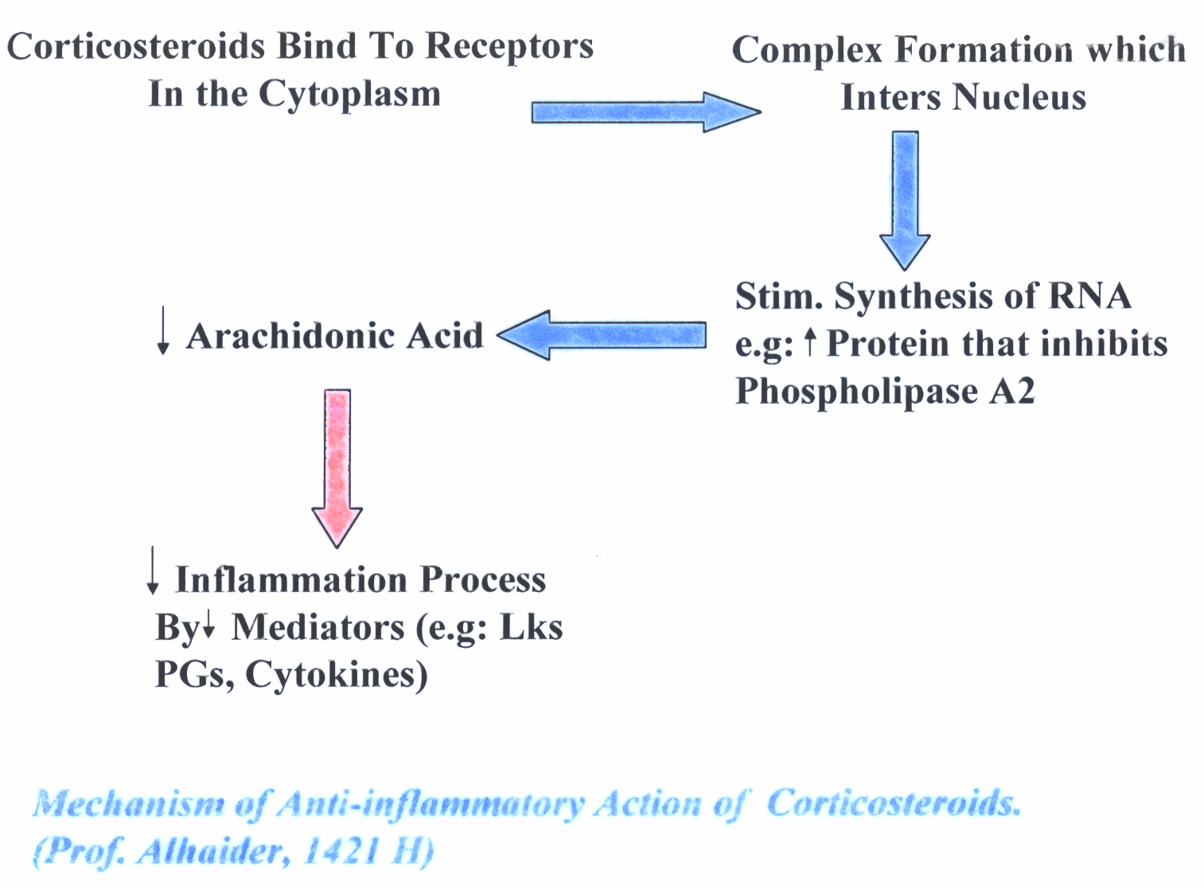

Slide 30
Table 3 : Types of inhaled corticosteriods that commonly used
Name of drug | Half life (hours) | Oral Bioavailability (%)
Flunisolide | 3.5 | 21
Triamcinolone | 3.9 | 10.6
Beclomethasone | 7.5 | 20
Budesonide | 5.1 | 11
Fluticasone | 10.5 | <1

Slide 31
Corticosteroids Inhalers are available in many forms. Sometimes, long acting b2-agonist mixed together in the same inhaler.
Side effects of Inhaled corticosteroids:
Cough
difficult or painful speech (Dysphonia)
Possible growth retardation in children.
Oral candidiasis Why?
How could you taper the dose of oral prednisolone?
Simply -5 mg every day. Unless patient takes steroids for long time.

Slide 32
C. Leukotriene-modifying agents
What is the effect of LKs on the bronchioles as compared to histamine?
1) Leukotrience synthesis inhibitors
(Lipooxygenase Inhibitors) e.g. Zileuton (Zylfo®)
2) Leukotrience Antagonists e.g Zafirlukast BID (Accolate®); Montelukast (Singulair ®) OD)

Slide 33
MOA: (see Figure)
PK: These drugs are available as oral form but with side effects less than corticosteroids
Side Effects:
- increase PT if given with warfarin.
- Churg Strauss syndrome
- Elevation of liver Enzymes

Slide 34
Limitations of Leukotriens Antagonists:
Why Leukotriens Antagonists did not prove to be as effective as inhaled corticosteroids?
Indications: Preventive medication in those who have difficulty with inhalers or side effects from inhaled corticosteroids.
Management of aspirin sensitive asthma.

Slide 35
Question:
Patients with aspirin-induced asthma, may show strong or week response to Leukotriens antagonists?

Slide 36
Anti-immunoglobulin E (e.g. Omalizumab) MOA:
Selective anti-IgE monoclonal antibody that binds to IgE and prevents its association with IgE receptors, thus preventing allergen from activating mast cells or basophiles
Decreases serum IgE
Due to the above effects, omalizumab decreases the numbers of eosinophils, T and B lymphocytes
Uses: for resistance type of asthma and allergic rhinitis.
Side effects and Limitations:
Infusion side effects and very expensive.

Slide 37
Chronic Obstructive Lung Diseases (COPD)
Does treatment of COPD differs from bronchial Asthma?
Antimuscarenic drugs like Ipratropium is preferred for COPD Why?
Short acting β2-adrenergic agonist is used like for Asthma.
However, oral or inhaled corticosteriods are only used for severe form of COPD. Why?
Mucolytics like Acetylcysteine may be used.
Routine administration of Oxygen may be included for advanced cases.

Slide 38
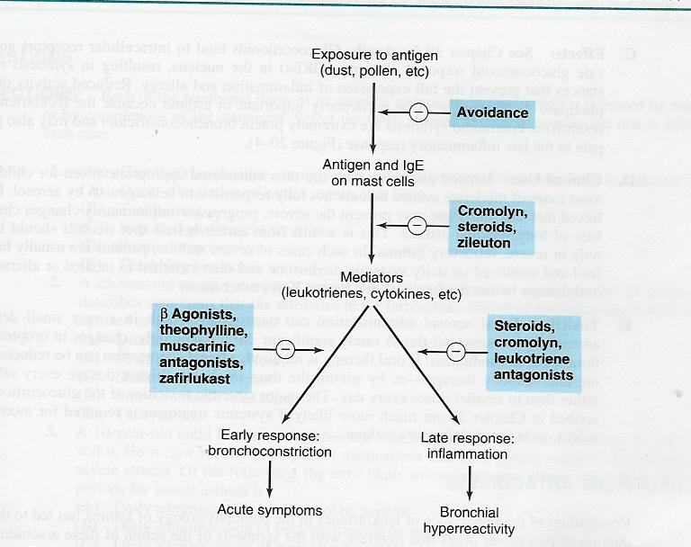
Summary for treatment of asthma

