Slide 1
LUNG FUNCTION IN HEALTH AND DISEASE: SPIROMETRY
Sultan Ayoub Meo
MBBS, PGC Med Ed, PG Dip Med Ed, M.Phil, Ph.D
Professor, Department of Physiology, College of Medicine
King Khalid University Hospital, King Saud University Riyadh, Saudi Arabia

Slide 2
SPIROMETRY
Spirometry is a widely used, effort depended basic lung function test
Assess the lung performance
Assess physiological parameters; lung volumes, capacities & flow rate
Differentiate between the obstructive and restrictive lung conditions
Play a critical role in the diagnosis, differentiation and management of respiratory illness.
Ruppel, Res Care Clin N Am 1997;
Pierce William, Aus Fam Phy J , 2005

Slide 3
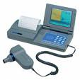
PHYSIOLOGICAL CONDITIONS AND SPIROMETRY
Physiology conditions:
Age
Gender
Height
Weight
Ethnic group
Pregnancy
Cotes, 1995

Slide 4
INDICATIONS OF SPIROMETRY
Based on clinical features / abnormal lab tests
Symptoms: Dsypnea, cough, sputum production, chest pain
Signs: Cyanosis, clubbing, chest deformity, diminished chest expansion, hyperinflation, diminished breath sounds, Prolongation of expiratory phase & crackles
Arterial blood gas analysis: Hypoxemia, hypercapnia
Abnormal chest X Ray:
Cotes, 1995
Notes:
Early and late ins phase

Slide 5
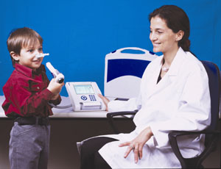
INDICATIONS OF SPIROMETRY
Describe the course of diseases affecting PFTs
Neuromuscular diseases: GillianBarre Syndrome, Myasthenia gravis
Pulmonary diseases: Obstructive airway diseases, Interstitial lung diseases
Adverse reactions: Drugs with known pulmonary toxicity [Pulmonary fibrosis]

Slide 6
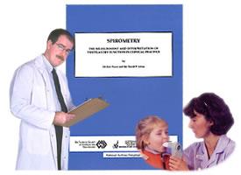
INDICATIONS OF SPIROMETRY
Monitoring indications
To assess the therapeutic interventions:
Bronchodilator therapy
Steroid treatment for asthma
Chronic obstructive lung disease
Interstitial lung disease

Slide 7
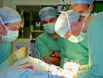
INDICATIONS OF SPIROMETRY
PRE OPERATIVE INDICATIONS
To determine the suitability for and management during and after anesthesia
To assess the risk for surgical procedures known to affect lung function
Cotes 1995; ACCP Chest 2003;
Regli et al., Anaesthesia, 2006

Slide 8
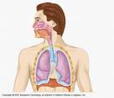
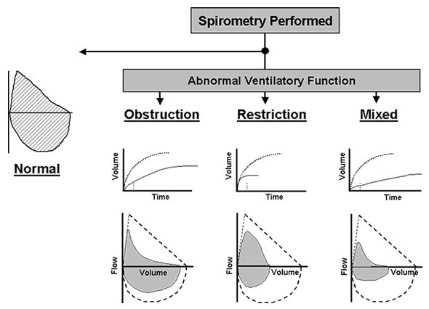
SPIROMETRY IN RESPIRATORY DISEASES

Slide 9
DIAGNOSIS OF COPD
EXPOSURE TO RISK
FACTORS
SYMPTOMS
cough
tobacco
sputum
occupation
dyspnea
indoor/outdoor pollution
è
SPIROMETRY

Slide 10
SMOKERS AND SPIROMETRY
Smoker & Non Smoker:
Non Smoker: In normal healthy non smoker subject after the age of 30 the expected decline in Lung function parameter [FEV1] is 25–30 ml/ year
Smoker: The average rate of decline of lung function in smokers as measured by Forced Expiratory Volume in 1 sec [FEV1] is 60-70 ml / year
Davis et al., Diabetes Care, 2004
Notes:
Early and late ins phase

Slide 11
SMOKERS AND SPIROMETRY

Slide 12
SMOKERS AND SPIROMETRY

