Slide 1
RESPIRATORY BLOCK
PROF. AHMED FATHALLA IBRAHIM

Slide 2
NASAL CAVITY

Slide 3
NASAL CAVITY

Slide 4
LARYNX, TRACHEA

Slide 5
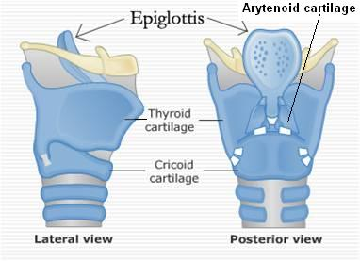
LARYNX, TRACHEA

Slide 6
TRACHEA & BRONCHI

Slide 7
TRACHEA & BRONCHI

Slide 8
LUNG & PLEURA
Cervical

Slide 9
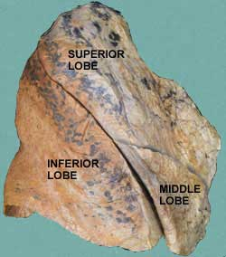
LUNG & PLEURA
Transverse (horizontal) fissure
Oblique fissure

Slide 10
RIGHT LUNG
S
V
C
Superior lobar bronchus
Inferior lobar bronchus
Superior pulmonary
vein
Pulmonary artery
I
V
C
Inferior pulmonary
vein
Esophagus
Cardiac impression

Slide 11
LEFT LUNG
Aortic arch
Pulmonary artery
Bronchus
Superior pulmonary
vein
Inferior
pulmonary vein
Cardiac impression
Lingula

Slide 12
RADIOLOGY
Clavicle
Aortic
knuckle
Scapula
Cardiophrenic angle
Left dome
of diaphragm
Right dome
of diaphragm

Slide 13
RADIOLOGY
T
B

Slide 14
RADIOLOGY
Esophagus

Slide 15
MEDIASTINUM

Slide 16
MEDIASTINUM

Slide 17
MEDIASTINUM
Descending aorta

Slide 18
MUSCLES INVOLVED IN RESPIRATION

Slide 19
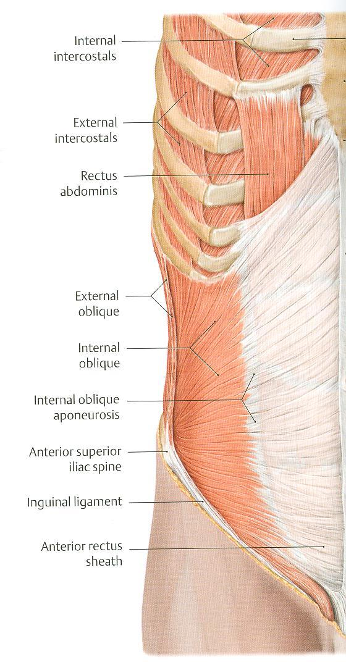
MUSCLES INVOLVED IN RESPIRATION

Slide 20
MUSCLES INVOLVED IN RESPIRATION

Slide 21
THANK YOU

