Slide 1
MICROBIOLOGY RESPIRATORY TRACT INFECTION PRACTICAL

Slide 2
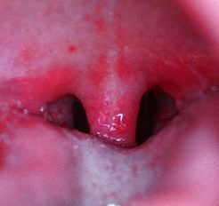
Case-I A 5 year old boy was brought to KKUH, OPD complaining of fever and sore throat.
He had regular vaccination history.
On examination his temperature was 38.5° c,
the tonsil area and pharynx were obviously inflamed with some foci of pus
1.What is the differential diagnosis?
2. What investigation should be done?

Slide 3
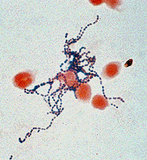
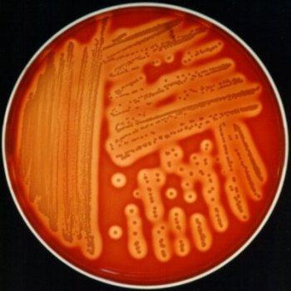
The CBC showed a total WBC of 15000/ml. Throat swab gram stain ,culture and gram stain of the colonies are shown below.
How would you describe them?
Beta hemolytic
colonies

Slide 4
1. What is the likely identity of this organism?
2. What is the best antibiotic therapy for this child?
3. If not treated what complication may this child have
after 6 weeks period?

Slide 5
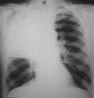
Case-II
A 28- year old male presented to the A/E of KKUH with a sudden onset of fever, right sided chest pain and productive cough of purulent sputum. On examination her temperature was 39 °c. There were Rhonchi and dullness on the right side of the chest..
X-ray showed massive consolidation on the right side of the chest

Slide 6
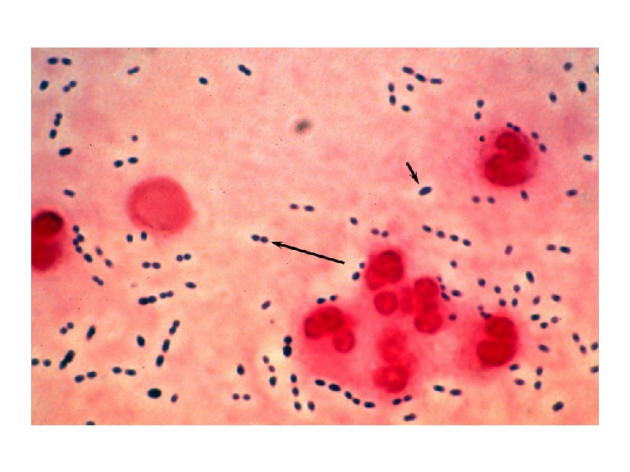
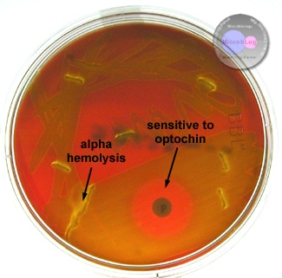
The CBC showed a total WBC 45,000/ ml,
90% of the cells were neutrophils.
The sputum gram stain and culture are shown below.

Slide 7
1. What is the likely bacterial pathogen?
2. What should have been the empirical therapy for this case and why?

Slide 8
Case-3
Abdul Karim is a 45 year old Saudi man who was admitted to KKUH because of 2-3 month history of loss of appetite, weight loss, and on and off fever with attacks of cough. Two days before admission .he coughed blood (haemoptysis) Abdul karim is diabetic for the last 5 years.
On examination Abdul Karim looked weak with a temperature 38.6 °c, CVS and Respiratory system examined was unremarkable.
The chest X- ray done showed multiple opacities and cavities
The ESR was increased (85 mm in hour)

Slide 9
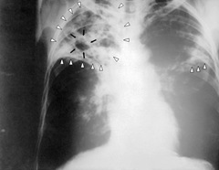
Chest X-Ray: Will show round cavitations – .

Slide 10
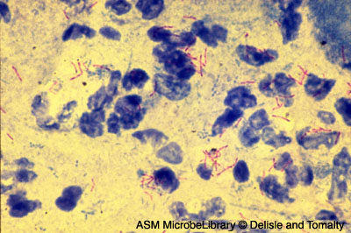
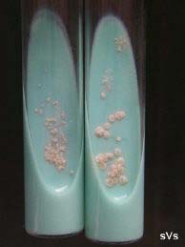
What further tests should be done
What is the probable diagnosis?
How can the diagnosis be confirmed?
After 3 week, the sputum grew a Mycobacterium species which was identified as M.tuberculosis by
the following tests
What molecular test can be done in conjunction with the above conventional tests?
L.J medium

