Slide 1
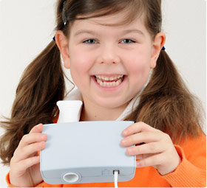
Dynamic Spirometer
By Dr. Maha al-Enazy

Slide 2
Objectives
To understand the different measurements of lung volume
To learn how spirometer works and the different graphs it produces
To diagnose lung diseases using the spirometer graphs

Slide 3
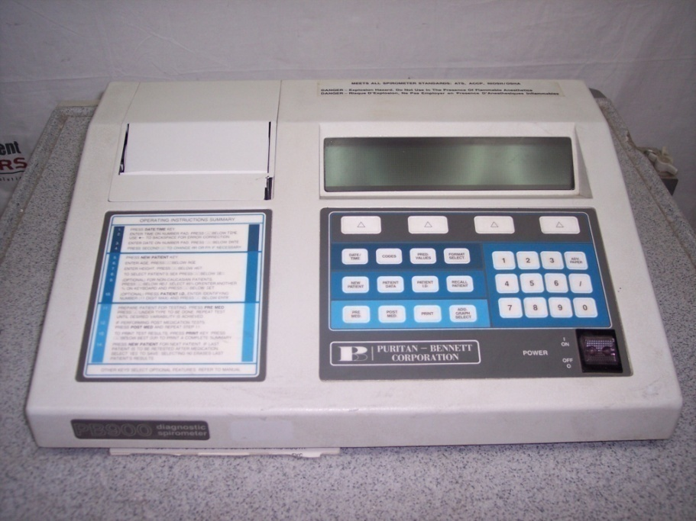
Dynamic Spirometer
It measures the flow and volume of air moving in and out of the lungs.
It is the most basic and frequently performed test of pulmonary (lung) function.

Slide 4
Why Dynamic?
It measures the rate at which the lung
changes volume during forced breathing maneuvers.

Slide 5
Importance of Dynamic Spirometer
Helps in the diagnosis of pulmonary diseases.
Follow disease progression.
Determine strength and function of the chest.

Slide 6
How is the test performed?
Equipment:
Spirometer
Nose Clips
Disposable mouth piece
Method:
Enter subject data
Apply Nose clips
Perform the test

Slide 7
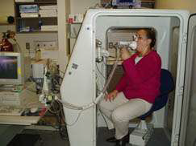
Make a tight seal around
the mouthpiece.
Ask subject to inhale
deeply.
Then ask the subject to
exhale as strong and as
fast as possible.

Slide 8
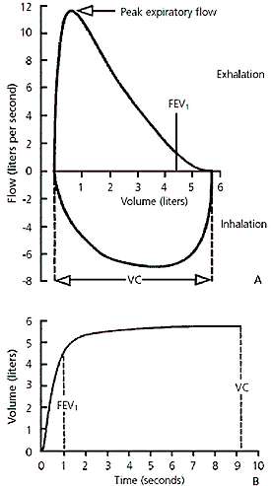
Results Obtained
Flow- Volume Curve
Volume-Time Curve (Forced Expiratory Curve)

Slide 9
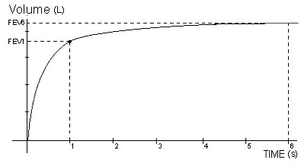
Measures of Volume- Time Curve :
FEV1=the volume of
air exhaled in the 1st second. (about 4.2 L. Values of between 80% and 120% of the average value are considered normal)
FVC= About 5L (FEV1 is 84% of FVC)
FEV1/FVC ratio=
normally ≈ 80% or a bit higher.

Slide 10
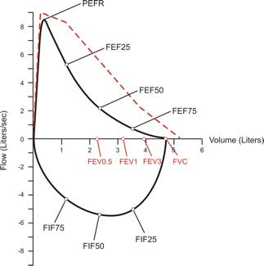
Flow- Volume Loop
Peak Expiratory Flow Rate (PEFR): Maximum of air flow achieved at the beginning of FVC or expiration maneuver. [ large airways]
Forced Expiratory Flow: FEF-25-75%: the average flow rate during the middle half of FVC [small airways].
FEF50% (MEF50%): Forced expiratory flow at 50% of FVC. (4-6L)

Slide 11
Results
Measurements are typically reported as absolute flows and volumes and as percentages of predicted values using data derived from a large population of people with normal lung function
Variables used to predict normal values include age, sex, ethnicity and height.

Slide 12
Patho-physiology: Lung Diseases
Obstructive Lung Disease
Restrictive Lung Disease

Slide 13
Obstructive
Difficulty exhaling all the air from the lungs due to :damage to the lungs or narrowing of the airways inside the lungs, exhaled air comes out more slowly than normal. At the end of a full exhalation, an abnormally high amount of air may still linger in the lungs.
Asthma, COPD, Emphysema, cystic fibrosis

Slide 14
Obstructive on Graphs
Flow Volume Loop
Volume- Time Curve
Inspiratory loop is normal
Muscle independent part of the expiratory loop= concave.
PEFR or
MEF50%
FEV1 (increased airway resistance)
FVC or (premature closure of airway in expiration)
FEV1/FVC

Slide 15
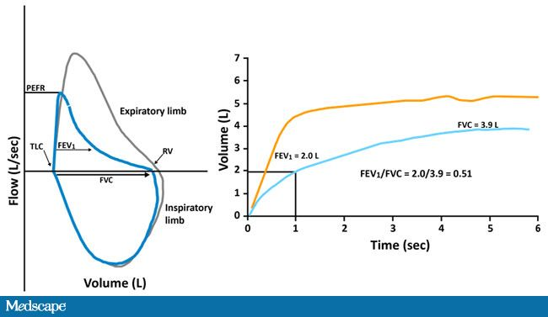

Slide 16
Restrictive
cannot fully fill their lungs with air. Their lungs are restricted from fully expanding. Decreased lung compliance.
Caused by stiffness in the lungs themselves. In other cases, stiffness of the chest wall, weak muscles, or damaged nerves may cause the restriction in lung expansion.
Interstitial lung disease, Obesity, Neuromuscular diseases.

Slide 17
Restrictive on the Graphs
Flow- Volume Loop
Volume- Time Curve
Miniature loop
FEV1
FVC
FEV1/FVC or

Slide 18
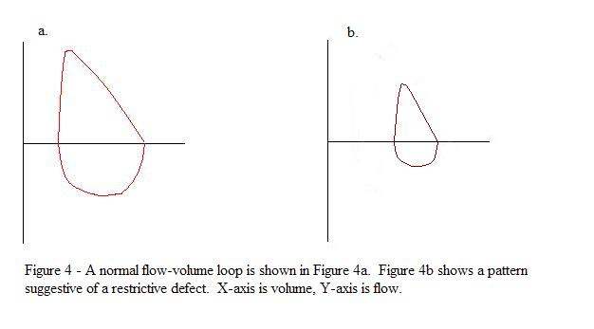
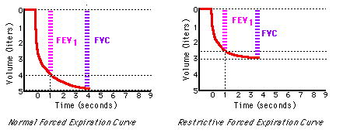

Slide 19
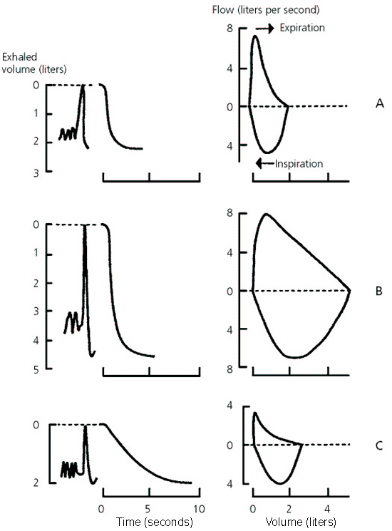
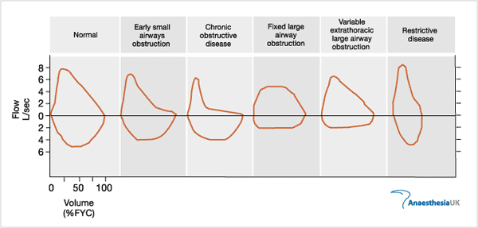
Restrictive VS. Obstructive

