Slide 1
Major arteries
of
the body

Slide 2
Objectives
At the end of the lecture, the student should be able to:
Define the ‘artery’ and understand the general principle of the arterial system.
Describe the aorta and its divisions & list the branches from each part.
List major arteries and their distribution in the head & neck, thorax, abdomen and upper & lower extremities
List main sites of arterial pulsation
Define arterial anastomosis, describe its significance and list the main sites of anastomosis.
Define end arteries and give examples.

Slide 3
General principle of arterial supply
Arteries carry blood away from the heart.
All arteries, carry oxygenated blood, except the pulmonary and umbilical arteries, which carry deoxygenated blood to the lungs (postnatal) and to the placenta (prenatal) respectively
The flow of blood depends on the pumping action of the heart
There are no valves in the arteries.
The branches of arteries supplying adjacent areas normally anastomose with one another freely providing backup routes for blood to flow if one artery is blocked.
The arteries whose terminal branches do not anastomose with branches of adjacent arteries are called “end arteries or terminal arteries”. End arteries are of two types:
Anatomic (True) End Artery: When no anastomosis exists, e.g. artery of the retina
Functional End Artery: When an anastomosis exists but is incapable of providing a sufficient supply of blood, e.g. splenic artery, renal artery

Slide 4
Aorta
The largest artery in the body
Arises from the left ventricle of the heart
Carries oxygenated blood to all parts of the body
Is divided into 4 parts:
Ascending aorta
Arch of aorta
Descending thoracic aorta
Descending abdominal aorta
2
1
3
4

Slide 5
Ascending Aorta
Originates from left ventricle.
Continues as the arch of aorta
Has three dilatations at its base, called aortic sinuses
Branches:
Right & Left coronary arteries, arise from aortic sinuses

Slide 6
Arch of Aorta
Continuation of the ascending aorta.
Leads to descending aorta.
Located behind the lower part of manubrium sterni and on the left side of trachea
2
1
3
Branches:
Brachiocephalic trunk.
Left common carotid artery.
Left subclavian artery

Slide 7
Common Carotid Artery
Origin:
Left from aortic arch.
Right from brachiocephalic trunk.
Each common carotid divides into two branches:
Internal carotid
External carotid

Slide 8
External Carotid Artery
It divides behind neck of the mandible into two terminal branches:
Superficial temporal
Maxillary artery
It supplies:
Scalp: Superficial temporal artery
Face: Facial artery
Maxilla: Maxillary artery
Tongue: Lingual artery
Thyroid gland: Superior thyroid artery

Slide 9
Internal Carotid Artery
Has no branches in the neck
Enters the cranial cavity, joins the basilar artery (formed by the union of two vertebral arteries) and forms ‘arterial circle of Willis’ to supply brain.
Supplies:
Brain
Nose
Scalp
Eye

Slide 10
Subclavian artery
It is the main source of the arterial supply of the upper limb
Origin:
Left arises from the aortic Arch
Right arises from the brachiocephalic trunk
At lateral border of the first rib, it is continuous in the axilla as the axillary artery
Main branches:
Vertebral artery to supply CNS
Internal thoracic artery to supply mammary gland & the thoracic wall

Slide 11
Upper limb arteries
Axillary artery:
continuation of subclavian artery
passes through the axilla and continues in the arm as the brachial artery.
Brachial
Descends close to the medial side of the humerus
Passes in front of the elbow joint (cubital fossa).
At the level of neck of radius, it divides into two terminal branches
Radial
Ulnar

Slide 12
Upper limb arteries
Ulnar
The larger terminal branch
Radial
The smaller terminal branch
Palmar Arches: formed by both ulnar & radial arteries.
superficial
Deep

Slide 13
Descending Thoracic Aorta
It is the continuation of aortic arch
At the level of the 12th thoracic vertebra, it passes through the diaphragm and continues as the abdominal aorta
Branches:
Pericardial
Esophageal
Bronchial
Posterior intercostal

Slide 14
Descending Abdominal Aorta
It enters the abdomen through the aortic opening of diaphragm.
At the level of L4, it divides into two common Iliac arteries.
Branches: divided into two groups:
Single branches
Paired branches

Slide 15
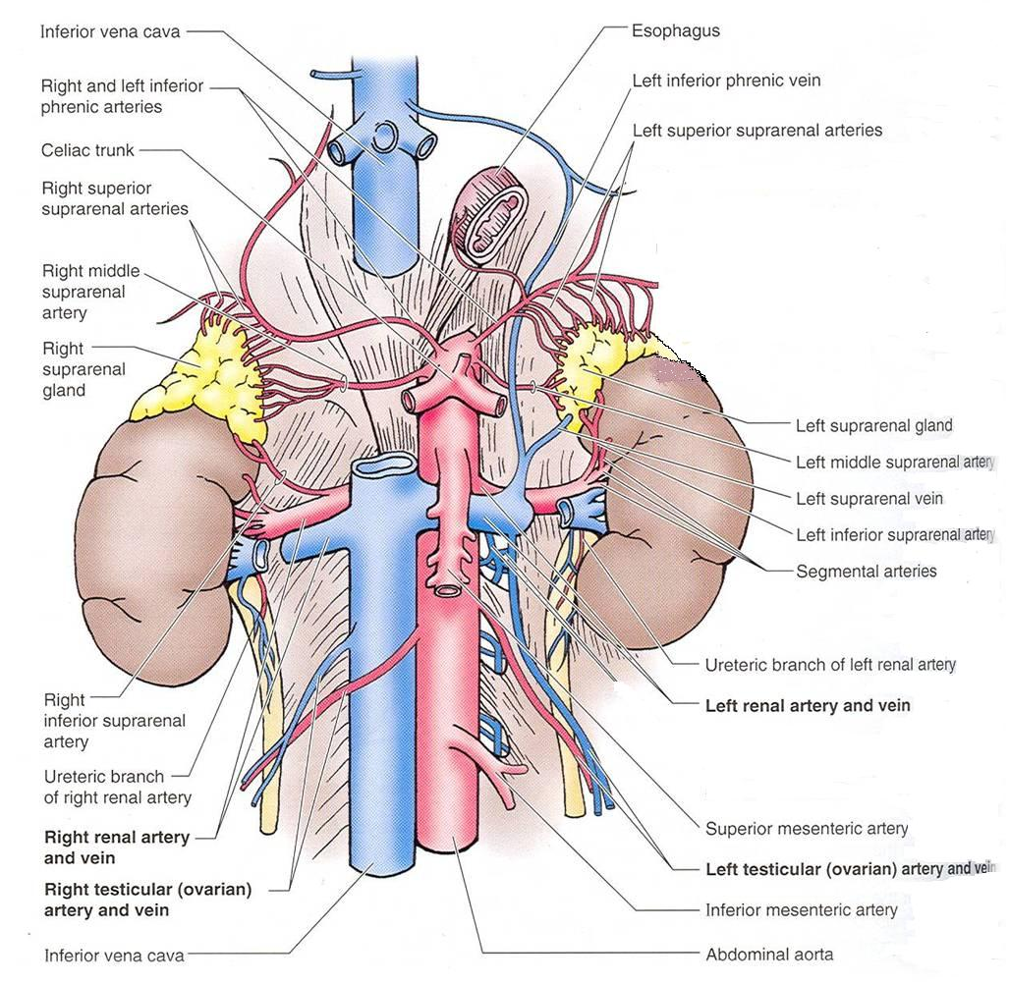
Single branches of Abdominal Aorta
Celiac Trunk
Left Gastric artery supplies Stomach
Hepatic artery supplies Liver & Pancreas
Splenic artery supplies Spleen
Superior Mesenteric Artery
Supplies:
Pancreas
Small Intestine (duodenum, jejunum & ileum)
Large Intestine (ascending colon and right 2/3 of transverse colon)
Inferior Mesenteric Artery
Supplies:
Large Intestine ( left 1/3 of transverse colon, descending colon)
Rectum & upper half of Anal Canal

Slide 16
Paired branches of Abdominal Aorta
inferior phrenic
Suprarenal
Renal
Gonadal (Testicular or Ovarian)
Common iliac

Slide 17
Common Iliac Arteries
The Abdominal Aorta terminates, at the level of the 4th lumbar vertebra, into two common iliac arteries; right & left.
Each divides into external & internal iliac arteries
External supplies lower Limb
Internal supplies Pelvis

Slide 18
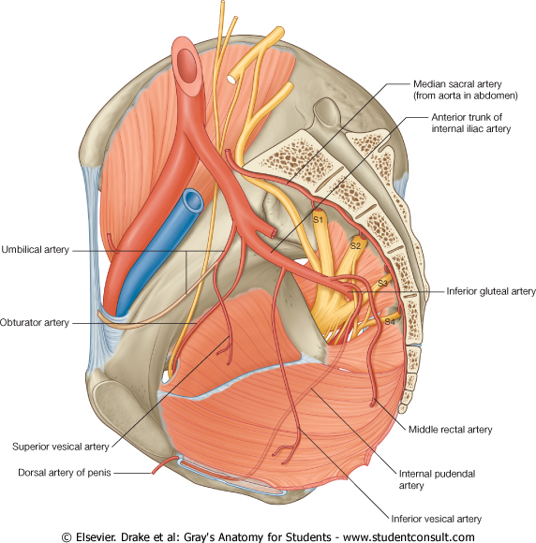
Internal Iliac Artery
Supplies:
Uterus
Vagina
Pelvic walls
Perineum
Rectum & anal canal
Urinary bladder

Slide 19
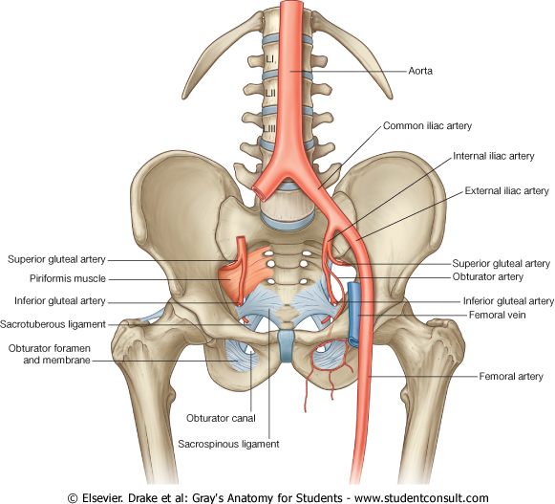
External iliac artery
The Source of arterial supply to the lower limb
Passes deep to the Inguinal Ligament and becomes the femoral artery

Slide 20
Arteries of Lower Limb
Femoral Artery
Is main arterial supply to lower limb
Enters the thigh behind the inguinal ligament
It lies in a sheath with the femoral vein in the anterior components
Ends at the lower end of the femur by entering the popliteal fossa.
Popliteal Artery
Deeply placed in the popliteal fossa.
It divides into Anterior & posterior tibial arteries.
Anterior Tibial Artery
It is the smaller terminal branch
It continues to the dorsum of foot as the Dorsalis Pedis artery
Posterior Tibial Artery
It terminates by dividing into Medial & Lateral Planter arteries to supply the sole of the foot.

Slide 21
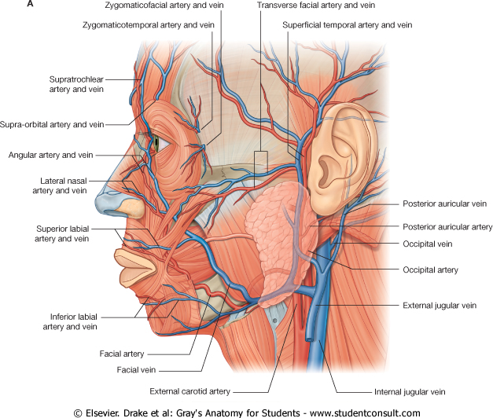
Sites for arterial pulsation
Superficial Temporal artery: in front of the ear.
Facial artery: at the lower border of the mandible.
Carotid artery: at the upper border of thyroid cartilage
Subclavian artery: as it crosses the 1st rib
Radial artery: in front of the distal end of the radius
Femoral artery: midway between anterior superior iliac spine & symphysis pubis
Popliteal artery: in the depths of popliteal fossa
Dorsalis Pedis artery: in front of ankle (between the 2 malleoli)

Slide 22
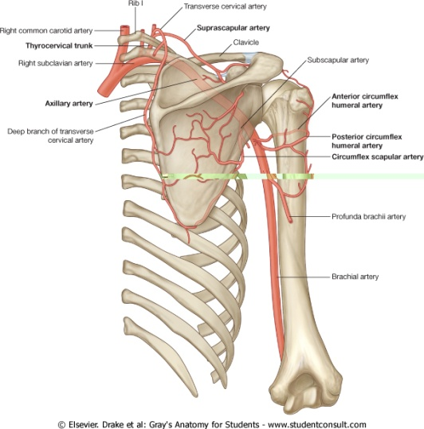
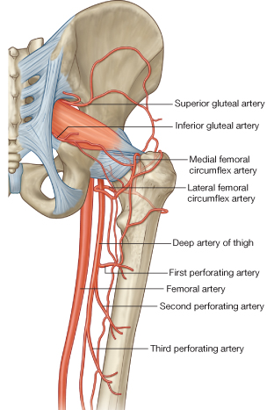
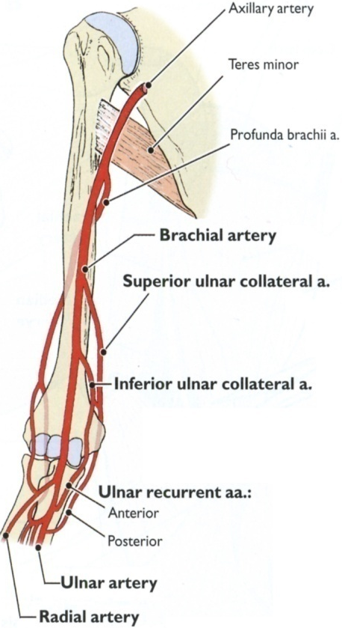
Main Sites of anastomosis
In the upper limb:
Scapular Anastomosis : between branches of subclavian & axillary arteries
Around the elbow: between branches of brachial, radial & ulnar arteries
In the lower limb:
Trochanteric & Cruciate anastomosis: between branches of internal iliac & femoral arteries

Slide 23
Thank you

