Slide 1
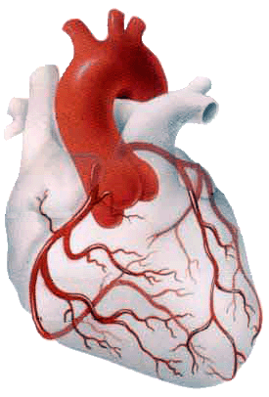
BLOOD SUPPLY OF THE HEART
Dr Jamila EL medany
&
Dr Essam Salama

Slide 2
Objectives
At the end of the lecture the student should be able to know about;
The arterial supply of the cardiac muscle regarding (origin, course, distribution and branches).
The coronary anastmosis.
The arterial supply to the conducting system of the heart.
The venous drainage of the heart regarding (origin, tributaries and termination).

Slide 3
Arterial Supply
The arterial supply of the heart is provided by Coronary Arteries :
Right Coronary artery &
Left Coronary artery
They are distributed over the cardiac surface, within the subepicadium connective tissue.
L Coronary artery

Slide 4
Origin of Coronary Arteries
RCA
LCA
From the initial part of the Ascending Aorta. (Immediately above the aortic valve).
AA

Slide 5
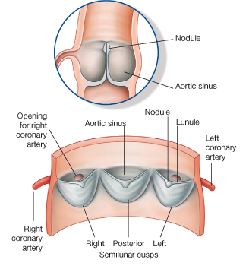
Right Coronary Artery
Arises from the anterior aortic sinus of the ascending aorta.
Descends in the right atrioventricular groove between the Right Auricle and the Pulmonary trunk.
At the inferior border of the heart it continuous posterioly to anastomose with the left coronary.

Slide 6
(RCA ) Supplies:
Right atrium,
Right ventricle,
part of Left Atrium,
Left ventricle & Atrioventricular septum.

Slide 7
Branches
(1) Right Conus artery:
To the infundibulum and the upper part of the anterior wall of the right ventricle.
(2) Anterior Ventricular arteries
To the anterior surface of the right ventricle.
The Marginal artery is the largest branch.
Ca

Slide 8
(3) Posterior ventricular arteries:
To the diaphragmatic surface of the right ventricle.
(4) Atrial branches:
To the right atrium .
The Artery of the SAN.

Slide 9
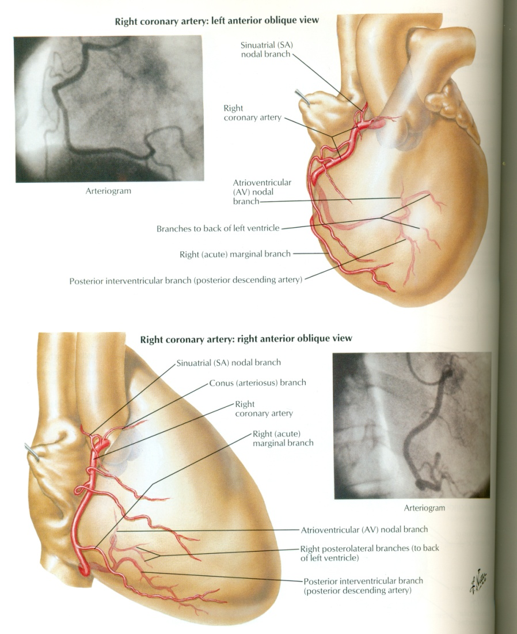
(5) Posterior Interventricular A:
Supplies:
a. Diaphragmatic surface of the R & L Ventricles.
b. Posterior part of the IVS Excluding its Apex.
C. Septal branch to the AVN.

Slide 10
Left Coronary Artery
The Larger of the two coronaries.
Arises from the left posterior aortic sinus of the ascending aorta.
Descends:
Between the pulmonary trunk and the left auricle.
In the IV groove to the apex of the heart.
Divides into two branches: (Anterior IV & Circumflex)
.

Slide 11
Left Coronary Artery
It anastomoses with the right coronary in the posterior IV groove (in 2/3 of people)
It Supplies:
Greater part of Left Atrium,
Left Ventricle and Ventricular Septum

Slide 12
Branches
Ventricular branches to both ventricles and the IV septum.
Circumflex artery gives :
Left Marginal to the left margin of the LV till the apex.
Anterior Interventricular A gives:
Left (Lateral) diagonal
Anterior &
Posterior ventricular to (LV)
Atrial to ( LA)

Slide 13
Variations of the Coronary Arteries
Right dominance:
In (90 %) of population, the Posterior Interventricular artery is a branch of the Right Coronary.
Left dominance:
In the rest (10%), the Posterior Interventricular artery arises from the Circumflex branch of the Left Coronary A

Slide 14
Coronary Anastomosis
Anastomoses between terminal branches of the right and left coronaries exist but not large enough to provide adequate blood supply.

Slide 15
Arterial Supply of Conducting System
SAN, AVN & AVB are usually supplied by Right coronary.
RBB of (AVB) is supplied by Left coronary
LBB of (AVB) is supplied by both right and left coronaries

Slide 16
Venous Drainage
1. Anterior cardiac veins:
Open directly into the Right Atrium.
2. Venae Cordis minime
Open into the heart chambers.
3. Coronary sinus

Slide 17
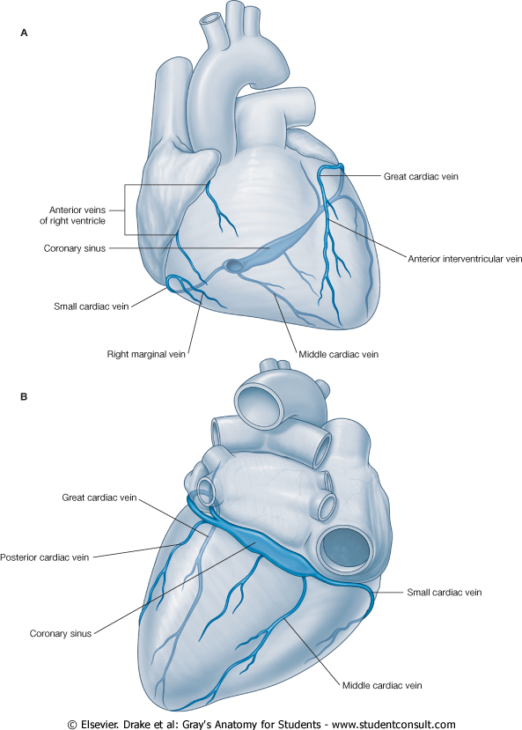
Coronary Sinus
Drains most of the venous blood of the heart.
Lies in the posterior part of the AV groove.
Origin :
It is the direct continuation of the Great Cardiac Vein.
Tributaries:
(1) Cardiac Veins:
A. Great.
B. Middle.
C. Small.
(2) Oblique vein of left atrium.

Slide 18
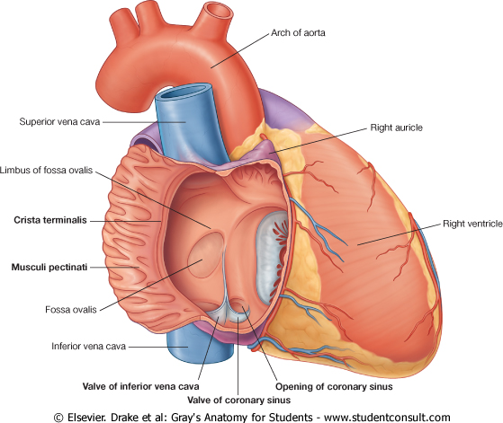
It empties into Right Atrium.
Its opening is inferior & to the left of the IVC opening.
It is guarded by a valve.

Slide 19
Thank you

