Slide 1
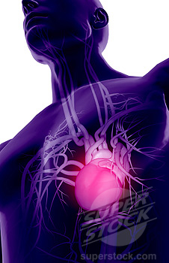
Major Body Arteries

Slide 2
Objectives
At the end of the lecture, the student should be able to:
Define the artery and understand the general principle of the arterial system.
Describe the aorta and its divisions, and list the branches from each part.
List major arteries and their distribution in the head & neck, thorax, abdomen and upper & lower limbs.
List main sites of arterial pulsation.
Define arterial anastomosis, describe its significance and list the main sites of anastomosis.
Define end arteries and give examples.

Slide 3
General Principles of Arterial Supply
Arteries carry blood away from the heart.
All arteries, carry oxygenated blood
except the pulmonary and umbilical arteries, which carry deoxygenated blood to the lungs and to the placenta respectively
The flow of blood depends on the pumping action of the heart
There are no valves in the arteries.
The branches of arteries supplying adjacent areas normally
anastomose with one another freely providing backup routes for blood to flow if one link is blocked.

Slide 4
Aorta
It is the largest artery in the body.
Originates from the left ventricle.
It is divided into 4 parts.
It carries oxygenated blood to all parts of the body.

Slide 5
Division of Aorta
Ascending Aorta
Arch of Aorta
Descending
Thoracic Aorta
Abdominal Aorta

Slide 6
Ascending Aorta
Originates from left ventricle.
Continuous as aortic arch.
Branches:
Right & Left coronary arteries
arise from aortic sinuses

Slide 7
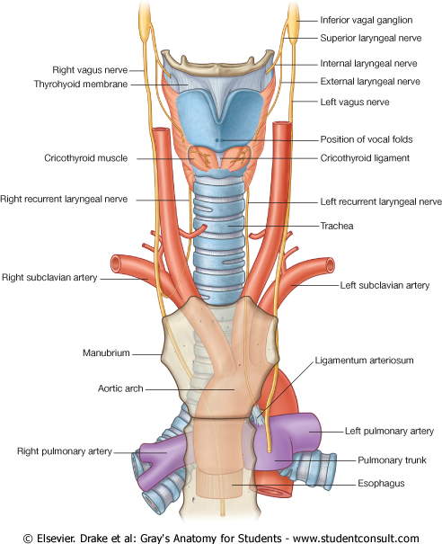
Arch of Aorta
Continuation of the ascending aorta.
Leads to descending thoracic aorta.
Located behind the lower part of manubrium sterni and on the left side of trachea.
Branches:
Left Subclavian artery
Left Common Carotid artery
Brachiocephalic trunk

Slide 8
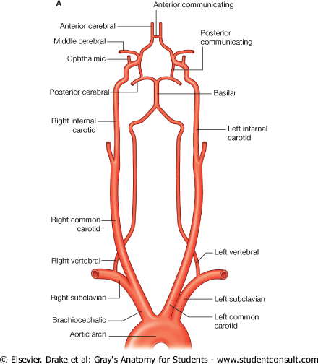
Common Carotid Arteries
The left common carotid arises from aortic arch.
The right common carotid arises from brachiocephalic trunk.
Each common carotid gives two branches:
Internal carotid
External carotid

Slide 9
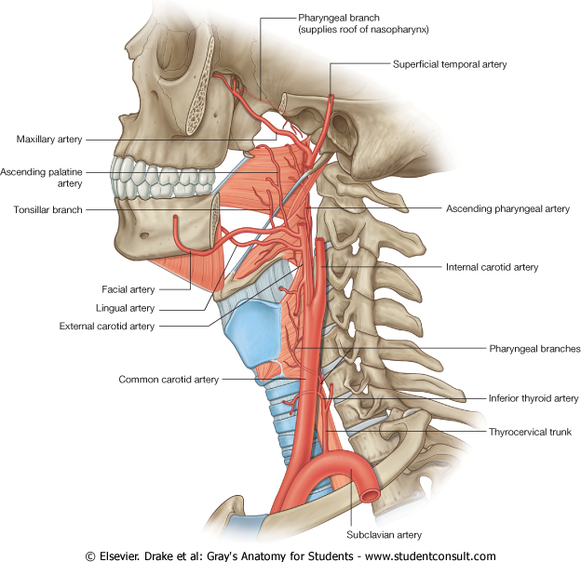
External Carotid Artery
It divides behind neck of the mandible into two 2 terminal branches:
Superficial temporal
Maxillary artery
It supplies:
Scalp: Superficial temporal artery
Face: Facial artery
Maxilla: Maxillary artery
Tongue: Lingual artery
Glands: Superior thyroid artery

Slide 10
Internal Carotid Artery
Has no branches in the neck and enters the cranial cavity.
It Supplies:
Brain
Nose
Scalp
Eye

Slide 11
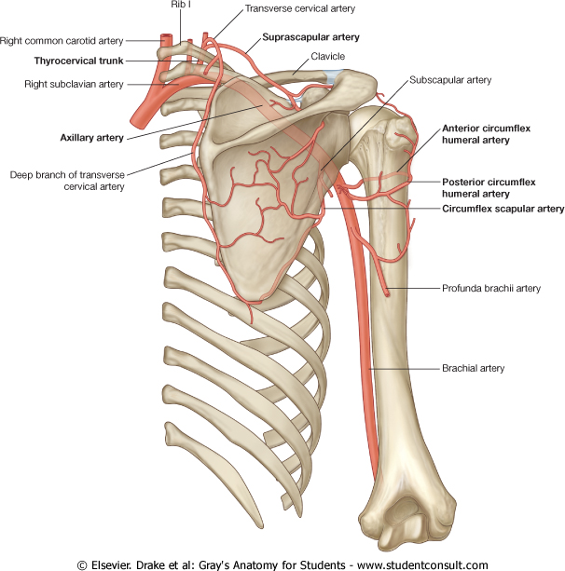
Subclavian Artery
Left subclavian arises from aortic arch
Right subclavian arises from brachiocephalic trunk
Main branches:
Vertebral artery to supply CNS
Internal thoracic artery to supply mammary gland & the thoracic wall.
At lateral border of the first rib, it is continuous in the axilla as the Axillary artery
It is the source of the arterial supply of the upper limb.

Slide 12
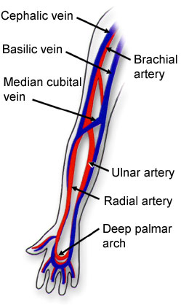
Upper Limb Arteries
Axillary
Brachial
Radial
Ulnar
Palmar Arches
Superficial
Deep

Slide 13
Upper Limb Arteries
Axillary
It passes through the Axilla.
It continues in the arm as the Brachial artery.
Brachial
It descends close to the medial side of the Humerus
It passes in front of the elbow joint (cubital fossa).
At the level of neck of radius, it divides into two terminal branches
Radial
Ulnar
Ulnar
The larger terminal branch
Radial
The smaller terminal branch
Palmar Arches
superficial & deep Palmar arches are formed by both Ulnar & Radial.

Slide 14
How We Are Doing!
Which statement is NOT true?
Ascending aorta originates from the left ventricle.
Left subclavian arises from aortic arch.
Vertebral artery to supply CNS.
External carotid artery divides into two 3 terminal branches.
Ascending aorta gives two branches.
Ulnar is the smaller terminal branch.

Slide 15
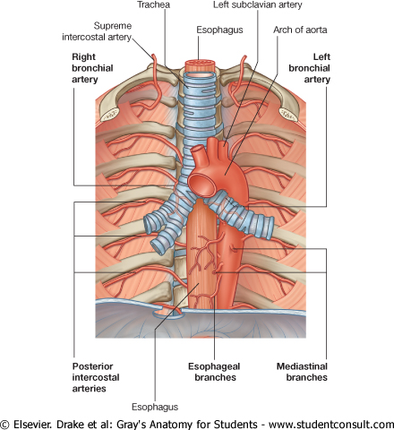
Descending Thoracic Aorta
It is the continuation of aortic arch
At the level of the 12th thoracic vertebra, it is continuous as the abdominal aorta which passes through the Diaphragm
Branches:
Pericardial
Esophageal
Bronchial
Posterior intercostal

Slide 16
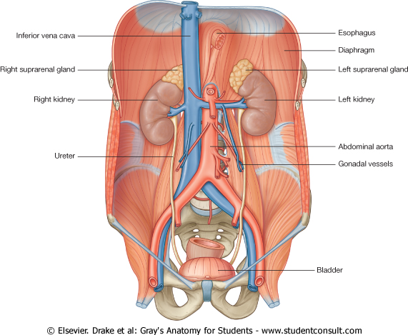
Descending Abdominal Aorta
It enters the abdomen through the aortic opening of diaphragm.
At the level of L4, it divides into two common Iliac arteries.
Branches:
They are divide into single and paired branches.

Slide 17
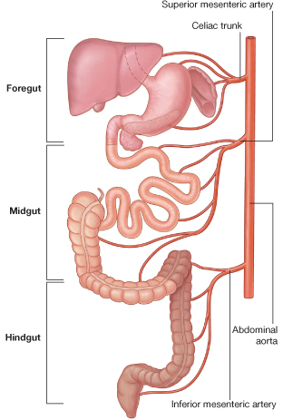
Single Branches
Celiac Trunk
Left Gastric artery
Stomach
Hepatic artery
Liver & Pancreas
Splenic artery
Spleen
Superior Mesenteric Artery
Pancreas
Small Intestine
Duodenum, Jejunum & Ileum
Large Intestine
Right 2/3 of Transverse Colon
Inferior Mesenteric Artery
Large Intestine
left 1/3 of transverse colon & descending colon
Rectum & Anal Canal

Slide 18
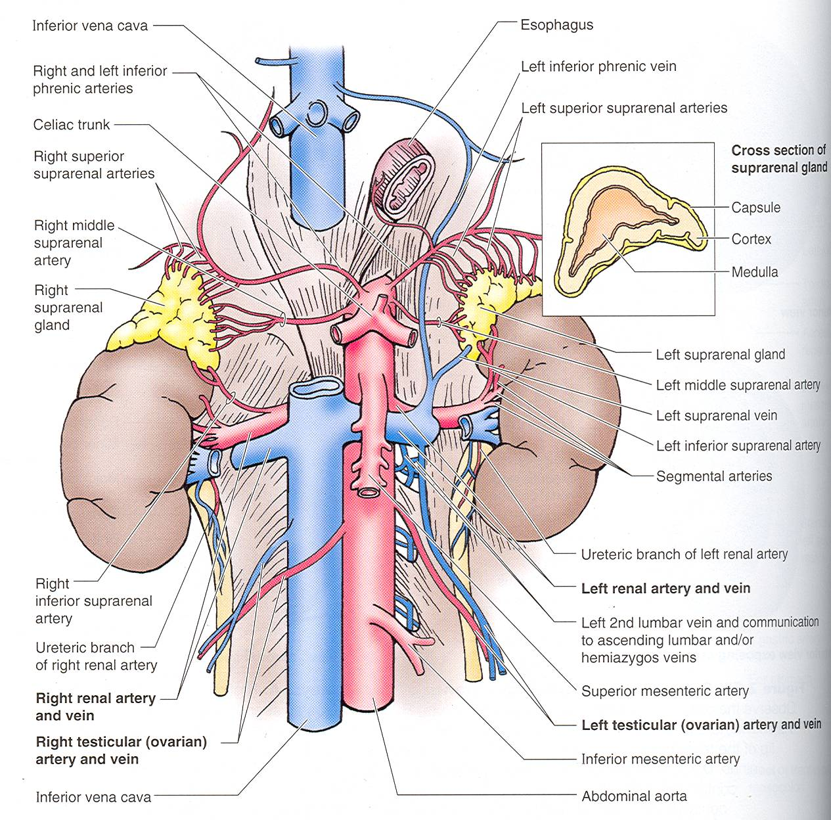
Paired Branches
Testicular or Ovarian
Renal
Suprarenal
Common Iliac

Slide 19
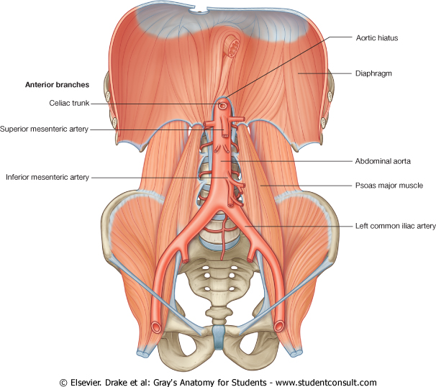
Common Iliac Artery
The Abdominal Aorta terminates, at the level of the 4th lumbar vertebra, into two common iliac arteries:
Right & Left
Each divides into external & internal iliac arteries
External supplies Lower Limb
Internal supplies Pelvis

Slide 20
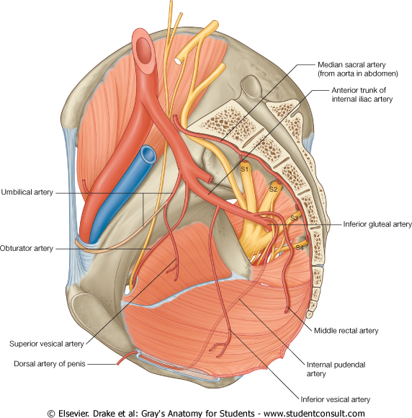
Internal Iliac Artery
Supplies:
Uterus
Vagina
Pelvic Walls
Perineum
Rectum & Anal Canal
Urinary Bladder

Slide 21
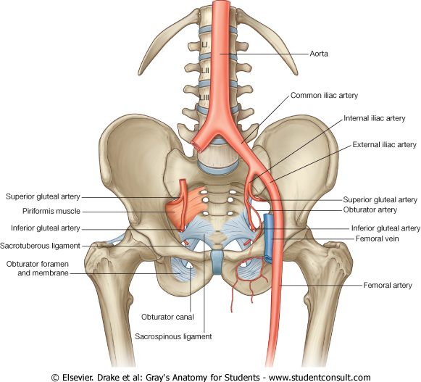
External Iliac Artery
The Source of arterial supply to the lower limb
Deep to the Inguinal Ligament it become the femoral artery

Slide 22
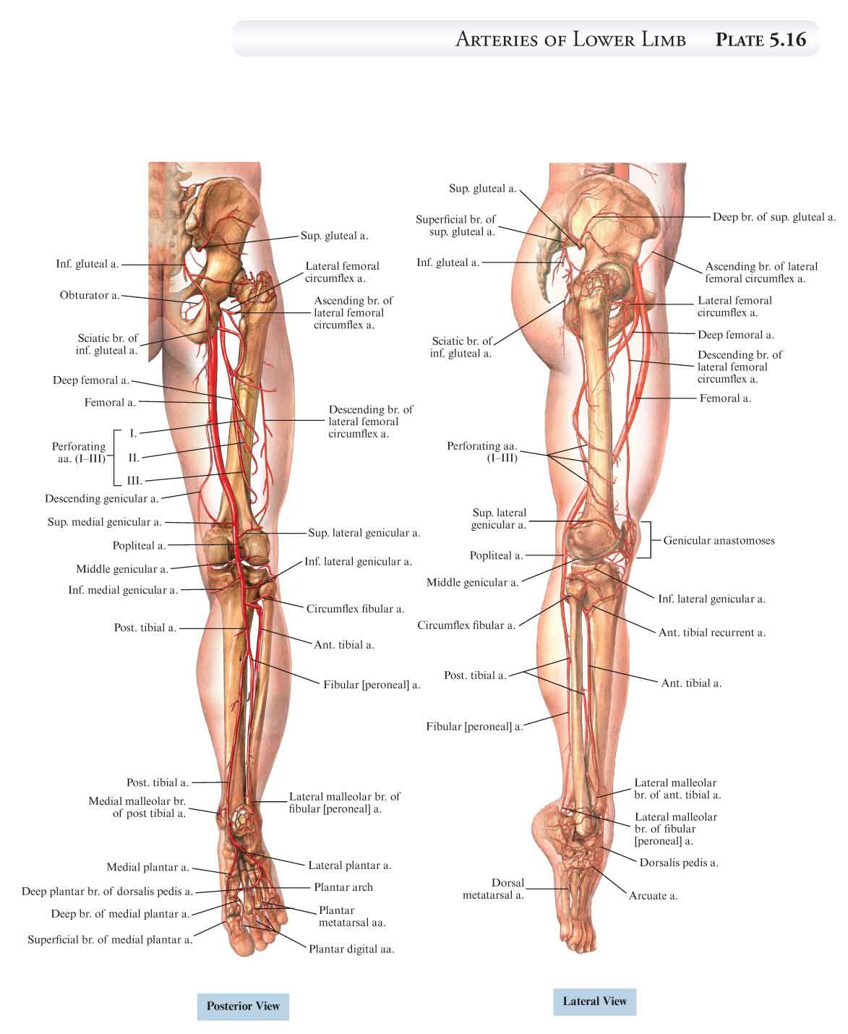
Arteries of Lower Limb
Femoral artery
Popliteal artery
Anterior tibial artery
Posterior tibial artery
Dorsalis pedis artery
Medial & Lateral planter arteries

Slide 23
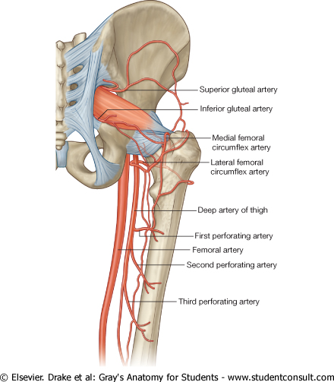
Arteries of Lower Limb
Femoral Artery
Is main arterial supply to lower limb
Enters the thigh behind the inguinal ligament
It lies in a sheath with the femoral vein in the anterior components
Ends at the lower end of the femur by entering the popliteal fossa.
Popliteal Artery
Deeply placed in the Popliteal Fossa.
It divides into Anterior & posterior tibial arteries.
Anterior Tibial Artery
It is the smaller terminal branch
It continues to the dorsum of foot as the Dorsalis Pedis artery
Posterior Tibial Artery
It terminates by dividing into Medial & Lateral Planter arteries to supply the sole of the foot.

Slide 24
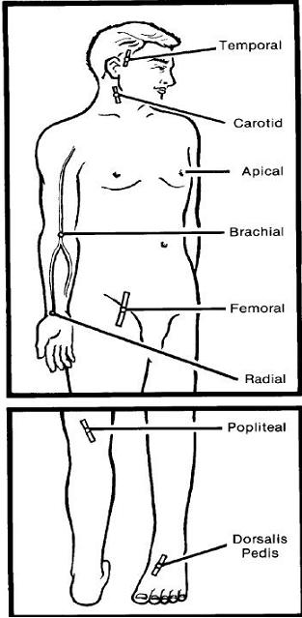
Sites for Arterial Pulsation
Superficial Temporal Pulse in front of the ear.
Facial Pulse at the lower border of the mandible.
Carotid Pulse at the upper border of thyroid cartilage
Subclavian Pulse as it crosses the 1st rib
Radial Pulse in front of the distal end of the radius
Femoral artery midway between Anterior Superior Iliac spine & symphysis pubis
Popliteal artery in the depths of popliteal fossa
Dorsalis Pedis artery in front of ankle (between the 2 malleoli)

Slide 25
Arterial Anastomosis
Anastomosis is the connection of two structures.
Arterial anastomosis is the joining of branches of arteries supplying adjacent areas
What is the main reason for having an arterial anastomosis?
To have multiple supply to a region (so in case one artery is blocked, the distal region is still perfused)
Anatomic end arteries
Their terminal branches do not anastomose with branches of adjacent arteries

Slide 26
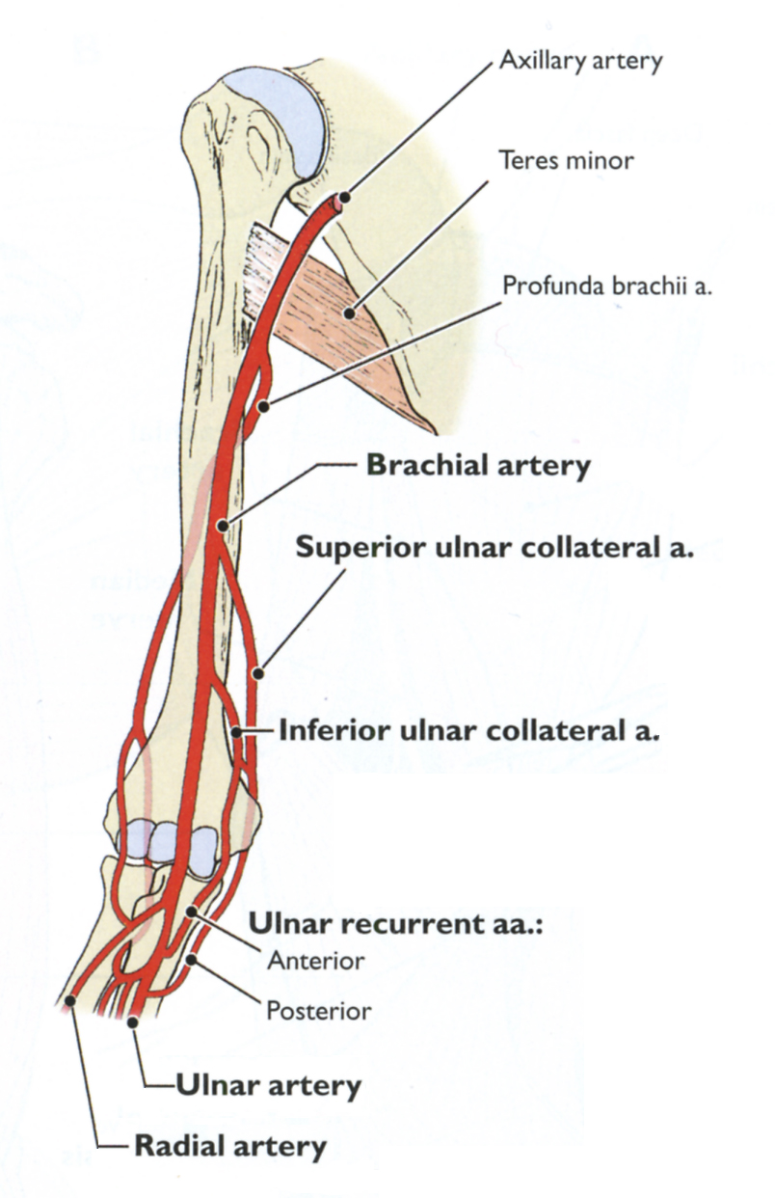
Main sites for Anastomosis
In the upper limb
Scapular Anastomosis between branches of Subclavian & Axillary
Around the elbow
Brachial, Radial & Ulnar

Slide 27
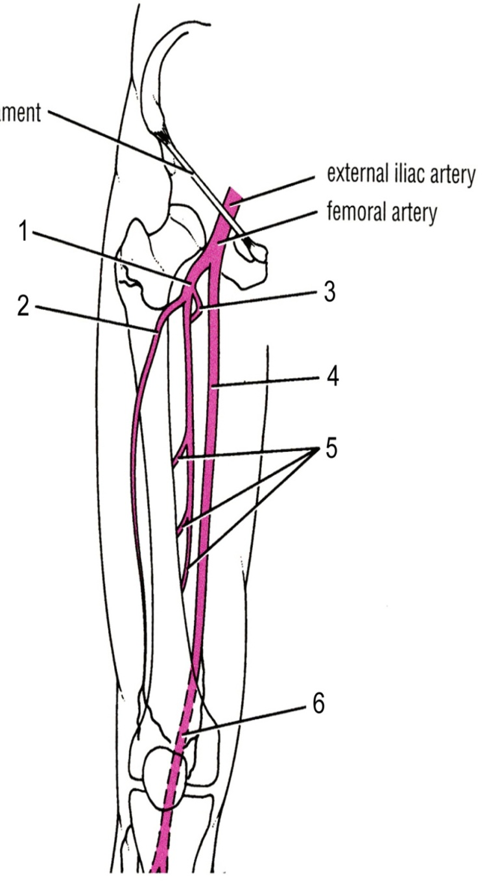
Main sites for Anastomosis
In the lower limb
Trochanteric & Cruciate
Provide anastomosis between Internal iliac & Femoral

Slide 28
End Arteries
The arteries whose terminal branches do not anastomose with branches of adjacent arteries are called “end arteries or terminal arteries”.
End arteries are of two types:
Anatomic (True) End Artery: When no anastomosis exists.
e.g. artery of the retina
Functional End Artery: When an anastomosis exists but is incapable of providing a sufficient supply of blood.
e.g. splenic artery, renal artery
Importance of end arteries:
Occlusion of an end-artery causes serious nutritional disturbances resulting in death of the tissue supplied by it. For example, occlusion of central artery of retina results in blindness. The results are severe because the blood flow to that region is completely stopped since there is no collateral circulation.

Slide 29
How We Are Doing!
Which statement is NOT true?
Celiac trunk is considered single artery.
External iliac is the main supply of the pelvis.
Abdominal aorta terminates at the level of L4 into two main branches
Renal artery is considered paired.
Superior mesenteric artery supplies Spleen.
Inferior mesenteric artery supplies rectum and anal canal.

Slide 30
QUESTION?

