Slide 1
Lactic Acidosis
Dr. Sumbul Fatma
1 Lecture
Cardiovascular Block

Slide 2
Overview
Introduction to metabolic acid-base disorders
Metabolic acidosis and alkalosis
Lactic acidosis
Definition
Lactate metabolism in tissue
Mechanisms involved in lactic acidosis
Types and causes of lactic acidosis
Diagnosis and treatment

Slide 3
Metabolic acid-base disorders
Changes in bicarbonate conc. in the extracellular fluid (ECF) cause acid-base disorders
Occur due to high conc. or loss of H⁺ ions
Can lead to:
Metabolic acidosis
Metabolic alkalosis

Slide 4
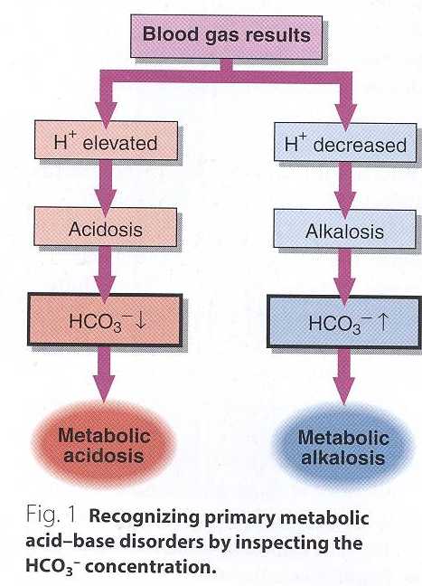

Slide 5
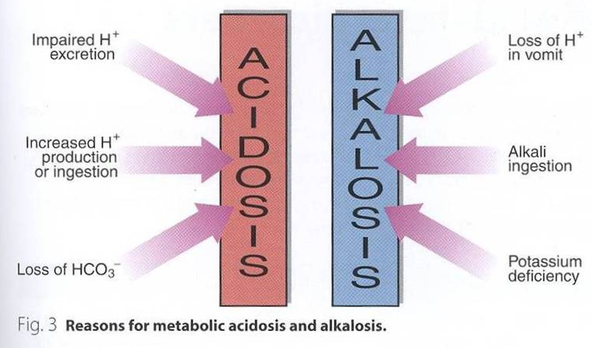

Slide 6
Metabolic acidosis
Reduction in bicarbonate conc. of ECF
Causes are:
Increased production of H⁺ ions
Ingestion of H⁺ or drugs metabolized to acids
Impaired excretion of H⁺

Slide 7
Anion gap
It is the difference between the sum of:
Na⁺ and K⁺ (cations) and
the sum of Cl – and HCO₃– (anions)
Helps in assessing acid-base problems
Normal anion gap: 3-11 mEq/L
High anion gap: >11 mEq/L (acidosis)
Low anion gap: <3 mEq/L (alkalosis)

Slide 8
Metabolic acidosis
High anion gap occurs in:
Renal disease
Diabetic ketoacidosis
Lactic acidosis
Chronic diarrhea
Poisoning
Renal tubular acidosis

Slide 9
Clinical effects of acidosis
Hyperventilation is the compensatory physiological response to acidosis
Increased H⁺ conc. stimulates respiratory response
(Hyperventilation: deep, rapid, and gasping respiratory pattern)
Arrhythmia, cardiac arrest
Loss of consciousness, coma, death

Slide 11
Metabolic alkalosis
Increase in bicarbonate conc. in ECF
Causes are:
Loss of H⁺ ions in gastric fluid due to vomiting
Ingestion of sodium bicarbonate
Potassium deficiency as a result of diuretic therapy

Slide 12
Clinical effects of alkalosis
Hypoventilation (depressed breathing)
Increases PCO₂ to compensate alkalosis
Respiratory arrest
Confusion, coma, death

Slide 14
Lactic acidosis
Elevated conc. of plasma lactate is called lactic acidosis
Occurs either due to:
Failure of circulatory system (hypoxia)
Disorders of carbohydrate metabolism

Slide 15
Lactate metabolism in tissue
The body tissues produce ~ 1500 mmoles of lactate each day
The lactate enters blood stream and metabolized mainly by the liver (Cori cycle)
All tissues can produce lactate under anaerobic conditions
Pyruvate is converted to lactate by lactate dehydrogenase enzyme

Slide 16
Pyruvate + NADH + H⁺
Lactate dehydrogenase
Lactate + NAD⁺

Slide 17
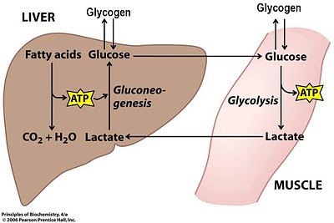
The Cori cycle

Slide 18
Lactate metabolism in tissue
The skeletal muscles produce high amounts of lactate during vigorous exercise
Lactate is metabolized in liver (60%) and kidney (30%) to glucose
Some lactate is metabolized to CO2 and water (Krebs cycle)

Slide 19
Mechanisms involved in lactic acidosis
Lactic acidosis can occur due to:
Excessive tissue lactate production
Impaired hepatic metabolism of lactate

Slide 20
Types and causes of lactic acidosis
Type A
Due to hypoxia in tissues (most common)
Hypoxia causes impaired oxidative phosphorylation and decreased ATP synthesis
To survive, the cells switch to anaerobic glycolysis for ATP synthesis
This produces lactate as a final product
The amount of oxygen required to recover from oxygen deficiency is called oxygen debt

Slide 21
Types and causes of lactic acidosis
Type A is due to inadequate supply of oxygen to tissues in:
Myocardial infarction
Pulmonary embolism
Uncontrolled hemorrhage
Tissue hypoperfusion (shock, cardiac arrest, acute heart failure, etc.)
Anaerobic muscular exercise

Slide 22
Types and causes of lactic acidosis
Type B
Due to disorders in carbohydrate metabolism
Congenital lactic acidosis is due to deficiency of pyruvate dehydrogenase enzyme
Chronic hepatic disease accompanied by shock or bleeding
Liver failure
Drug intoxication

Slide 23
Diagnosis and treatment
Diagnosis done by measuring blood lactate levels
Hyperlactemia: 2 – 5 mmols/L
Severe lactic acidosis: > 5 mmols/L
Treatment:
Correcting the underlying conditions
Restoring adequate tissue oxygen
Avoiding sodium bicarbonate

