Slide 1
Biochemical Markers of
Myocardial Infarction
Cardiovascular Block
Presented by:
Dr. Rana Hasanato MD,KSFCB

Slide 2
Overview
Myocardial infarction
Time-course of plasma enzyme changes
Cardiac troponins I and T
Creatine kinase (CK-MB)
Myoglobin
Lactate dehydrogenase (LDH)
Aspartate aminotransferase (AST)

Slide 3
Myocardial Infarction
Myocardial infarction is due to:
Restricted blood supply (oxygen) to heart tissue (ischemia) → damage to heart tissue (infarction) →the release of enzymes and other proteins into the blood (markers)

Slide 4
Markers of diagnostic value in MI:
Cardiac troponins I and T
Creatine Kinase (CK-MB)
Myoglobin
Lactate dehydrogenase (LDH)
Aspartate aminotransferase (AST)

Slide 5
Time-course of enzyme changes
Plasma enzymes follow a pattern of activities after a MI
The initial lag phase lasts for about 3 hours
Enzymes rise rapidly to peak levels in 18-36 hours
The levels return to normal based on enzyme half-life
Rapid rise and fall indicates diagnostic value

Slide 6
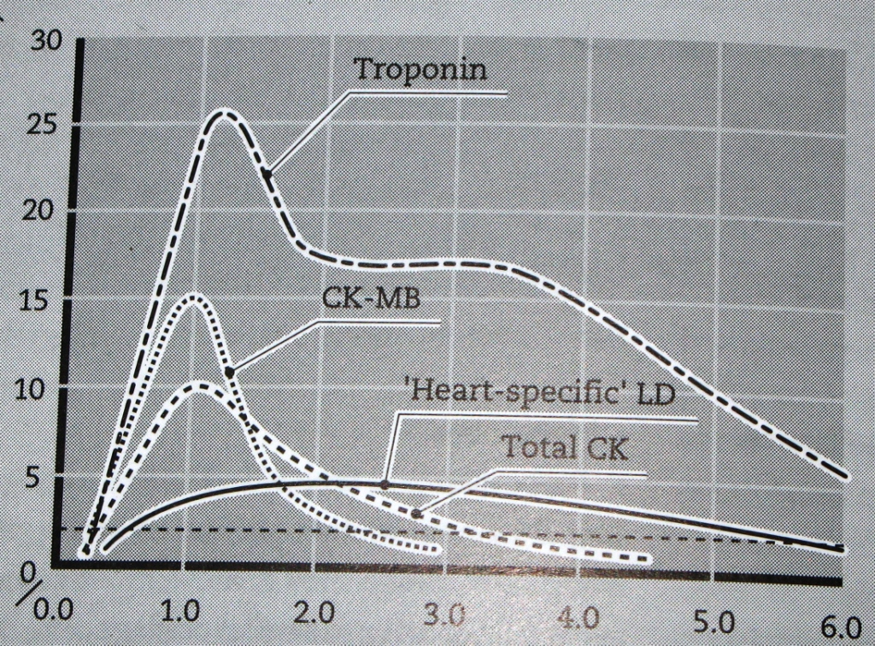
Marker activity after MI
Activity
Time since onset of symptoms (days)

Slide 7
Blood samples collected after MI:
Baseline (upon admission)
Between 12 to 24 hours after the onset of symptoms

Slide 8
Troponins
Troponins are structural proteins in cardiac myocytes and in skeletal muscle
Involved in the interaction between actin and myosin for contraction
cTn are mainly bound to proteins, with small amount soluble in the cytosol
Two main cardiac troponins (cTn):
cTnI: inhibitory protein
cTnT: binds to tropomyosin

Slide 9
cTn are structurally different from muscle troponins
Highly specific markers for detecting MI
Appear in plasma in 3-4 h after MI
Remain elevated for up to 10 days

Slide 10
After a MI, cytosolic troponins are released rapidly into the blood (first few hours)
Structurally bound troponins are released later for several days

Slide 11
Plasma enzyme changes
Enzyme | Detectable (hours) | Peak value (hours) | Duration (days)
CK-MB | 3-10 | 12-24 | 1.5-3
Total CK | 5-12 | 18-30 | 2-5
AST | 6-12 | 20-30 | 2-6
LDH (heart specific) | 8-16 | 30-48 | 5-14
Cardiac troponins | 3-4 | ~ 48 | Upto 10

Slide 12
Marker activity after MI
Activity
Time since onset of symptoms (days)

Slide 13
Creatine Kinase (CK)
Three main CK isoenzymes comprising two polypeptide chains B or M
Type | Composition | Comment
Skeletal Muscle | 98% CK-MM 2% CK-MB | Elevated in muscle disease
Cardiac muscle | 70-80% CK-MM 20-30% CK-MB | Cardiac muscle has highest amount of CK-MB
Brain | CK-BB
Plasma | Mainly CK-MM

Slide 14
CK-MB
CK-MB is more sensitive and specific for MI than total CK
It rises and falls transiently after MI
It is required in the following conditions:
When very early evidence of infarction
Post-operative and traumatized patients suspected for MI
Patients suspected of having a second infarct

Slide 15
Marker activity after MI
Activity
Time since onset of symptoms (days)

Slide 16
Myoglobin
Myoglobin is a sensitive marker of cardiac damage
It rises very rapidly after the MI at about the same rate as CK-MB
Myoglobin is non-specific because it is also elevated in muscle disease

Slide 17
Lactate dehydrogenase (LDH)
LDH increases within 6-12 h of MI
Reaches a max. level in 48 h
Remains elevated for 5-6 days after MI
A non-specific marker of tissue injury:
High levels are found in liver, lung, kidney and other diseases

Slide 18
Aspartate aminotransferase (AST)
AST and ALT are mainly liver enzymes
AST is also present in the heart
A non-specific marker of MI
It is elevated in liver and other diseases

Slide 19
Take home message
cTn are highly specific to heart muscle damage
They remain elevated in plasma longer than CK-MB
They have higher sensitivity and specificity than CK-MB
They are measured in combination with myoglobin and CK-MB

