Slide 1
بسم الله الرحمن الرحيم

Slide 2
Oxidative Stress and Atherosclerosis
By
Reem M. Sallam, M.D.; Ph.D.

Slide 3
Oxidative stress
A condition in which cells are subjected to excessive levels of Reactive Species (Oxygen or Nitrative species) & they are unable to counterbalance their deleterious effects with antioxidants.
It has been implicated in the ageing process & in many diseases (e.g., atherosclerosis and coronary heart diseases).

Slide 4
Oxidative Stress
Imbalance between oxidant production
and antioxidant mechanisms
Oxidative damage to:
DNA
Proteins
Lipids (unsaturated fatty acids)
Oxidative stress and diseases:
Inflammatory conditions e.g., Rheumatoid arthritis
Athersclerosis and coronary heart diseases
Obesity
Cancers
G6PD deficiency hemolytic anemia

Slide 5
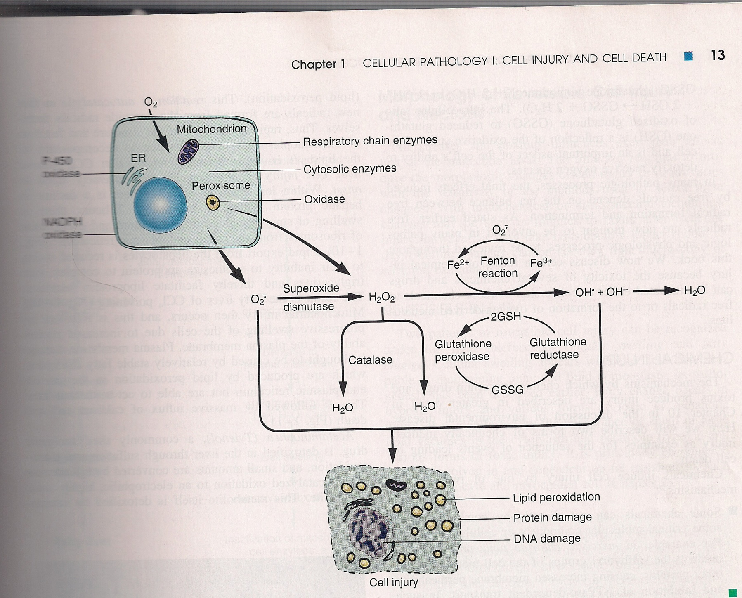

Slide 6
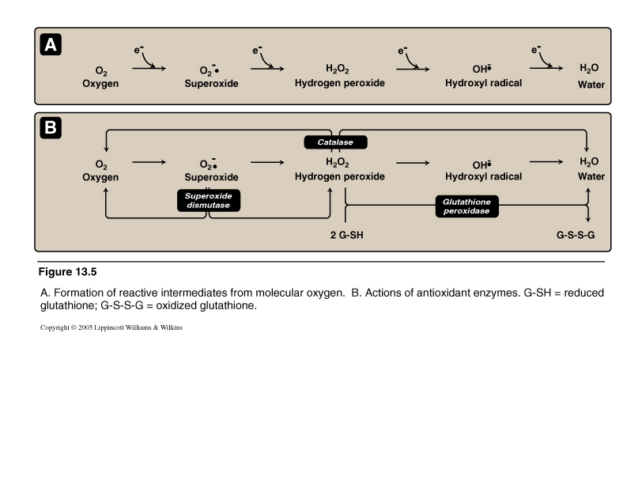
Reactive Oxygen Species (ROS)
Oxygen-derived free radicals:
e.g., Superoxide and hydroxyl radicals
Non-free radical: Hydrogen peroxide

Slide 7
Antioxidant Mechanisms

Slide 8
ROS: Types and Sources
Types:
  Free radical:
  Superoxide (O₂. )
  Hydroxyl radical (OH.)
  Peroxyl radical (ROO.)
  Non free radical:
  Hydrogen peroxide (H₂O₂)
Sources:
  During course of metabolism
  e.g., O₂. by auto-oxidation of hemoglobin
  and xanthine oxidase
  OH. by Fenton reaction
  O₂. , H₂O₂ , OH. By partial reduction of molecular oxygen in electron transport chain in mitochondria
  Ingestion of toxins, chemicals or drugs

Slide 9
Antioxidants
Enzymes:
  Superoxide dismutase
  Catalase
  Glutathione system (glutathione, NADPH, reductase, peroxidase & selenium)
  Vitamins:
  Vitamin C (ascorbic acid)
  Vitamin A and β-carotenes
  Vitamin E
Trace elements:
  Selenium

Slide 10
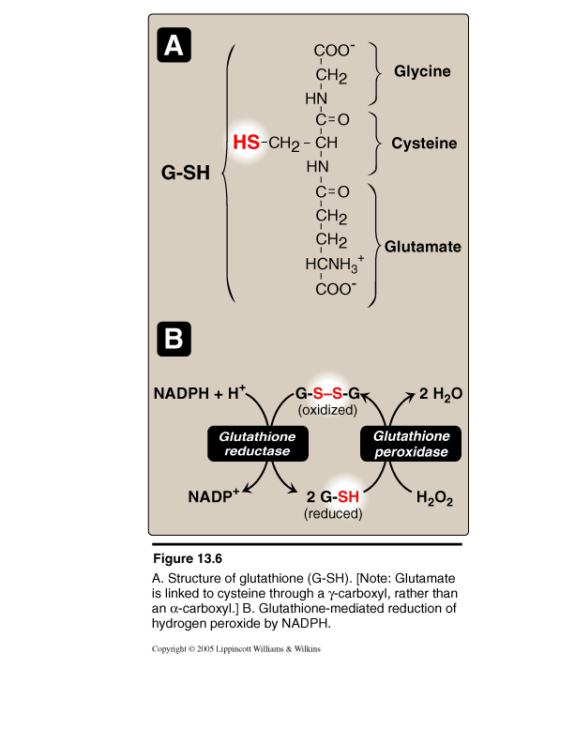
Glutathione System
*
Selenium
* Glucose-6-phosphate dehydrogenase (G-6-PD) is the main source for NADPH generation and is, therefore, essential for proper function of glutathione system

Slide 11
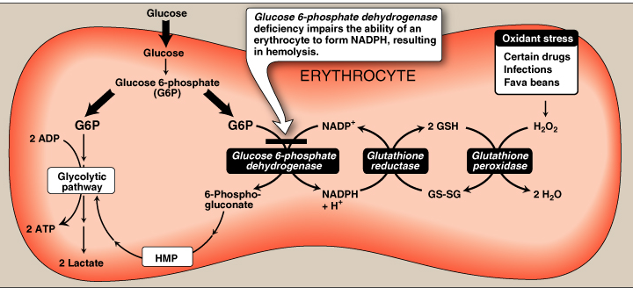
Biochemical Basis of
G6PD Deficiency Hemolytic Anemia

Slide 12
Molecular & Vascular Effects of ROS
Molecular effects:
  Lipid peroxidation (polyunsaturated fatty acids)
  Protein denaturation
  Inactivation of enzymes
  DNA damage
  Cell signaling effects
  (e.g., release of Ca²⁺ from intracellular stores)
  Cytoskeletal damage
  Chemotaxis
Vascular effects:
  Altered vascular tone
  Increased endothelial cell permeability

Slide 13
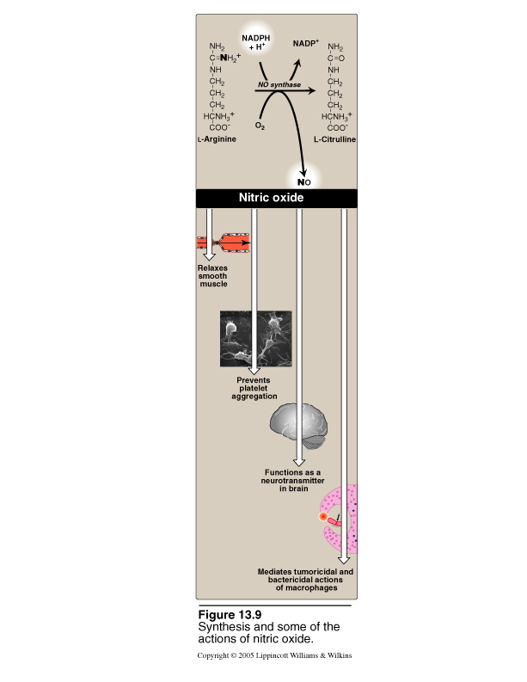
Nitric Oxide (NO)
NO:
Free radical gas
Very short half-life (seconds)
Metabolized into nitrates & nitrites
Synthesis:
Enzyme: NO synthase (NOS)
Precursor: L-Arginine
Effects:
Relaxes vascular smooth muscle
Prevents platelet aggregation
Bactricidal & Tumoricidal effects
Neurotransmitter in brain

Slide 14
Oxidative Stress: Role of Nitric Oxide (NO)
This may be both beneficial and detrimental, depending upon when and where NO is released
NO produced by endothelial NOS (eNOS) → improving vascular dilation and perfusion (i.e., beneficial).
Vasodilators such as nitroglycerin is metabolized into NO and causes vasodilatation
In contrast, NO production by neuronal NOS (nNOS) or by the inducible form of NOS (iNOS) has been reported to have detrimental effects.
Increased iNOS activity is generally associated with inflammatory processes

Slide 15
Pathogenesis of Atherosclerosis
Modified (oxidized) LDL … Oxidative stress
(imbalance between oxidants and antioxidants)
Endothelial injury of arterial wall
Adherence of monocytes to endothelial cells and their movement into intima where it becomes macrophages
Uptake of oxLDL by macrophage scavenger receptor:
Scavenger receptor class A (SR-A)
Low-affinity, non-specific receptor
Un-regulated receptor
Foam cell transformation: Accumulation of excess lipids inside the cells (unregulated receptor)
Atherosclerotic plaque formation

Slide 16
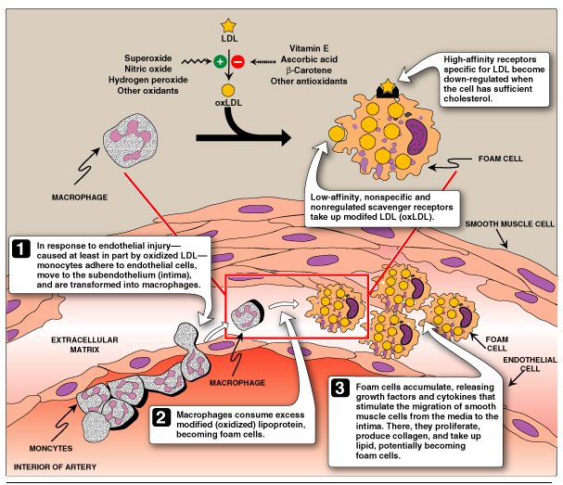
Athersclerotic plaque Formation

Slide 17
Compare to physiological uptake of
LDL (unmodified)
by high-affinity, specific & tightly regulated
LDL-Receptor

Slide 18
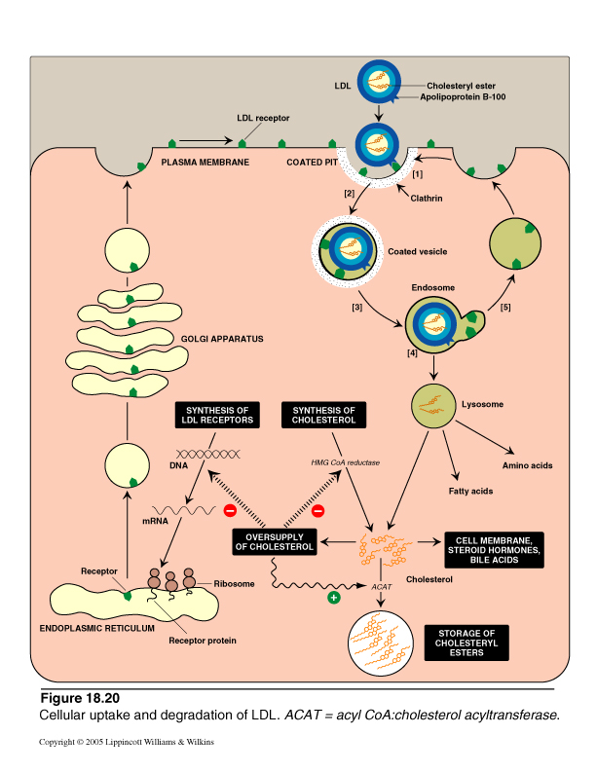
LDL: Receptor-Mediated Endocytosis

