Slide 1
Biochemical Markers of
Myocardial Infarction
Cardiovascular Block
1 Lecture | Dr. Usman Ghani

Slide 2
Overview
Myocardial infarction
Time-course of plasma enzyme changes
Creatine kinase (CK)
Lactate dehydrogenase (LDH)
Aspartate aminotransferase (AST)
Myoglobin
Cardiac troponins I and T

Slide 3
Myocardial Infarction
Myocardial infarction (heart attack) is due to:
Restricted blood supply (oxygen) to heart tissue (ischemia)
Causes damage to heart tissue (infarction)
Infarction causes the release of enzymes and other proteins into the blood (markers)

Slide 4
Markers of diagnostic value in MI:
Creatine Kinase (CK)
Aspartate aminotransferase (AST)
Lactate dehydrogenase (LDH)
Myoglobin
Cardiac troponins I and T

Slide 5
Time-course of enzyme changes
Plasma enzymes follow a pattern of activities after a MI
The initial lag phase lasts for about 3 hours
Enzymes rise rapidly to peak levels in 18-36 hours
The levels return to normal based on enzyme half-life
Rapid rise and fall indicates diagnostic value

Slide 6
Blood samples collected after MI:
Baseline (upon admission)
Between 12 to 24 hours after the onset of symptoms

Slide 7
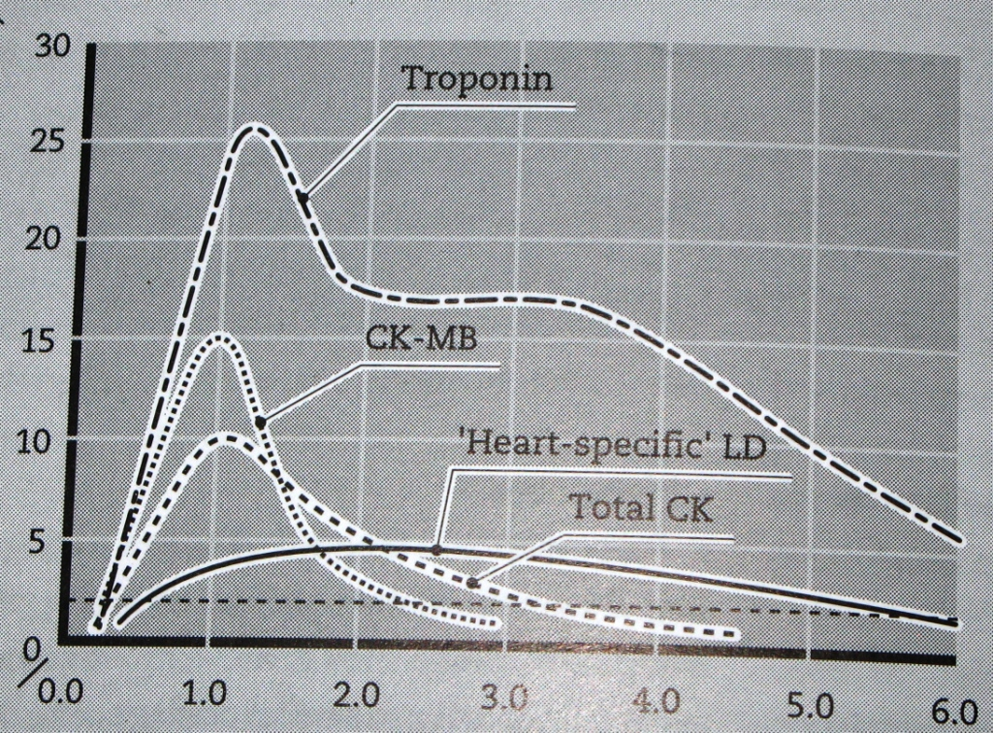
Marker activity after MI
Activity
Time since onset of symptoms (days)

Slide 8
Plasma enzyme changes
Enzyme | Detectable (hours) | Peak value (hours) | Duration (days)
CK-MB | 3-10 | 12-24 | 1.5-3
Total CK | 5-12 | 18-30 | 2-5
AST | 6-12 | 20-30 | 2-6
LDH (heart specific) | 8-16 | 30-48 | 5-14
Cardiac troponins | 3-4 | ~ 48 | Upto 10

Slide 9
Creatine Kinase (CK)
Three main CK isoenzymes comprising two polypeptide chains B or M
Skeletal Muscle: 98% CK-MM; 2% CK-MB
Elevated in muscle disease
Cardiac muscle: 70-80% CK-MM; 20-30% CK-MB
Cardiac muscle has highest amount of CK-MB
Brain: CK-BB
Plasma: Mainly CK-MM

Slide 10
CK-MB
CK-MB is more sensitive and specific for MI than total CK
Not a first-line test for MI:
It rises and falls transiently after MI
Methods to detect CK-MB are not reliable
It is elevated in muscle disease

Slide 11
Marker activity after MI
Activity
Time since onset of symptoms (days)

Slide 12
CK-MB
It is a first-line test if very early evidence of infarction is required in:
Post-operative patients suspected of MI
Patients suspected of having a second infarct
CK-MB provides late diagnosis of MI (within 48 h)
If patient is seen first time within 48 h

Slide 13
Lactate dehydrogenase (LDH)
LDH increases within 6-12 h of MI
Reaches a max. level in 48 h
Remains elevated for 5-6 days after MI
A non-specific marker of tissue injury:
High levels are found in liver, lung, kidney and other diseases

Slide 14
Aspartate aminotransferase (AST)
AST and ALT are mainly liver enzymes
AST is also present in the heart
A non-specific marker of MI
It is elevated in liver and other diseases

Slide 15
Myoglobin
Myoglobin is a sensitive marker of cardiac damage
It rises very rapidly after the MI at about the same rate as CK-MB
Myoglobin is non-specific because it is also elevated in muscle disease

Slide 16
Troponins
Troponins are structural proteins in cardiac myocytes and in skeletal muscle
Involved in the interaction between actin and myosin for contraction
Troponins are also present in cytosol of cardiac myocytes
Two main cardiac troponins (cTn):
cTnI
cTnT

Slide 17
cTn are structurally different from muscle troponins
Highly specific markers for detecting MI
Appear in plasma in 3-4 h after MI
Remain elevated for upto 10 days

Slide 18
MI can be diagnosed several days after the onset of chest pain
Whereas CK-MB returns to normal level in 48 h after the onset of chest pain
After a MI, cytosolic troponins are released rapidly into the blood (first few hours)
Structurally bound troponins are released later for several days

Slide 19
Marker activity after MI
Activity
Time since onset of symptoms (days)

Slide 20
cTn are highly specific to heart muscle damage
They remain elevated in plasma longer than CK-MB
They have higher sensitivity and specificity than CK-MB
They are measured in combination with myoglobin and CK-MB

