Slide 1
بسم الله الرحمن الرحيم
WALL OF THE HEART
AND
CARDIAC VALVES

Slide 2
WALL OF THE HEART AND CARDIAC VALVES
By the end of the lecture, the student should be able to describe the microscopic structure of:
1. Wall of the heart:
- Endocardium.
- Myocardium.
- Epicardium.
2. Cardiac valves.

Slide 3
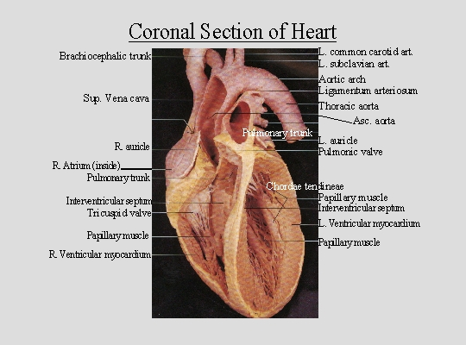
WALL OF THE HEART
(A) Endocardium: 1- Endothelium
2- Subendothelial C.T.
3- Dense C.T. layer
4- Subendocardial layer
(B) Myocardium
(C) Epicardium:
1- Mesothelium
2- C.T. layer

Slide 4
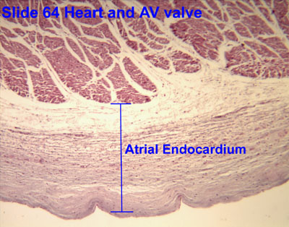
ENDOCARDIUM
1- Endothelium: simple squamous epithelium.
2- Subendothelial C.T. layer
3- Dense C.T. layer
4- Subendocardial layer:
Loose C.T. layer that contains Purkinje fibers, small blood vessels
& nerves.
It attaches to the
endomysium of the
cardiac muscle.

Slide 5
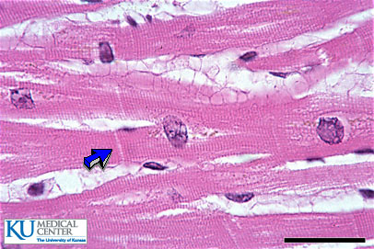
MYOCARDIUM
It is the middle layer
It is the most thick layer
It contains cardiac muscle cells with
endomysium (loose C.T.)

Slide 6
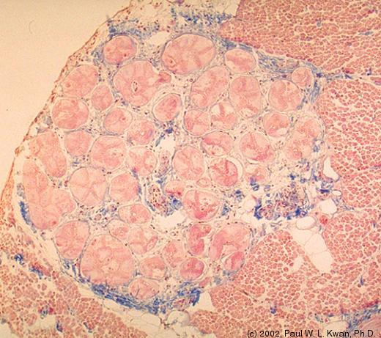
MODERATOR BAND (T.S.) AND PURKINJE FIBERS
Endocardium
Myocardium
Lumen
Moderator band

Slide 7
EPICARDIUM (Visceral layer of pericardium)
Mesothelium: simple squamous epithelium.
Subepicardial C.T. layer:
Loose C.T. contains the coronary vessels,
nerves, ganglia & fat cells.

Slide 8
LEAFLET (CUSP) OF HEART VALVE
Myocardium
Endocardium
Leaflet

Slide 9
HEART VALVES (CARDIAC VALVES)
Each leaflet (cusp) of heart valve is formed of:
(1) A core of Dense irregular C.T.
(2) This core is covered by: Endocardium.
The leaflets of the heart valves are normally AVASCULAR.
Blood capillaries can be found only in the base of the leaflet.

Slide 10
BEST WISHES

