Slide 1
Infective Endocarditis

Slide 2
Introduction
Endocarditis, irrespective of the underlying cardiac condition,
is a serious, life-threatening disease that was always fatal in the preantibiotic era.
Advances in antimicrobial therapy
Early recognition and management of complications of IE
Improved surgical technology have reduced the morbidity
and mortality of IE.
Numerous comorbid factors, may complicate IE such as
older age, diabetes mellitus
immunosuppressive conditions or therapy
dialysis.

Slide 3
DEFINITION
Infection or colonization of endocardium , heart valves , congenital defects by bacteria , rickettsiae , fungi
.
Low grade persistent bacteraemia

Slide 4
IMPORTANCE
Serious disease
mortality : 30 %
Damage of heart or other organs
Follow dental procedures ( tooth extraction)
Rheumatic heart disease
Congenital heart disease

Slide 5
Calssification
Classified into four groups:
Native Valve IE
Prosthetic Valve IE
Intravenous drug abuse (IVDA) IE
Nosocomial IE

Slide 6
Classification
Acute
Affects normal heart valves
Rapidly destructive
Metastatic foci
Commonly Staph.
If not treated, usually fatal within 6 weeks
Subacute
Often affects damaged heart valves
Indolent nature
If not treated, usually fatal by one year

Slide 7
ETIOLOGY
SUSCEPTIBLE PATIENT
BACTEREMIA

Slide 8
FACTORES AFFECTING SEVERITY AND OUTCOME
BACTERIAL FACTORS
VIRULENCE
No BACTERIA IN THE BLOOD

Slide 9
HOST FACTORS :
. FACTORS INCREASING SUSCEPTIBILITY
LOCAL
CONGINITALOR RHEUMATIC HEART DISEASE
PROSTHETIC HEART VALVES
OTHER CARDIOVASCULAR DISEASE
HEART SURGERY
GENIRAL
UNDERLYING DISEASE ( DIABETES.M )
DRUGS
IATROGENIC:
IMMUNOSUPPRESSIVE TREATMENT
CYTOTOXIC AGENTS
SELF- INFLICTED
ALCOHOLISM
ADDICTION (INJECTED DRUGS )
PROTECTIVE FACTORS
ANTIMICROBIAL CHEMOTHERAPY

Slide 10
SOURCES OF INFECTION
Dental extraction and other dental procedures
Cardiac surgery ( prosthetic valves)
Intravenous medication
Iv. Drug addiction
Intracardiac or intravenous catheters
Obstetric or gynaecologic procedures

Slide 11
PREDISPOSING FACTORS
A- cardiac lesions
Chronic rheumatic valvular disease
Congenital heart disease and defects
Atherosclerosis
Prosthetic valves
Immediate
Delayed
Distorted shape causes stasis of blood flow and settee of bacteria on the endocardium
Virulent bacteria`, staph. aureus and strept. Pneumoniae can infect normal heart

Slide 12
B. systemic factors
Immunosuppressive treatment
Immune defects ( disease)
Alcoholism
Iv. Drug abuse

Slide 13
PORTAL OF ENTRY
Dental extraction bleeding bacteraemia
Rocking the tooth in the socket pumping effect on the vessels of periodontal ligament , forces bacteria from gingival pockets into blood stream 40 – 80 % bacteraemia
Sensitivity of blood culture techniques
Severity of gingival infection
Oral irrigation device

Slide 14
NOTE
Bacteraemia may follow scaling , tooth brushing, endodontic therapy .
Lack of clinical effect of many bacteraemia is due to small number or low virulence
They are rapidly cleared by normal body defence ( leucocytes )
Strept. Faecalis may cause endocarditis after genitourinary or gut procedures

Slide 15
CAUSATIVE ORGANISMS
Viridans streptococci
Most common cause of sub- acute bacterial endocarditis (SBE)
Produce glucagons adhere to endocardium
E.g :
Streptococcus mutans
Streptococcus sanguis

Slide 16
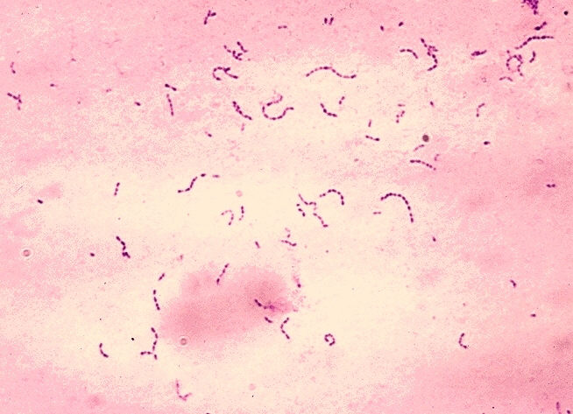
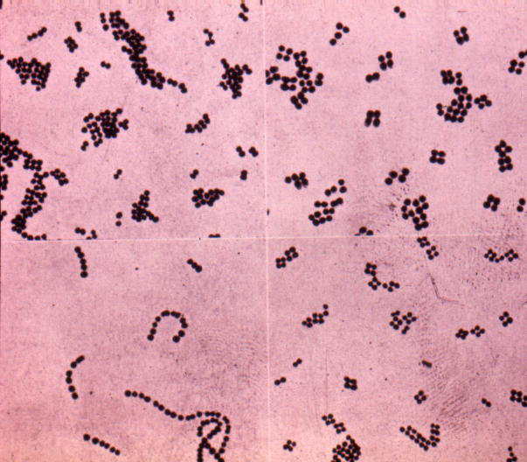
Streptococcus faecalis
Streptococcus faecium
Streptococcus pneumoniae
Staphylococcus aureus
Acute endocarditis
Staphylococcus epidermidis
Prosthetic heart valves
Brucella species
Actinobacillus actinomycetes comitans
Rickettisae
Fungi
Coxiella burneti
Candida albicans

Slide 17
PATHOGENESIS
Formation of vegetations
Fibrin , platelets (thrombi) , bacteria colonies Attached to heart valves
Break off infected emboli distant organs ( kidney , brain )
Immune complex formation causes glomerular damage haematuria
Valves infection destruction heart failure .
Drug addicts tricuspid,pulmonary valves of right side of heart lung emboli pneumonia

Slide 18
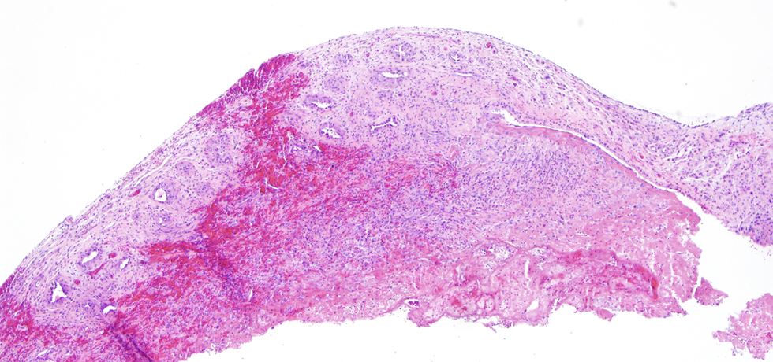
PATHOLOGICAL CHANGES IN IE

Slide 19
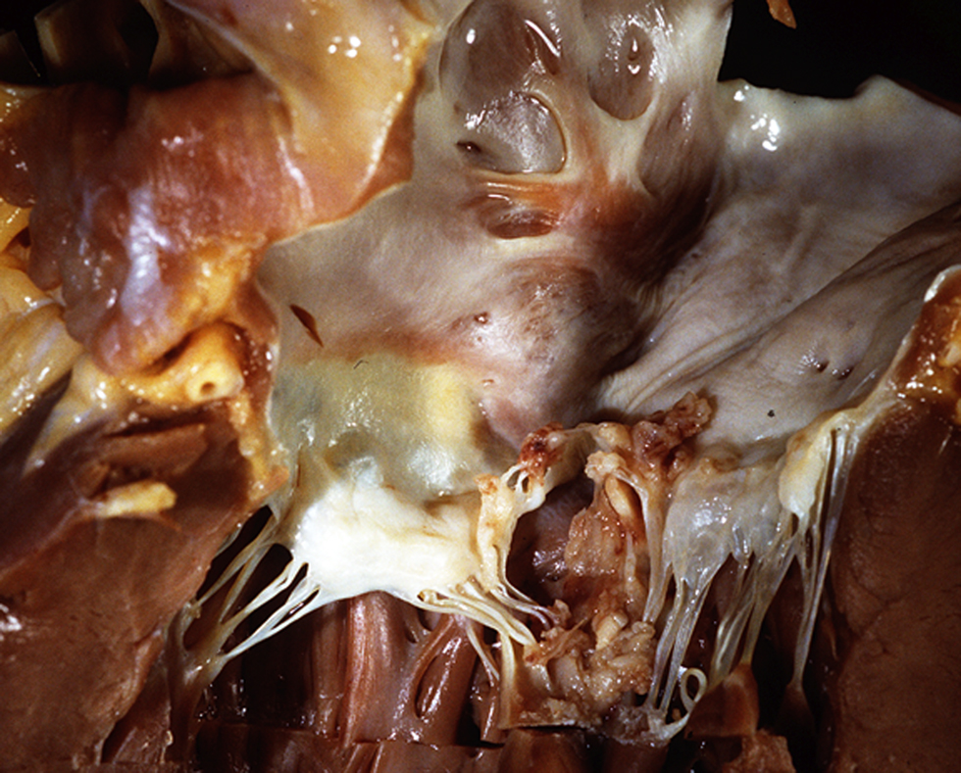

Slide 20
CLINICAL FEATURES
Onset is insidious ( SBE) – 3 weeks after extraction
Fever ( mild and prolonged )
Malaise , weight loss , weakness
Changing murmurs
Anaemia , leucocytosis
Microscopic haematuria
Petechiae
Spleenomegaly
Splinter haemorrhage
Hypergammaglobulinaemia
Age young , elderly

Slide 21
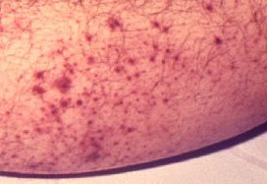
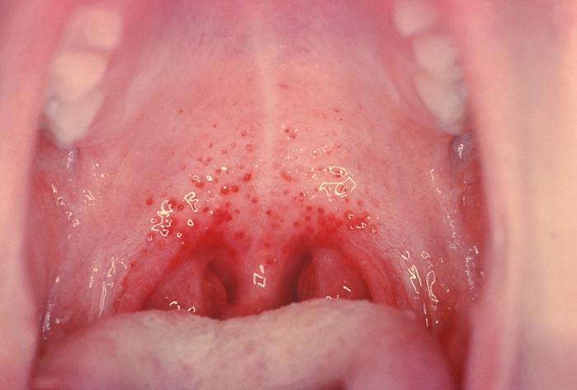
Petechiae
Nonspecific
Often located on extremities
or mucous membranes

Slide 22
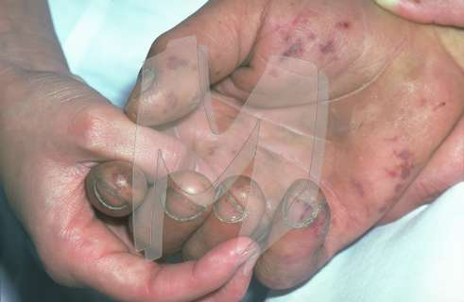
Embolic manifestations of endocarditis

Slide 23
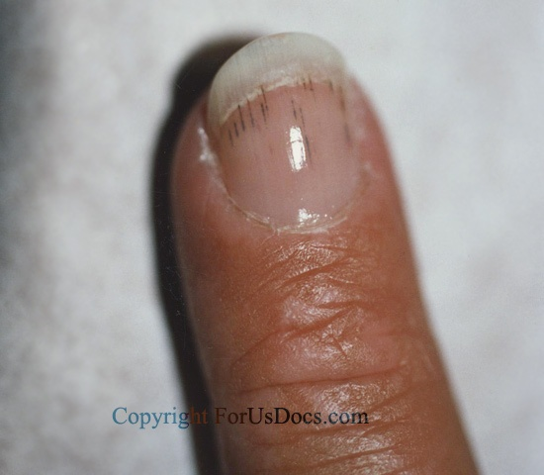
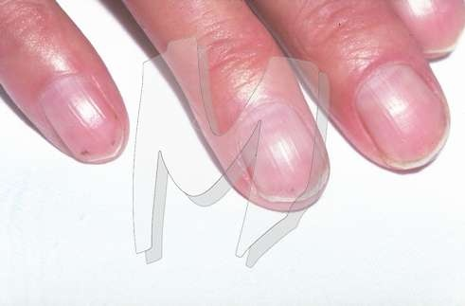
Splinter hemorrhage

Slide 24
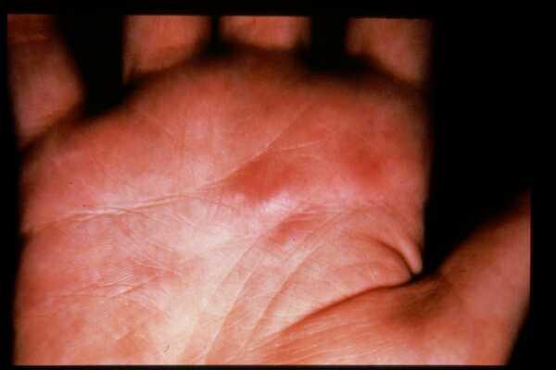
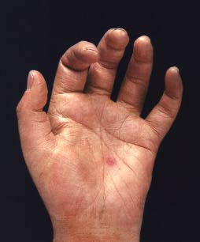
Osler’s Nodes
More specific
Painful and erythematous nodules
Located on pulp of fingers and toes
More common in subacute IE

Slide 25
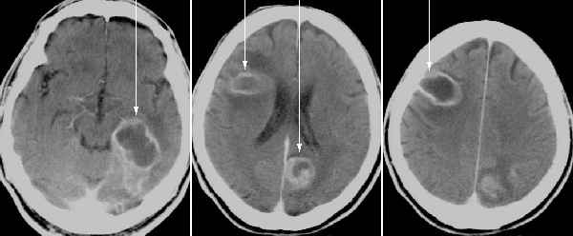
CNS manifestations of endocarditis

Slide 26
MORTALITY
With antibiotic treatment
30%
High mortality
Virulance of organism or sever infection
Presence of underlying disease
Elderly
Inadequate treatment
poor prognosis
Candidal
Staphylococcus
Gram-negative

Slide 27
LABORATORY DIAGNOSIS
A – serial blood culture ( 2-3 sets before antibiotic therapy )
Aerobic
Anaerobic
Additional tests
CBC, ESR and CRP, Complement levels (C3, C4, CH50)
RF
Urinalysis
B- serological tests
CFT ( coxiella burniti )
C- sensitivity test

Slide 28
Endocarditiis causes: continuous Bacteraemia
There are three clinical patterns of bacteremia:
Transient-
lasts minutes to hours: following manipulation of infected tissues(abscess,furuncle,or during a surgical procedure);instrumentation of contaminated mucosal surfaces (dental procedures,cytoscopy,or sigmoidoscopy);and at the onset of bacterial pneumonia,arthritis,osteomylitis,and meningitis.
Intermittent
commonly occurs with undrained abscesses.
Contineous
reflects an endovascular infection such as endocarditis or endarteritis,suppurative thrombophlebitis,or an infected aneurysm. It also occurs in the first two weeks of typhoid fever and brucellosis.

Slide 29
Technique for collection of blood for culture
Blood for culture contaminated by normal skin flora e.g.
Staphylococcus epidermidis
Diphtheriods and
Propioniobacteria(anaerobic diphtheroides)
So first clean the site(mainly anticubital fossa)with alcohol 70%and leave for 1-11/2 minutes)or cholorhexidine or iodine

Slide 30
Blood culture by automated machines e.g. Bactec or Bactalert-upto 5 days when signal positive, the specimen is gram stained
reported to clinician then cultured identified and tested for antimicrobial susceptibility

Slide 31
Imaging
Chest x-ray
Look for multiple focal infiltrates and calcification of heart valves
ECG
Rarely diagnostic
Look for evidence of ischemia, conduction delay, and arrhythmias
Echocardiography

Slide 32
Local Spread of Infection
Heart failure
Extensive valvular damage
Paravalvular abscess (30-40%)
Most common in aortic valve, IVDA, and S. aureus
May extend into adjacent conduction tissue causing arrythmias
Higher rates of embolization and mortality
Pericarditis
Fistulous intracardiac connections

Slide 33
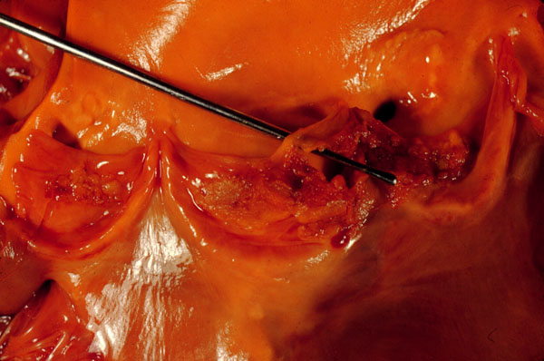
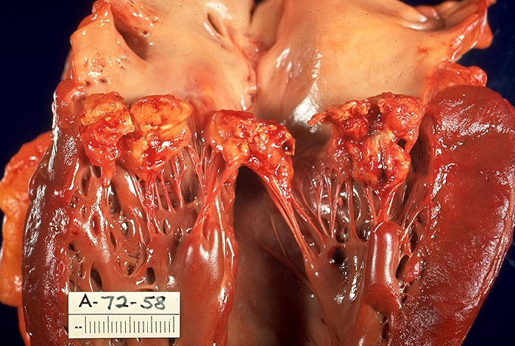
Local Spread of Infection
Acute S. aureus IE with perforation of the
aortic valve and aortic valve vegetations.
Acute S. aureus IE with mitral valve ring
abscess extending into myocardium.

Slide 34
Embolic Complications
Stroke
Myocardial Infarction
Fragments of valvular vegetation or vegetation-induced stenosis of coronary ostia
Ischemic limbs
Hypoxia from pulmonary emboli
Abdominal pain (splenic or renal infarction)

Slide 35
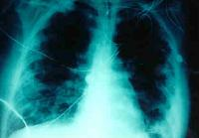
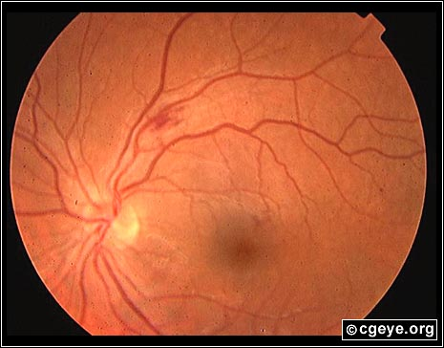
Septic Emboli

Slide 36
Metastatic Spread of Infection
Metastatic abscess
Kidneys, spleen, brain, soft tissues
Meningitis and/or encephalitis
Vertebral osteomyelitis
Septic arthritis

Slide 37
TREATMENT
Disk diffusion test ( not sufficient )
MIC , MBC
Criteria of antibiotic
Bactericidal
Parenteral
High dose
Prolonged

Slide 38
Viridans streptococci –Benzyl penicillin I.V
4 MU I.V. every 4 hrs for 4 weeks
or
penicillin + gentamicin
Streptococcus faecalis ampicillin + gentamicin I.V
Recurrence after cure is common in:
drug addicts
immunodeficient patients

Slide 41
