Slide 1
Atherosclerosis CVS lecture 2 Atherosclerosis
Shaesta Naseem

Slide 2
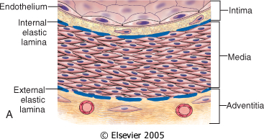
Vessel wall structure
Notes:
Small arterioles within the adventitia (termed vasa vasorum, literally "vessels of the vessels") supply the outer 50% to 65% of the media.

Slide 3
Arteriosclerosis
It literally means "hardening of the arteries with loss of elasticity”.
Three patterns:
Atherosclerosis :
The dominant pattern of arteriosclerosis
Mönckeberg medial sclerosis :calcific deposits in muscular arteries
Arteriolosclerosis: small arteries and arterioles (hypertension and DM)
.

Slide 4
Atherosclerosis
Primarily affects the elastic (aorta, carotid, iliac) and large to medium sized muscular arteries (coronary, popliteal)
Chronic inflammatory response in walls of arteries.
Slowly progressive.
Greatest morbidity and mortality of all human diseases via narrowing /occlusion and weakness of wall.

Slide 5
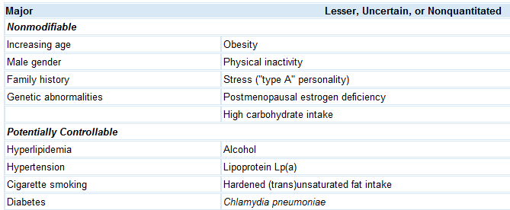
Atherosclerosis Risk factors

Slide 6
LDL Vs. HDL
LDL cholesterol : deliver cholesterol to peripheral tissues.
HDL, "good cholesterol“: mobilizes cholesterol from developing and existing atheromas and transports it to the liver for excretion in the bile
Notes:
Consequently, higher levels of HDL correlate with reduced risk.

Slide 7
Pathogenesis of Atherosclerosis
•Cause?
- Current hypothesis: Response to Injury
- Initiated by endothelial dysfunction
•Disease of the intima
–Intimal thickening
–Intra-and extra-cellular lipid accumulation
–Chronic Inflammation
•Basic Lesion: is termed atheroma, fibro-fatty plaque, or atheromatous plaque

Slide 8
Atherosclerosis Pathogenesis
Response-to-injury hypothesis
Endothelial injury
Not completely understood
Nevertheless, the two most important causes of endothelial dysfunction are:
Hemodynamic disturbances
Hypercholesterolemia
Inflammation is also an important contributor.
Notes:
Chronic hyperlipidemia, particularly hypercholesterolemia, can directly impair EC function by increasing local production of reactive oxygen species

Slide 9
Response to injury hypothesis
Injury to the endothelium
(dysfunctional endothelium)
Chronic inflammatory response
Migration of SMC from media to intima
Proliferation of Smooth Ms Cells in intima
Excess production of Extra cellular Matrix
Enhanced lipid accumulation

Slide 10
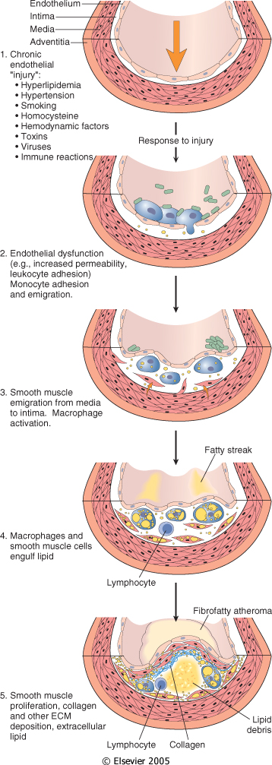
Evolution of arterial wall changes in the response to injury hypothesis.
→Normal.
Endothelial injury with adhesion of monocytes and platelets (the latter to sites where endothelium has been lost).
Migration of monocytes and smooth muscle cells into the intima.
Notes:
Thus, non-denuding endothelial dysfunction underlies human atherosclerosis; in the setting of intact but dysfunctional ECs there is increased endothelial permeability, enhanced leukocyte adhesion, and altered gene expression.

Slide 11
Smooth muscle cell proliferation in the intima with ECM production.
Well-developed plaque

Slide 12
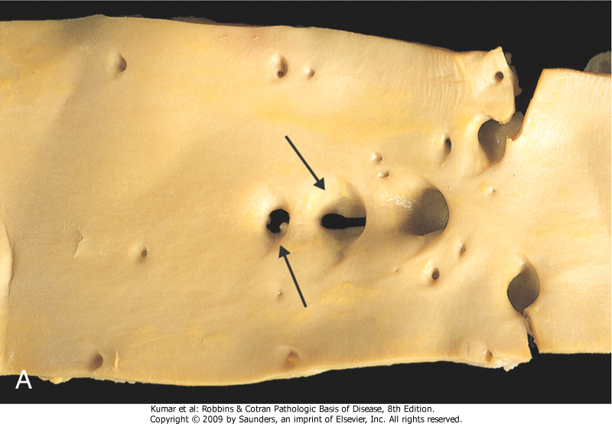
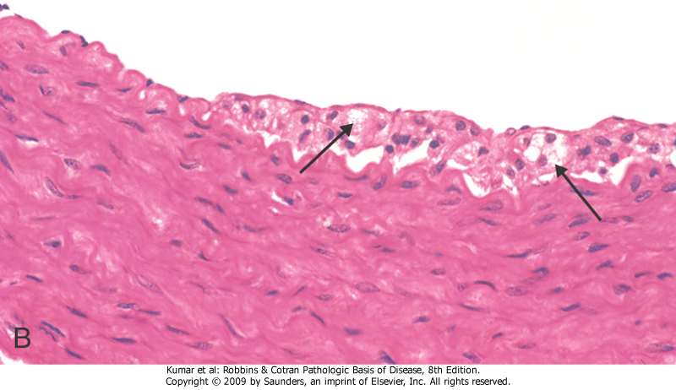
Fatty streak, a collection of foamy macrophages in the intima.
A, Aorta with fatty streaks (arrows), associated largely with the ostia of branch vessels. B, Intimal, macrophage-derived foam cells
Notes:
Fatty streaks can appear in the aortas of infants younger than 1 year and are present in virtually all children older than 10 years

Slide 13
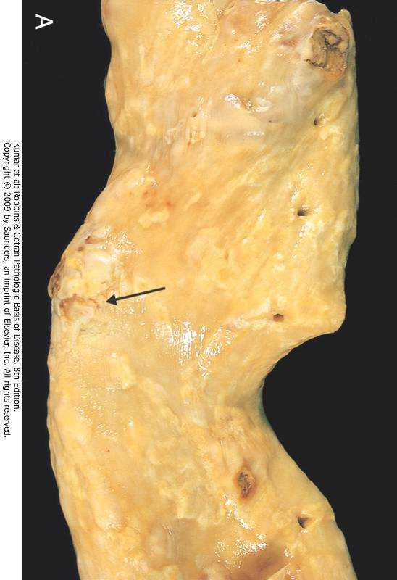
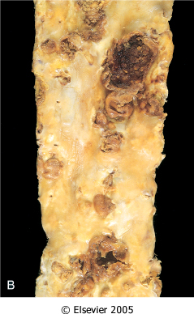
Plaques
vary from 0.3 to 1.5 cm in diameter, but can coalesce to form larger masses
Notes:
Gross views of atherosclerosis in the aorta. A, Mild atherosclerosis composed of fibrous plaques, one of which is denoted by the arrow. B, Severe disease with diffuse and complicated lesions (with plaque rupture and superimposed thrombosis), some of which have coalesced.

Slide 14
Major components of a well developed intimal atheromatous plaque overlying an intact media
Notes:
The main components of a fibrofatty plaques:
Lipids
Extracellular matrix
Cells, Proliferating smooth muscle cells

Slide 15
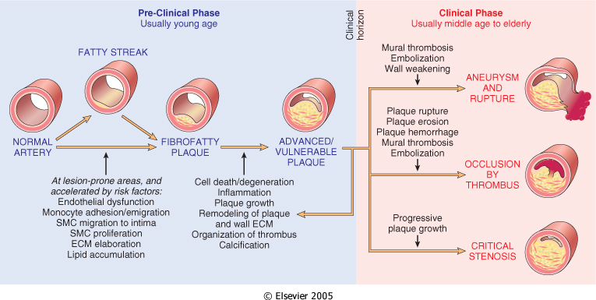
Atherosclerosis
Consequences

Slide 16
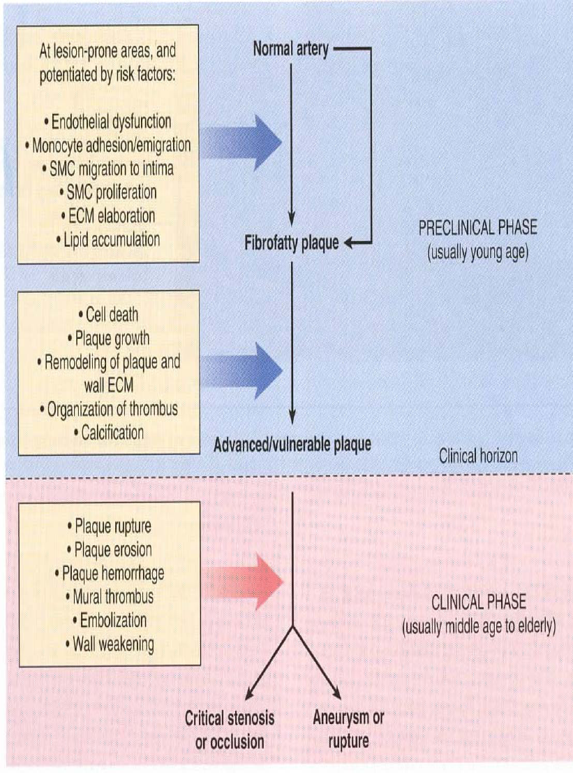
ATHEROSCLEROSIS:
Pathology, Pathogenesis, Complications, Natural History

Slide 17
Atherosclerosis Clinical Complications
Myocardial infarction (heart attack)
Cerebral infarction (stroke)
Aortic aneurysms
Mesentric occlusion
Peripheral vascular disease (gangrene of the legs)

Slide 18
Morphological changes that are seen on macro and microscopic levels in atherosclerosis
Neovascularization (formation of new blood vessels)
Calcification
Hemorrhage
Fissure
Ulcer
Thrombosis
Medial thinning
Cholesterol microemboli
Aneurysmal dilatation

Slide 19
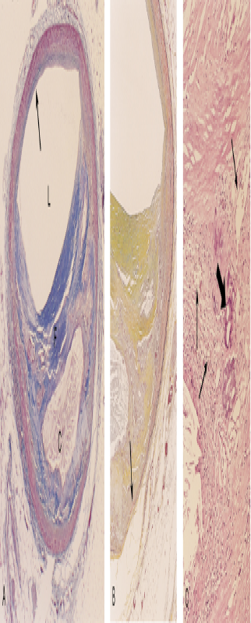
Neovascularisation
Calcification
Inflam. cells
Elastin membrane
destroyed
Fibrous cap
Cholesterol clefts
Notes:
fibrous cap is composed of SMCs and relatively dense collagen. Beneath and to the side of the cap (the "shoulder") is a more cellular area containing macrophages, T cells, and SMCs. Deep to the fibrous cap is a necrotic core.
With calcification we have neovascularisation (proliferative blood vessels and inflammatory cells)

Slide 20
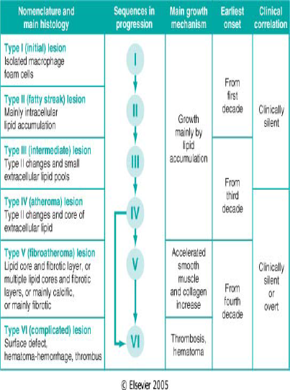
AHA Classification of atherosclerosis with growth mechanism and clinical correlation

Slide 21
Summary of Atherosclerotic Process
Multifactorial process (risk factors)
Initiated by endothelial dysfunction
Up regulation of endothelial and leukocyte adhesion molecules
Macrophage diapedesis
LDL transcytosis
LDL oxidation
Foam cells
Recruitment and proliferation of smooth muscle cells (synthesis of connective tissue proteins)
Formation and organization of arterial thrombi

Slide 22
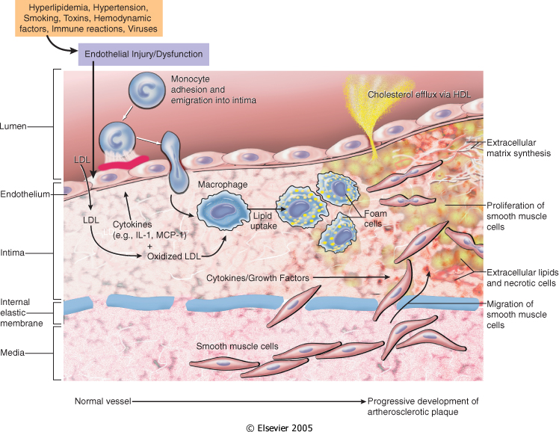
Hypothetical sequence of cellular interactions in atherosclerosis.
Notes:
Hyperlipidemia and other risk factors are thought to cause endothelial injury, resulting in adhesion of platelets and monocytes and release of growth factors, including platelet-derived growth factor (PDGF), which lead to smooth muscle cell migration and proliferation.
Foam cells of atheromatous plaques are derived from both macrophages and smooth muscle.
Extracellular lipid is derived from insudation from the vessel lumen, and also from degenerating foam cells. Cholesterol accumulation in the plaque reflects an imbalance between influx and efflux, and high-density lipoprotein (HDL) probably helps clear cholesterol from these accumulations.
Smooth muscle cells migrate to the intima, proliferate, and produce ECM, including collagen and proteoglycans. IL-1, interleukin-1; MCP-1, monocyte chemoattractant protein 1

