Slide 1
Ischemic Heart Disease CVS lecture 3
Shaesta Naseem

Slide 2
Ischemic Heart Disease
A group of related syndromes resulting from myocardial ischemia
Notes:
Ischemia is an imbalance between cardiac blood supply (perfusion) and myocardial oxygen demand
ischemia can result from increased demand (e.g., increased heart rate or hypertension)
diminished oxygen-carrying capacity (e.g., anemia, carbon monoxide poisoning)

Slide 3
Ischemic Heart Disease
The vast majority of ischemic heart disease is due to coronary artery atherosclerosis
Less frequent contributions of:
vasospasm
vasculitis
Is it exactly the same as coronary artery disease (CAD)?
Frequently yes
Notes:
in the vast majority of cases, IHD is due to a reduction in coronary blood flow caused by obstructive atherosclerotic disease
Thus, IHD is also frequently called coronary artery disease (CAD).

Slide 4
IHD usually presents as one or more of the following clinical syndromes:
Myocardial infarction, the most important form of IHD, in which ischemia causes the death of heart muscle.
Angina pectoris, in which the ischemia is of insufficient severity to cause infarction, but may be a harbinger of MI.
Chronic IHD with heart failure.
Sudden cardiac death.

Slide 5
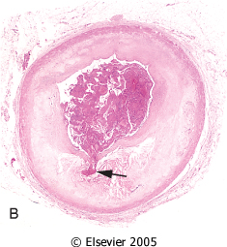
Ischemic Heart Disease
75% stenosis = →symptomatic ischemia induced by exercise
90% stenosis = symptomatic even at rest
Pathogenesis
↓ coronary perfusion relative to myocardial demand
Role of Acute Plaque Change
(Erosion/ulceration, Hemorrhage into the atheroma, Rupture/fissuring, Thrombosis)
Role of Inflammation
T cell, Macrophages, CRP
Role of Coronary Thrombus
The most dreaded complication
Role of Vasoconstriction (VC)
Platelet & Endothelial factors,
VC substances

Slide 6
Ischemic Heart Disease
Angina Pectoris
Chest discomfort = prolonged, recurrent, different qualities. Can radiate down the left arm or to the left jaw (referred pain)
Cause = transient myocardial ischemia( seconds to minutes), Due to inadequate perfusion
Patterns
Stable = 75% vessel block, transient ( <15 minutes), aggravated by exertion, relived by rest & Nitroglycerin (VD)
Prinzmetal = coronary spasm, episodic, Typical EKG change – ST elevation, Relived by VD but not rest
Unstable = 90% vessel block or Acute plaque change ( superimposed thrombus), prolonged ( >15 min.), not relived by rest, VD, Pre-infarction Angina
Notes:
Duration and severity is not sufficient for infarction.
Nitroglycerin, by reducing the venous return, large doses-> increase blood to heart
Unstable angina: Results from a small fissure or rupture of atherosclerotic plaque triggering:
Platelet aggregation
Vasoconstriction
Formation of a mural thrombus that may not be occlusive
Usually proceed MI

Slide 7
Ischemic Heart Disease Myocardial infarction
MI= Also called Heart attack
Incidence = disease of old
elderly (45% in 65 yrs. old)
young ( 10% in 40yrs. Old),
Sex = Male > Female
Ethnic = same in African & American
Risk factors
Major modifiable- SMOKING,DM, HTN Hypercholesterolemia
HRT for Postmenopausal females – will not protect the heart

Slide 8
Ischemic Heart Disease Myocardial infarction
The severity or duration of ischemia is enough to cause cardiac muscle death
Typically results from acute thromboses that follow plaque disruption

Slide 9
MI - Types
Transmural
Full thickness
Superimposed thrombus in atherosclerosis
Sub-endocardial
Inner 1/3 to half of ventricular wall
Decreased circulating blood volume( shock, Hypotension, Lysed thrombus)
Notes:
Transmural , severe coronary atherosclerosis with acute plaque rupture and superimposed thrombosis
Two mechanisms:
Fixed atherosclerosis but with increased demand, vasospasm or hypotension
OR
Evolving transmural with relieve of the obstruction (often multifocal)

Slide 10
Ischemic Heart Disease
MI
Pathogenesis
Coronary vessel occlusion
Atherosclerosis with thrombus = MC cause ( 90% cases)
Others = vasospasm (10%)
Most important mechanism = dynamic changes in the plaque (rather than plaque size)
Plaque disruption→ PLTS aggregation→ thrombus and VC (happens in minutes)
Irreversible changes = after 30 minutes of ischemia
Mechanism of cell death = necrosis ( Coagulative)

Slide 11
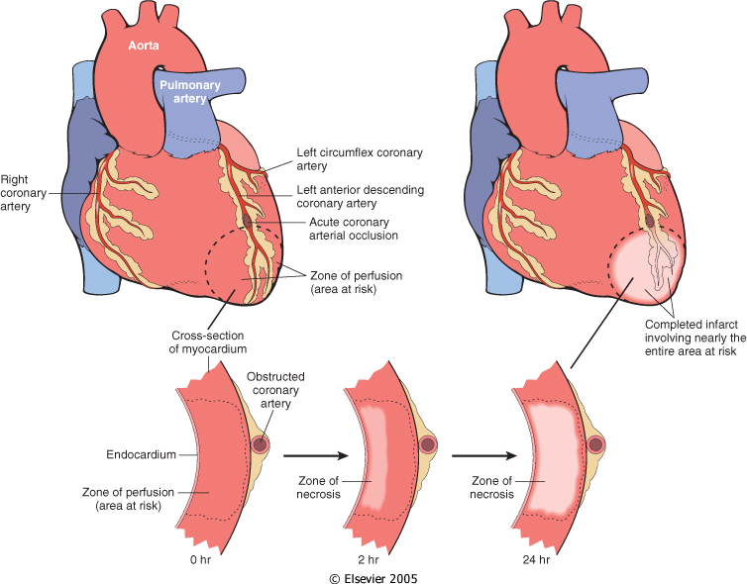
Progression of myocardial necrosis after coronary artery occlusion. Necrosis begins in a small zone of the myocardium beneath the endocardial surface in the center of the ischemic zone. The area that depends on the occluded vessel for perfusion is the "at risk" myocardium (shaded).
Notes:
if a coronary artery develops atherosclerotic occlusion at a sufficiently slow rate, it may be able to stimulate collateral blood flow from other major epicardial vessels; such collateral perfusion can then protect against MI even in the setting of a complete vascular occlusion. Unfortunately, acute coronary occlusions cannot spontaneously recruit collateral flow and will result in infarction
Influences extrinsic to the plaque are also important. Adrenergic stimulation can elevate physical stresses on the plaque through systemic hypertension or local vasospasm. Indeed, the adrenergic stimulation associated with awakening and rising may underlie the known peak incidence (between 6 AM and 12 noon) of acute MIs. Intense emotional stress can also contribute to plaque disruption.

Slide 12
Myocardial Infarction
The left anterior descending artery supplies blood to the bulk of the anterior left ventricular wall, while the left circumflex artery provides blood to the left atrium and the posterior and lateral walls of the left ventricle.
The right coronary artery provides blood mainly to the right atria and right ventricles.
Nearly 50% of all myocardial infarctions involve the left anterior descending artery that supplies blood to the main pumping mass of the left ventricle.
The next most common site for myocardial infarction is the right coronary artery, followed by the left circumflex.

Slide 13
Ischemic Heart Disease
MI -Morphology
light microscopy
First 12 hrs. after MI – no change
Up to 3 days = Coagulative necrosis, neutrophils
1-2 weeks = Granulation tissue
≥ 3 weeks = fine scar
≥ 2 months = dense scar
EM – membrane disruption and Mitochondrial densities
Special stain = TTC ( Triphenyl Tetrazolium chloride),
Detects and stains Mahogany brown with Lactate dehydrogenase
Unstained area = infarction
Mahogany brown = viable
White, glistening= scar
Most common and nonspecific change in ischemia = sub-endocardial myocyte vacuolization

Slide 14
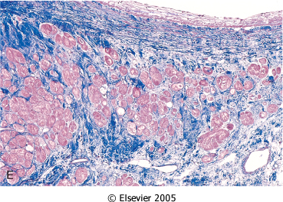
MI- Microscopic features
One-day-old infarct
Up to 3 days duration
wavy fibers
Neutrophilic infiltrate
coagulative necrosis
>3 weeks
1 -2 weeks
Granulation tissue
Scar

Slide 15
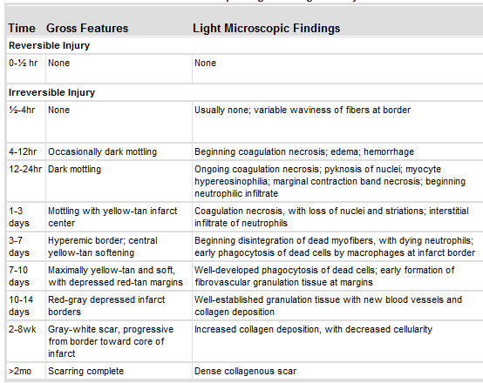

Slide 16
Ischemia to myocardium
It leads to loss of function within minutes and causes necrosis after 20 to 40 minutes
For approximately 30 minutes after the onset of even the most severe ischemia, myocardial injury is potentially reversible.
Thereafter, progressive loss of viability occurs that is complete by 6 to 12 hours.
The benefits of reperfusion are greatest when it is achieved early, and are progressively lost when reperfusion is delayed
Notes:
Within seconds of vascular obstruction, cardiac myocyte aerobic glycolysis ceases, leading to inadequate production of adenosine triphosphate (ATP) and accumulation of potentially noxious breakdown products (e.g., lactic acid).
Ischemia to myocardium rapidly (minutes) leads to loss of function and causes necrosis after 20 to 40 minutes
For approximately 30 minutes after the onset of even the most severe ischemia, myocardial injury is potentially reversible. Thereafter, progressive loss of viability occurs that is complete by 6 to 12 hours. The benefits of reperfusion are greatest when it is achieved early, and are progressively lost when reperfusion is delayed

Slide 17
Ischemic Heart Disease
MI –Reperfusion
Mechanisms
Intrinsic
Extrinsic =
Thrombolytic drugs = < 1hr. After onset of MI
PTCA/CABG = > 1hr. After onset of MI
Target = clot lysis and restoration of blood flow
Post- reperfusion changes =
Contraction bands = hyper contracting myocytes,
Stunned myocardium = transient, protective dysfunction
Reperfusion damage = mostly apoptosis by free radicals

Slide 18
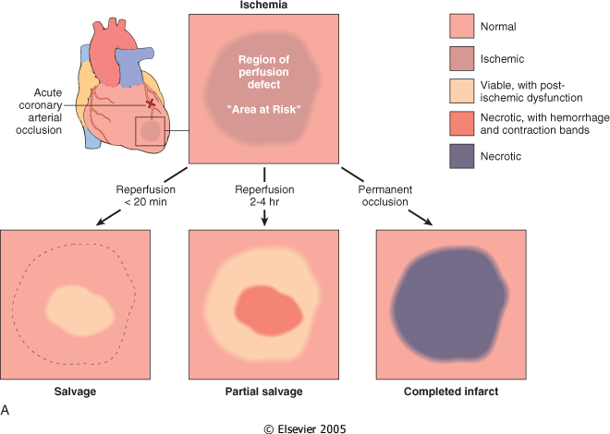
Consequences of myocardial ischemia followed by reperfusion

Slide 19
Ischemic Heart Disease
MI = Clinical
Silent MI = DM, Elderly, Cardiac transplantation recipients,
Typical features = Rapid, weak pulse and sweating profusely (diaphoretic), Dyspnea, chest pain
Lab=
Diagnostic
Best markers = Troponins ( T & I), both sensitive and cardio – specific
Next best – CK-MB
Other markers: Lactate dehydrogenase
Myoglobin
Predictive
CRP- >3mg/l – highest risk
Notes:
Troponins and CK-MB have high specificity and sensitivity for myocardial damage

Slide 20
Ischemic Heart Disease ECG
Changes such as:
Q waves (indicating transmural infarcts)
ST-segment abnormalities
T-wave inversion
Arrhythmias

Slide 21
Ischemic Heart Disease Laboratory evaluation
TnI and TnT are not normally detectable in the circulation
After acute MI both troponins:
Become detectable after 2 to 4 hours
Peak at 48 hours
Their levels remain elevated for 7 to 10 days

Slide 22
Ischemic Heart Disease Laboratory evaluation
CK-MB is the second best marker
CK-MB activity:
Begins to rise within 2 to 4 hours of MI
Peaks at 24 to 48 hours
Returns to normal within approximately 72 hours
Although cardiac troponin and CK-MB are equally sensitive at early stages of an MI, persistence of elevated troponin levels for approximately 10 days allows the diagnosis of an acute MI long after CK-MB levels have returned to normal
Notes:
Total CK activity is not a reliable marker of cardiac injury (i.e., it could come from skeletal muscle injury).
Although cardiac troponin and CK-MB are equally sensitive at early stages of an MI, persistence of elevated troponin levels for approximately 10 days allows the diagnosis of an acute MI long after CK-MB levels have returned to normal.

Slide 23
Ischemic Heart Disease
MI –Complications
In 75% of Patients with MI
Poor prognosis in = elderly, females, DM, old case of MI, Anterior wall infarct – worst, posterior –worse, Inferior wall – best
1. Arrhythmia = Ventr. Fibrillation –arrhythmia lead to sudden death in MI patients, before they reach hospital.
2. Pump failure – LVF, cariogenic shock, if >LV wall infarcts, lead to death ( 70% of hospitalized MI patients)
3.Ventricular rupture = Free or lateral LV wall – MC site, later cause false aneurysm,
4.True aneurysm = rupture is very rare
5.Pericarditis = Dressler’s syndrome ( Late MI complication)
6.Recurrence
Notes:
Dressler’s syndrome :It consists of a triad of features, fever, pleuritic pain and pericardial effusion.

Slide 24
Ischemic Heart Disease MI death and complications rates
25% die, presumably due to arrythmia
10% of the rest will die within a month
80-90% will develop complications
Overall 30% die in the 1st year and then 10% per year
Notes:
Number are not very consatant

Slide 25
Ischemic Heart Disease
Chronic IHD = also called ischemic cardiomyopathy
Progressive heart failure due to ischemic injury, either from:
prior infarction(s) (most common)
chronic low-grade ischemia
Cause =compromised ventricular function
Morphology =vacuoles, Myocyte Hypertrophy
Diagnosis= by exclusion

Slide 26
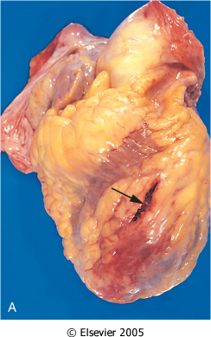
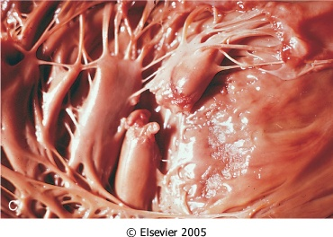
Cardiac rupture syndromes : Anterior myocardial rupture in an acute infarct (arrow). B, Rupture of the ventricular septum (arrow). C, Complete rupture of a necrotic papillary muscle.
Notes:
Complications of myocardial infarction. Cardiac rupture syndromes (A-C). A, Anterior myocardial rupture in an acute infarct (arrow). B, Rupture of the ventricular septum (arrow). C, Complete rupture of a necrotic papillary muscle. D, Fibrinous pericarditis, showing a dark, roughened epicardial surface overlying an acute infarct. E, Early expansion of anteroapical infarct with wall thinning (arrow) and mural thrombus. F, Large apical left ventricular aneurysm. The left ventricle is on the right in this apical four-chamber view of the heart.

Slide 27
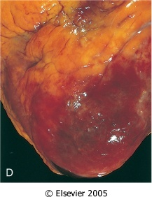
D: Fibrinous pericarditis, showing a dark, roughened epicardial surface overlying an acute infarct.
E, Early expansion of antero-apical infarct with wall thinning (arrow) and mural thrombus.
Notes:
Dressler’s

Slide 28
Ischemic Heart Disease Sudden cardiac death
Unexpected death from cardiac causes either without symptoms or within 1 to 24 hours of symptom onset (different authors use different time points)
Results from a fatal arrhythmia, most commonly in patients with severe coronary artery disease
Notes:
is defined as unexpected death from cardiac causes in individuals without symptomatic heart disease or early after symptom onset (usually within 1 hour).

Slide 29
Ischemic Heart Disease Acute coronary syndrome
is applied to three catastrophic manifestations of IHD:
Unstable angina
Acute MI
Sudden cardiac death
They share common patho-physiologic basis in coronary atherosclerotic plaque disruption and associated intra-luminal platelet-fibrin thrombus formation

Slide 30
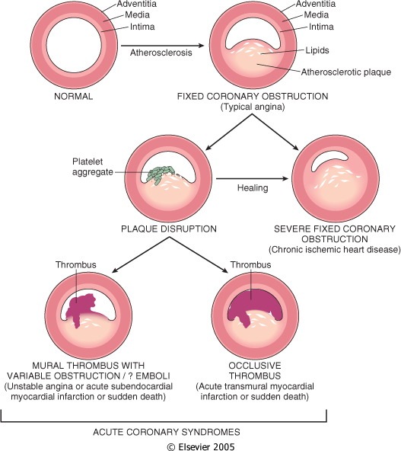
Acute Coronary syndromes
Frequently initiated by an unpredictable and abrupt conversion of stable atherosclerotic plaque to unstable plaque followed by thrombosis.
Notes:
Plaque disruption= fissure, ulceration or rupture
Fissures frequently occur at the junction of the fibrous cap and the adjacent normal plaque-free arterial segment, a location at which the mechanical stresses are highest and the fibrous cap is thinnest. Fibrous caps are also continuously remodeling; the balance of collagen synthesis and degradation determines its mechanical strength and thus plaque stability
Vasospasm and/or platelet aggregation can contribute but are infrequently the sole cause of an occlusion

