Slide 1
Hypertension lecture 4
Shaesta Naseem

Slide 2
Hypertension Definition
Blood pressure is a function of cardiac output and peripheral vascular resistance.
Blood pressure BP = CO x TPR
Hypertension (HTN) is usually considered when there is :
A sustained diastolic pressure greater than 89 mm Hg
OR
A sustained systolic pressure in excess of 139 mm Hg

Slide 3
Classification of BP
Category
Systolic
Diastolic
Normal
< 120
And
<80
Prehypertension
120-139
Or
80-90
Hpyertension, Stage 1
140-159
Or
90-99
Hypertension,
Stage 2
>160
Or
> 100

Slide 4
Hypertension :Risk factors *
Hereditary
Race. African-Americans
Gender. Men & postmenopausal women
Age
Obesity
Diet, particularly sodium intake
Other factors associated with HTN include:
Heavy alcohol consumption
Diabetes
Use of oral contraceptives
Sedentary or inactive lifestyle

Slide 5
Hypertension Types and causes
Essential (Primary) Hypertension (90-95%)
Secondary Hypertension

Slide 6
Essential Hypertension
85 - 90% of hypertensives have essential hypertension
Causes are multifactorial and results from the combined effects of
multiple genetic polymorphisms &
interacting environmental factors
Common in blacks or with positive family history
Worsened by obesity, increased sodium intake, stress, oral contraceptive use, or tobacco use

Slide 7
Secondary Hypertension
10 - 15% of hypertensives
Increased BP secondary to another disease process

Slide 8
Causes of Secondary Hypertension
Renal:
Acute glomerulonephritis
Chronic renal disease
Polycystic disease
Renal artery stenosis
Renal vasculitis
Renin-producing tumors
Endocrine:
Adrenocortical hyper function (Cushing syndrome, primary aldosteronism, congenital adrenal hyperplasia)
Exogenous hormones (glucocorticoids, estrogens )
Pheochromocytoma
Acromegaly
Hypothyroidism (myxedema)
Hyperthyroidism (thyrotoxicosis)
Pregnancy-induced

Slide 9
Causes of Secondary Hypertension contd.
Cardiovascular:
Coarctation of aorta
Polyarteritis nodosa (or other vasculitis)
Increased intravascular volume
Increased cardiac output
Rigidity of the aorta
Neurologic
Psychogenic
Increased intracranial pressure
Sleep apnoea
Acute stress, including surgery

Slide 10
………………………………………………..

Slide 12
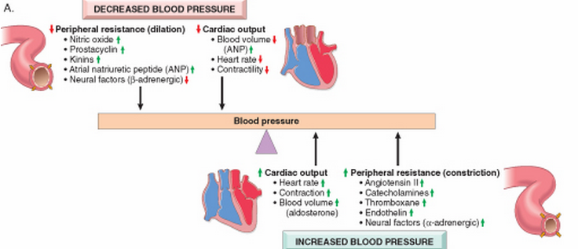
Blood pressure regulation
Blood pressure is a function of cardiac output and peripheral vascular resistance → two hemodynamic variables that are influenced by multiple genetic, environmental, and demographic factors
Notes:
Peripheral resistance is regulated predominantly at the level of the arterioles
Resistance vessels also exhibit autoregulation, whereby increased blood flow induces vasoconstriction to protect tissues against hyperperfusion
Moreover, lower volumes or pressures result in a reduced glomerular filtration rate in the kidney with increased resorption of sodium by proximal tubules
atrial natriuretic peptide, secreted by heart atria in response to volume expansion (e.g., in heart failure) inhibits sodium reabsorption in distal tubules and causes global vasodilation.

Slide 14
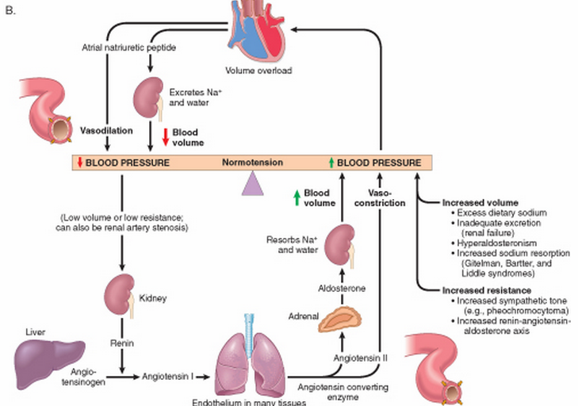
Renin-angiotensin-aldosterone and atrial natriuretic peptide role in maintaining blood pressure homeostasis.

Slide 15
Hypertension Remember!
Peripheral resistance is regulated predominantly at the level of the arterioles
Reduced renal sodium excretion in the presence of normal arterial pressure is probably a key initiating event for the pathogenesis of most forms of hypertension

Slide 16
Hypertension Vascular pathology
Accelerate atherogenesis
Arteriosclerosis (particularly in the kidney), lead to thick wall and narrow lumen
It can be either:
Hyaline:
Hyper plastic (in malignant HTN)
Notes:
.

Slide 17
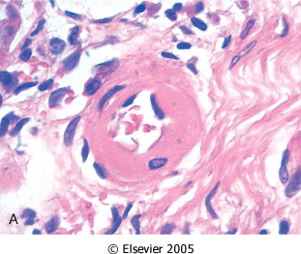
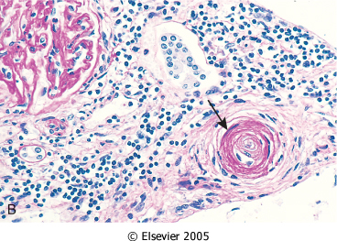
Hyaline arteriolosclerosis. : The arteriolar wall is thickened with increased protein deposition (hyalinized), and the lumen is markedly narrowed
Hyperplastic arteriolosclerosis (onion-skinning; arrow) causing lumenal obliteration (arrow).

Slide 18
Hyperplastic Arteriolosclerosis:
Narrow Lumen
Onion Skin Thickening
Of arterioles.

Slide 19
Hypertension Pathology
Increased BP → inflammation, sclerosis of arteriolar walls → narrowing of vessels → decreased blood flow to major organs
Left ventricular overwork → hypertrophy, CHF
Nephrosclerosis → renal insufficiency, failure

Slide 21
Signs/Symptoms
Primary hypertension is asymptomatic until complications develop
Signs/Symptoms are non-specific
Result from target organ involvement
Dizziness, flushed face, headache, fatigue, epistaxis, nervousness

Slide 22
Consequences of Hypertension:
Blood Vessels
Atherosclerosis and its complications aneurism, Dissection, Rupture, necrosis. Arteriolosclerosis,
Heart
Hypertensive cardiomyopathy, IHD, MI.
Kidney
Benign/Malignant nephrosclerosis. Infarction
Eyes:
Hypertensive retinopathy
Brain:
Haemorrhage, infarction,
splinter & Lacunar hemorrhages
Notes:
Third the death of HTN patients is due to CHF patients
Reduction of blood pressure dramatically reduces the incidence and death rates from IHD, heart failure, and stroke

Slide 23
Hypertensive Retinopathy:
Grade I – Thickening of arterioles.
Grade II – Focal Arteriolar spasms. Vein constriction.
Grade III – Hemorrhages (Flame shape), dot-blot and Cotton wool and hard waxy exudates.
Grade IV - Papilloedema

Slide 24
Cerebral Infarction (Stroke) :
Haemorrhagic
Necrosis

Slide 25
Benign Nephrosclerosis
Leathery Granularity
due to minute scarring

Slide 26
Malignant Hypertension:
B.P > 210/120 mm Hg
May complicate any type of HTN.
Microscopically: Necrotizing arteriolitis, Intravascular thrombosis.
It leads to :
Rapidly progressive end organ damage.
Renal failure
Hypertensive encephalopathy.
Left ventricular failure.
Retinal hemorrhages and exudates, with or without papilledema
Leads to death in 1 or 2 years if untreated.

Slide 27
Necrotizing arteriolitis:
Thrombosis
Fibrinoid Necrosis

Slide 28
Systemic hypertensive heart disease
Criteria :
left ventricular hypertrophy (usually concentric) in the absence of other cardiovascular pathology
History or pathologic evidence of hypertension
The free LV wall is > 2cm and the weight of the heart is > 500 grams
Long-term: dilatation and wall thinning
Treatment of HTN helps recovery
Notes:
Hypertensive heart disease (HHD) -> increased demands placed on the heart by hypertension->pressure overload and ventricular hypertrophy.
Although most commonly seen in the left heart as the result of systemic hypertension, pulmonary hypertension can cause right-sided HHD, or cor pulmonale

Slide 29
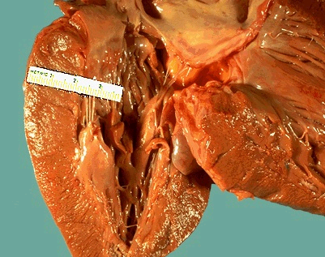
This left ventricle is very thickened (slightly over 2 cm in thickness), but the rest of the heart is not greatly enlarged.
This is typical for hypertensive heart disease.
The hypertension creates a greater pressure load on the heart to induce the hypertrophy.

Slide 30
The left ventricle is markedly thickened in this patient with severe hypertension that was untreated for many years. The myocardial fibers have undergone hypertrophy.
Left Ventricular Hypertrophy

Slide 31
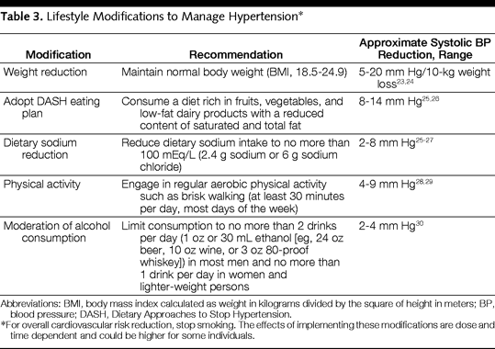
Table 3. Lifestyle Modifications to Manage Hypertension*

