Slide 1
Atherosclerosis
Hisham Al Khalidi

Slide 2
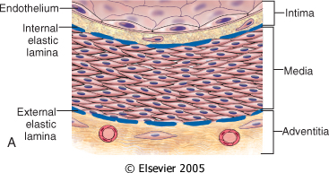
Vessel wall structure
Notes:
small arterioles within the adventitia (termed vasa vasorum, literally "vessels of the vessels") supply the outer 50% to 65% of the media.

Slide 3
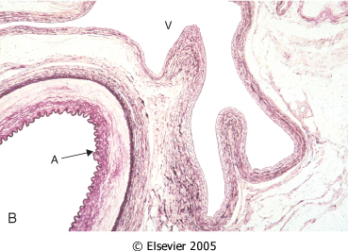

Slide 4
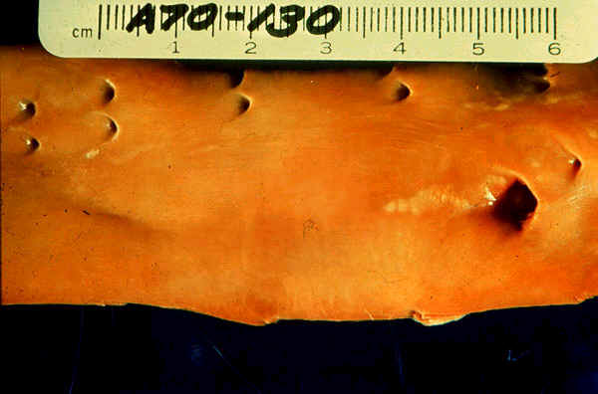
Notes:
Fatty streaks can appear in the aortas of infants younger than 1 year and are present in virtually all children older than 10 years

Slide 5
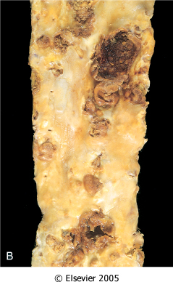
Notes:
Plaques vary from 0.3 to 1.5 cm in diameter but can coalesce to form larger masses

Slide 6
Atherosclerosis
A type of arteriosclerosis
Chronic inflammatory response in the walls of arteries
Slowly progressive
A build-up of fat (cholesterol) within the artery wall
Characterized by intimal lesions called: atheromas, atheromatous or fibrofatty plaques

Slide 7
Atherosclerosis Common sites
Abdominal aorta
Coronaries
Popliteal artery
The internal carotid arteries
The vessels of the circle of Willis

Slide 8
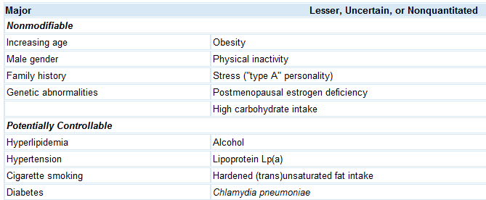
Atherosclerosis Risk factors
Notes:
Elevations of homocysteine (analogue to AA cysteine) also occur in the rare hereditary disease homocystinuria and in the methylene-tetrahydrofolate-reductase polymorphism genetic traits. The latter is quite common (about 10% of the world population) and it is linked to an increased incidence of thrombosis and cardiovascular disease, which occurs more often in people with above minimal levels of homocysteine

Slide 9
LDL Vs. HDL
LDL cholesterol : deliver cholesterol to peripheral tissues
HDL, "good cholesterol“: mobilizes cholesterol from developing and existing atheromas and transports it to the liver for excretion in the bile
Notes:
Consequently, higher levels of HDL correlate with reduced risk.
VLDL

Slide 11
Atherosclerosis Fibrous cap

Slide 12
Atherosclerosis Pathogenesis
The main components of a fibrofatty plaques:
Lipids
Extracellular matrix
Cells, Proliferating smooth muscle cells

Slide 13
Atherosclerosis Pathogenesis
response-to-injury hypothesis
Endothelial injury
Not completely understood
Nevertheless, the two most important causes of endothelial dysfunction are:
Hemodynamic disturbances
Hypercholesterolemia
Inflammation is also an important contributor.
Smooth muscle cell proliferation
Notes:
Chronic hyperlipidemia, particularly hypercholesterolemia, can directly impair EC function by increasing local production of reactive oxygen species

Slide 14
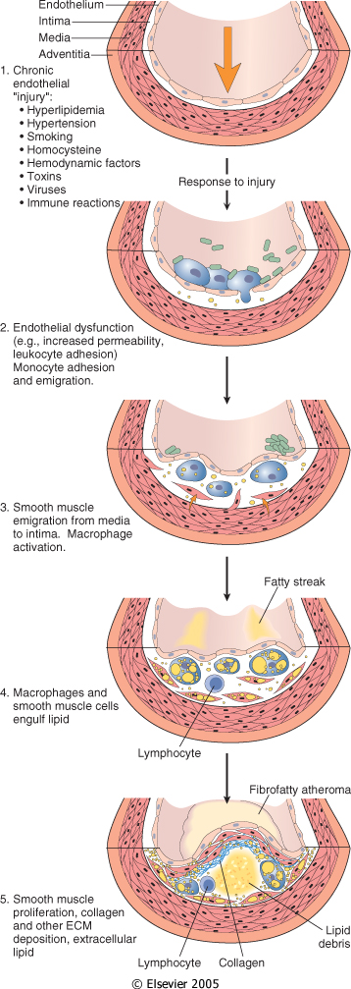
Notes:
Thus, non-denuding endothelial dysfunction underlies human atherosclerosis; in the setting of intact but dysfunctional ECs there is increased endothelial permeability, enhanced leukocyte adhesion, and altered gene expression.

Slide 16
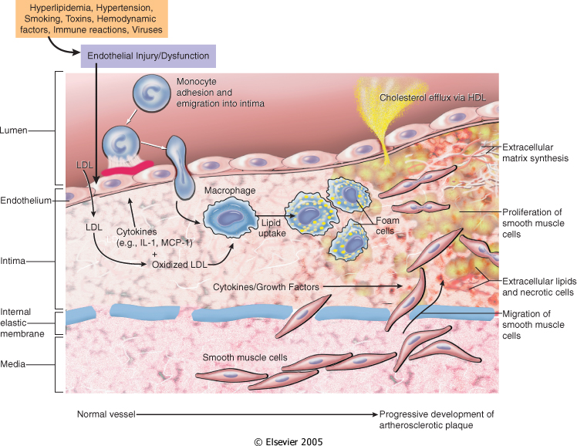
Notes:
Platelte adhere at he site of the injury
Together with vascular wall cells and macrophages they secret:
Growth factore
Cytokines
Lipids are stored in macrophages
And Smooth muscle cells
The inflammation keep going

Slide 18
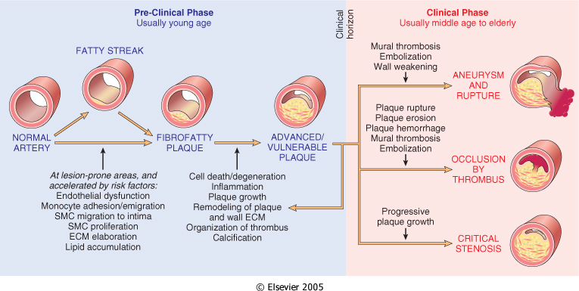
Atherosclerosis
Consequences

Slide 19
Atherosclerosis Clinical Complications
Myocardial infarction (heart attack)
Cerebral infarction (stroke)
Aortic aneurysms
Mesentric occlusion
Peripheral vascular disease (gangrene of the legs)

Slide 21
Morphological changes that are seen on macro and microscopic levels in atherosclerosis
Calcification
Hemorrhage
Fissure
Ulcer
Thrombosis
Neovascularization
Medial thinning
Cholesterol microemboli
Aneurysmal dilatation

Slide 22
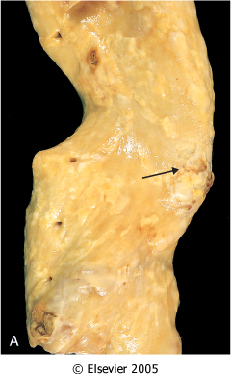
Notes:
Plaques vary from 0.3 to 1.5 cm in diameter but can coalesce to form larger masses

Slide 23
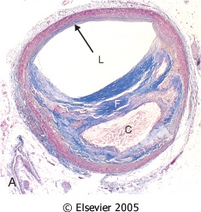
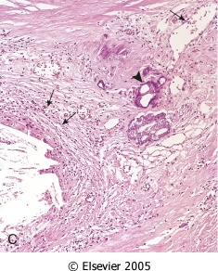
Notes:
fibrous cap is composed of SMCs and relatively dense collagen. Beneath and to the side of the cap (the "shoulder") is a more cellular area containing macrophages, T cells, and SMCs. Deep to the fibrous cap is a necrotic core

