Slide 1
Cardiovascular
pharmacology

Slide 2
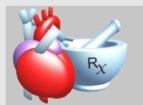

Slide 3
- Antiarrhythmic drugs
- Drugs in heart failure
- Antihypertensive drugs
- Antianginal drugs
- Antihyperlipidemic drugs

Slide 4
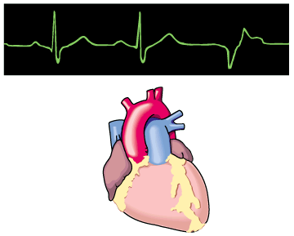
Antiarrhythmic Drugs

Slide 5
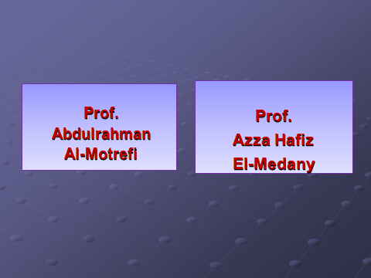

Slide 6
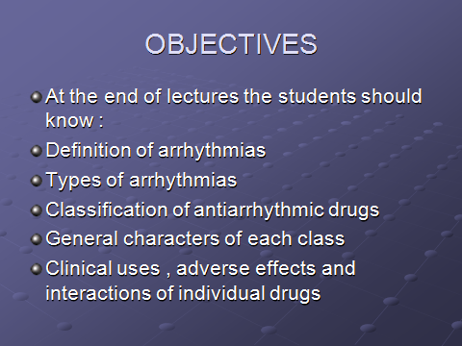

Slide 7
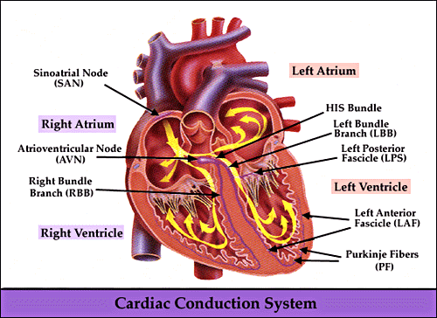

Slide 8
CARDIAC CONDUCTION SYSTEM
- S.A. node
- Inter-nodal pathways
- A.V. node
- Bundle of His and branches
- Purkinje fibres

Slide 9
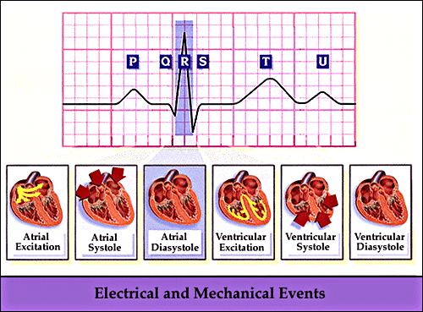

Slide 10
CARDIAC ACTION POTENTIAL
DEFENITIONS
Depolarization
Repolarization
Resting membrane potential
Inward current
Outward current

Slide 11
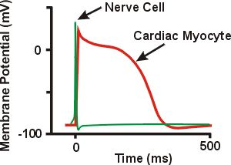
Action Potential

Slide 12
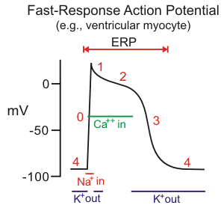

Slide 13
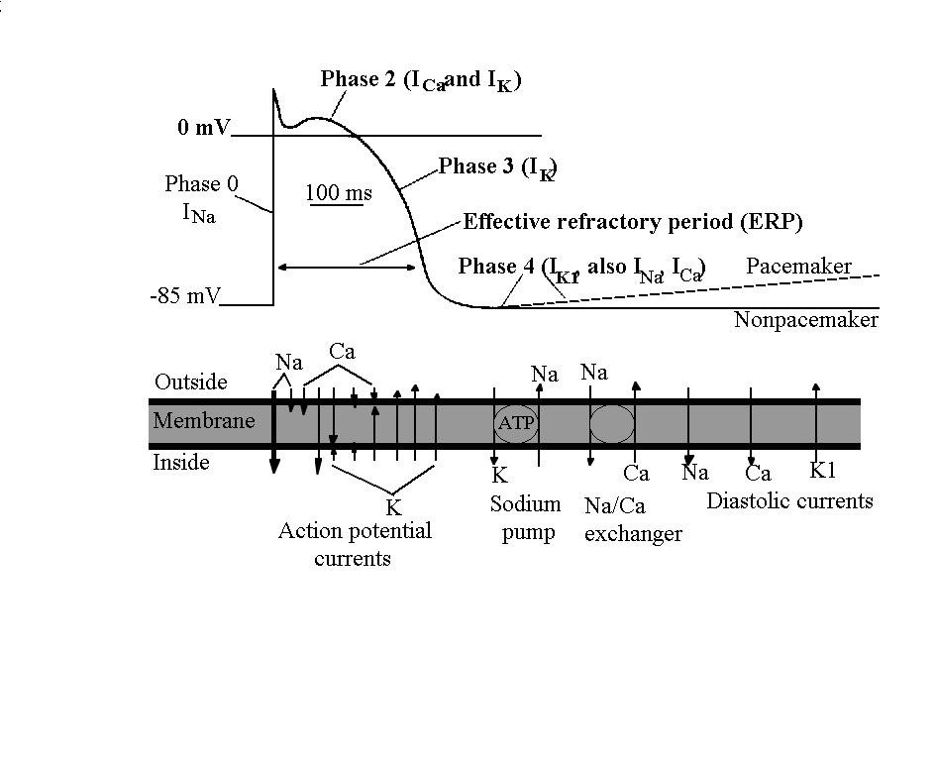
T-Ca²⁺ kanál

Slide 14
WHAT IS ARRHYTHMIA?
An Abnormality in the :
■ rate ............... high= tachycardia
low = bradycardia
■ regularity ..... extrasystoles
■ site of origin ... ectopic pacemakers
■ or disturbance in conduction

Slide 15
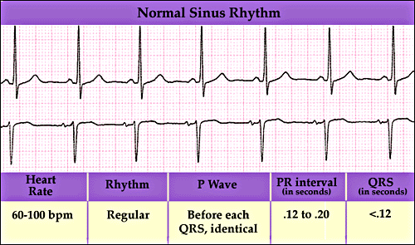

Slide 16
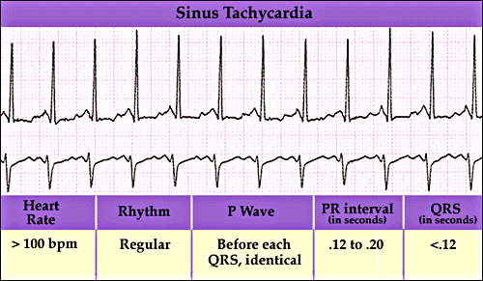

Slide 17
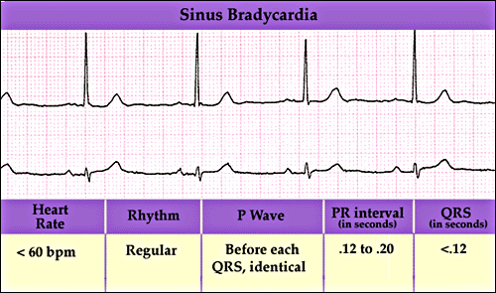

Slide 18
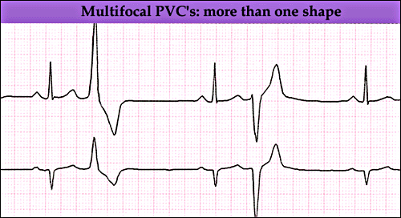

Slide 19
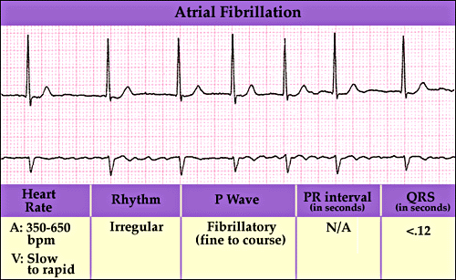

Slide 20
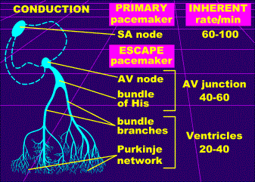

Slide 21
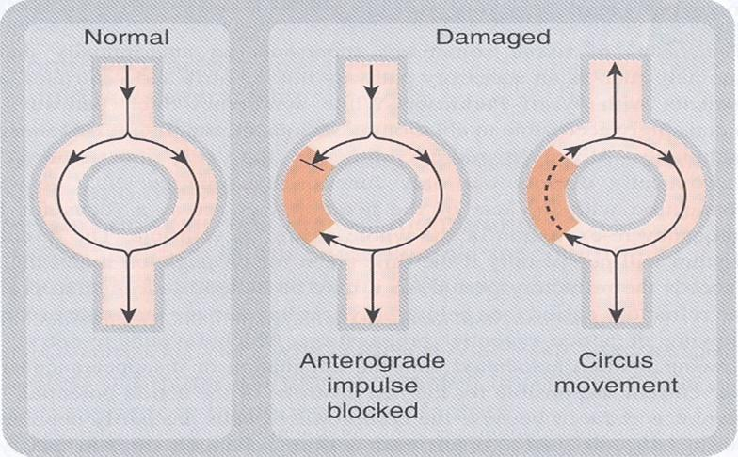
Circus Movement

Slide 22
Therapeutic use & Rationale of antiarrhythmic drugs
The ultimate goal of antiarrhythmic drugs therapy is to restore normal rhythm & conduction
When it is possible to revert to normal sinus rhythm , drugs are used to prevent more serious & lethal arrhythmias.

Slide 23
Continue
Antiarrhythmic drugs are used to :
⬆ or ⬇ conduction velocity
Alter the excitability of cardiac cells by changing the effective refractory period
Suppress abnormal automaticity

Slide 24
CLASSIFICATION
OF
ANTIARRHYTHMIC DRUGS

Slide 25
Vaughn Williams classificatin
CLASS 1
Na+ channel blockers ( membrane stabilizing drugs)
CLASS II:
β- adrenoceptor blockers
CLASS III:
drugs that prolong action potential duration
CLASS IV:
calcium channel blockers

Slide 26
CLASS 1
Blocking the rapid inflow of Na+ ions ,decreasing the rate of rise of depolarization ( slope of Phase O )
Suppress abnormal automaticity by decreasing the slope of phase 4 , which is generated by pacemaker currents

Slide 27
CLASS 1
At high concentration they have local anaesthetic effect
-Ve inotropic effect
( cardiac depression )

Slide 28
CLASS 1
SUBCLASSIFIED INTO :
{1A } : Block potassium channels
leading to prolongation of action
potential duration & refractory period of
both atrial & ventricular tissues

Slide 29
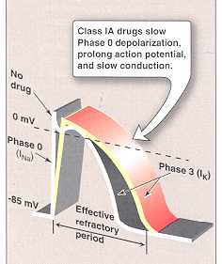

Slide 30
QUINIDINE
Isomer of quinine

Slide 31
QUINIDINE ( other actions )
Anticholinergic effect.
- Increase conduction through the A.V. node
May lead to high ventricular rate in
atrial flutter. Can be prevented by
administration of a drug that slow A.V.
conduction such as digoxin, β blocker calcium channel blockers.
Depress cardiac contractility

Slide 32
QUINIDINE
ECG changes:
- prolongation of P-R and Q-T interval
- widens QRS complex
Has α-adrenergic blocking effect which
cause vasodilatation and reflex sinus
tachycardia
This effect is seen more after i.v. dose

Slide 33
Clinical uses of quinidine
In almost all types of arrhythmias
Common uses: atrial flutter & fibrillation
Can be used for ventricular tachycardia
To maintain sinus rhythm after D.C cardioversion

Slide 34
Adverse effects of quinidine
GIT:
anorexia, nausea, vomiting, diarrhea
CARDIAC:
quinidine syncope:
episodes of fainting
(due to torsades de pointes developing at therapeutic plasma levels )
may terminate spontaneously or lead to fatal ventricular fibrillation

Slide 35
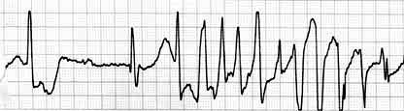
Torsades de pointes

Slide 36
Adverse effects ( continue)
Anticholinergic adverse effects
Cinchonism
( tinnitus , headache & dizziness)
Hypotension

Slide 37
Adverse effects ( continue)
- At toxic concentrations, can precipitate arrhythmia and produce asystole ( cardiac arrest ) if serum concentrations exceed 5 µg/ml or in high potassium levels ( > 5mmol/L).

Slide 38
QUINIDINE
Drug interactions:
- Increase concentration of digoxin:
- Displace digoxin from plasma proteins
- Decrease digoxin renal excretion
GIVEN ORALLY ....rarely given I.V.

Slide 39
PROCAINAMIDE
AS compared to quinidine
less toxic on the heart...
can be given I.V.
more effective in ventricular than in
atrial arrhythmias
Weak anticholinergic
No α-blocking actions

Slide 40
PROCAINAMIDE
Therapeutic uses:
- In atrial and ventricular arrhythmias
Second choice ( after lidocaine ) in ventricular arrhythmias after acute
myocardial infarction

Slide 41
ADVERSE EFFECTS
In long term therapy causes systemic lupus erythematosus (in 5-15% )
Hypotension
Torsades de pointes
Hallucination & psychosis

Slide 42
CLASS 1 B
Shorten action potential duration
e.g.
lidocaine
mexiletine

Slide 44
LIDOCAINE
USES :
Drug of choice for treatment of ventricular arrhythmias in emergency as in :
cardiac surgery , acute myocardial infarction
- NOT effective in atrial arrhythmias
- NOT effective orally (3% bioavailability)
- GIVEN I.V. bolus or slow infusion

Slide 45
ADVERSE EFFECTS :
hypotension
Neurological adverse effects
(paresthesia, tremor, dysarthria (slurred speech), hearing disturbances, confusion and convulsions )
T1/2 = 2hrs

Slide 46
MEXILETINE
- Given ORALLY
USES :
1- ventricular arrhythmia
2- digitalis-induced arrhythmias
3- chronic pain e.g. diabetic neuropathy and
nerve injury
ADVERSE EFFECTS :
1- nausea , vomiting
2- neurological
3- arrhythmias & hypotension
t_{1/2} = 10 hr

Slide 47
CLASS 1C
have no or little effect on action potential duration
e.g.
flecainide
propafenone

Slide 48
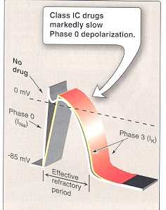

Slide 49
FLECAINIDE
USES :
Supraventricular arrhythmias in
patients with normal hearts
- Wolff-Parkinson-White syndrome
- Ventricular arrhythmias
{ very high risk of proarrhythmia }
- Reserved for resistant arrhythmias

Slide 50
Wolff-Parkinson-White syndrome
Pre-excitation of the ventricles due to an accessory pathway known as the Bundle of Kent.
This accessory pathway is an abnormal electrical communication from the atria to the ventricles

Slide 51
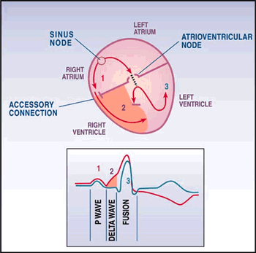

Slide 52
ADVERSE EFFECTS :
1- CNS : dizziness, tremor, blurred
vision, abnormal taste sensations, paresthesia
2- Arrhythmias
3- heart failure due to -ve inotropic effect

Slide 53
OTHER CLASS 1C DRUGS :
PROPAFENONE:
- Chemical structure similar to propranolol
- has weak beta-blocking action
- cause metallic taste and constipation

Slide 54
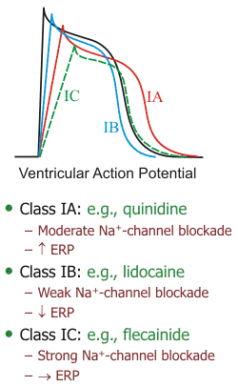

Slide 55
CLASS 11 DRUGS
β- ADRENOCEPTOR BLOCKERS
PHARMACOLOGICAL ACTIONS :
block β₁- receptors in the heart → reduce the sympathetic effect on the heart causing :
- decrease automaticity of S.A. node and
ectopic pacemakers
- prolong refractory period ( slow conduction ) of the A.V node this help prevent re-entry arrhythmias

Slide 56
CLINICAL USES :
Atrial arrhythmias ( with emotion, exercise
thyrotoxicosis )
WPW
digitalis-induced arrhythmias
To reduce the incidence of post myocardial infarction arrhythmias
Propranolol
Atenolol

Slide 57
Class III
Prolong the action potential duration & refractory period .
{Prolong phase 3 }

Slide 58
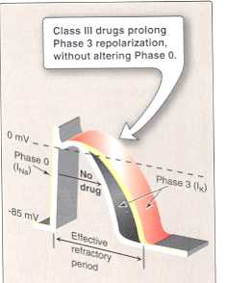

Slide 59
CLASS III
AMIODARONE
- Prolong action potential duration and effective refractory period
Has an additional action of classes
( 1, 2 and 4 )
Vasodilating effect
( α- and β-adrenoceptor &calcium channel blocking effects )

Slide 60
AMIODARONE
Clinical uses
Serious ,resistant ventricular arrhythmias,
Maintenance of sinus rhythm after D.C. cardioversion of atrial flutter and fibrillation
Resistant supraventricular arrhythmias
e.g. WPW

Slide 61
ADVERSE EFFECTS
1-bradycardia & heart block, heart failure
2- pulmonary fibrosis
3- hyper- or hypothyroidism
4- photodermatitis ( in 25%) and skin deposits
5- Bluish discoloration of the skin

Slide 62
(CONTiNUE)
5- tremor, headache, ataxia, paresthesia
6- constipation
7- corneal microdeposits
8- hepatocellular necrosis
9- peripheral neuropathy

Slide 63
AMIODARONE
Pharmacokinetics:
extremely long t_{1/2} = 13 - 103 DAYS
Drug Interactions:
reduce clearance of several drugs e.g.
quinidine, warfarin, procaiamide, flecainide

Slide 64
PURE CLASS III
Ibutilide
Given by a rapid I.V. infusion
Acute conversion of atrial flutter or atrial fibrillation to normal sinus rhythm.
Causes QT interval prolongation , so it precipitates torsades de pointes.

Slide 65
Class 1V calcium channel blockers
Verapamil , Diltiazem
Main site of action ( A.V.N & S.A.N )
(causing slow conduction & prolong effective refractory period ).

Slide 66
CALCIUM-CHANNEL BLOCKERS
USES
1- atrial arrhythmias
2- supraventricular arrhythmias
e.g. WPW
NOT effective in ventricular arrhythmias

Slide 67
MISCELLENIOUS ANTIARRHYTHMIC DRUGS
ADENOSINE
DIGITALIS

Slide 68
ADENOSINE
- naturally occurring nucleoside
half-life= less than 10 sec.
Mechanism: In cardiac tissues
Binds to type 1 (A1) receptors which are coupled to Gi- proteins , activation of this pathway cause :
Opening of potassium channels
(hyperpolarization)
Decrease cAMP which inhibits L-type calcium channels (⬇ calcium influx ) causing

Slide 69
Continue….
decrease in conduction velocity (negative dromotropic effect ) mainly at AVN.
In cardiac pacemaker cells ( SAN) , inhibits pacemaker current, which ⬇ the slope of phase 4 of pacemaker action potential ( ⬇ spontaneous firing rate {negative chronotropic effect})

Slide 70
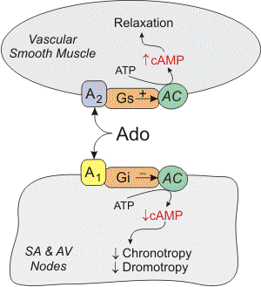

Slide 71
ADENOSINE
■ First drug of choice in
paroxysmal supraventricular tachycardia
■ preferred over verapamil ( safer
and does not depress contractility )
■ given 6 mg I.V. bolus followed by 12 mg if
necessary

Slide 72
ADENOSINE
Adverse effects:
■ Flushing in about 20% of patients
■ Shortness of breath and chest burning in 10% of patients ( bronchospasm)
■ AV block ( contraindicated in heart block)
■ Rarely: hypotension, nausea, paresthesias,

Slide 73
BRADYARRHYTHMIAS
ATROPINE
■ can be used in sinus bradycardia after myocardial infarction and in heart block
■ in emergency heart block isoprenaline may be combined with atropine

Slide 74
NONPHARMACOLOGIC THERAPY OF ARRHYTHMIAS
Implantable Cardiac Defibrillator (ICD)
can automatically detect and treat fatal
arrhythmias such as ventricular fibrillation

Slide 75
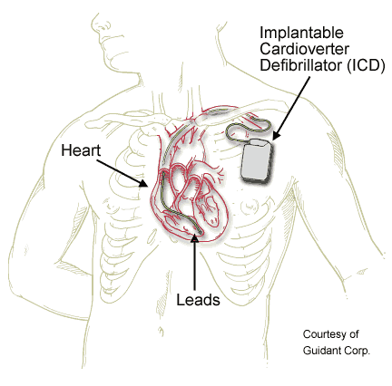

Slide 76

Thank you

