Slide 2
Prof.
Abdulrahman
Al-Motrefi
Prof.
Azza Hafiz
El-Medany

Slide 3
OBJECTIVES
At the end of lectures the students should
Describe brifely the pathophysiology of heart failure
Identify the causes of heart failure
Describe the different classes of drugs used in the treatment of heart failure

Slide 4
OBJECTIVES ( cont.)
Describe the mechanism of the used drugs for treatment of heart failure
Describe the main therapeutic uses , side effects & drug interactions of these drugs

Slide 5
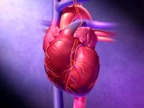
HEART FAILURE
?
Inability of the heart to maintain an adequate cardiac output to meet the metabolic demands of the body.

Slide 6
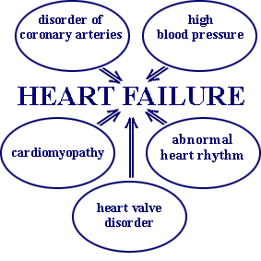
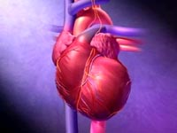
CAUSES OF HEART FAILURE

Slide 7
↓ Force of contraction
Low C.O.
↓ Carotid sinus firing
↓ Renal blood flow
Activate renin-angiotensin-
Aldosterone system
Activate sympathetic system
↑ Sympathetic discharge
ALDOST.
Remodeling
Ag. II
Salt & Water
Retention
Volume expansion
Vasoconstriction
↑ Force of
Cardiac .cont.
Venous VC
Arterial VC
↑ HR .
↑ Preload
↑ Preload
↑ Afterload
↑ C.O. Via
compensation
Pathophysiology of CHF

Slide 8
Heart failure symptoms
Tachycardia
Decreased exercise tolerance (rapid fatigue) .
Dyspnea ( pulmonary congestion)
Peripheral edema.
Cardiomegaly.

Slide 10
Factors affecting cardiac output and
Heart Failure
Cardiac contractility
Preload
Afterload
Heart rate.

Slide 11
Drugs used in the treatment of heart failure
Drugs that increase contractility
Cardiac glycosides
Phosphodiesterase inhibitors
β- adrenoceptor agonists

Slide 12
Drugs that decrease preload
Diuretics
Venodilators

Slide 13
Drugs that decrease afterload
Arteriolodilators

Slide 14
Drugs that decrease preload & afterload
Combined arteriolo- and venodiators:
Angiotensin converitng enzyme
inhibitors & Angiotensin receptor blockers
α1-adrenoceptor antagonists
Directly-acting vasodilators

Slide 15
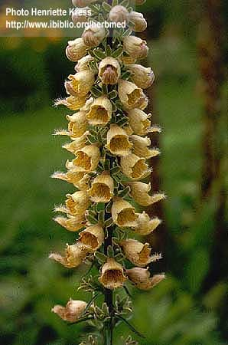
CARDIAC GLYCOSIDES
Digitalis Lanata
Digoxin / Digitoxin / Ouabain
Sugar &steroid like

Slide 16
CARDIAC GLYCOSIDES
PHARMACOLOGICAL ACTIONS:
CARDIAC:
1- Increase in force of contraction of the
myocardium ( +ve inotropic effect )
accompanied by reduction of the size of the
failing heart leading to increased cardiac
output.

Slide 17
Mechanism of action
Inhibits Na⁺ / K⁺ ATP ase , which leads to
increase intracellular calcium through the Na⁺
- Ca⁺⁺ exchanger

Slide 18
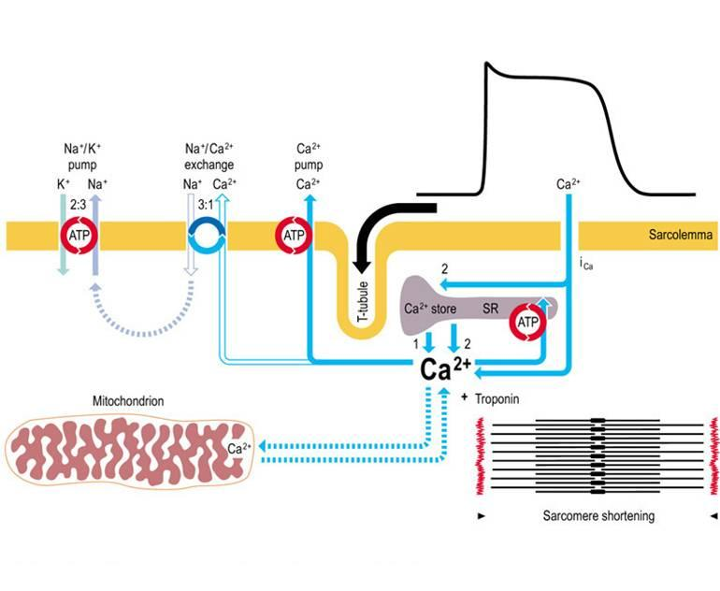
MECHANISM OF ACTION

Slide 19
CARDIAC GLYCOSIDES
PHARMACOLOGICAL ACTIONS (CONT’D) :
2- Increase of heart excitability and automaticity:
► This effect is not therapeutically useful
( digitalis-induced arrhythmia )
► digitalis toxicity increases the automaticity of
Purkinji fibers and they take over as the heart
pacemaker ( arrhythmia )

Slide 20
CARDIAC GLYCOSIDES
PHARMACOLOGICAL ACTIONS (CONT’D) :
3- Effects on conduction & refractory period:
► slowing of conduction and prolongation of atrial
& A.V. node refractory period.
( In ECG : prolongation of the PR interval )
Bradycardia
( Increase Vagal activity on the heart )

Slide 21
CARDIAC GLYCOSIDES
PHARMACOLOGICAL ACTIONS (CONT’D) :
Shortening of refractory period of ventricular muscles
( short QT interval )

Slide 22
Therapeutic uses
Congestive heart failure
Atrial arrhythmias :
Atrial flutter
Atrial fibrillation
Supraventricular tachycardia

Slide 23
CARDIAC GLYCOSIDES
Digoxin /
PHARMACOKINETICS
Drug has narrow therapeutic index
Absorption: orally : 40-80% leading to variable bioavailability
I.V. acts within 15 min-3hrs
Distribution & Metabolism: 25% protein bound, cumulative, metabolized in liver to cardioactive metabolite
Elimination; Slow, mainly renal , t_{1/2} 40 hrs

Slide 24
Cardiac adverse effects
digitalis-induced arrhythmias
can cause any type of arrhythmia especially:
- extrasystoles, coupled beats
- ventricular tachycardia or fibrillation
- A.V.block, cardiac arrest.

Slide 25
Extra -cardiac adverse effects
GIT :Anorexia, nausea,vomiting, diarrhea
C.N.S. :Headache, visual disturbances,
drowsiness

Slide 26
Factors That increase digitalis toxicity
Small Lean body mass
Renal diseases
Hypothyroidism
Hypokalemia
Hypomagnesemia
Hypercalcemia

Slide 27
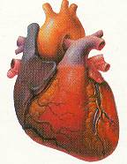
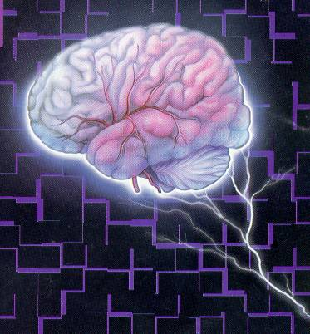
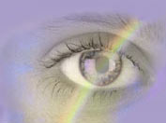
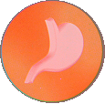
Treatment OF ADVERSE EFFECTS
HEART
CNS
Vision
GIT
???
Atropine
Antiarrythmics
K supplements
FAB fragment
Digoxin , diuretic

Slide 28
Contraindications
Toxic myocarditis
Constrictive pericarditis
DC cardioversion

Slide 29
Drug interactions
Diuretics→ hypokalemia (arrhythmia)
Quinidine : ↑plasma level of digitalis

Slide 30
β-Adrenoceptor agonists
Dopamine : α ,β₁ and dopamine receptors
Used : acute H.F. mainly in patients with impaired renal blood flow.
Dobutamine : Selective β₁ agonist
Used : acute heart failure

Slide 31
Phosphodiesterase Inhibitors
Bipyridines :
( Amrinone , Milrinone )
Half-life = 3-6hrs.
Excreted in urine.

Slide 32
Mechanism of action
Inhibit phosphodiesterase isozyme 3 in cardiac & smooth muscles → :↑ cAMP
In the heart : Increase myocardial contraction
In the peripheral vasculature : Dilatation of arteries & veins → ↓ afterload & preload.

Slide 33
Therapeutic uses
Used only intravenously for management of
acute heart failure

Slide 34
Adverse effects
Nausea ,vomiting
Arrhythmias (less than digitalis )
Thrombocytopenia
Liver toxicity
(Milrinone has less hepatotoxic and bone marrow depression than amrinone )

Slide 35
Reduction of preload
Diuretics
Venodilators

Slide 36
Diuretics
Reduce salt and water retention→↓blood volume and venous pressure.
Reduction of edema and its symptoms
Reduction of cardiac size →improve cardiac performance
e.g. hydrochlorothiazide

Slide 37
Venodilators
Selective venodilators as nitroglycerine is used
when the main symptom is dyspnea due to pulmonary congestion.
( Dilate venous capacitance vessels )

Slide 38
Reduction of Afterload
Arteriodilators
Selective arteriodilators as hydralazine is used
when the main symptom is rapid fatigue due to low cardiac output.
Reduce peripheral vascular resistance

Slide 39
Reduction of afterload & preload

Slide 40
Angiotensin converting enzyme inhibitors
MECHANISM OF ACTION
VASOCONSTRICTION
VASODILATATION
ALDOSTERONE
VASOPRESSIN
SYMPATHETIC
Angiotensinogen
RENIN
BRADYKININ
Angiotensin I
A.C.E.
Inhibitor
ACTIVATION
ANGIOTENSIN II

Slide 41
Angiotensin receptor blockers
Mechanism of action
- block AT₁ receptors
- decrease actions of angiotensin II

Slide 42
Uses of converting enzyme inhibitors & angiotensin receptor blockers in heart failure
↓Peripheral resistance ( Afterload )
↓Venous return ( Preload)
↓sympathetic activity
↓remodeling→↓mortality rate

Slide 43
Direct acting vasodilators
Sodium nitroprusside
given I.V. in refractory heart failure.
Acts immediately and effects lasts for 1-5 minutes.

Slide 44
β - adrenoceptor blockers in heart failure

Slide 45
Uses of β-adrenoceptor blockers in heart failure
Reduce catecholamine myocyte toxicity (remodeling)
Decrease mortality rate
Decrease heart rate
Inhibit renin release
e.g. Carvedilol ( antioxident )

Slide 46
Management of chronic heart failure
Reduce work load of the heart
Limits patient activity
Reduce weight
Control hypertension
Restrict sodium
Diuretics
ACEI or ARB’s

Slide 47
Management of chronic heart failure (Cont.)
Digitalis
β- blockers
Direct vasodilators

Slide 48
Management of acute heart failure
Volume replacement
Diuretics
Positive inotropic drugs
Vasodilators
Antiarrhythmic drugs
Treatment of myocardial infarction

