Slide 1
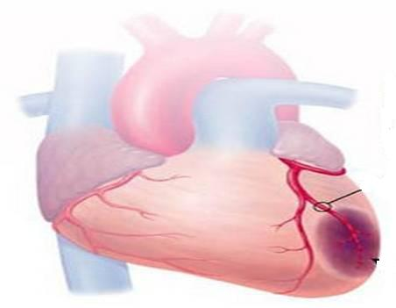
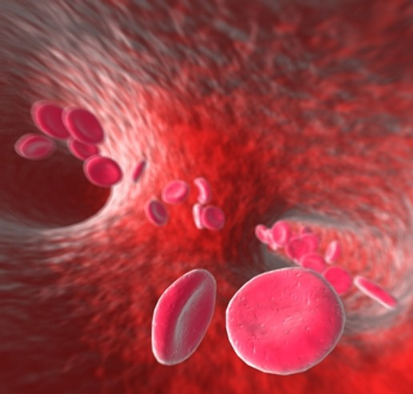
ANTIANGINAL DRUGS

Slide 2
ANTIANGINAL DRUGS
ILOs
By the end of those 2 lectures
[24 slides for studing]
you will be able to:
Recognize variables contributing to a balanced myocardial supply vs demand
Identify etiopathogenic cascades contributing to ischemic heart disease
Justify the different related clinical presentations of ischemic heart disease
Expand on the drugs used to alleviate acute anginal attacks vs those meant for prophylaxis & improvement of survival
Detail the pharmacology of nitrates, other vasodilators, and other drugs used as antianginal therapy
Sum up the varied therapeutic recommendations for treatment of different clinical presentations of ischemic heart disease

Slide 3
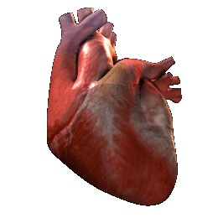
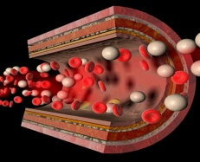
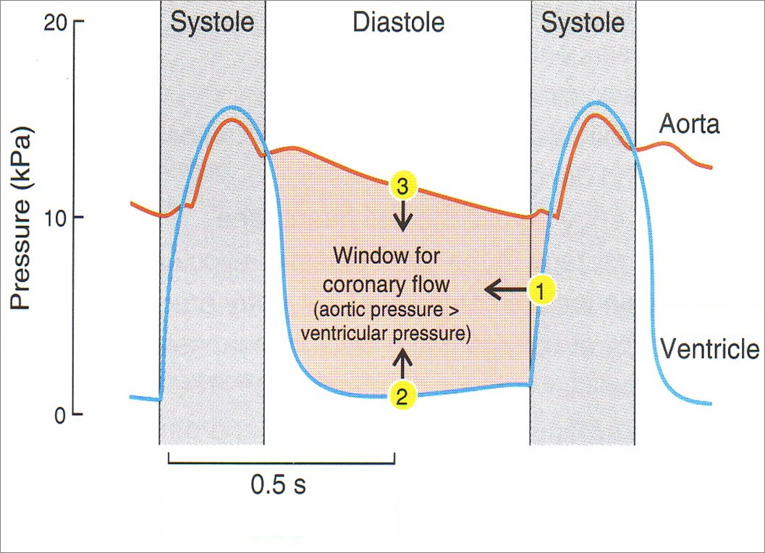
Coronary SUPPLY
Pumping Heart DEMAND
WORK
O₂
G
ATP
FFA
O₂
G
O₂
O₂
O₂
ATP
G
O₂
O₂
FFA
FFA
G
O₂
ATP
[S]
[D]
[S]
◉ DP
Shortening of D
 Ventricular End-DP

Slide 4
Coronary SUPPLY
Pumping Heart DEMAND
WORK
O₂
G
ATP
FFA
O₂
G
O₂
O₂
O₂
ATP
G
O₂
O₂
FFA
FFA
G
O₂
ATP
?
?
ISCHEMIC HEART DISEASE
?

Slide 5
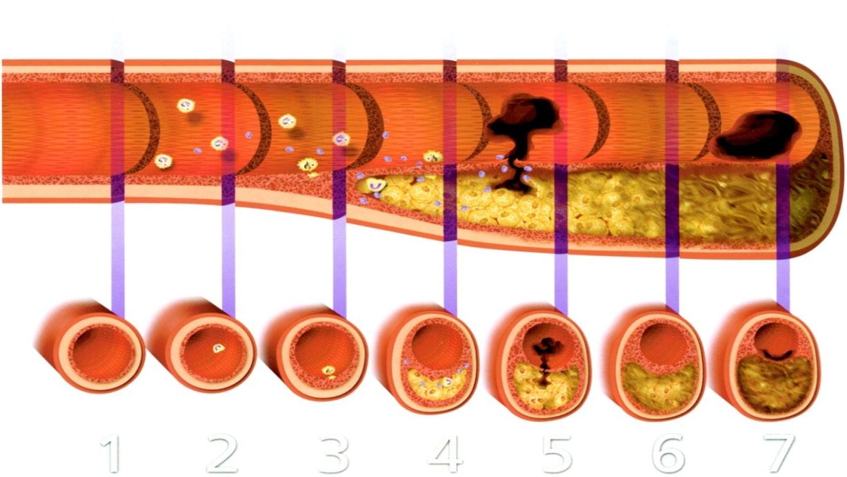
CORONARY NARROWING
CORONARY HEART DISEASES [CHD]
FUNCTIONAL
STRUCTURAL
SPASM
ATHEROSCLEROTIC
PLAQUE
ISCHEMIC HEART DISEASES [IHD]
+ THROMBOSIS
SPASTIC ANGINA
ANGINA
Stabilized
Vulnerable
STABLE ANGINA
UNSTABLE ANGINA
ACUTE MYOCARDIAL INFARCTION [AMI]
ACUTE CORONARY SYNDROME [ACS]

Slide 6
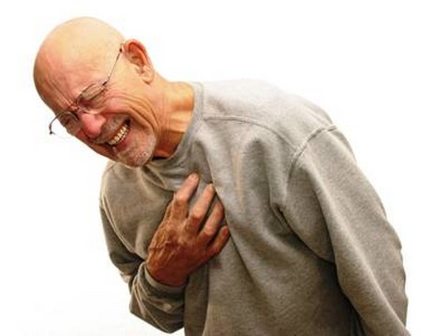
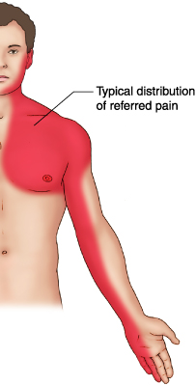
ANGINA Pectoris
By a Spasm or Stabilized Plaque
Chest pain (varying in severity) due to ischemia of heart muscle caused by obstruction or spasm of coronary arteries
Constricting & tight, oppressive, crushing
Starts in the centre behind the sternum or on left side of the front of chest & spread out to shoulder arm…..a
Pain is due to (accumulation of metabolites K⁺, PGs, Kinins, Adenosine….) 2^{ndry} to the ischemia
Prinzmetal’s Angina
Stable Angina
Unstable Angina
Vulnerable Plaque
VARIANT ANGINA
EFFORT ANGINA
CRESCENDO ANGINA
Occurs at rest Cyclic (vasospasm) due to contraction of VSMC
>in younger women
Develops by exertion
Resolves at rest
Lasts ~5 min
Insidious onset
Occurs at rest / minimal exertion
Severe / Lasting >10 min; Either of;
* New onset (nothing for last 4–6 w)
* Crescendo pattern; getting > severe / prolonged / frequent than previous
ACS
Sustained Spasm

Slide 7
RELATION OF PATHOPHYSIOLOGICAL FINDINGS TO ACS
Vulnerable
Plaque  ACUTE OCCLUSION 
(~Subtotal / Total) ACS
Vulnerable
Plaque 
Rupture / erosion / fissuring
exposure of thrombogenic
surface platelets adhere 
thrombosis  OCCLUSION
Internal haemorrhage  sudden growth  OCCLUSION

Slide 8
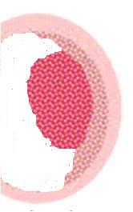
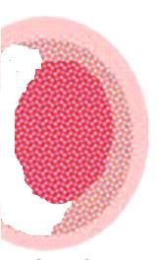
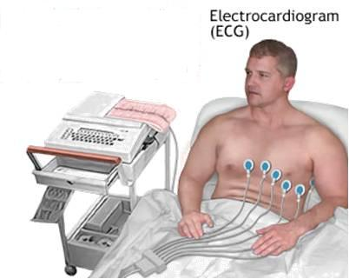
ACUTE CORONARY SYNDROMES [ACS]
Acute ~Subtotal / Total OCCLUSION
Umbrella term that covers a spectrum of acute clinical conditions ranging from
Unstable angina (38%)
NSTEMI (25%)
STEMI (30%)
ATP, Ion PumpsCa 
~~Action Potention, elect. Activities & functions
Inflam. Mediators, ROS TNFα, NF_{κ}B, ….
Apoptosis
Proteolysis, Membrane damage….
Cardiac Enzymes (Markers)
ECG CHANGES
Necrosis
Non ST – Elevation
ST – Elevation
-ve
+ve
Unstable Angina
AMI
AMI
NSTEMI
STEMI

Slide 9
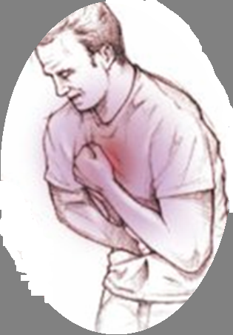
DRUGS USED IN TREATMENT OF ANGINA
Agents that improve symptoms & ischemia
Organic nitrates
Calcium channel blockers
Potassium channel openers
β-adrenoceptor blockers
Metabolically acting agents
Others
Vasodilators.
Agents that improve prognosis
Aspirin /
Other antiplatelets
Statins
ACE Inhibitors
β-AD blockers
ANTIANGINAL DRUGS

Slide 10
DRUGS USED IN TREATMENT OF ANGINA
Vasodilators.

Slide 11
NITRODILATORS
Release NO via enzymatic reaction
Release NO spontaneously
ORGANIC NITRATES
Na NITROPRUSSIDE
ANTIANGINAL DRUGS
ANTIHYPERTENSIVES
Short Acting
Long Acting
Nitroglycerine [GTN]
Amyl Nitrite
Isosorbide mono & dinitrate
Erythrityl tetranitrate
Pentaerythritol tetranitrate
Unstable angina
Heart Failure
Rapid
Slower
For terminating an acute attack
For long-term prophylaxsis
I.V. or infusion
Sublingual
Oral sustained release Transdermal patches
Preparations;
can influence a change in indications

Slide 12
ORGANIC NITRATES
ANTIANGINAL DRUGS
Nitrates
◉
Nitrosothiols
◉
Nitrite Ion in endothelial cell (EC)
◉
Acts as NO donner
Mimick action of
Endogenous NO
Endothelial Cell [EC]
Diffusion
Vascular Smooth Muscle [ VSMC]
?
Mechanism
O₂
In VSMC [ In SMC ]
Binds soluble GC
Formation of cGMP
Activation of PKG
RELAXATION
H₂O
PKG
Phosphorylate
P
MLCK
MLCK
Inactive form
Active form
P
MLC
MLC
Contraction
Actin
Relaxation
N.B. NO is well developed in Arteriolar > Venular System
Exogenous NO donners act on Venular > Arteriolar system

Slide 13
Pharmacodynamic Actions
ORGANIC NITRATES
1. Anti-Anginal Actions
 Myocardial Oxygen Supply;
Dilatation of large coronary vessels.
Redistribution of coronary flow from normal to ischemic region.
Dilatation of collaterals.
◉ Myocardial Oxygen Demand by cardiac work indirectly ;
Venodilatations: of capacitance vessels preload   central venous P  CO
Arteriolar vasodilatation:  peripheral resistance &  afterload (reflex tachycardia???)  BP at high dose
Platelet Aggregation
Endothelial protective action  leukocyte-endothelial interactions (anti-inflammatory); antiatherogenic potentials
2. Other Pharmacodynamic Actions
SMC Relaxation of
Bronchi NO activates cGMP in BSMC  bronchodilatation
Gastrointestinal tract & biliary system
Genitourinary tract

Slide 14
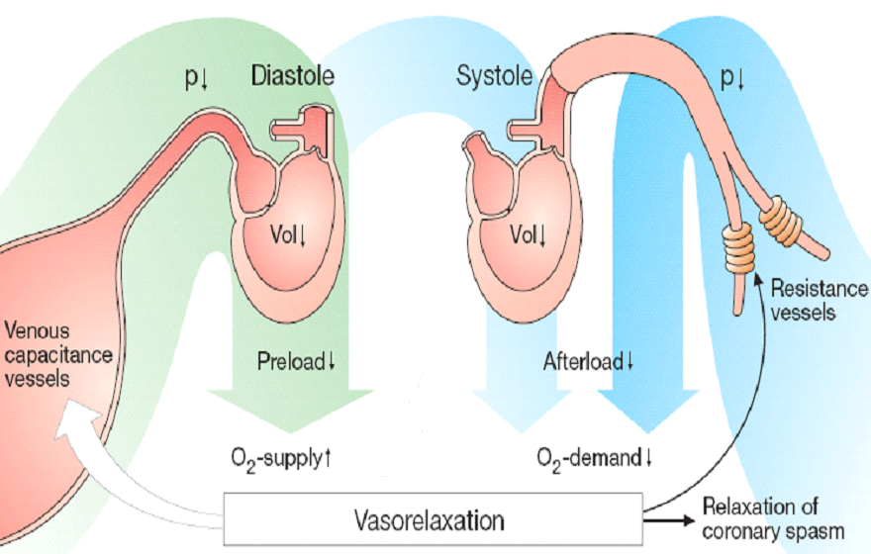
ORGANIC NITRATES
CV effects of Nitrates on Preload & Afterload

Slide 15
ORGANIC NITRATES
How Nitrates increases flow to ischemic zone ?
In Ischemia
With Nitrates

Slide 16
Pharmacokinetics
ORGANIC NITRATES
Nitroglycrine [GTN];
Significant first pass metabolism occurs in the liver (10-20%) bioavailability
(so sublingual or via transdermal patch)
Oral isosorbide dinitrate & mononitrate
Very well absorbed & 100% bioavailability
The dinitrate undergoes denitration to two mononitrates both possess antianginal activity (t_{1/2} 1-3 hours)  Further denitrated metabolites conjugate to glucuronic acid in liver. Excreted in urine.
Indications
IN STABLE ANGINA;
Acute symptom relief  sublingual GTN
Prevention; Persistant prophylaxis  Isosorbide mono or dinitrate
Situational prophylaxis  as before exercising, climbing…etc
 sublingual GTN
IN VARIANT ANGINA sublingual GTN
IN UNSTABLE ANGINA  IV GTN
Refractory AHF  IV GTN
CHF  Isosorbide mononitrate + hydralazine [ if contraindication to ACE Is ]
AMI IV GTN

Slide 17
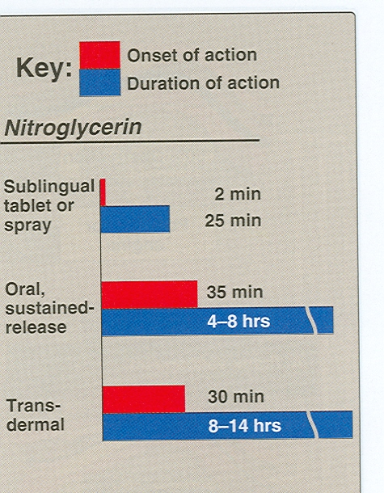
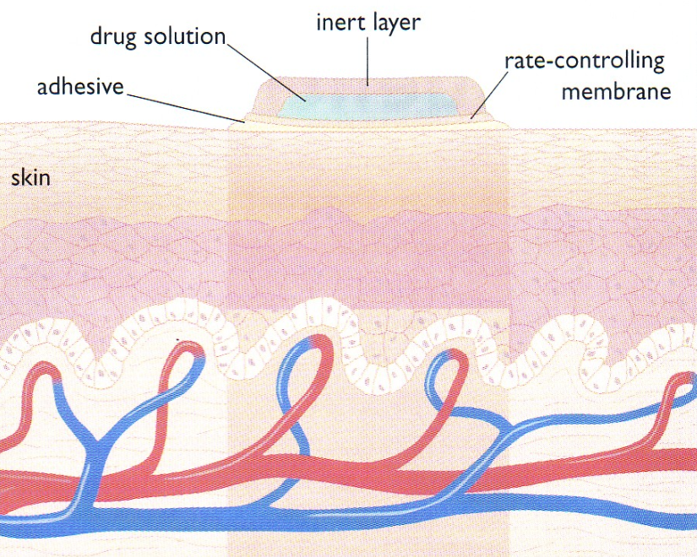
Preparations
Nitroglycerine
Sublingual tablets or spray
Transdermal patch
Oral or bucal sustained release
I.V. Preparations
Isosorbide dinitrate & mononitrate
Dinitrate Sublingual tablets
Dinitrate Oral sustained release
Mononitrate Oral sustained release
Infusion Preparations

Slide 18
ADRs
ORGANIC NITRATES
Postural hypotension with reflex tachycardia: especially if the patient is standing stationary.
Nitrite syncope with fainting & collapse due to  dilatation of venous capacitance vessels + severe  of venous return  CO & BP.
Nitrite syncope is treated by putting the patient in a low head position.
Flushing of blush area (face, neck and upper trunk) is unpleasant
Throbbing headache (>common) & tendency to  intra-cranial pressure  used cautiously in cerebral bleeding & head trauma
Drug rash.
Visual disturbance.
Carcinogenesis
Met-hemoglobinemia
(in overdose & accidental poisoning)

Slide 19
ORGANIC NITRATES
NIRATE TOLERANCE
Loss of vasodilator response of nitrates on use of long-acting preparations (oral, transdermal) or continuous intravenous infusions, for more than a few hours without interruption.
Magnitude of tolerance is a function of dosage & frequency of use.
Causes
After 1st day of continuous nitrates, compensatory neurohormonal counter-regulation occurs (RAAS, NE, Vasopressin ….etc activation) therapeutic efficacy (PSEUDOTOLERANCE).
After 3 days, dysfunction of ECs & VSMC occur by many different molecular mechanisms, aside the partial depletion of free-SH groups that permits formation of nitrosothiols from the organic nitrate to give NO (TOLERANCE)
Nitrate tolerance can be overcomed by:
Smaller doses at increasing intervals (Nitrate free periods twice a day).
Giving drugs that maintain tissue SH group e.g. Captopril.

Slide 20
Precautions during nitrate therapy
ORGANIC NITRATES
10 hours nitrate free period.
Never stop nitrate therapy suddenly.
Do not take double dose.
Do not use after expiry date; GTN is volatile; shelf-life ~6w after opening
Must be stored in cool, tightly capped, dark container
Contraindication
Known sensitivity to organic nitrates.
Glaucoma; nitrates  aqueous formation
Head trauma or cerebral haemorrhage
Increase intracranial pressure .
Uncorrected hypovolemia
Concomitant administration of PDE₅ Inhibitors that are used for the treatment of erectile dysfunction  BP Myocardial Ischemia
○ so we must space doses i.e. Nitrates [ morning], PDE₅ Is [Evening]

Slide 21
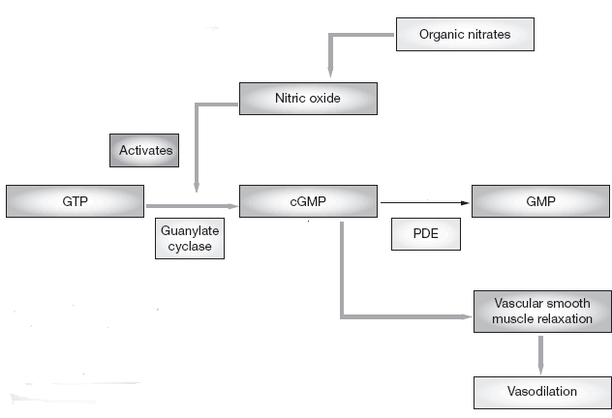
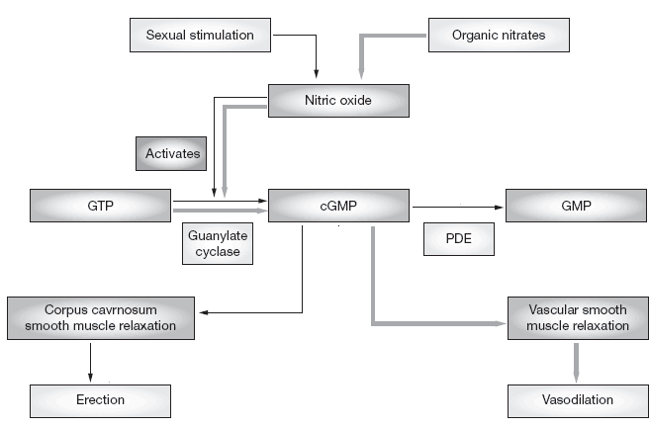
ORGANIC NITRATES
PDE₅ Is
cGMP
X
Vasodilatation
BP
coronary perfusion
MYOCARDIAL ISCHEMIA

Slide 22
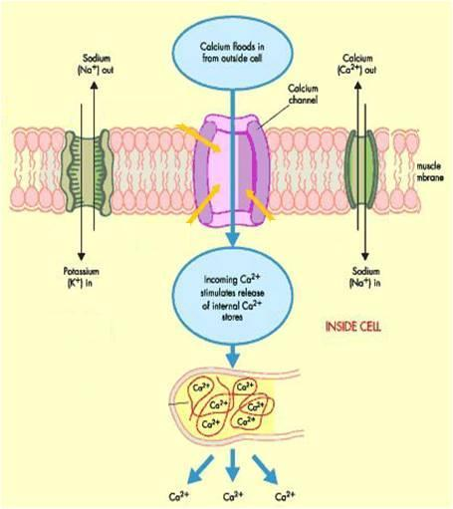
Ca CHANNEL BLOCKERS
ANTIANGINAL DRUGS
Classification
Dihydropyridines:- Nifedipine , Nicardipine, Amlodepine
Phenylalkylamines:- Verapamil
Benzthiazepines:- Diltiazem
Heterogeneous
Mechanism
Binding of calcium channel blockers [CCBs] to the L-type Ca channels
◉ their frequency of opening
in response to depolarization
Nifedipine
X
entry of Ca   Ca from internal stores  No Stimulus-Contraction Coupling  RELAXATION
Diltiazem
Verapamil
Phosphatase
MLCK
P
Ca²⁺ CaM Kinase
Active form
MLCK
P
MLC
MLC
Release Ca from intracellular stores
Ca²⁺ CaM complex
Contraction
Actin
Relaxation

Slide 23
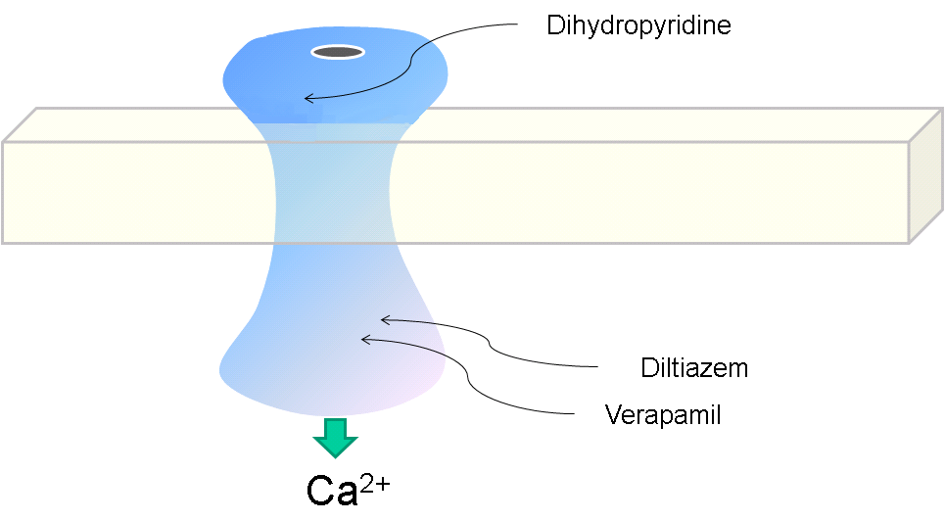
Ca CHANNEL BLOCKERS
Ca Channel Types & Distribution
Pharmacodynamic Actions
Distribution | Type
Cardiac & VSMCs / neurons | L
Heart / neurons | T
Neurons | N
Cerebellar Purkinje neurons | P
1. Anti-Anginal Actions
Nifedipine
Diltiazem
◉ Cardiomyocyte Contraction
Verapamil
cardiac work through their –ve inotropic & chronotropic action (verapamil & diltiazem)  myocardial oxygen demand
VSMC
Contraction
◉ After load  cardiac work 
myocardial oxygen demand
Coronary dilatation (nifedipine & nicardipine (short acting) / amlodipine (long acting) > diltiazem & verapamil  myocardial oxygen supply
N.B. Selectivity of Ca channel blockers
Nifedipine  VSMCs
Verapamil  Cardiomyocytes > VSMCs
Diltaizem  Intermediate action on both

Slide 24
Indications AS ANTIANGINAL
Ca CHANNEL BLOCKERS
IN STABLE ANGINA;
Regular prophylaxis 
Long acting dihydropyridines ; amlodipine & SR formulation nifedipine, diltiazem > verapamil
Short acting dihydropyridine avoided  BP symathetic activation refelx tachycardia +syncope impair coronary fillingischemia …..
Can be combined to β-AR blockers??? Which group is much safer???
→ Can be combined with nitrates??? Which group is much safer???
→ Dihydropyridenes  no  contractility  useful antianginal if with CHF
→ Verapamil & diltiazem  < vasoactivity  as antianginal if hypotension
IN VARIANT ANGINA Attacks prevented (> 60%) / sometimes variably aborted
IN UNSTABLE ANGINA; Seldom added in refractory cases

Slide 25
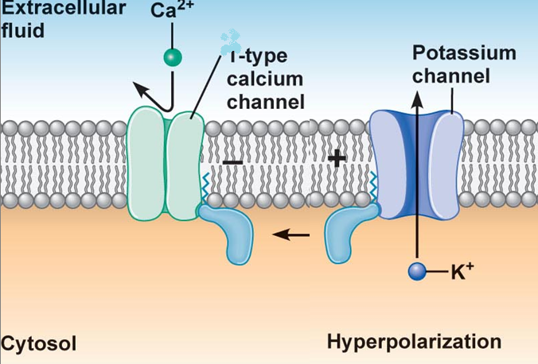
K CHANNEL OPENERS
ANTIANGINAL DRUGS
Nicorandil
Mechanism
It has dual mechanism of action;
1. Opens K_{ATP} channels (> arteriolar dilator)
2. NO donner as it has a nitrate moiety (> venular dilator)
Pharmacodynamic
1. On VSMC
K channel opening
◉
Hyperpolarization
◉
VASODILATATION
L
1. On Cardiomyocyte
Nicorandil
K channel opening
◉
Repolarization
◉
Cardiac work
Inhibit Ca entry
1.Opening of K_{ATP} channels

Slide 26
Nicorandil
K CHANNEL OPENERS
2. Acting as NO donner
2. On VSMC
NO donner
◉
 cGMP/ PKG
◉
VASODILATATION
Indications
Prophylactic 2nd line therapy in stable angina & refractory variant angina
ADRs
Flushing, headache,
Hypotension, palpitation, weakness
Mouth & peri-anal ulcers, nausea and vomiting.

Slide 27
DRUGS USED IN TREATMENT OF ANGINA
β
– AR BLOCKERS

Slide 28
β - AR BLOCKERS
Β₂
VSMC
CARDIOMYOCYTE
Β₁
NO Vasodilatation
◉ Cardiac Work
Β₂
SMC
β₁ – Selective > Non – Selective
NO Relaxation
Atenolol
Bisoprolol
Metoprolol
Pharmacodynamic Actions
1. Anti-Anginal Actions
cardiac work through their
-ve inotropic & chronotropic action
afterload
renin angiotensin release
 myocardial oxygen demand
Though no coronary dilatation, yet  prolonged diastole   perfusion time   coronary filling & flow 
myocardial oxygen supply

Slide 29
β - AR BLOCKERS
ANTIANGINAL DRUGS
Indications as antianginal
IN STABLE ANGINA;
Regular prophylaxis  Cardio-selective are better. Why???  to spare β₂-AR
They are 1st choice on prolonged use   incidence of sudden death specially due to ventricular tachycardia  by their antiarrhythmic action.
Can be combined with nitrates  abolish its induced reflex tachycardia.
Can be combined with dihydropyridene CCBs but not verapamil nor diltiazem  for fear of conduction defect (bradycardia, heart block)
IN VARIANT ANGINA contraindicated  as it has no vasodilator action & allow unopposed α-adrenergic coronary vasoconstriction to occur.
IN UNSTABLE ANGINA  halts progression to AMI  improve survival
In Myocardial Infarction; given early  infarct size,
morbidity & mortality  CARDIOPROTECTIVE
◉ myocardial O₂ demand.
 Redistribution of blood flow in the myocardium.
free fatty acids.
Anti-arrhythmic action.
◉ incidence of sudden death.

Slide 30
β - AR BLOCKERS
Precautions
β- blockers should be withdrawn gradually as sudden stoppage  give rise to a withdrawal manifestations:
Rebound angina, arrhythmia, myocardial infarction & hypertension WHY ?  Up-regulation of β-receptors.
Non-selective are better avoided as they blocks vasodilatory effects of sympathetic stimulation  afterload &  oxygen consumption.
Not used in variant angina  worsen symptoms and aggrevate condition
Given to diabetics with ischemic heart disease  [Benefits > hazards) & ACE inhibitor must too be added specially in ACSs

Slide 31
DRUGS USED IN TREATMENT OF ANGINA
Metabolically acting agents

Slide 32
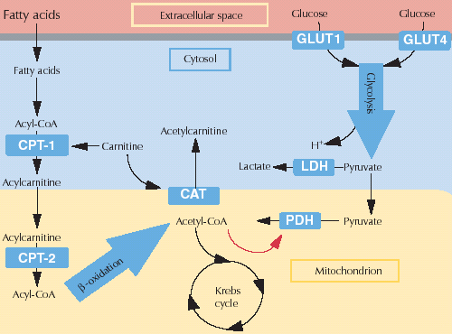
ANTIANGINAL DRUGS
Metabolically Acting Agents
TRIMETAZIDINE
Mechanism
O₂ requirement for glucose utilization is < FFA utilization i.e. oxidation of FFA requires > oxygen per unit of ATP generated than oxidation of CHO.
During ischemia, metabolism shifts to oxidation of FFA.
So, to treat we can enhance > utilization of CHO (less energy cost) ; by giving 
Partial FFA Oxidation Inhibitors
(pFOX Inhibitors), TRIMETAZIDINE
Pharmacol Effects
Restores energy balance in the cell.
◉ fatty acid metabolism by -ve 3 Ketoacyl Thiolase [3KAT]
-ve anaerobic glycolysis
X
Allowing only aerobic glycolysis
3KAT
-ve acidosis & FR accumulation 
◉ apoptosis  Cytoprotective
Thus shift myocardial metabolism to 
OXYGEN DEMAND WITHOUT ALTERING HEMODYNAMICS

Slide 33
Metabolically Acting Agents
Indication
Used when ever needed as add on therapy to nitrates, CCBs or β-blockers
ADRs  GIT disturbances
Contraindications
Hypersensitivity reaction
In pregnancy & lactation
Ranolazine
Newly introduced. Considered one of the metabolically acting agents like trimetazedine.
+ affects Na dependent-Ca Channels  prevents Ca load   apoptosis  cardioprotective.
It prolongs the QT interval so not given with; Class Ia & III antiarrhthmics
Toxicity develops due to interaction with CYT 450 inhibitors as; diltiazem, verapamil, ketoconazole, macrolide antibiotics, grapefruit juice

Slide 34
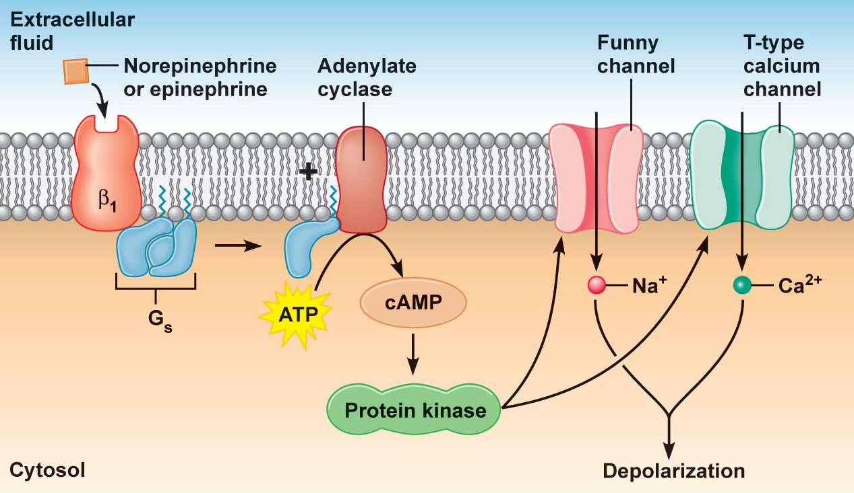
DRUGS USED IN TREATMENT OF ANGINA
OTHERS
Ivabradine
Not classified  claimed to be CARDIOTONIC agent
X
SAN
Acts on the “ Funny Channel” a special Na channel in SAN HRmyocardial work Myocardial O₂ demand
OTHERS

Slide 35
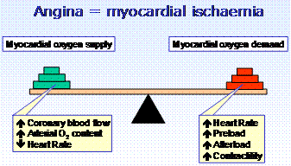
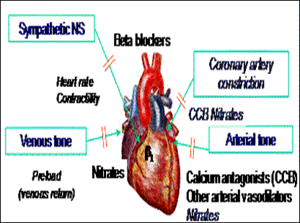
ANTIANGINAL DRUGS SET THE BALANCE BACK
◉
◉
◉
◉
In attack & situational prophylaxsis
Short acting nitrates
For prophylactic therapy
β-adrenoceptors blockers.
Calcium channel blockers
Long - acting nitrates.
Potassium channel openers
Metabolic modifiers & others
In Combinations

Slide 36
DRUGS USED IN TREATMENT OF ANGINA
Agents that improve prognosis
Aspirin / Other antiplatelets
Statins
ACE Inhibitors
β-AD blockers
Main Stay of Prophylactic Treatment
Halt progression
Prevent acute insults
Improve survival

Slide 37
THERAPEUTIC GUIDELINES FOR ISCHEMIC HEART DISEASES
Stable Angina:
Acute symptoms by short acting nitrates
Maintain therapy by a suitable antianginal drug (Nitrates and/or β- Blockers and/or CCB + metabolic modifiers).
Vasospastic Angina:
Prevention and even abortion of an attack of coronary artery spasm is achieved by Nitrates and/or CCB.
Propranolol is contraindicated.
ACS
Unstable angina:  Better transfer to ICU or CCU.
Antianginal drugs (Nitrates &/or B-blockers, CCB in refractory cases) + Aspirin or Antiplatelets & IV Heparin.
IF THERAPY FAIL to any REVASCULARIZATION ?  OPENING OF OCCLUDED VESSEL either by;
Percutaneous coronary intervention; PCI
Surgical coronary artery bypass grapht; CABG

Slide 38
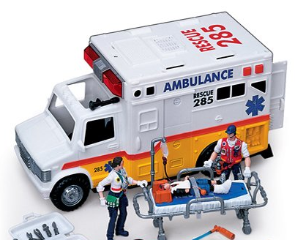
ACS
AMI: Transfer to CCU & apply the following measures:
Before & During Transfer:
Cardiopulmonary resuscitation / Oxygen & I.V fluids.
Nitroglycrine sublingual up to 3 doses with 5 minutes intervals
Analgesics, as morphine, for severe pain.
Chewable aspirin 160 mg.
In ICU or CCU units:
Thrombolytics: to induce clot lysis & restore blood flow
Anti-coagulant: IV Heparin, continue on aspirin orally
O₂ & Opiates: IV morphine or meperidine.
Nitrates: IV infusion of GTN + early β-blockers  myocardial damage.
ACE Inhibitors start early postmyocardial fibrosis & improve survival
Statin therapy start early stabilize plaque

Slide 39
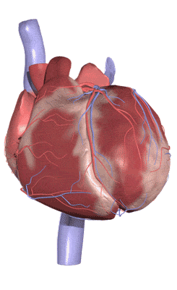
GOOD LUCK

Slide 40
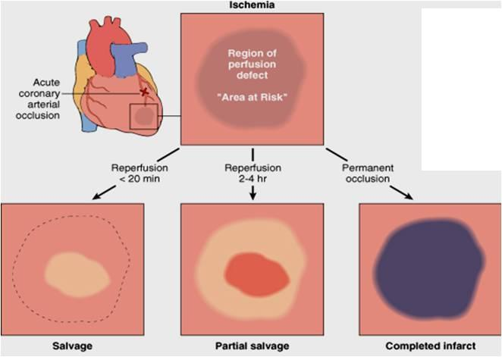
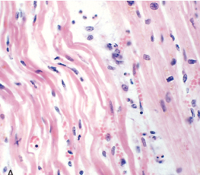
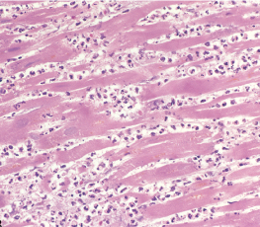
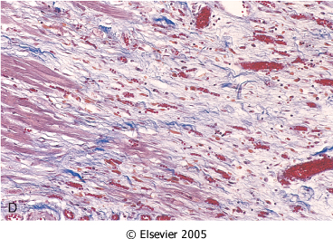
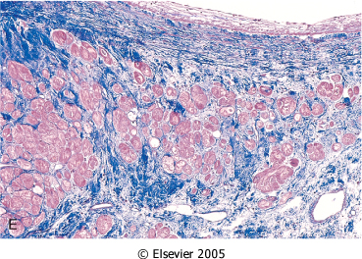
SEQUENCE OF EVENTS AFTER AMI
After 1 day
< 3days
Coagulative Necrosis
Neutrophilic Infiltrate
1-2 weeks
>3 weeks
Benefits of adding ACE Inhibitors & β-blockers
Granulation T.
Scaring & Fibrosis
Post-myocardial Fibrosis

Slide 41
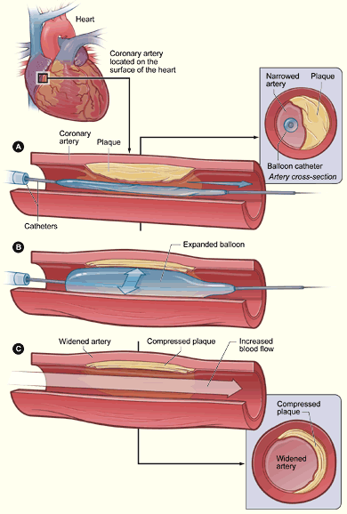
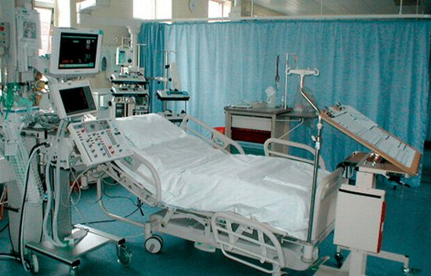
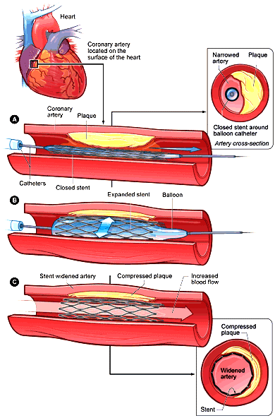
PCI
Ballon Angioplasty
+ STENT DEPLOYMENT

