Slide 1
Treatment of Hypertension

Slide 2
Prof.
Abdulrahman
Al-Motrefi
Prof.
Azza Hafiz
El-Medany

Slide 3
OBJECTIVES
At the end of lectures , the students should :
Identify factors that control blood pressure
Identify the pharmacologic classes of drugs used in treatment of hypertension
Know examples of each class.

Slide 4
OBJECTIVES ( continue)
Describe the mechanism of action , therapeutic uses & common adverse effects of each class of drugs

Slide 5
Hypertension
► Hypertension is the most common
cardiovascular disease ( 24% in USA)
► Cause damage to blood vessels in
kidney, heart & brain
► increase incidence of renal failure,
coronary disease, stroke and heart
failure

Slide 6
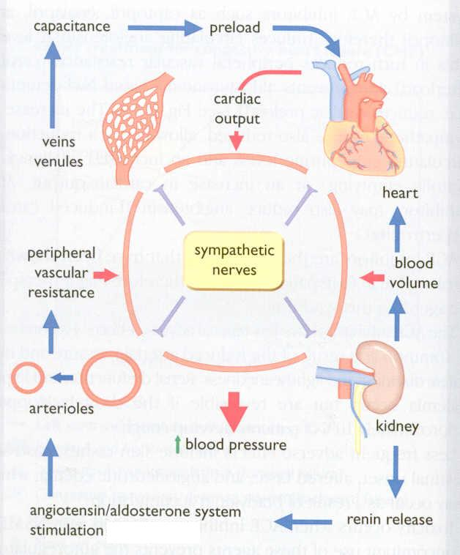
FACTORS IN BLOOD PRESSURE CONTROL

Slide 7
Hypertension
Blood pressure is determined by :
1- Blood volume
2- Cardiac output ( rate & contractility )
3- Peripheral resistance

Slide 8
Rationale for pharmacologic treatment of hypertension
Patients with primary hypertension are generally treated with drugs that :
Reduce blood volume
Reduce systemic vascular resistance
Reduce cardiac output

Slide 9
Rationale for pharmacologic treatment of hypertension
continue …..
Patients with secondary hypertension are best treated by controlling or removing the underlying disease or pathology , although they still require antihypertensive drugs

Slide 10
Classification of Antihypertensive Drugs

Slide 11
Antihypertensive Agents
I- Diuretics
II- Drugs acting on the renin-angiotensin-
aldosterone system
III- Calcium channel blockers
IV- Vasodilators
V- Drugs acting on sympathetic system

Slide 12
I- Diuretics
e.g. hydrochlorothiazide
furosemide
► cause sodium and water loss
decrease volume of blood
decrease cardiac output
lower blood pressure.
►diuretics may be adequate in
mild to moderate hypertension

Slide 13
II- Drugs acting on the renin-
angiotensin - aldosterone system
1- Angiotensin-converting enzyme
inhibitors (ACEI)
captopril - enalapril
lisinopril - quinapril
ramipril - benazepril
fosinopril

Slide 14
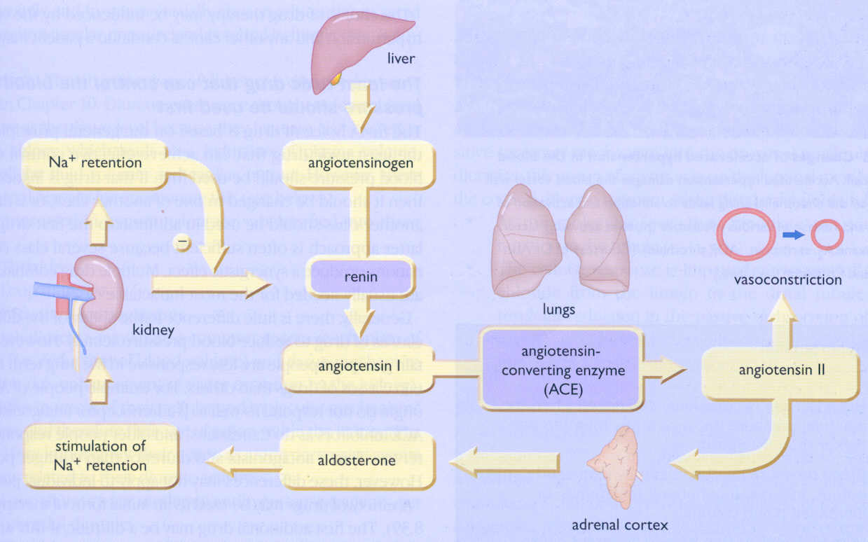
RENIN-ANGIOTENSIN-ALDOSTERONNE SYSTEM

Slide 15
Angiotensin converting enzyme inhibitors
MECHANISM OF ACTION
VASOCONSTRICTION
VASODILATATION
ALDOSTERONE
VASOPRESSIN
Angiotensinogen
RENIN
BRADYKININ
Angiotensin I
A.C.E.
Inhibitor
INACTIVATION
ANGIOTENSIN II

Slide 16
ACE inhibitors
► The antihypertensive effect of ACE inhibitors
results primarily from blocking synthesis of Ang11 resulting in :
Vasodilatation ( reduction of peripheral resistance ) with little change in C.O
Prevent aldosterone release from adrenal cortex
Prevent inactivation of bradykinin

Slide 17
Notice
ACE inhibitors are particularly effective when hypertension results from excessive renin production
( Renovascular hypertension )

Slide 18
ACE inhibitors (Cont’d): Pharmacokinetics
Captopril, enalapril and ramipril .
All are rapidly absorbed from GIT after oral administration.
Food reduce their bioavailability.
Enalapril , ramipril are prodrugs, converted to the active metabolite in the liver
Have a long half-life & given once daily
Enalaprilat is the active metabolite of enalapril given by i.v. route in hypertensive emergency.

Slide 19
ACE inhibitors (Cont’d): Therapeutic uses
Treatment of essential hypertension &
hypertension in patients with :
- chronic renal disease
- Ischemic heart disease.
- diabetes
Treatment of heart failure .

Slide 20
Adverse Effects of ACEI
Acute renal failure, especially in patients
with renal artery stenosis
Hyperkalemia, especially in patients with
renal insufficiency or diabetes
Severe hypotension in hypovolemic patients (due to diuretics, salt restriction or gastrointestinal fluid loss)

Slide 21
Adverse Effects of ACEI (Cont’d):
Dry cough sometimes with wheezing
Angioneurotic edema ( swelling in the nose , throat, tongue, larynx)
(may be caused by inhibition of bradykinin metabolism which accumulate in bronchial mucosa)

Slide 22
Adverse Effects of ACEI (Cont’d):
1- Dysgeusia ( reversible loss or altered taste )
2- Skin rash, fever
3- Proteinuria and neutropenia
These effects (1-3) are due to a sulfhydryl group
in the molecule of captopril. These effects do not happen with enalapril, ramipril which do not
contain this molecule in structure

Slide 23
(Cont’d): Contraindications of ACEI
During the second and third trimesters of pregnancy due to the risk of : fetal hypotension ,anuria ,renal failure &
malformations .
Renal artery stenosis.

Slide 24
ACE inhibitors (Cont’d): Drug interactions
With potassium-sparing diuretics
NSAIDs impair their hypotensive effects
by blocking bradykinin-mediated vasodilatation.

Slide 25
Angiotensin receptor blockers
losartan - valsartan
irbesartan - candesatran
telmisartan - eprosartan
zolasartan - tasosartan

Slide 26
ANGIOTENSIN RECEPTOR BLOCKERS:
❏ Cause selective block of AT₁ receptors
❏ - No effect on bradykinin ( more selective)
- have the advantage of not causing the
adverse effects of ACE inhibitors such
as cough & angioedema
❏ Produce more complete inhibition of angiotensin
as there are other enzymes ( not only ACE) that
can generate angiotensin

Slide 27
2- ANGIOTENSIN RECEPTOR BLOCKERS: Adverse effects
As ACEI except for cough ,wheezing , and angioedema.
Same contraindications as ACEI.

Slide 28
ANGIOTENSIN RECEPTOR BLOCKERS: Losartan
Orally effective
Has a potent active metabolite.
Long half-life, taken once daily.
Can not cross BBB

Slide 29
ANGIOTENSIN RECEPTOR BLOCKERS: Valsartan
- Has no active metabolites.
- As losartan in side effects and contraindications.
Both have the same Clinical uses as ACEI.

Slide 30
III- CALCIUM CHANNEL BLOCKERS

Slide 31
Classification
Dihydropyridine group (nifedipine, amlodipine, nicardipine) act mainly on smooth muscle and used as vasodilators
Verapamil act more on the myocardium and used as antiarrhythmic drug
Diltiazem has intermediate effect.

Slide 32
CALCIUM CHANNEL BLOCKERS:
Verapamil, diltiazem, nifedipine, amlodipine, nicardipine
❏ Block the influx of calcium through L- type calcium channels resulting in:
1- Peripheral vasodilatation
2- Decrease cardiac contractility
Both effects lower blood pressure

Slide 33
Pharmacokinetics
❏ given orally and intravenous injection
❏ well absorbed from G.I.T
❏ verapamil and nifedipine are highly bound to
plasma protiens ( more than 90%)
while diltiazem is less ( 70-80%)

Slide 34
Pharmacokinetics ( cont ):
❏ onset of action --- within 1-3 min --- after i.v.
30 min – 2 h --- after oral dose
❏ verapamil & diltiazem have active metabolites,
nifedipine does not
❏ sustained-release preparations can permit
once-daily dosing

Slide 35
Therapeutic Uses
Treatment of chronic hypertension with oral preparation
Nicardipine can be given by I.V. route & used in hypertensive emergency

Slide 36
ADVERSE EFFECTS
Verapamil | Diltiazem | Nifedipine
Headache , Flushing , Hypotension | Headache, Flushing, Hypotension | Headache , Flushing, Hypotension
Peripheral edema (ankle edema) | Peripheral edema (ankle edema) | Peripheral edema (ankle edema)
Cardiac depression, A-V block , bradycardia | Cardiac depression , A-V block , bradycardia | Tachycardia
Constipation

Slide 37
VI- VASODILATORS

Slide 38
Vasodilators
Sodium nitroprusside | Diazoxide | Minoxidil | Hydralazine
Arterio & venodilator | Arteriodilator | Arteriodilator | Arteriodilator | Site of action
Release of nitric oxide ( NO) | Opening of potassium channels | Opening of potassium channels in smooth muscle membranes by minoxidil sulfate ( active metabolite ) | Direct | Mechanism of action
Intravenous infusion | Rapid intravenous | Oral | Oral | Route of admin.
Notes:
,

Slide 39
Sodium nitropruside |  | Diazoxide | Minoxidil |  | Hdralazine | Continue Vasodilators
1.Hpertensive emergency |  | 1.Hypertensive emergency | 1.Moderate –severe hypertension |  | 1.Moderate -severe hypertension. | Therapeutic uses
In combination with diuretic & β-blockers
2.Severe heart failure | 2.Treatment of hypoglycemia due to insulinoma |  | 2. baldness | 2.Hypertensive pregnant woman

Slide 40
Sodium nitropruside | Diazoxide | Minoxidil |  | Hdralazine |  | Continue Vasodilators
Severe hypotension | Hypotension, reflex tachycardia, palpitation, angina, salt and water retention ( edema) |  |  |  |  | Adverse effects
1.Methemoglobinduring infusion 2. Cyanide toxicity 3. Thiocyanate toxicity | Inhibit insulin release from β cells of the pancreas causing hyperglycemia Contraindicated in diabetics |  | Hypertrichosis. Contraindicated in females |  | lupus erythematosus like syndrome | Specific adverse effects

Slide 41
SODIUM NITROPRUSSIDE
ADVERSE EFFECTS:
Cyanide toxicity
Due to accumulation of cyanide
( metabolic acidosis, arrhythmias, severe
hypotension and death)

Slide 42
SODIUM NITROPRUSSIDE
Treatment of cyanide toxicity
Sodium thiosulphate increases metabolism
of cyanide to thiocyanate
hydroxocobolamine combines with cyanide
to form cyanocobolamine (non toxic)
-
❏ Thiocyanate accumulation cause thiocyanate
toxicity ( in renal disease )
manifested as weakness, psychoses, muscle
spasms and convulsions

Slide 43
V- Drugs acting on sympathetic
system

Slide 44
Adrenoceptor –Blocking Agents β- adrenoceptor blockers
Propranolol , Atenolol
Monotherapy in mild to moderate hypertension.
In severe cases used in combination with other drugs.
May take two weeks for optimal therapeutic response
They lower blood pressure by :
- decreasing cardiac output.
- inhibiting the release of renin

Slide 45
α-ADRENOCEPTOR BLOCKERS:
prazosin
- block α- receptors in arterioles and venules
- reduce blood pressure by decreasing both afterload & preload

Slide 46
Centrally Acting Adrenergic Drugs
METHYLDOPA
❏ Stimulating central α₂ receptors causing reduce in sympathetic outflow from vasopressor center in brain stem
❏ reduce peripheral resistance ( vasodilation)
Decrease cardiac output
❏ Safely used in hypertensive pregnant women

Slide 47
METHYLDOPA
ADVERSE EFFECTS :
1- sedation, tremors
2- nightmares, mental depression,
3- lactation due to increase in prolactin secretion

Slide 48
CENTRALLY ACTING SYMPATHOLYTIC DRUGS (CONT’D):
CLONIDINE
❏ similar to methyldopa, it acts to reduce
sympathetic outflow from vasopressor centre
in brain stem
❏ lowers blood pressure by reducing cardiac
output ( due to decreased heart rate and
relaxation of capacitance vessels with a
reduction in peripheral resistance )

Slide 49
CLONIDINE
ADVERSE EFFECTS
1- dry mouth
2- sedation
3- mental depression
PRECAUTIONS:
Tricyclic antidepressants may block
the antihypertensive effect of clonidine

Slide 50
CLONIDINE
PRECAUTIONS:
sudden withdrawal may cause hypertensive
crisis due to increased sympathetic activity.
stop gradually with initiation of other
antihypertensive therapy
Mangement of the hypertensive crisis
Clonidine i.m. or α- & β- beta-blockers

Slide 51
NON-DRUG TRETMENT OF HYPERTENSION
1- reduce weight
2- stop smoking, caffeine, alcohol
3- exercise
4- discontinue drugs that increase BP
- oral contraceptives
- steroids
- non-steroidal anti-inflammatory

Slide 52
NON-DRUG TRETMENT OF HYPERTENSION
- antihistamines / decongestants
- sympathomimetics
- tricyclic anti-depressants
- MAO inhibitors
5- nutritional
- Na+ restriction
- K+ supplement
- polyunsaturated fat

Slide 53
Demographic Variations
- Blacks & elderly respond better to:
- Ca++ blockers - Centrally-acting agents
- Alpha-blockers - Diuretics
Less respond to:
- Beta-blockers - ACE inhibitors
- Young Patients respond poorly to:
- Diuretics
Good responsd to:
- ACE inhibitors - Alpha & Beta-blockers
- Ca++ blockers

Slide 54
THANK YOU

