Slide 1
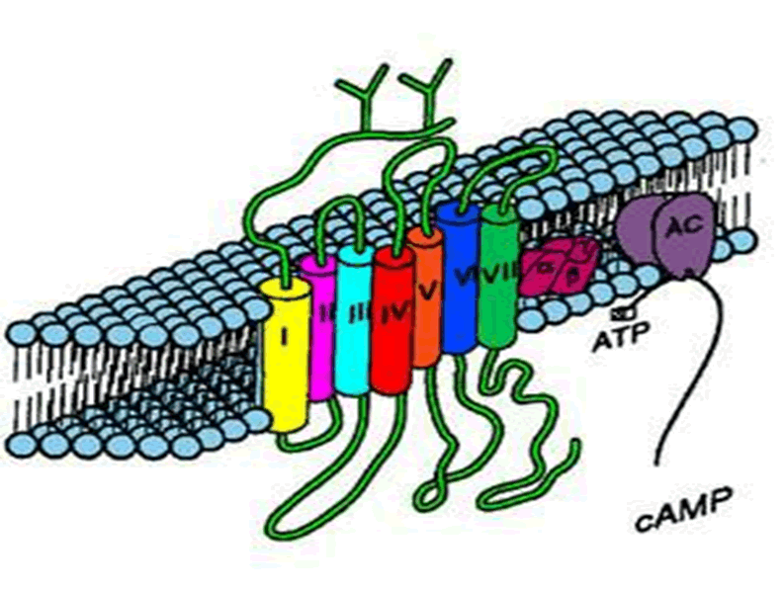
ADRENERGICS DEPRESSANTS
Adrenolytics
Sympatholytics

Slide 2
Adrenoceptor Blockers
Adrenolytics
Adrenergic Neuron Blockers Sympatholytics
Alpha & beta- adrenergic receptor blockers

Slide 3
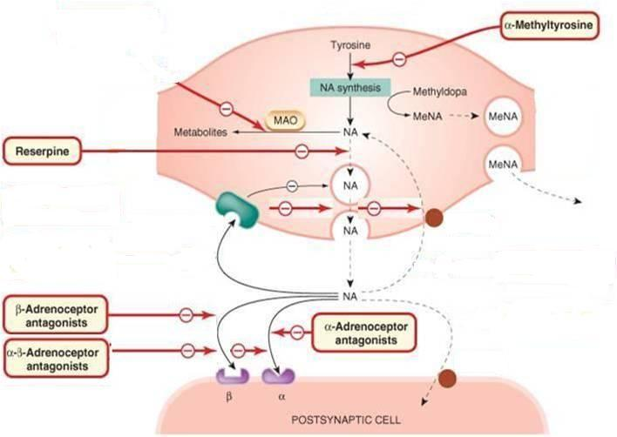
Sympatholytics
on ADR nerve endings
1
Methyle Dopa
2
Guanethidine
Synthesis
3
Storage
False transmitter
Depletion
-ve
α₂
α₂ adrenoceptor
Agonist Clonidine or Methyle dopa
+
Release
Uptake
+ve
α₂ Adrenoceptor
antagonist
Yohimbine
2
3
1
4
Adrenolytics
on ADR receptors

Slide 4
ADRENERGICS DEPRESSANTS
Sympatholytics

Slide 5
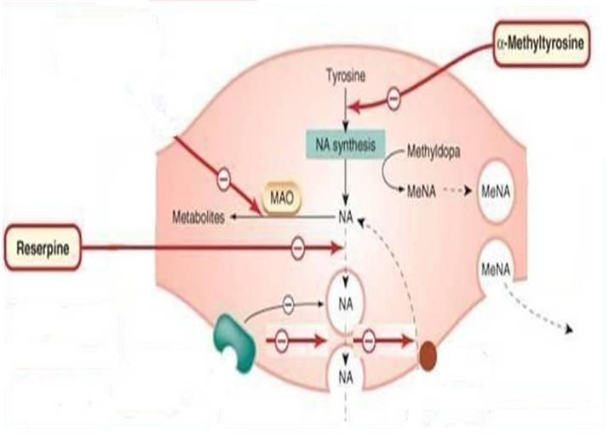
Sympatholytics
on ADR nerve endings
Methyle Dopa
X
Synthesis
Guanethidine
X
False Transmitter
+
α₂
α₂ Adrenoceptor
agonist
Clonidine & Methyle dopa
-ve
METHYLDOPA
Forms false transmitter that is released instead of NE
Acts as α₂ receptor agonist to inhibit NE release
Used as; Antihypertensive drug of choice in PREGNANCY
CLONIDINE
Acts directly as α₂ receptor agonist to inhibit NE release
Little Used as Antihypertensive agent due to rebound hypertension upon abrupt withdrawal.

Slide 6
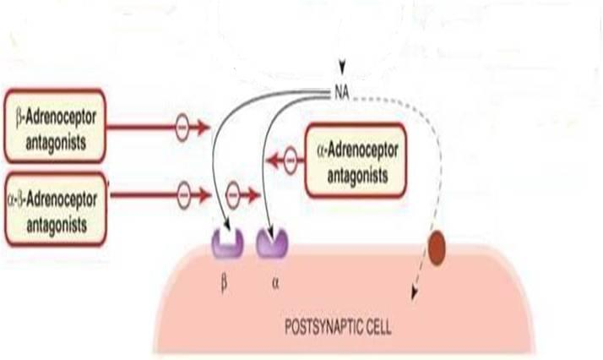
ADRENERGICS DEPRESSANTS
Adrenolytics
2
β Adrenergic Blockers
α₂ Adrenoceptor
antagonist
Yohimbine
2
3
α Adrenergic Blockers
1
4
αβ Adrenergic Blockers

Slide 7
ADRENERGICS DEPRESSANTS
Adrenolytics;
α Adrenergic Blockers

Slide 8
α ADRENOCEPTOR BLOCKERS
Non-Selective
X
Selective
Ergot
Blocks α₁& α₂
Blocks either α₁or α₂
α₂ ADR blocker
Irreversible
Yohimbine
Phenoxybenzamine
Release NE & ADH !!!
Aphrodisiac ???
Reversible
Phentolamine
α₁ ADR blocker
t_{1/2} 12 hrs / Acts 3dys
In Irreversible shock
( >microcirculation
+ADH)
In Pheochromocytoma; 1-2 w before surgical removal 
-ve Hypertensive crisis
Shorter
Prazosin
Tamsulosin
doxazosin, terazosin, trimazosin
uroselective

Slide 9
Selective α₁ ADRENOCEPTOR BLOCKERS
Tamsulosin
Uroselective α_{1A}
◉
Contracts bladder wall
Relaxes bladder neck & sphincters  used in Benign Prostatic Hypertrophy (BPH)
BPH
Prazosin (short t _{½}⁾
doxazosin, terazosin, trimazosin
 Longer t _{1/2}
peripheral vasodilatation (arteries & veins)
+ minimal changes in CO & renal blood flow  used in Raynaud’s disease
Can be used in hypertension, Heart Failure
ADR: Tachyphylaxis hypotension syncope (Postural hypotension=first dose effect), fluid retention, head-ache, nasal stuffiness, ejaculation & impotence.

Slide 10
ADRENERGICS DEPRESSANTS
Adrenolytics;
β Adrenergic Blockers

Slide 11
β ADRENOCEPTOR BLOCKERS
Block β₁& β_{2.}
Pharmacodynamic Classification
1
According to extent of blocked of each type they are either
Non-Selective
Selective
Block β₁& β₂
Block β₁>> β₂
Propranolol, Sotalol, Timolol (Eye)
Atenolol, Bisoprolol, Metoprolol, Esmolol
Labetalol, Carvedilol (Mixed)
2
According to presence of agonistic/antagonistic action;
Intrinsic Sympathomimetic Activity ( ISA )
Without ISA
With ISA
Propranolol, Atenolol, Sotalol, Bisoprolol, Timolol, Metoprolol;
Acebutalol
Carvedilol
Labetalol
3
According to presence of membrane stabilizing effects i.e. Block Na Channels
Quinidine-like action
Propranolol, Acebutalol
Labetalol

Slide 12
4
According to presence of CNS depressant effects i.e. Sedative effect
◉ Anxiety
Propranolol, Metoprolol, Labetalol > Carvedilol
β ADRENOCEPTOR BLOCKERS
Pharmacokinetic Classification
According to their lipid solubility
Lipophylic
Hydrophilic
 | Lipophylic | Hydrophilic
Oral absorption | Complete | Irregular
Liver metabolism | Yes | No
t _{1/2} | Short | Long
CNS side effects | High | low
 | Propranolol, Metoprolol, Timolol Labetalol > Carvedilol | Atenolol, Nadolol Sotalol, Acebutalol Bisprolol, Esmolol

Slide 13
PROPRANOLOL
Non-Selective Competitive Blocker of β₁ & β₂
Has quinidine-like & sedative actions /No ISA
Is the chosen as prototype
Kinetics
Lipophilic, completely absorbed,70% destroyed during 1st pass hepatic metabolism, 90-95% protein bound, cross BBB and excreted in urine.
Dynamics
β-blocking Effect
Cell Membrane Stabilization
CNS Effect
Heart; β₁
Negative inotropic, chronotropic, dromotropic   CO
Antianginal effects:
◉ Force & rate of contraction   cardiac work
◉ O₂ consumption due to bradycardia
Anti-arrhythmic effects:excitability,  automaticity &  conductivity due to its sympathetic blocking + quinidine-like actions

Slide 14
PROPRANOLOL
BV; β₂
Antagonize β₂ vasodilatory effect   peripheral resistance (PR) !!!
The resultant vasoconstriction  blood flow to all organs except brain  cold extremities + intermittent claudications (Therefore, it is contraindicated in peripheral diseases like Raynaud’s disease
BP;
Antihypertensive   BP in hypertensive patients after about 4 weeks due to effects on:
Heart:  CO (β₁)
Kidney:  renin & aldosterone secretion (β₁). (Very important)
Presynaptic (β₂) : Block them   NE release from adrenergic nerve terminals.
CNS:  sympathetic outflow (β₁).
Baro-receptors: Resetting
Bronchi: β₂
Bronchospasm > in susceptible patients N. B. Selective β-blockers are better choice for Asthma

Slide 15
PROPRANOLOL
Metabolic:
In liver;  Glycogenolysis  Hypoglycaemia (β₂)
In pancreas;  glucagon secretion (β₂)
In adipocytes;  Lipolysis (β₃)
Na retension; 2^{ndry} to BP renal perfusion
Hyperkalema
Hypoglycaemia
Cell Membrane Stabilization
Block Na channels  direct depressant to myocardium
 local anesthetic effect
CNS Effect
◉ tremors & anxiety  protect against social anxiety
 combat performance anxiety  performance enhancement
INDICATIONS of β-Blockers see summary
Hypertension;
Arrhythmias; Ventricular > atrial; special during exercise & anesthesia
Angina; > on effort N.B. Its anti-anxiety adds to the antianginal effect
It does not cause coronary dilatation

Slide 16
INDICATIONS
PROPRANOLOL
Myocardial infarction; given early ???  infarct size,
◉ morbidity & mortality  CARDIOPROTECTIVE
◉ myocardial O₂ demand.
 Redistribution of blood flow in the myocardium.
free fatty acids.
Anti-arrhythmic action.
◉ incidence of sudden death.
Pheochromocytoma; used with α-blockers (never alone):
* α-blockers lower the elevated blood pressure.
* β-blockers protect the heart from NE.
Hyperthyroidism;
* Controls symptoms; tachycardia, tremors, sweating
* Protects the heart against the sympathetic over-stimulation.
* Lowers the conversion rate of T₄ into T₃ (the active form)
Migraine (Prophylactic);  catecholamine-induced vaso-dilatation in the brain vasculature.

Slide 17
Other INDICATIONS
PROPRANOLOL
Chronic glaucoma;  IOP  by  secretion of aqueous humor by ciliary body. N.B. Timolol is the β-blocker given in glaucoma
Familial tremors
Anxiety (specially social & performance type)
ADR
Due to block of cardiac β₁-receptors:
Bradycardia by -ve chrontropic treated by atropine
Hypotension ……
Due to blockade of β₂- receptor: (only with non-selective β-blockers)
Asthma, emphysema, chronic bronchitis  by bronchospasm
Cold extremities & intermittent claudication by vasoconstriction
Coronary spasm  in variant angina patients (not a coronary dilators)
Erectile dysfunction & impotence
Hypoglycemia by glucogenolysis. But all β-blockers mask hypo- glycaemic manifestations i.e. tachycardia, sweating,…  COMA
 TG &  HDL

Slide 18
Other ADR
PROPRANOLOL
Depression, nightmares, vivid dreams and hallucinations (CNS acting).
Sodium retention  can add diuretic
Hyperkalemia  due to β₂ blockade
Sudden stoppage will give rise to a withdrawal syndrome:
Rebound angina, arrhythmia, myocardial infarction & hypertension WHY ?  Up-regulation of β-receptors.
N.B. Occurs more with β-blockers, that do not possess ISA.
To prevent withdrawal manifestations  drug withdrawn gradually
Safer in patients with: COPD
Rauynald’s phenomenon & PVD ….etc / Variant Angina. Diabetics/ Dyslipidemias,
Selective
Only (β₁)

Slide 19
Contraindications
PROPRANOLOL
Uncompensated Heart Failure.
Massive Myocardial Infarction.
Heart Block.
Bronchial Asthma (not with cardio-selective β-blockers).
Peripheral vascular disease (not with cardio-selective β-blockers).
Diabetic patients. (Type I) (On Insulin or oral hypoglycaemic)  Masking of hypoglycaemia / GIVEN CAUSIOUSLY
Hypotension
Alone in pheochromocytoma (must be with an α-blocker).
Interactions
Pharmacokinetic Interactions
Pharmacodynamic Interactions
Drug Inducers   its therapeutic effect
Drug Inhibitors   its adverse / toxic effects

Slide 20
Interactions
PROPRANOLOL
Pharmacodynamic Interactions
Bradycardia / heart block  with verapamil both induce A.V block -ve dromotropism
Attenuation of hypertensive effect  with NSAIDs  because they  formation of vasodilating prostaglandins.
Claudications, parasthesia, …etc with ergot alkaloids in migraine.
Enhanced neuromuscular blockade  Tubocurarine
Hypoglycaemia  with anti-diabetic drugs ( insulin > sulfonylureas) > Non selective β-blockers

Slide 21
LABETALOL
Blocks β & α₁
Rapid acting, non-selective with ISA & local anesthetic effect
Do not alter serum lipids or blood glucose
Used in  Severe hypertension in pheochromocytoma & hypertensive crisis during abrupt withdraw of clonidine
Used in pregnancy-induced hypertension instead of methyldopa
ADR; Orthostatic hypotension, sedation & dizziness
CARVEDILOL
Blocks β > α₁ (so more VASODIALATING)
Non-selective with no ISA & no local anesthetic effect.
Has ANTIOXIDANT
Favorable metabolic profile.
Used effective in  CONGESTIVE HEART FAILURE  reverses its patho- physiological changes
ADR; Edema

Slide 22
Agents specifically indicated for hypertension
Atenolol, Bisoprolol, Metoprolol,
Agents specifically indicated for cardiac arrhythmia
Esmolol (ultra-short scting), Sotalol, Propranolol??
Agents specifically indicated for congestive heart failure
Carvedilol, Bisoprolol, Metoprolol
Agents specifically indicated for myocardial infarction
Atenolol, Metoprolol
Agents specifically indicated for glaucoma
Timolol
Agents specifically indicated for migraine prophylaxis
Propranolol
Agents specifically indicated for relief of anxiety (social & performance)
Propranolol
Agents specifically indicated in thyrotoxicosis
Propranolol

Slide 23
GOOD LUCK

Slide 24
Drugs | Selectivity | Partial agonist activity | Local Anesthetic activity | Lipid solubility | t ½ (h)
Propranolol | β1 , β2 | - | + | High | 4-6
Pindolol | β1 , β2 | + | Weak | Moderate | 3-4
Nadolol | β1 , β2 | - | - | Low | 14-24
Timolol | β1 , β2 | - | - | Moderate | 4-5
Atenolol | β1 | - | - | Low | 6-9
Acebutalol | β1 | + | + | Low | 3-4
Metoprolol | β1 | - | - | Moderate | 3-4
Esmolol | Β1 | - | - | Low | 10 min
Bisoprolol | β1 | - | - | Low | 9-12
Labetalol | β1>β1+ α1 | + | + | Moderate | 5
Carvedilol | β + α1 | - | - | Moderate | 6-8

