Slide 1
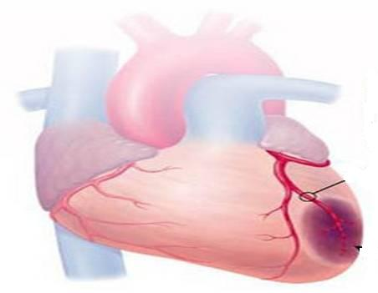
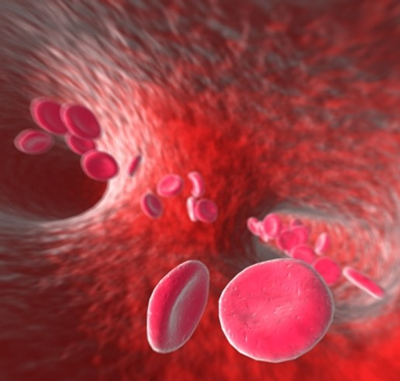
ANTIANGINAL DRUGS

Slide 2
ANTIANGINAL DRUGS
ILOs
By the end of those 2 lectures
[24 slides for studing]
you will be able to:
Recognize variables contributing to a balanced myocardial supply vs demand
Identify etiopathogenic cascades contributing to ischemic heart disease
Justify the different related clinical presentations of ischemic heart disease
Expand on the drugs used to alleviate acute anginal attacks vs those meant for prophylaxis & improvement of survival
Detail the pharmacology of nitrates, other vasodilators, and other drugs used as antianginal therapy
Sum up the varied therapeutic recommendations for treatment of different clinical presentations of ischemic heart disease

Slide 3
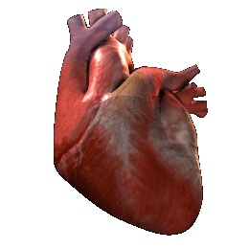
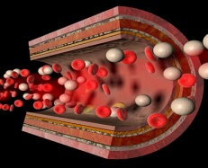
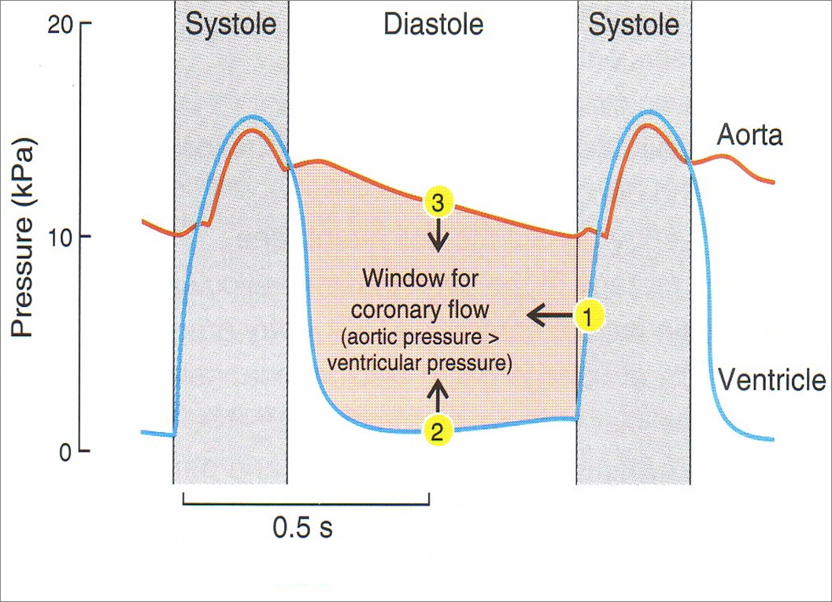
Coronary SUPPLY
Pumping Heart DEMAND
WORK
O₂
G
ATP
FFA
O₂
G
O₂
O₂
O₂
ATP
G
O₂
O₂
FFA
FFA
G
O₂
ATP
[S]
[D]
[S]
◉ DP
Shortening of D
 Ventricular End-DP

Slide 4
Coronary SUPPLY
Pumping Heart DEMAND
WORK
O₂
G
ATP
FFA
O₂
G
O₂
O₂
O₂
ATP
G
O₂
O₂
FFA
FFA
G
O₂
ATP
?
?
ISCHEMIC HEART DISEASE
?

Slide 5
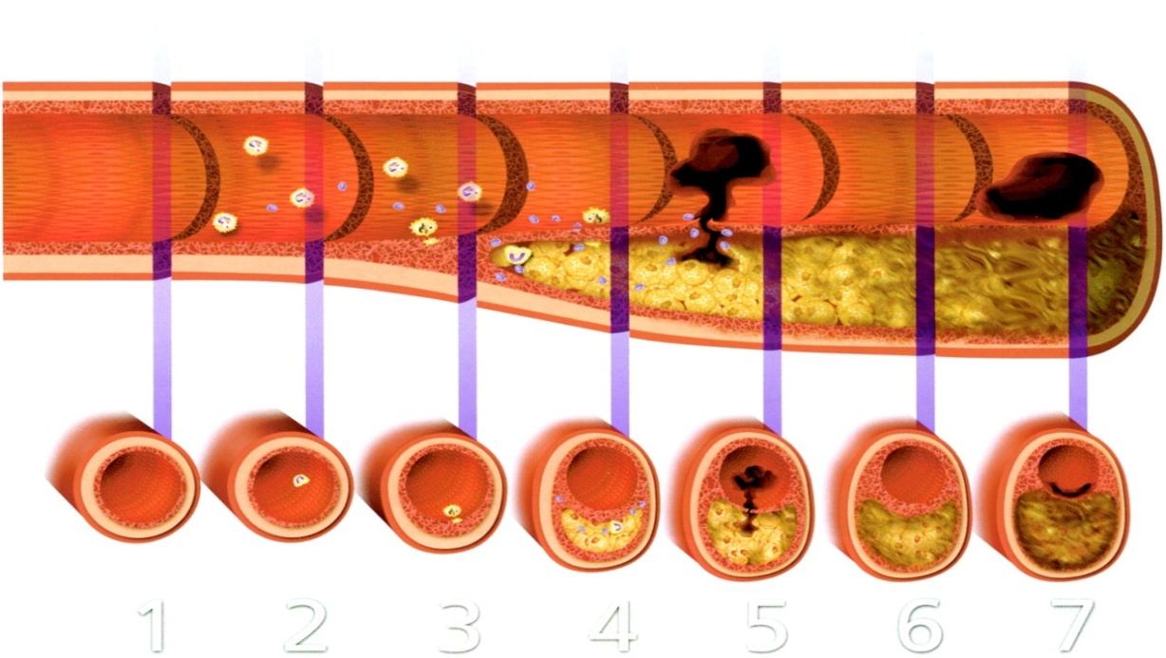
CORONARY NARROWING
CORONARY HEART DISEASES [CHD]
FUNCTIONAL
STRUCTURAL
SPASM
ATHEROSCLEROTIC
PLAQUE
ISCHEMIC HEART DISEASES [IHD]
+ THROMBOSIS
SPASTIC ANGINA
ANGINA
Stabilized
Vulnerable
STABLE ANGINA
UNSTABLE ANGINA
ACUTE MYOCARDIAL INFARCTION [AMI]
ACUTE CORONARY SYNDROME [ACS]

Slide 6
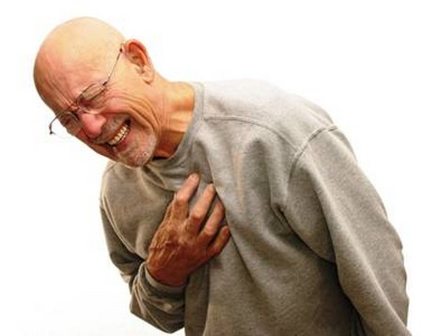
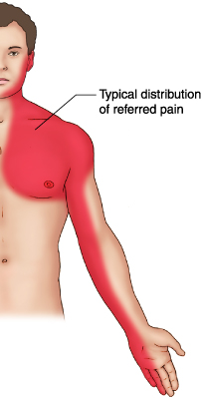
ANGINA Pectoris
By a Spasm or Stabilized Plaque
Chest pain (varying in severity) due to ischemia of heart muscle caused by obstruction or spasm of coronary arteries
Constricting & tight, oppressive, crushing
Starts in the centre behind the sternum or on left side of the front of chest & spread out to shoulder arm…..a
Pain is due to (accumulation of metabolites K⁺, PGs, Kinins, Adenosine….) 2^{ndry} to the ischemia
Prinzmetal’s Angina
Stable Angina
Unstable Angina
Vulnerable Plaque
VARIANT ANGINA
EFFORT ANGINA
CRESCENDO ANGINA
Occurs at rest Cyclic (vasospasm) due to contraction of VSMC
>in younger women
Develops by exertion
Resolves at rest
Lasts ~5 min
Insidious onset
Occurs at rest / minimal exertion
Severe / Lasting >10 min; Either of;
* New onset (nothing for last 4–6 w)
* Crescendo pattern; getting > severe / prolonged / frequent than previous
ACS
Sustained Spasm

Slide 7
RELATION OF PATHOPHYSIOLOGICAL FINDINGS TO ACS
Vulnerable
Plaque  ACUTE OCCLUSION 
(~Subtotal / Total) ACS
Vulnerable
Plaque 
Rupture / erosion / fissuring
exposure of thrombogenic
surface platelets adhere 
thrombosis  OCCLUSION
Internal haemorrhage  sudden growth  OCCLUSION

Slide 8
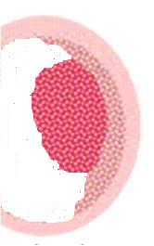
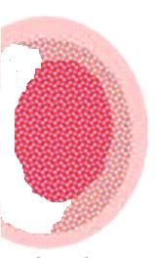
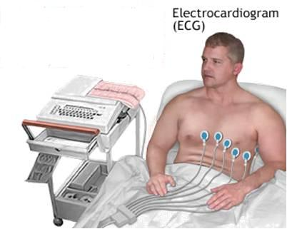
ACUTE CORONARY SYNDROMES [ACS]
Acute ~Subtotal / Total OCCLUSION
Umbrella term that covers a spectrum of acute clinical conditions ranging from
Unstable angina (38%)
NSTEMI (25%)
STEMI (30%)
ATP, Ion PumpsCa 
~~Action Potention, elect. Activities & functions
Inflam. Mediators, ROS TNFα, NF_{κ}B, ….
Apoptosis
Proteolysis, Membrane damage….
Cardiac Enzymes (Markers)
ECG CHANGES
Necrosis
Non ST – Elevation
ST – Elevation
-ve
+ve
Unstable Angina
AMI
AMI
NSTEMI
STEMI

Slide 9
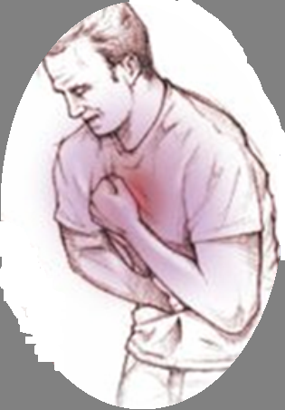
DRUGS USED IN TREATMENT OF ANGINA
Agents that improve symptoms & ischemia
Organic nitrates
Calcium channel blockers
Potassium channel openers
β-adrenoceptor blockers
Metabolically acting agents
Others
Vasodilators.
Agents that improve prognosis
Aspirin /
Other antiplatelets
Statins
ACE Inhibitors
β-AD blockers
ANTIANGINAL DRUGS

Slide 10
DRUGS USED IN TREATMENT OF ANGINA
Vasodilators.

Slide 11
NITRODILATORS
Release NO via enzymatic reaction
Release NO spontaneously
ORGANIC NITRATES
Na NITROPRUSSIDE
ANTIANGINAL DRUGS
ANTIHYPERTENSIVES
Short Acting
Long Acting
Nitroglycerine [GTN]
Amyl Nitrite
Isosorbide mono & dinitrate
Erythrityl tetranitrate
Pentaerythritol tetranitrate
Unstable angina
Heart Failure
Rapid
Slower
For terminating an acute attack
For long-term prophylaxsis
I.V. or infusion
Sublingual
Oral sustained release Transdermal patches
Preparations;
can influence a change in indications

Slide 12
ORGANIC NITRATES
ANTIANGINAL DRUGS
Nitrates
◉
Nitrosothiols
◉
Nitrite Ion in endothelial cell (EC)
◉
Acts as NO donner
Mimick action of
Endogenous NO
Endothelial Cell [EC]
Diffusion
Vascular Smooth Muscle [ VSMC]
?
Mechanism
O₂
In VSMC [ In SMC ]
Binds soluble GC
Formation of cGMP
Activation of PKG
RELAXATION
H₂O
PKG
Phosphorylate
P
MLCK
MLCK
Inactive form
Active form
P
MLC
MLC
Contraction
Actin
Relaxation
N.B. NO is well developed in Arteriolar > Venular System
Exogenous NO donners act on Venular > Arteriolar system

Slide 13
Pharmacodynamic Actions
ORGANIC NITRATES
1. Anti-Anginal Actions
 Myocardial Oxygen Supply;
Dilatation of large coronary vessels.
Redistribution of coronary flow from normal to ischemic region.
Dilatation of collaterals.
◉ Myocardial Oxygen Demand by cardiac work indirectly ;
Venodilatations: of capacitance vessels preload   central venous P  CO
Arteriolar vasodilatation:  peripheral resistance &  afterload (reflex tachycardia???)  BP at high dose
Platelet Aggregation
Endothelial protective action  leukocyte-endothelial interactions (anti-inflammatory); antiatherogenic potentials
2. Other Pharmacodynamic Actions
SMC Relaxation of
Bronchi NO activates cGMP in BSMC  bronchodilatation
Gastrointestinal tract & biliary system
Genitourinary tract

Slide 14
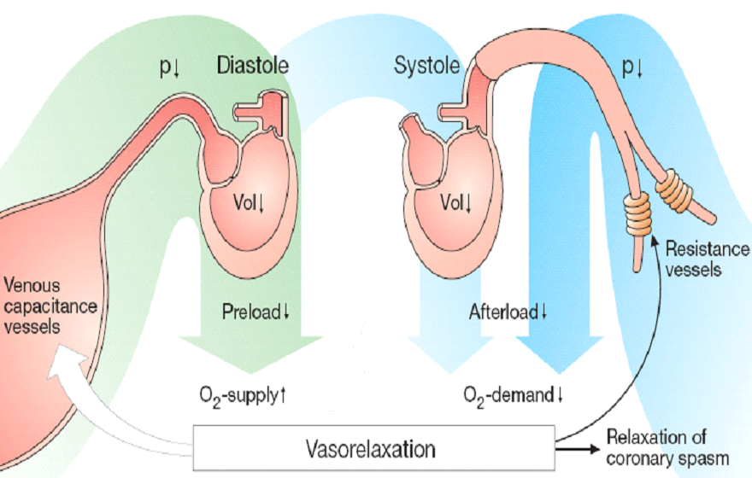
ORGANIC NITRATES
CV effects of Nitrates on Preload & Afterload

Slide 15
ORGANIC NITRATES
How Nitrates increases flow to ischemic zone ?
In Ischemia
With Nitrates

Slide 16
Pharmacokinetics
ORGANIC NITRATES
Nitroglycrine [GTN];
Significant first pass metabolism occurs in the liver (10-20%) bioavailability
(so sublingual or via transdermal patch)
Oral isosorbide dinitrate & mononitrate
Very well absorbed & 100% bioavailability
The dinitrate undergoes denitration to two mononitrates both possess antianginal activity (t_{1/2} 1-3 hours)  Further denitrated metabolites conjugate to glucuronic acid in liver. Excreted in urine.
Indications
IN STABLE ANGINA;
Acute symptom relief  sublingual GTN
Prevention; Persistant prophylaxis  Isosorbide mono or dinitrate
Situational prophylaxis  as before exercising, climbing…etc
 sublingual GTN
IN VARIANT ANGINA sublingual GTN
IN UNSTABLE ANGINA  IV GTN
Refractory AHF  IV GTN
CHF  Isosorbide mononitrate + hydralazine [ if contraindication to ACE Is ]
AMI IV GTN

Slide 17
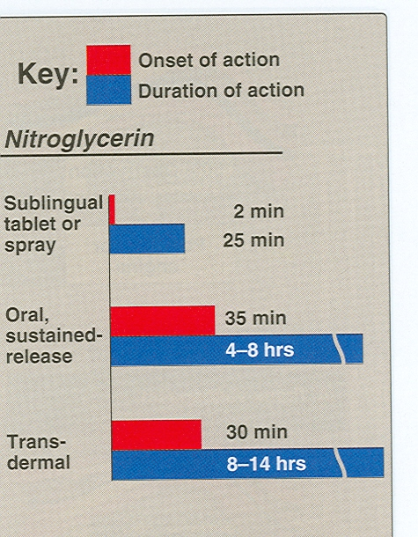
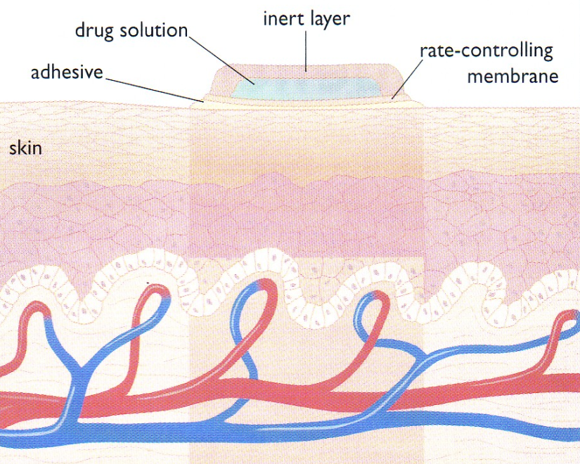
Preparations
Nitroglycerine
Sublingual tablets or spray
Transdermal patch
Oral or bucal sustained release
I.V. Preparations
Isosorbide dinitrate & mononitrate
Dinitrate Sublingual tablets
Dinitrate Oral sustained release
Mononitrate Oral sustained release
Infusion Preparations

Slide 18
ADRs
ORGANIC NITRATES
Postural hypotension with reflex tachycardia: especially if the patient is standing stationary.
Nitrite syncope with fainting & collapse due to  dilatation of venous capacitance vessels + severe  of venous return  CO & BP.
Nitrite syncope is treated by putting the patient in a low head position.
Flushing of blush area (face, neck and upper trunk) is unpleasant
Throbbing headache (>common) & tendency to  intra-cranial pressure  used cautiously in cerebral bleeding & head trauma
Drug rash.
Visual disturbance.
Carcinogenesis
Met-hemoglobinemia
(in overdose & accidental poisoning)

Slide 19
ORGANIC NITRATES
NIRATE TOLERANCE
Loss of vasodilator response of nitrates on use of long-acting preparations (oral, transdermal) or continuous intravenous infusions, for more than a few hours without interruption.
Magnitude of tolerance is a function of dosage & frequency of use.
Causes
After 1st day of continuous nitrates, compensatory neurohormonal counter-regulation occurs (RAAS, NE, Vasopressin ….etc activation) therapeutic efficacy (PSEUDOTOLERANCE).
After 3 days, dysfunction of ECs & VSMC occur by many different molecular mechanisms, aside the partial depletion of free-SH groups that permits formation of nitrosothiols from the organic nitrate to give NO (TOLERANCE)
Nitrate tolerance can be overcomed by:
Smaller doses at increasing intervals (Nitrate free periods twice a day).
Giving drugs that maintain tissue SH group e.g. Captopril.

Slide 20
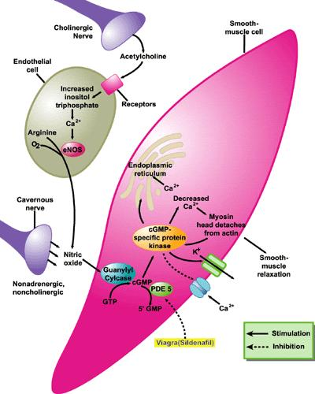
Precautions during nitrate therapy
ORGANIC NITRATES
10 hours nitrate free period.
Never stop nitrate therapy suddenly.
Do not take double dose.
Do not use after expiry date; GTN is
volatile; shelf-life ~6w after opening
Must be stored in cool, tightly capped dark container, no cotton wool or others.
Contraindication
Known sensitivity to organic nitrates.
Glaucoma; nitrates  aqueous formation
Head trauma or cerebral haemorrhage
Increase intracranial pressure .
Uncorrected hypovolemia
Concomitant administration of PDE₅ Inhibitors that are used for the treatment of erectile dysfunction  BP Myocardial Ischemia
VSMC
Dilatation
PDE₅ Inhibitors

Slide 21
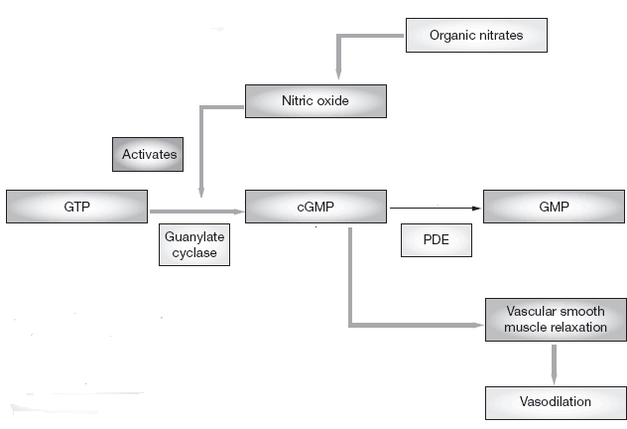
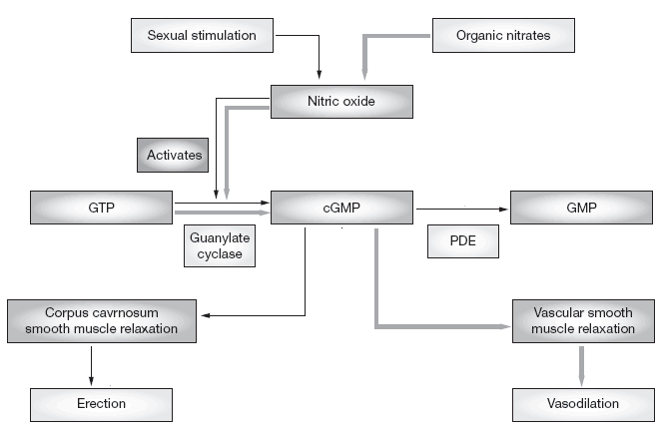
ORGANIC NITRATES
PDE₅ Is
cGMP
X
Vasodilatation
BP
coronary perfusion
MYOCARDIAL ISCHEMIA

