Slide 1
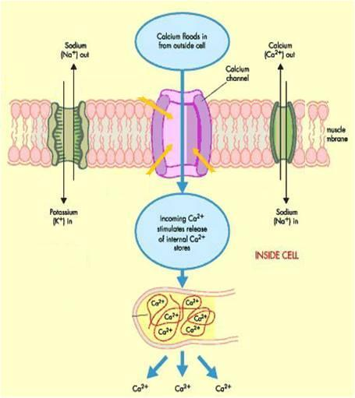
Ca CHANNEL BLOCKERS
ANTIANGINAL DRUGS
Classification
Dihydropyridines:- Nifedipine , Nicardipine, Amlodepine
Phenylalkylamines:- Verapamil
Benzthiazepines:- Diltiazem
Heterogeneous
Mechanism
Binding of calcium channel blockers [CCBs] to the L-type Ca channels
◉ their frequency of opening
in response to depolarization
Nifedipine
X
entry of Ca   Ca from internal stores  No Stimulus-Contraction Coupling  RELAXATION
Diltiazem
Verapamil
Phosphatase
MLCK
P
Ca²⁺ CaM Kinase
Active form
MLCK
P
MLC
MLC
Release Ca from intracellular stores
Ca²⁺ CaM complex
Contraction
Actin
Relaxation

Slide 2
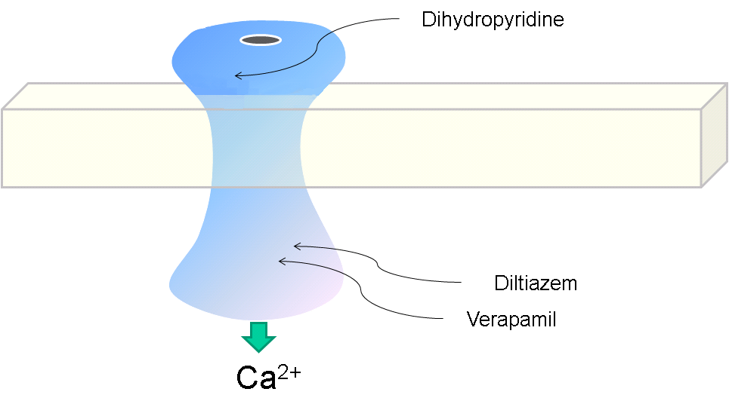
Ca CHANNEL BLOCKERS
Ca Channel Types & Distribution
Pharmacodynamic Actions
Distribution | Type
Cardiac & VSMCs / neurons | L
Heart / neurons | T
Neurons | N
Cerebellar Purkinje neurons | P
1. Anti-Anginal Actions
Nifedipine
Diltiazem
◉ Cardiomyocyte Contraction
Verapamil
cardiac work through their –ve inotropic & chronotropic action (verapamil & diltiazem)  myocardial oxygen demand
VSMC
Contraction
◉ After load  cardiac work 
myocardial oxygen demand
Coronary dilatation (nifedipine & nicardipine (short acting) / amlodipine (long acting) > diltiazem & verapamil  myocardial oxygen supply
N.B. Selectivity of Ca channel blockers
Nifedipine  VSMCs
Verapamil  Cardiomyocytes > VSMCs
Diltaizem  Intermediate action on both

Slide 3
Indications AS ANTIANGINAL
Ca CHANNEL BLOCKERS
IN STABLE ANGINA;
Regular prophylaxis 
Long acting dihydropyridines ; amlodipine & SR formulation nifedipine, diltiazem > verapamil
Short acting dihydropyridine avoided  BP symathetic activation refelx tachycardia +syncope impair coronary fillingischemia …..
Can be combined to β-AR blockers??? Which group is much safer???
→ Can be combined with nitrates??? Which group is much safer???
→ Dihydropyridenes  no  contractility  useful antianginal if with CHF
→ Verapamil & diltiazem  < vasoactivity  as antianginal if hypotension
IN VARIANT ANGINA Attacks prevented (> 60%) / sometimes variably aborted
IN UNSTABLE ANGINA; Seldom added in refractory cases

Slide 4
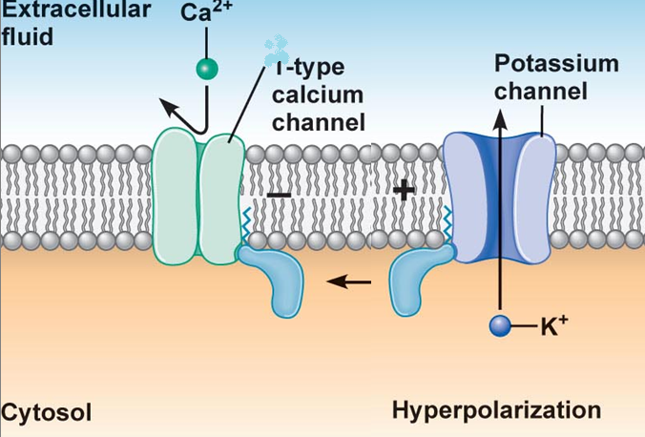
K CHANNEL OPENERS
ANTIANGINAL DRUGS
Nicorandil
Mechanism
It has dual mechanism of action;
1. Opens K_{ATP} channels (> arteriolar dilator)
2. NO donner as it has a nitrate moiety (> venular dilator)
Pharmacodynamic
1. On VSMC
K channel opening
◉
Hyperpolarization
◉
VASODILATATION
L
1. On Cardiomyocyte
Nicorandil
K channel opening
◉
Repolarization
◉
Cardiac work
Inhibit Ca entry
1.Opening of K_{ATP} channels

Slide 5
Nicorandil
K CHANNEL OPENERS
2. Acting as NO donner
2. On VSMC
NO donner
◉
 cGMP/ PKG
◉
VASODILATATION
Indications
Prophylactic 2nd line therapy in stable angina & refractory variant angina
ADRs
Flushing, headache,
Hypotension, palpitation, weakness
Mouth & peri-anal ulcers, nausea and vomiting.

Slide 6
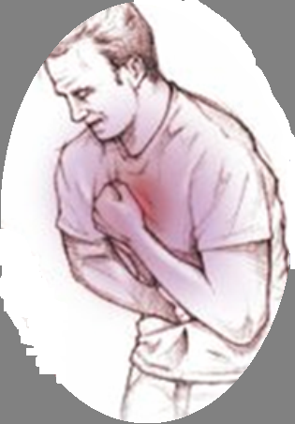
DRUGS USED IN TREATMENT OF ANGINA
β
– AR BLOCKERS

Slide 7
β - AR BLOCKERS
Β₂
VSMC
CARDIOMYOCYTE
Β₁
NO Vasodilatation
◉ Cardiac Work
Β₂
SMC
β₁ – Selective > Non – Selective
NO Relaxation
Atenolol
Bisoprolol
Metoprolol
Pharmacodynamic Actions
1. Anti-Anginal Actions
cardiac work through their
-ve inotropic & chronotropic action
afterload
renin angiotensin release
 myocardial oxygen demand
Though no coronary dilatation, yet  prolonged diastole   perfusion time   coronary filling & flow 
myocardial oxygen supply

Slide 8
β - AR BLOCKERS
ANTIANGINAL DRUGS
Indications as antianginal
IN STABLE ANGINA;
Regular prophylaxis  Cardio-selective are better. Why???  to spare β₂-AR
They are 1st choice on prolonged use   incidence of sudden death specially due to ventricular tachycardia  by their antiarrhythmic action.
Can be combined with nitrates  abolish its induced reflex tachycardia.
Can be combined with dihydropyridene CCBs but not verapamil nor diltiazem  for fear of conduction defect (bradycardia, heart block)
IN VARIANT ANGINA contraindicated  as it has no vasodilator action & allow unopposed α-adrenergic coronary vasoconstriction to occur.
IN UNSTABLE ANGINA  halts progression to AMI  improve survival
In Myocardial Infarction; given early  infarct size,
morbidity & mortality  CARDIOPROTECTIVE
◉ myocardial O₂ demand.
 Redistribution of blood flow in the myocardium.
free fatty acids.
Anti-arrhythmic action.
◉ incidence of sudden death.

Slide 9
β - AR BLOCKERS
Precautions
β- blockers should be withdrawn gradually as sudden stoppage  give rise to a withdrawal manifestations:
Rebound angina, arrhythmia, myocardial infarction & hypertension WHY ?  Up-regulation of β-receptors.
Non-selective are better avoided as they blocks vasodilatory effects of sympathetic stimulation  afterload &  oxygen consumption.
Not used in variant angina  worsen symptoms and aggrevate condition
Given to diabetics with ischemic heart disease  [Benefits > hazards) & ACE inhibitor must too be added specially in ACSs

Slide 10
DRUGS USED IN TREATMENT OF ANGINA
Metabolically acting agents

Slide 11
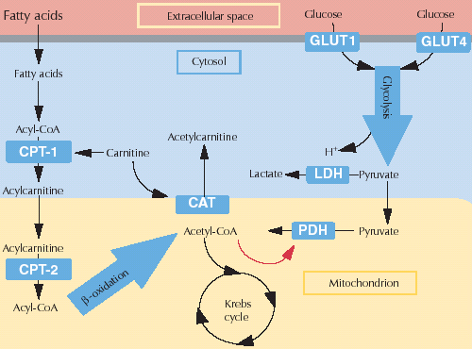
ANTIANGINAL DRUGS
Metabolically Acting Agents
TRIMETAZIDINE
Mechanism
O₂ requirement for glucose utilization is < FFA utilization i.e. oxidation of FFA requires > oxygen per unit of ATP generated than oxidation of CHO.
During ischemia, metabolism shifts to oxidation of FFA.
So, to treat we can enhance > utilization of CHO (less energy cost) ; by giving 
Partial FFA Oxidation Inhibitors
(pFOX Inhibitors), TRIMETAZIDINE
Pharmacol Effects
Restores energy balance in the cell.
◉ fatty acid metabolism by -ve 3 Ketoacyl Thiolase [3KAT]
-ve anaerobic glycolysis
X
Allowing only aerobic glycolysis
3KAT
-ve acidosis & FR accumulation 
◉ apoptosis  Cytoprotective
Thus shift myocardial metabolism to 
OXYGEN DEMAND WITHOUT ALTERING HEMODYNAMICS

Slide 12
Metabolically Acting Agents
Indication
Used when ever needed as add on therapy to nitrates, CCBs or β-blockers
ADRs  GIT disturbances
Contraindications
Hypersensitivity reaction
In pregnancy & lactation
Ranolazine
Newly introduced. Considered one of the metabolically acting agents like trimetazedine.
+ affects Na dependent-Ca Channels  prevents Ca load   apoptosis  cardioprotective.
It prolongs the QT interval so not given with; Class Ia & III antiarrhthmics
Toxicity develops due to interaction with CYT 450 inhibitors as; diltiazem, verapamil, ketoconazole, macrolide antibiotics, grapefruit juice

Slide 13
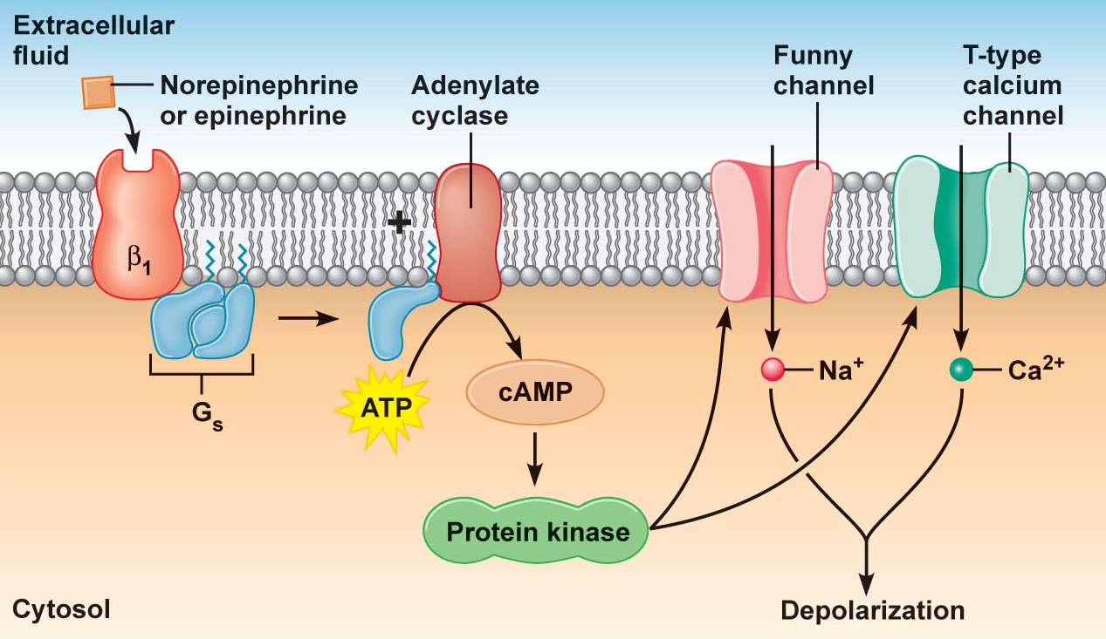
DRUGS USED IN TREATMENT OF ANGINA
OTHERS
Ivabradine
Not classified  claimed to be CARDIOTONIC agent
X
SAN
Acts on the “ Funny Channel” a special Na channel in SAN HRmyocardial work Myocardial O₂ demand
OTHERS

Slide 14
DRUGS USED IN TREATMENT OF ANGINA
Agents that improve prognosis
Aspirin / Other antiplatelets
Statins
ACE Inhibitors
β-AD blockers
Main Stay of Prophylactic Treatment
Halt progression
Prevent acute insults
Improve survival

Slide 15
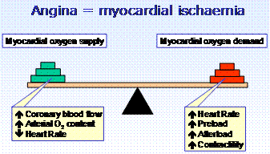
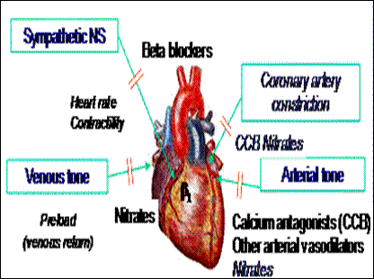
ANTIANGINAL DRUGS SET THE BALANCE BACK
◉
◉
◉
◉
In attack & situational prophylaxsis
Short acting nitrates
For prophylactic therapy
β-adrenoceptors blockers.
Calcium channel blockers
Long - acting nitrates.
Potassium channel openers
Metabolic modifiers & others
In Combinations

Slide 16
THERAPEUTIC GUIDELINES FOR ISCHEMIC HEART DISEASES
Stable Angina:
Acute symptoms by short acting nitrates
Maintain therapy by a suitable antianginal drug (Nitrates and/or β- Blockers and/or CCB + metabolic modifiers).
Vasospastic Angina:
Prevention and even abortion of an attack of coronary artery spasm is achieved by Nitrates and/or CCB.
Propranolol is contraindicated.
ACS
Unstable angina:  Better transfer to ICU or CCU.
Antianginal drugs (Nitrates &/or B-blockers, CCB in refractory cases) + Aspirin or Antiplatelets & IV Heparin.
IF THERAPY FAIL to any REVASCULARIZATION ?  OPENING OF OCCLUDED VESSEL either by;
Percutaneous coronary intervention; PCI
Surgical coronary artery bypass grapht; CABG

Slide 17
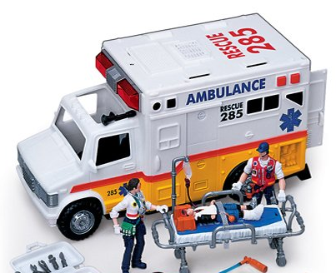
ACS
AMI: Transfer to CCU & apply the following measures:
Before & During Transfer:
Cardiopulmonary resuscitation / Oxygen & I.V fluids.
Nitroglycrine sublingual up to 3 doses with 5 minutes intervals
Analgesics, as morphine, for severe pain.
Chewable aspirin 160 mg.
In ICU or CCU units:
Thrombolytics: to induce clot lysis & restore blood flow
Anti-coagulant: IV Heparin, continue on aspirin orally
O₂ & Opiates: IV morphine or meperidine.
Nitrates: IV infusion of GTN + early β-blockers  myocardial damage.
ACE Inhibitors start early postmyocardial fibrosis & improve survival
Statin therapy start early stabilize plaque

Slide 18
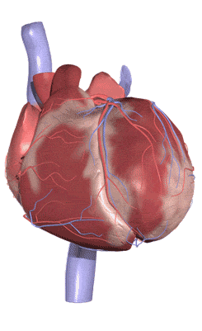
GOOD LUCK

Slide 19
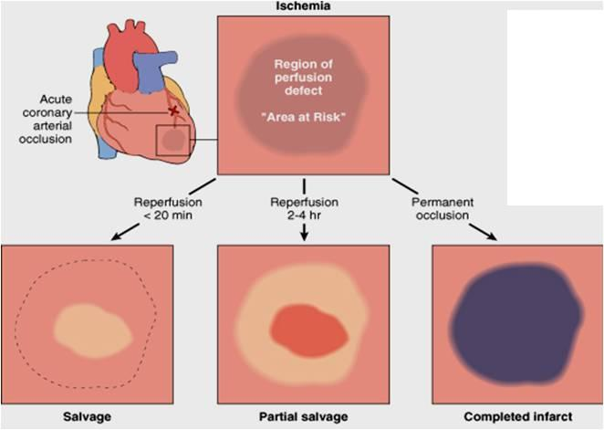
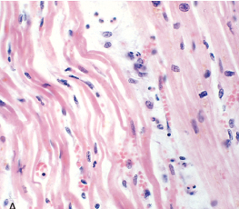
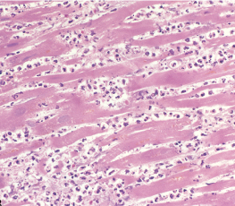
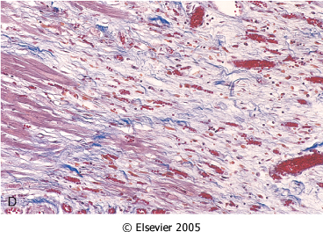
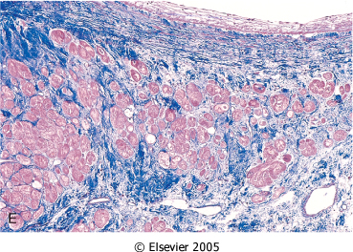
SEQUENCE OF EVENTS AFTER AMI
After 1 day
< 3days
Coagulative Necrosis
Neutrophilic Infiltrate
1-2 weeks
>3 weeks
Benefits of adding ACE Inhibitors & β-blockers
Granulation T.
Scaring & Fibrosis
Post-myocardial Fibrosis

Slide 20
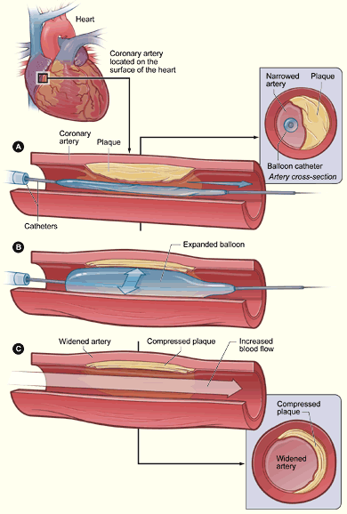
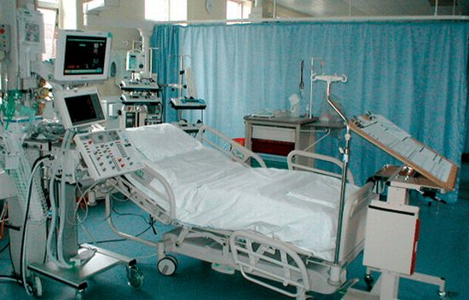
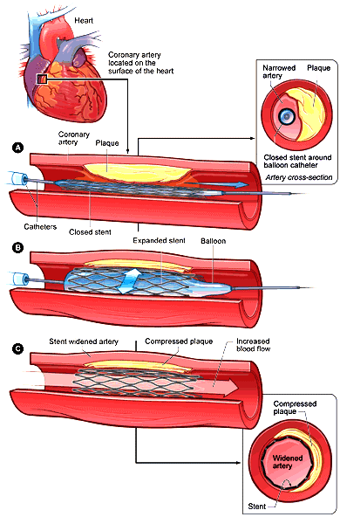
PCI
Ballon Angioplasty
+ STENT DEPLOYMENT

