Slide 1
Fibrinolytic Drugs
(Thrombolytic Drugs )
By Prof. Hanan Hagar
Dr.Abdul latif Mahesar

Slide 2
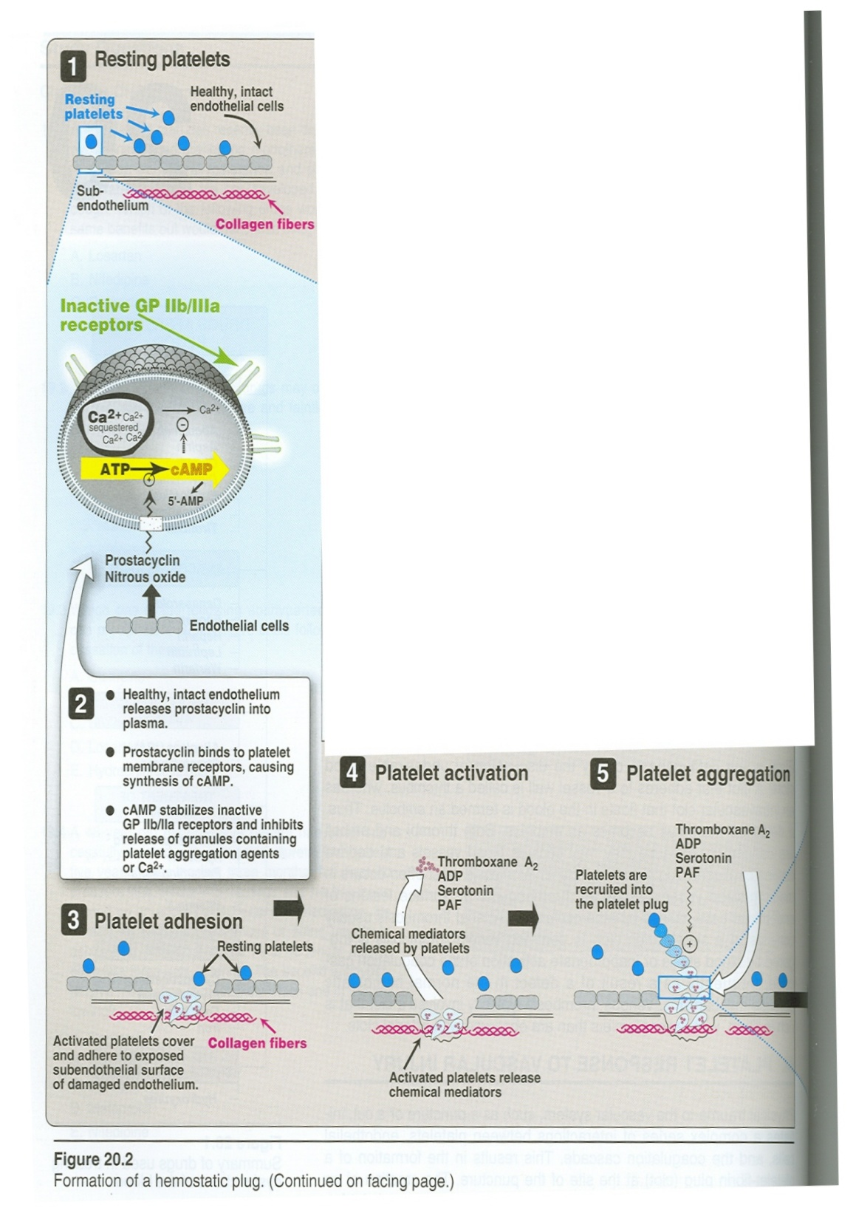

Slide 3
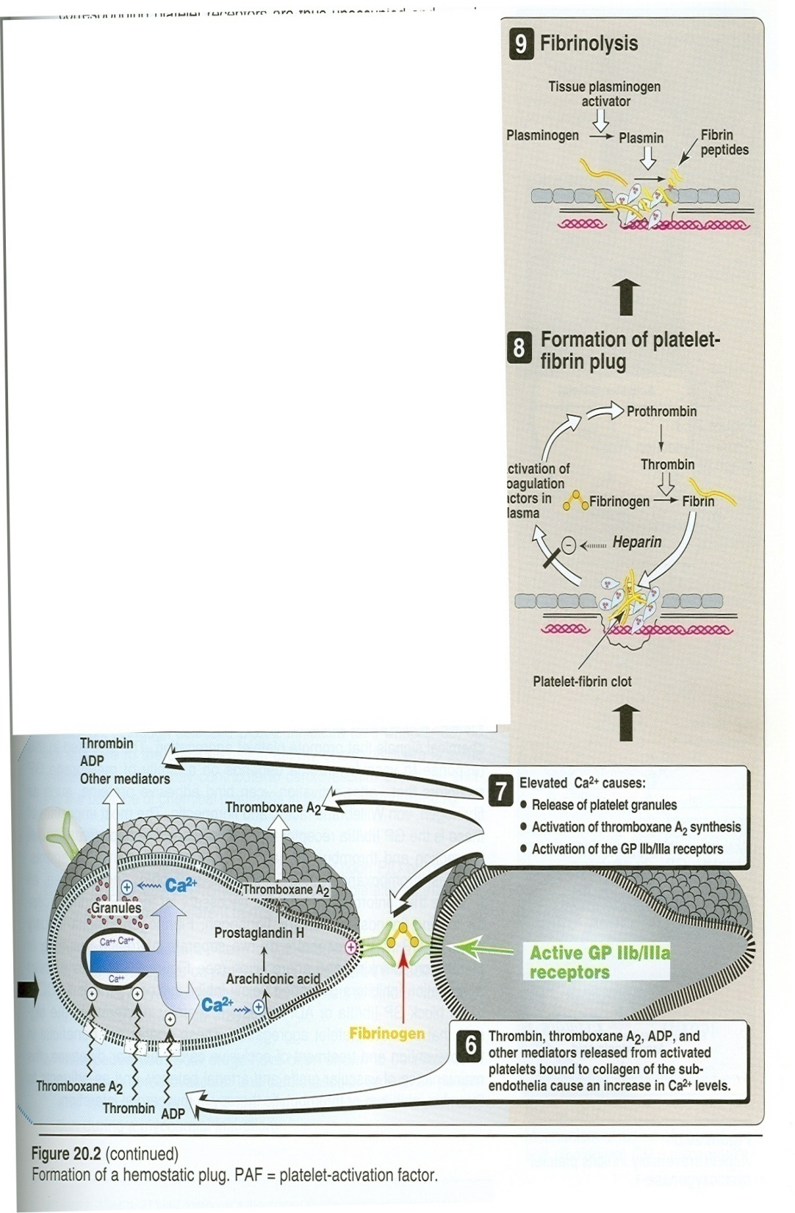

Slide 4
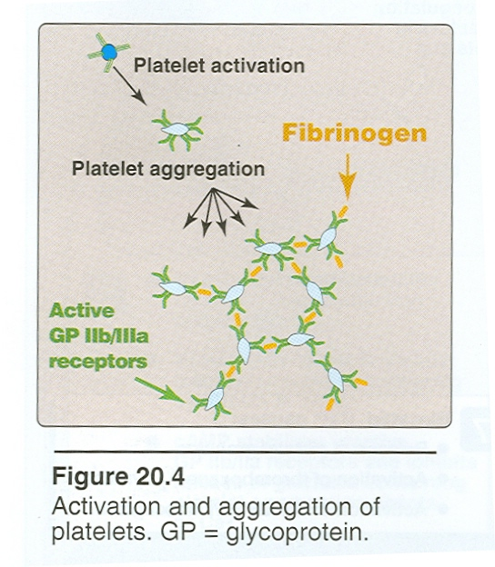

Slide 5
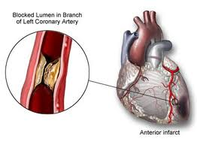

Slide 6
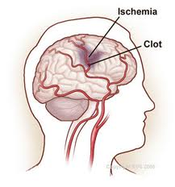

Slide 7
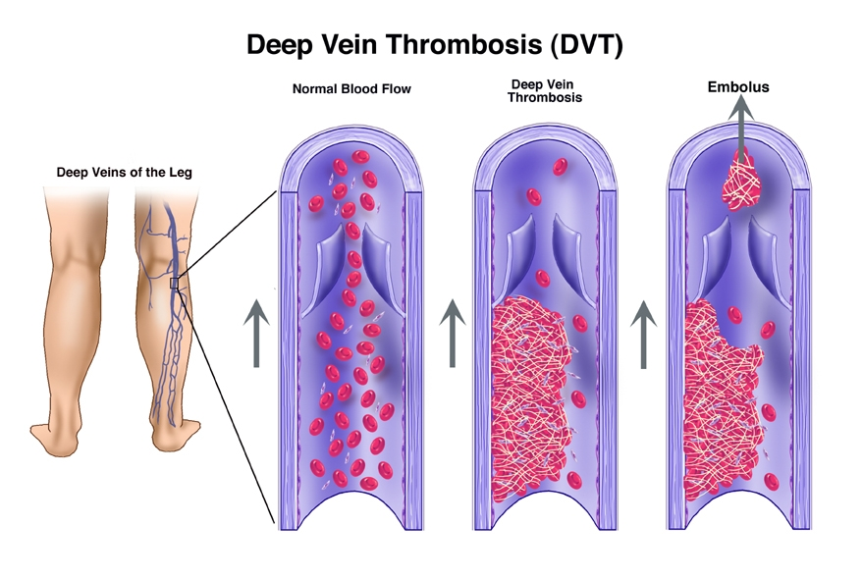

Slide 8
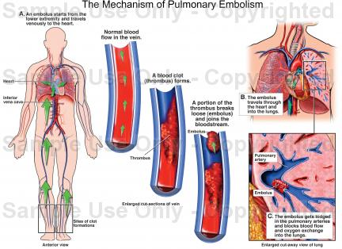

Slide 9
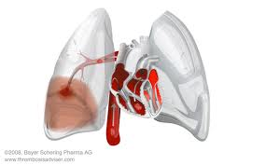

Slide 10
Fibrinolytics/thrombolytics are drugs that cause lysis of already formed thrombus
Fibrinolyic drugs
1. Streptokinase.
2. Anistreplase.
3. Urokinase
4. Tissue plasminogen activators ( t -PA).
Alteplase, Reteplase,Tenecteplase

Slide 11
Mechanism of Action
These acts directly or indirectly to accelerate the conversion of plasminogen to plasmin within the thrombus
Plasmin degrades fibrin clots and other plasma proteins (non-fibrin specific)

Slide 12
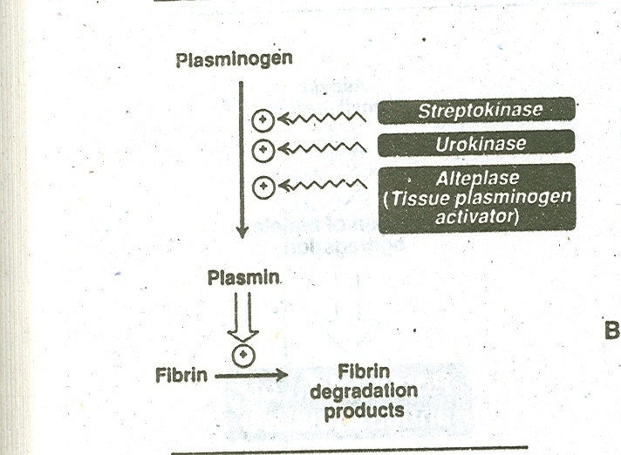

Slide 13
Uses
Acute myocardial infarction.
Acute thrombotic stroke.
Peripheral artery occlusion.
Pulmonary embolism.
Deep venous thrombosis.

Slide 14
Precautions
Should be given as soon as possible.
Fibrinolytics are given intravenously.
Bleeding can occur (Systemic fibrinolysis).
Contraindications
Pregnancy
Cerebrovascular disease
Uncontrolled hypertension.
Peptic ulcer

Slide 15
Streptokinase
Is a protein synthesized by B-hemolytic streptococci.
Mechanism of Action
acts indirectly by forming plasminogen-streptokinase complex which converts inactive plasminogen into active plasmin.
It is the least expensive.
T 1/2 = half an hour.
I.V. Infusion (250,000U then 100,000U/h for 24-72 h).

Slide 16
Side effects
Bleeding due to activation of circulating plasminogen
Hypersensitivity due to antigenicity (rash, fever, allergic reaction).
Hypotension.
not used in patients with streptococcal infections (have antistreptococcal antibodies and may develop fever, allergic reactions and resistance upon treatment with streptokinase).

Slide 17
Anistreplase ( APSAC )
Anisoylated plasminogen-streptokinase activator complex
Is a complex of purified human plasminogen + bacterial streptokinase that rendered inactive by introducing anisoyl group at its active site.
It is a prodrug, de-acylated in circulation into the active plasminogen-streptokinase complex (acts directly to convert plasminogen into plasmin).

Slide 18
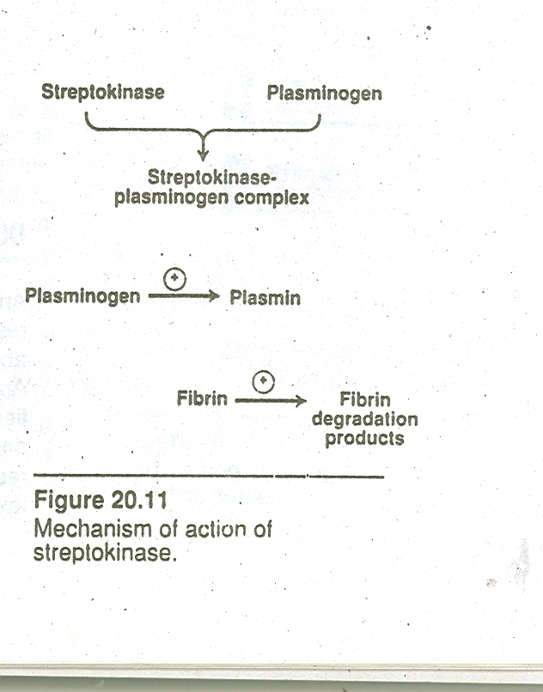

Slide 19
Advantages
Longer duration of action (T_{1/2} is 70-120 min).
Given as a bolus I.V. (30 U over 3 - 5 min.).

Slide 20
Disadvantages
(less than streptokinase alone).
1. Expensive.
2. Antigenic.
3. Allergic reactions.
4. Bleeding due to minimal fibrin specificity
Drug interactions:
Anticoagulants(heparin,warfarin) and antiplatelet agents(aspirin,dipyridamole)

Slide 21
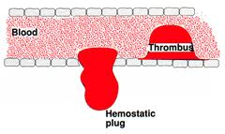

Slide 22
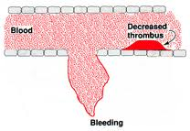

Slide 23
Urokinase
Human enzyme synthesized by the kidney, obtained from either urine or cultures of human embryonic kidney cells.
acts directly converting plasminogen to active plasmin.
given by intravenous infusion
Dose 300,000U over 10 min then 300,000U/h for
12h.

Slide 24
Disadvantages
1. Expensive. 2. Systemic lysis.
Advantages
1. Not antigenic.
2. No Hypotension.

Slide 25
Tissue Plasminogen Activators ( t - PA )
Alteplase
Alteplase ( Single Chain ).
Is a recombinant human t - PA.
Synthesis by recombinant DNA technology.

Slide 26
Advantages
Clot specific ( fibrin specific ).
activate fibrin-bound plasminogen rather than free plasminogen in blood.
2. Limited systemic fibrinolysis.
3. Non–antigenic (Can be used in patients with antistreptococcal antibodies).

Slide 27
Alteplase
very short half life (5 min.)
(60 mg i.v. bolus + 40 mg infusion over 2 h).

Slide 28
Contraindications to thrombolytic therapy
Absolute contraindications include:
Recent head trauma or caranial tumor
Previous hemorrhagic shock
Stroke
Active internal bleeding
Major surgery within two weeks
Relative contraindications include:
Active peptic ulcer, diabetic retinopathy, pregnancy, uncontrolled hypertension

Slide 29
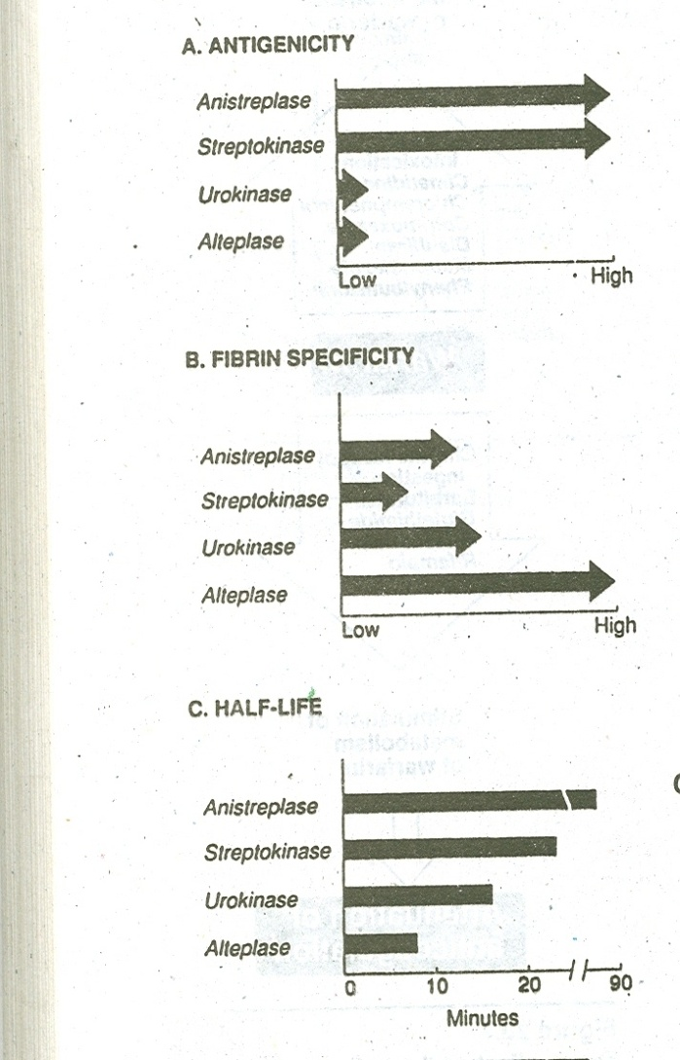

Slide 30
Antiplasmin
(Antifibrinolytics)
inhibit plasminogen activation and thus inhibit fibrinolysis and promote clot stabilization.
        Tranexamic Acid.
        Aminocaproic Acid
        Aprotinin.

Slide 31
Aminocaproic Acid & tranexamic acid
Synthetic
It competitively inhibits plasminogen activation
Given orally
Intravascular thrombosis
Aprotinin
It acts by blocking plasmin.
Uses
Can be taken orally or I.V.
1. Adjunctive therapy in hemophilia.
2. Antidote for fibrinolytics.

