Slide 1
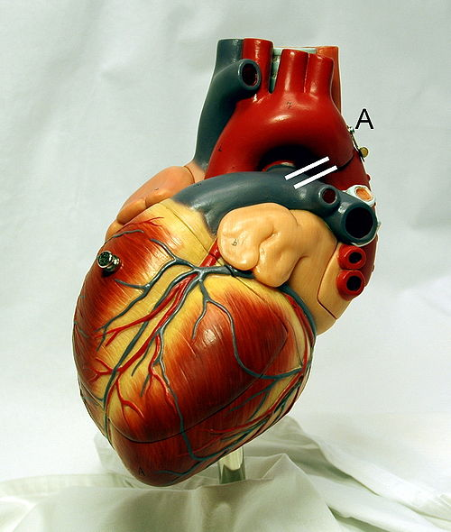
Cardiovascular System Block Cardiac Arrhythmias (Physiology)
Dr. Mona Soliman, MBBS, MSc, PhD
Associate Professor
Department of Physiology
Chair of Cardiovascular Block
College of Medicine
King Saud University

Slide 2
Lecture Objectives
Describe sinus arrhythmias
Describe the main pathophysiological causes of cardiac arrhythmias
Explain the mechanism of cardiac block
Explain the origin of an ectopic foci
Enumerate the common arrhythmias and describe the basic ECG changes

Slide 3
The ECG and the rhythm disturbances

Slide 4
Normal Sinus Rhythm
Regular
Single p-wave precedes every QRS complex
P-R interval is constant and within normal range
P-P interval is constant

Slide 5
Causes of Cardiac Arrhythmias
Rate above or below normal
Regular or irregular rhythm
Narrow or broad QRS complex
Relation to P waves

Slide 6
Abnormal Sinus Rhythm
Tachycardia: an increase in the heart rate
Heart rate > 100 beats per minute
Causes:
Increased body temperature
Sympathetic stimulation
Inspiration
Drugs: digitalis

Slide 7
Abnormal Sinus Rhythm
Bradycardia:
Slow heart rate < 60 beats per minute
Causes:
Parasympathetic stimulation
Expiration

Slide 8
Abnormal Cardiac Rhythms that Result from Impulse Conduction Block
A-V Block
When impulse from the S-A node is blocked
Causes:
Ischemia of the A-V node
Compression of the A-V node by scar formation
Inflammation of the A-V node
Strong vagal stimulation

Slide 9
Types of the A-V Block
First degree block
Second degree block
Third degree block

Slide 10
Types of the A-V Block
First degree block
Prolong P-R interval (0.2 seconds)

Slide 11
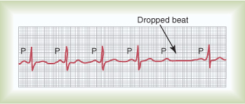
Types of the A-V block
Second Degree Block
P-R interval > 0.25 second
Only few impulses pass to the ventricles
→ atria beat faster than ventricles
→“dropped beat” of the ventricles

Slide 12
Types of the A-V block
Third degree block (complete)
Complete dissociation of P wave and QRS waves
→The ventricle escape from the influence of S-A node
Stokes-Adams Syndrome: AV block comes and goes

Slide 13
Ventricular Fibrillation
The most serious of all arhythmias
Cause: impulses stimulate one part of the ventricles, then another, then itself. Many part contracts at the same time while other parts relax (Circus movement)
Tachycardia
Irregular rhythm
Broad QRS complex
No P wave
Treatment : DC shock

Slide 14
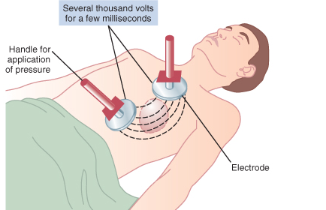
Ventricular Fibrillation
Treatment : DC shock

Slide 15
Atrial Fibrillation
Cause: as ventricular fibrillation
It occurs more frequently in patients with enlarged heart
The atria do not pump if they are fibrillating
The efficiency of ventricular pumping is decreased 20 to 30%
A person can live for years with atrial fibrillation

Slide 16
Atrial Flutter
A single large wave travels around and around in the atria
The atria contracts at high rate (250 time per minute)

Slide 17
Ischemia and the ECG
One of the common uses of the ECG is in acute assessment of chest pain
Cause: restriction of blood flow to the myocardium, either:
Reversible: angina pectoris
Irreversible: myocardial infarction
Ischemia → injury → infarction

Slide 18
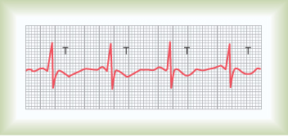
Reversible ischemia
Inverted T wave
ST segment depression

Slide 19
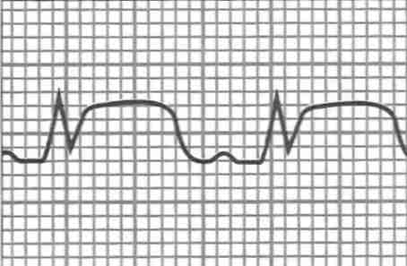
Myocardial Infarction
Complete loss of blood supply to the myocardium resulting in necrosis or death of tissue
ST segment elevation
Deep Q wave

Slide 20
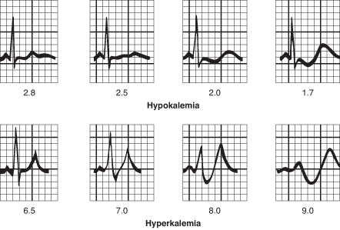
Potassium and the ECG
Hypokalemia:
flat T wave
Hyperkalemia:
Tall peaked T wave

Slide 21
For further readings and diagrams:
Textbook of Medical Physiology by Guyton & Hall
Chapter 10 (Cardiac Arrhythmias and their Electrocardiographic Interpretation)

