Slide 1
CARDIAC OUTPUT and Venous Return Dr. Eman EL Eter Associate Prof. Physiology Dep.

Slide 2
Lecture 8: Objectives
By the end of this lecture the students are expected to:
Define cardiac output, stroke volume, end-diastolic and end-systolic volumes.
Define physiological conditions affecting CO
List causes of high and low output pathological states.
Define venous return and describe factors controlling venous return

Slide 3
Lecture outline
Cardiac output is the amount of blood pumped by each ventricle per minute (5L/min). It varies physiologically with age, body mass index, physical activity, sleep, meals, pregnancy, etc.. But there are pathological conditions that lead to a significant increase in CO including hyperthyroidism, anemia and conditions decreasing CO as myocardial infarction. CO is well controlled and regulated by Many Factors: venous return, ABP , blood volume and nervous regulation. This lecture will focus on Venous return as an important factor determining CO. Venous return represents the amount of blood returning to the heart per minute. Venous return is controlled by many factors:1) Frank-Starling’s mechanism, 2) mean systemic filling pressure, 3) tissue metabolism, 4) thoracic pump, 5) Gravity, 6) Muscle pump, 7) blood volume.

Slide 4
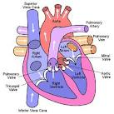
Definitions
Cardiac output:
: Amount of blood pumped by each ventricle per minute.
Stroke volume (SV):
Volume of blood ejected by each ventricle/beat.
CO = SV x HR
Stroke volume is expressed in ml/beat and heart rate in beats/minute. Therefore, cardiac output is in ml/minute. Cardiac output may also be expressed in liters/minute.

Slide 5
Definitions………..
End-diastolic volume (EDV):
Amount of blood remaining in the heart by the end of diastole.
140 mL
End-systolic volume (ESV):
Amount of blood remaining in the heart by the end of systole.
=70 mL
SV = EDV-ESV

Slide 6
Stroke volume
SV = EDV - ESV.
This measurement can be affected by changes in the heart's ability to contract, the force of contraction, the volume of blood available to be pumped or other variables such as resistance within the circulatory system that can affect or alter these factors. Severe hemorrhage or shock, heart damage or extreme infections can change the heart's ability to pump effectively.
It is affected by cardiac contractility, preload, and afterload.

Slide 7
Heart Rate
When heart rates become excessively fast, the heart may not have enough time to adequately fill with blood between beats; this can result in a decreased cardiac output.
When heart rates are too slow the cardiac output can also decrease significantly, and interventions may be required to increase the heart rate. Implanted pacemakers may be surgically placed to ensure a consistent adequate heart rate.

Slide 8
Physiological variations in CO
Exercise (up to 700%)
Eating ( 30%)
High environmental temperature ( )
Pregnancy ( )
Anxiety ( 50-100%)
Sympathomimitics, epinephrine ( )
Sitting or standing from lying position ( 20-30%)

Slide 9
Pathological variations in CO
Increasing CO:
Fever
Hyperthyroidism
Anemia
Decreasing CO:
Hypothermia.
Hypothyroidism
Myocardial diseases e.g. infarction, failure…
Rapid arrhythmias

Slide 10
Factors affecting CO
Venous return
Heart rate
Stroke volume
Blood volume.
ABP
Neural factors

Slide 11
How is cardiac output regulated?

Slide 12
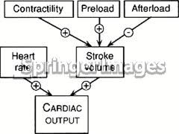

Slide 13
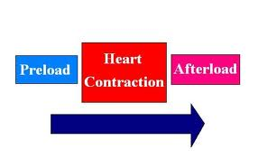
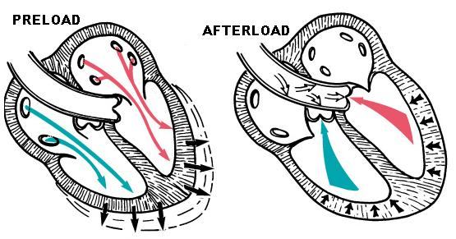
Initial stretching of the cardiac myocytes prior to contraction.
Is the "load" that the heart must eject blood against i.e. aortic pressure

Slide 14
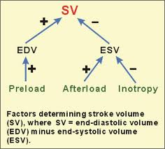

Slide 15
Stroke volume
Affected by:
Preload.
Afterload
Cardiac contractility

Slide 16
Factors affecting Cardiac output:
Venous return (Preload):
It represents the amount of blood returning to the heart per minute.
Venous return is controlled by many factors:
1) Frank-Starling’s mechanism,
2) mean systemic filling pressure,
3) tissue metabolism, 4) thoracic pump, 5) Gravity, 6) Muscle pump, 7) blood volume.

Slide 17
VR & CO
VR CO
VR CO

Slide 18
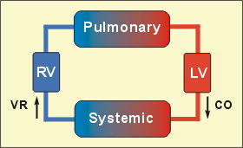
1.Venous Return (Preload)
Under steady-state conditions, venous return must equal cardiac output (CO) because the cardiovascular system is essentially a closed loop. Otherwise, blood would accumulate in either the systemic or pulmonary circulations.

Slide 19
Factors determining CO: Preload, cont.,…..
VR EDV stretching of vent.fiber SV
VR EDV SV
Mechanism:
Frank-Starling mechanism:
Aability of the heart to pump all blood coming to it without allowing systemic stasis, within limits
It acts by increasing the sarcomere length & force of contraction of the cardiac muscle.

Slide 20
Factors affecting VR (Preload)
Skeletal Muscle contraction: muscle pump mechanism.
Venous compliance. Or mean systemic filling presure. Sympathetic activation of veins decreases venous compliance.
What is the effect of removal of sympathatic activity to veins?

Slide 21
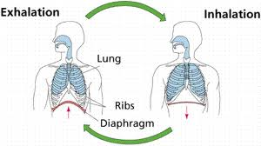
Factors affecting VR (Preload), cont…
Respiratory activity. (Thoracic pump)
During inspiration the venous return
increases because of a decrease in right atrial pressure.
Vena cava compression.
An increase in the resistance of the vena cava, as occurs when the thoracic vena cava becomes compressed during a Valsalva maneuver or during late pregnancy, decreases venous return.

Slide 22
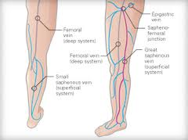
Factors affecting VR (Preload), continued,…
Gravity.
Total tissue metabolism.
Blood volume.
Muscle pump

Slide 23
Afterload
Afterload can be defined as the "load" that the heart must eject blood against.
In simple terms, the afterload is closely related to the aortic pressure.

Slide 24
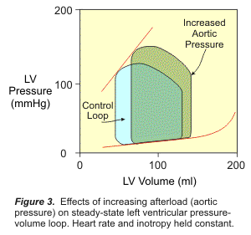
Afterload

Slide 25
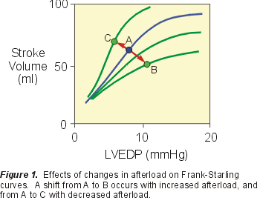
Effect of an increase in afterload on SV
An increase in afterload, lead to an increase in end-systolic volume and a decrease in stroke volume. An increase in afterload shifts the Frank-Starling curve down and to the right (from A to B). Explanation:, an increase in afterload decreases the velocity of fiber shortening which reduces the rate of volume ejection so that more blood is left within the ventricle at the end of systole (increase end-systolic volume)
A decrease in afterload shifts the Frank-Starling curve up and to the left (A to C)

Slide 26
Extrinsic Regulation of CO
1. Nervous:
-Sympathetic: HR & SV.
-Parasympathetic: HR
2. Chemical
-Potassium
-Calcium.
-Thyroxin.
-Catecholamine.

Slide 27
What are the factors affecting EDV:
Increase:
-Stronger atrial contraction.
-Increased total blood volume
-Increased venous tone.
-Increased sk m pump.
-Increased negative intrathoracic pressure.
Decrease:
Standing
Increased intrapericardial pressure.
Decreased ventricular compliance

