Slide 1
Lecture:10 Contractility, Stroke volume and Heart Failure

Slide 2
Lecture:10 Contractility, Stroke volume and Heart Failure
By the end of this lecture the students are expected to:
Explain how cardiac contractility affect stroke volume.
Calculate CO using Fick’s principle equation.
Explain pathophysiology of heart failure and differentiate between left and right failure.
Explain how the pathophysiology associated with heart failure results in typical signs and symptoms.

Slide 3
Lecture outline
The contractility of the myocardium exerts a major influence on SV. Contractility is increased in response to sympathetic stimulation and this is reflected by shifting the pressure volume-loop upward and to the left (positive inotropic effect). Changes in heart rate and rhythm also affect myocardial contractility. Measuring cardiac output using Fick’s principle equation depends on measuring O2 consumption per minute and arterio-venous oxygen difference. Heart failure occurs when the heart loses its function as a pump which may result from ischemia, hypertension, cardiomyopathy,etc… Heart failure could be right or left-sided. There are differences between them regarding causes, effect on body systems and clinical manifestations. The path- physiological mechanisms of heart failure include: systolic dysfunction or diastolic dysfunction.

Slide 4
Cardiac contractility and stroke volume
Systolic function of the heart is governed by:
1. Contractile state of the myocardium.
2. Preload of the ventricle.
3. Afterload applied to the ventricle.
4. Heart Rate.

Slide 5
Measurement of CO
Echocardiographic techniques:
Ejection fraction= SV/EDV X 100
Radionuclide imaging techniques can be used to estimate real-time changes in ventricular dimensions, thus computing stroke volume, which when multiplied by heart rate, gives cardiac output.

Slide 6
Measurement of CO, cont….
Fick’s Principle : An old technique can be used to compute cardiac output (CO) indirectly from whole body oxygen consumption (VO2) and the mixed venous (O2ven) and arterial oxygen contents (O2art); however, this technique is seldom used. The CO is calculated as follows:
CO = VO2/(O2art – O2ven)
The blood contents of oxygen are expressed as ml O2/ml blood, and the VO2 is expressed in units of ml O2/min. If O2art and O2ven contents are 0.2 ml and 0.15 ml O2/ml blood, respectively, and VO2 is 250 ml O2/minute, then CO = 5000 ml/min, or 5 L/min. Ventricular stroke volume would simply be the cardiac output divided by the heart rate.

Slide 7
Heart Failure
What is Heart Failure?
It is a pathological process in which systolic and /or diastolic function of the heart is impaired as a result, CO is low and unable to meet the metabolic demands of the body.

Slide 8
Pathophysiology of heart failure
Heart failure can be caused by factors originating from within the heart (i.e., intrinsic disease or pathology) or from external factors that place excessive demands upon the heart.
Intrinsic factors:
dilated cardiomyopathy and hypertrophic cardiomyopathy, myocardial infarction..
External factors:
- Pressure load: long-term, uncontrolled hypertension,
- increased stroke volume :
(volume load; arterial-venous shunts),
hormonal disorders such as hyperthyroidism, and pregnancy.

Slide 9
Causes of Heart Failure
Myocardial infarction
Coronary artery disease
Valve disease
Idiopathic cardiomyopathy
Viral or bacterial cardiomyopathy
Myocarditis
Pericarditis
Arrhythmias
Chronic hypertension
Thyroid disease
Septic shock
Aneamia
Arterio-venous shunt.

Slide 10
Acute HF
Acute heart failure develops rapidly and can be immediately life threatening because the heart does not have time to undergo compensatory adaptations. Acute failure (hours/days) may result from:
cardiopulmonary by-pass surgery,
acute infection (sepsis),
acute myocardial infarction,
severe arrhythmias, etc.
Acute heart failure can often be managed successfully by pharmacological or surgical interventions.

Slide 11
Chronic HF
Chronic heart failure is a long-term condition (months/years) that is associated with the heart undergoing adaptive responses (e.g., dilation, hypertrophy) to a precipitating cause. These adaptive responses, however, can be deleterious ?

Slide 12
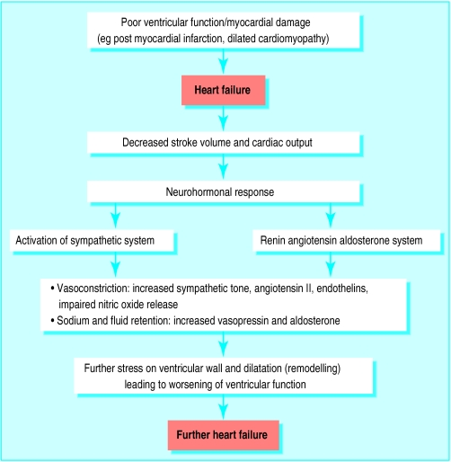
Neurohormonal mechanisms and compensatory mechanisms in heart failure BMJ 2000; 320:167-170

Slide 13
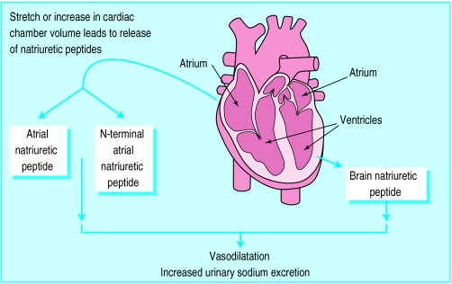
Effect of natriuretic peptide

Slide 14
Summary of the consequences to the neurohormonal responses to impaired cardiac performance
Responses | Short-term effects | Long-term effects
Salt & water retention | Increase preload | Pulmonary congestion Systemic congestion
Vasoconstriction | Maintain BP for perfusion of vital organs | Exacerbate pump dysfunction by increasing afterload Increase cardiac energy expenditure
Sympathetic stimulation | Increase heart rate and ejection | Increase energy expenditure, Risk of dysrrhythmia, Sudden death

Slide 15
Left-sided failure
Respiratory signs are common:
Signs & symptoms are due to pulmonary congestion and low CO
-Tachypnea :(increased rate of breathing) and increased work of breathing.
- pulmonary edema can develop (fluid in the alveoli).
-Cyanosis : which suggests severe hypoxemia, is a late sign of extremely severe pulmonary edema.

Slide 16
Left ventricular failure
Additional signs indicating left ventricular failure include:
a laterally displaced apex beat (which occurs if the heart is enlarged)
gallop rhythm (additional heart sounds) may be heard as a marker of increased blood flow, or increased intra-cardiac pressure.

Slide 17
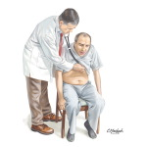
Left-sided HF

Slide 18
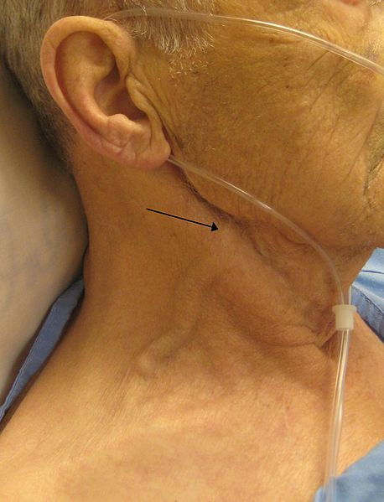
Right-sided failure
Pitting peripheral edema,
ascites,
Hepatomegaly
Jugular venous pressure is frequently assessed as a marker of fluid status, which can be accentuated by the hepatojugular reflux.

Slide 19
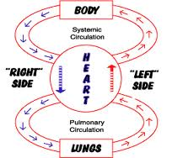

Slide 20
Left vs Right HF

Slide 21
Treatment
The control of congestive heart failure symptoms, can be divided into three categories:
(1) reduction of cardiac workload, including both preload and afterload;
(2) control of excessive retention of salt and water; and
(3) enhancement of myocardial contractility.

