Slide 1
CONDUCTIVITY AND Contractility
Prof. Ashraf Husain

Slide 4
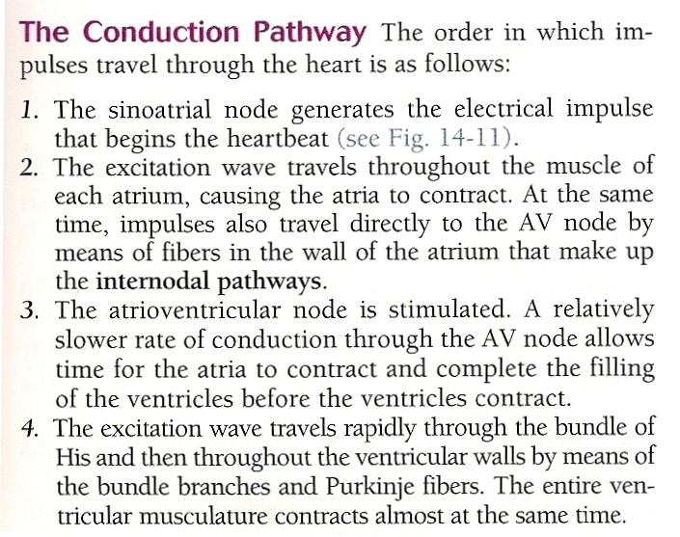

Slide 5
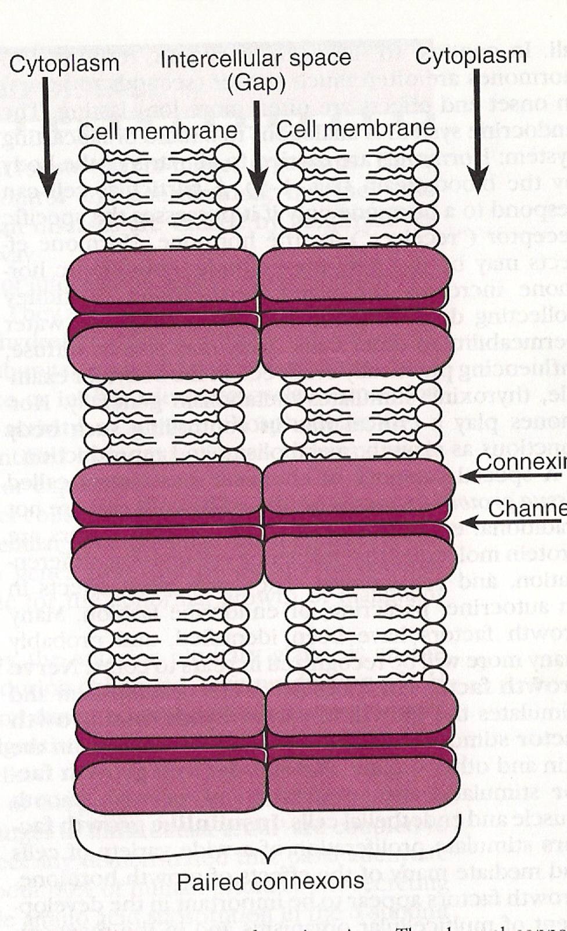

Slide 9
