Slide 2
CORONARY CIRCULATION & ISCHEMIC HEART DISEASE
Prof. Ashraf Husain

Slide 3
Coronary circulation
The two coronary arteries supply the myocardium.
Arise from the sinuses behind two cusps of aortic valve at the root of the aorta.
Eddy current keep the valves away from the orifices of arteries it keeps the orifices patent throughout the cardiac cycle.
Venous drainage is through the coronary sinus and anterior cardiac veins into right atrium.

Slide 4
5% of Cardiac Out Put = 250ml pass through coronary artery/min.
RCA has a greater flow in 50% of individual.
LCA has a greater flow in 20% of individual.
Equal distribution of flow in 30% of individual.
At rest the heart extract 70-80% of O₂ from each unit of blood delivered to it.

Slide 6
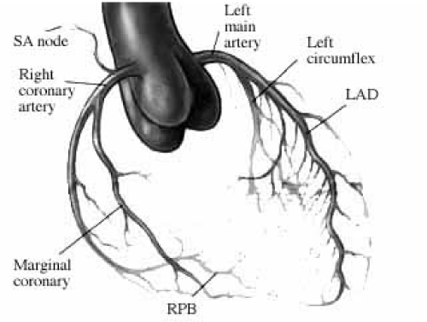

Slide 7
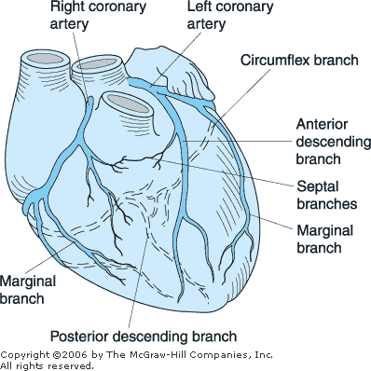

Slide 8
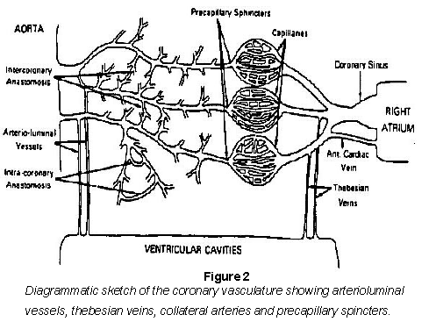

Slide 10
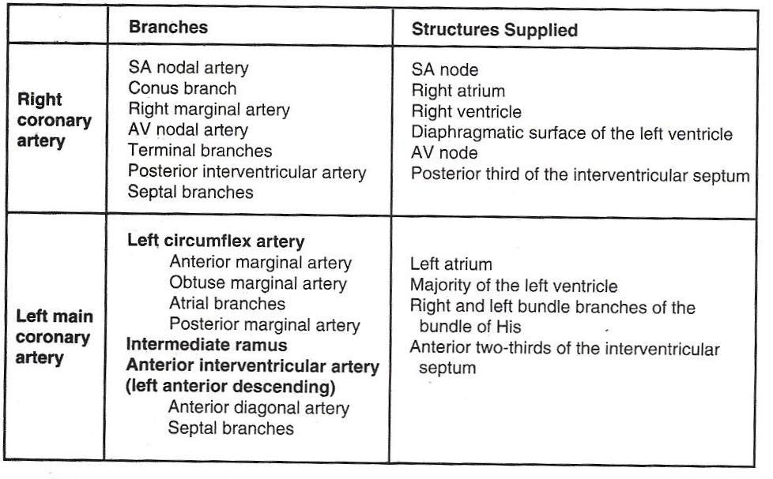

Slide 11
HEART RATE
Increase in heart rate reduces the coronary blood flow
During systole the blood flow is less while during diastole it is maximum.
During diastole the compression on the coronary arteries are less.
Reactive hyperemia is a main cause of increase coronary blood flow during diastole.

Slide 12
FACTORS CONTROLING CORONARY CIRCULATION
 | Pressure (mm Hg) in |  |  | Pressure Differential (mm Hg) Between Aorta and
 | Aorta | Left Vent | Right Vent | Left Vent | Right Vent
Systole | 120 | 121 | 25 | -1 | 95
Diastole | 80 | 0 | 0 | 80 | 80

Slide 14
CHEMICAL FACTORS
Coronary vasodilators is caused by
Lack of O2
Increased CO₂, H⁺, K⁺, lactate, PGs, and adenosine.

Slide 15
Neural factor
Has a marginal role in controlling the coronary blood flow.

Slide 20
STRESS ECG

Slide 22
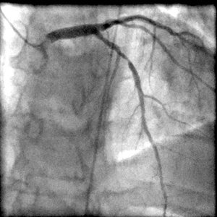
CORONARY ANGIOGRAPHY

