Slide 1
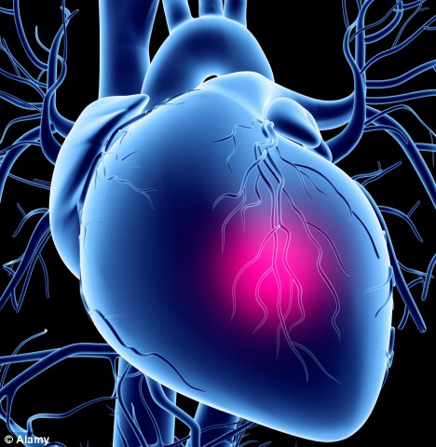
Physiology Team 431
Team leaders
Mohammed Asiri
Nour Al-Khawaja
Abdullah Al-Towim
Khalid Al Mohaimedi
AbdulRahman Al-Bakr
Fahad Al-showishi
Saad Al-Mdemig
Ahmad Al-Zuhair
Mohammed Al Numeir
Majid Al-Oriny
Abdullrahman Alshahrani
Tariq Al-Otaibi
Abdulmalik Almufarrih
Ahmed Almarzuqi
Nasser Al-moosa
Abdulaziz Al-hamad
Yafa Al-shamlan
Sara Al-anazy
Lama Mokhlis
Tmader alaofi
Hayfa alabdulkareem
Dalal fatani
Alaa Al-anazi
Jomanah alshammari
Shehanah alomair

Slide 2
Capillary Circulation & Edema Formation
Dr. Eman El Eter

Slide 3
Functions of capillaries
Exchange between blood & tissues:
Nutrients,
Oxygen
Drainage of waste products: tissues….to blood
Capillary tone
Capillary tone refers to the number of closed capillaries at rest. Normally about 80%-85% of the capillaries are closed and 20%-15% are open.
If 50% of capillaries are opened, this leads to shock.
Capillary tone is important because it maintain pressure for perfusion.
Only 5% of blood found in the capillaries.
Auto-regulation : ability of tissues to regulate blood flow according to its metabolic needs.

Slide 4
This selected area of the blood vessel called ( Metarteriole) , it contain a Sphincter that contact and relax according to the
metabolic needs of the tissue.
This sphincter called precapillary sphincter because it located
before the beginning of capillary.
Capillary doesn't have a vascular smooth muscle.
Metarteriole
Sphincter

Slide 5
Temperature regulation
In hot weather > sphincter relaxes > increase blood flow > get rid of excess heat.
In cold weather > sphincter contracts > decrease blood flow > conserve heat .

Slide 6
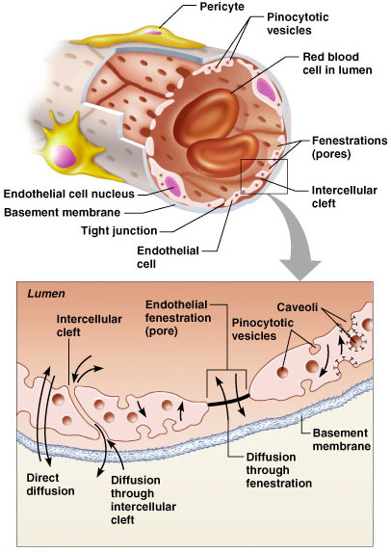
Capillary exchange of gases& nutrients
Systemic capillaries have fenestrations ( pores) that help in exchange materials.
Capillaries are different depending on organ supplied.
Ex. Renal capillaries have higher number of fenestrations to help in filtration in glomerus.

Slide 7
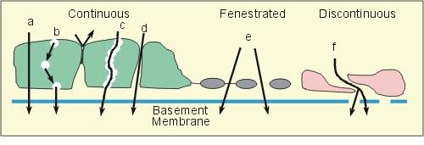
Movement across capillaries
Fluid, electrolytes, gases, small and large molecular weight substances can transverse the capillary endothelium by several different mechanisms: diffusion, bulk flow, vesicular transport, and active transport.
Interstitial fluid (Extracellular Fluid) is continuously exchanged, it never stays in stagnant state .
This movement are maintained by several mechanisms.

Slide 8
Capillary exchange of gases and nutrients

Slide 9
Forces determining tissue fluid formation Starling’s Forces
There is a free exchange of water, electrolytes, and small molecules between the intravascular and extravascular compartments of the body.
The primary site of this exchange is capillaries and small post-capillary venules.
Several mechanisms are involved in this exchange; however, the most important are bulk flow and diffusion.
The rate of exchange, in either direction, is determined by Starling ‘s Forces..

Slide 10
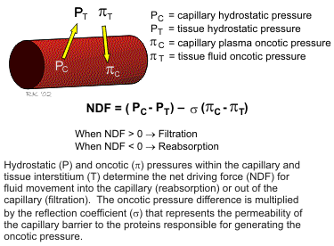
Forces determining tissue fluid formation: Starling’s Forces
Capillary Hydrostatic P. : pressure caused by blood flow in capillary.
Tissue Hydrostatic P.: pressure caused by intestinal fluid in interstitial space.
Capillary plasma oncotic P.: pressure caused by proteins in plasma.
Tissue plasma oncotic P. : pressure caused by proteins in intestinal fluid

Slide 11
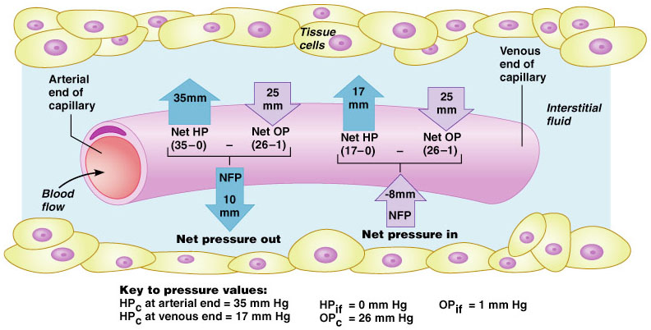
Net Filtration Pressure

Slide 12
Forces at arteriolar end and venular end of capillaries

Slide 13
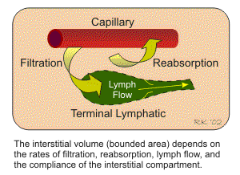
Edema Formation
Factors Precipitating Edema
Increased capillary hydrostatic pressure (as occurs when venous pressures become elevated by gravitational forces, in heart failure or with venous obstruction.
Decreased plasma oncotic pressure )as occurs with hypoproteinemia during malnutrition).
Increased capillary permeability caused by proinflammatory mediators (e.g., histamine, bradykinin) or by damage to the structural integrity of capillaries so that they become more "leaky" (as occurs in tissue trauma , burns, and severe inflammation)
Lymphatic obstruction (as occurs in filariasis or with tissue injury).
Edema : accumulation of fluids in extracellular space.
In Venous obstruction: when vein is obstructed > no reabsorption > accumulation of fluid in extracellular space > Edema..
In Lymphatic obstruction > no drainage >lead to accumulation of fluid > Lymphedema

Slide 14
Causes of Edema:
Edema means accumulation of fluid in the ECF space
Causes:
A. Increased capillary pressure:
1. Excess retention of salt and water by kidney:
a. Renal failure
b. Excess aldosterone. Ex. Because of tumor .
c. Heart failure.

Slide 15
Causes of edema, continued,…
2. Increased venous pressure:
a. Heart failure
b. Venous obstruction. e.g. thrombus, pregnancy, tumor, etc..
c. Failure of venous pump e.g. varicose veins.
3. Decreased arteriolar resistance:
a. Vasodilator drugs.
b. Excess body heat.
Veins contain valves, when valves are damaged > accumulation of blood in veins > increase venous pressure.

Slide 16
Causes of edema, continued,…
B. Low plasma proteins:
1. Loss of proteins in urine.
2. Loss from the skin (burns)
3. Failure to produce:
a. Liver diseases
b. Malnutrition.

Slide 17
Causes of edema, continued,…
C. Increased capillary permeability:
1. Release of histamine in allergy.
2. Toxins.
3. Infections
4. Vit C deficiency
5. Burns
Vit C is important for endothelial cells to stick on the basement membrane.

Slide 18
Causes of edema, continued,…
D. Lymphatic obstruction:
1. Cancer
2. Filaria
3. congenital
Filariasis : is a parasitic disease, an infectious tropical disease.

Slide 19
Here I will mention several points that have been discussed in male lecture and were not included in female slides.

Slide 20
Precapillary sphincter: smooth muscles which acts as a janitor. If they relax, more blood will flow to the tissue. If they constrict, less blood will
flow to the tissue.
-The blood flow in the capillaries is efficiently regulated by the precapillary sphincter.
-The precapillary sphincter is highly regulated by humoral regulation. “Chemicals Regulation”
-The precapillary sphincter is sensitive to oxygen and carbon dioxide. If the tissue contains low amount of Oxygen and high amount of Carbon Dioxide, the smooth muscles will relax and more blood will flow to the tissue. And vice versa.

Slide 21
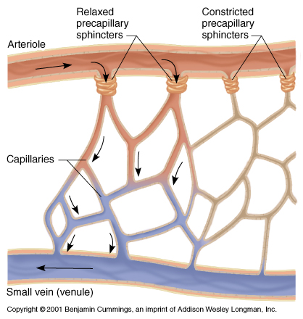

Slide 22
HOW DIFFUSION OCCURS?
Lipid soluble substances diffuse directly through the endothelial cells.
While water soluble substances will pass through the pores or the intercellular cleft of the capillary.
The amount of fluid filtered depends on the tissue need. “Vasomotion”

Slide 23
The plasma colloidal osmotic pressure is 28 mmHg.
Albumin is responsible of 80% of the plasma colloidal osmotic pressure.
- In any condition where the Albumin amount will be less than normal (liver disease, malnutrition, …etc), the plasma osmotic pressure will fall and there will be an abnormal fluid exchange, and as a result, edema develops.

Slide 24
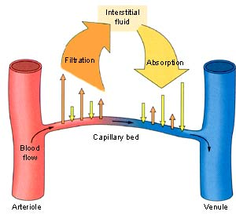
The starling equilibrium point: there is no net outward or inward movement. Forces are equal.

Slide 25
Lymphatic circulatory system
-It is a separate circulatory system in the body.
-It has two main uses:
1- move large protein molecules.
2- move fats.
-It finally inters the thoracic duct which directly drains into the subclavian vein.

Slide 26
Useful links
http://highered.mcgraw-hill.com/sites/0072507470/student_view0/chapter21/animation__fluid_exchange_across_the_walls_of_capillaries.html
http://www.cvphysiology.com/Microcirculation/M010.htm
http://ylearnonline.com/page.php/resources/view_all?id=arteries_arterioles_capillaries_colloidal_osmotic_pressure_endothelium_pulse_veins_venules_t_page_13&from=search

