Slide 1
Chemical Examination of Urine Renal Block
Dr. Rana Hasanato

Slide 2
Learning objectives: 1. To understand the normal and abnormal chemical composition of urine in relation to renal diseases and conditions 2. To differentiate between pre-renal, renal and post- renal proteinuria with clinical examples of each 3. To acquire knowledge on the types of Glycosuria, hematuria and hemoglobinuria

Slide 3
Urine is a fluid excreted by most animals including humans
It is formed in the kidneys (renal glomeruli)
The fluid undergoes chemical changes before it is excreted as urine
Normal urine excretion by a healthy person is about 1.5 L per day

Slide 4
Normal composition of urine
Urine contains organic and inorganic constituents:
Major inorganic salts:
Sodium
Potassium
Chlorides
Small amounts of Ca, Mg, S & phosphates
Traces of Fe, Cu, Zn and I₂

Slide 5
Major organic constituents:
Non-protein nitrogen (NPN) compounds
Organic acids
Sugars
Traces of proteins, vitamins, hormones, and pigments

Slide 6
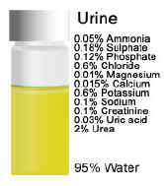

Slide 7
Abnormal composition of urine
Proteins:
Normal urine contains very little protein (< 200 mg/day)
More than this level leads to a condition called Proteinuria

Slide 8
Abnormal composition of urine
Causes:
Pre-renal
Renal
Post-renal
Prerenal proteinuria:
Some abnormal conditions increase plasma protein
levels before reaching the kidneys Causes increased filtration of these proteins in the kidneys
This exceeds the normal reabsorptive capacity of renal tubules Results in overflow of proteins in the urine

Slide 9
Multiple myeloma causes pre-renal proteinuria
A proliferative disorder of the immunoglobulin-producing plasma cells
The serum contains elevated levels of monoclonal light chains antibodies (Bence-Jones protein)
Bence-Jones protein is filtered in kidneys in high amounts
Exceeding the tubular reabsorption capacity
Hence excreted in the urine

Slide 10
The Bence-Jones protein coagulate at 40–60 ºC
Dissolves at 100 ºC
Multiple myeloma cases are diagnosed by using:
Serum electrophoresis
Immunoelectrophoresis

Slide 11
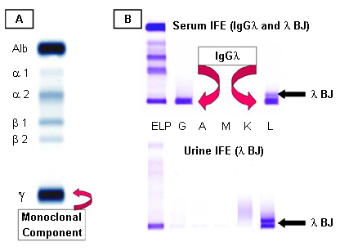
Multiple myeloma
A: serum protein electrophoresis demonstrating the M component.
B: serum and urine immunofixation electrophoresis

Slide 12
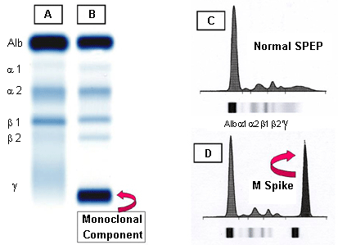
A: normal serum.
B: multiple myeloma showing M component in the gamma region.
C: densitometry tracing of A showing the 5 zones of the high resolution agarose electrophoresis.
D: densitometry of the M component of B, termed the M Spike

Slide 13
Renal Proteinuria
Associated with renal disease
Glomerular proteinuria
High glomerular permeability
Causes filtration of high molecular weight proteins
(e.g. glomerulonephritis)
Tubular proteinuria
Low tubular reabsorption with normal glomerular permeability
Causes excretion of low molecular weight proteins
(e.g. chronic nephritis)

Slide 14
Orthostatic (Postural) Proteinuria
Persistent benign protenuria
Occurs frequently in young adults due to periods spent in a vertical posture
Increased pressure on the renal vein in the vertical position causes orthostatic proteinuria
Disappears in horizontal posture

Slide 15
Microalbuminuria:
- Presence of small amounts of albumin in the urine
(20– 200 mg/L)
Cannot be detected by ordinary urine testing
Needs special tests for detection
- Early indicator of glomerular affection due to
uncontrolled diabetes mellitus or hypertension

Slide 16
3 - Post renal proteinuria:
Proteins added to the urine as it passes through the structures of the lower urinary tract (ureters, bladder , urethra, prostate and vagina)
- Due to Lower urinary tract infection, trauma, tumors and stones

Slide 17
Glycosuria : (Presence of sugar in urine)
1 - Glucosuria: Presence of detectable amount of glucose in urine
- Uncontrolled DM :The concentration of glucose in the plasma exceeds the renal threshold
- Renal glucosuria : Normal plasma glucose concentration with proximal tubular malfunction → ↓ renal threshold (gestational diabetes and Fanconi’s syndrome)

Slide 18
2 - Fructosuria: (Presence of fructose in urine) - Alimentary causes : High fructose intake - Metabolic : Low fructokinase or aldolase B in the liver
3 – Galactosuria: (Presence of galactose in urine) - Alimentary : High galactose intake - Metabolic : Low galactokinase or galactose -1- phosphate uridyl transferase in the liver

Slide 19
Ketonuria : Presence of ketones, acetone, acetoacetic acid & β -hydroxybutyric acid in urine
1 – Diabetic ketoacidosis
2 – Starvation
3 – Prolonged vomiting
4 – Unbalanced diet: high fat & Low CHO diet
5 – Phenylketonuria (inborn error of amino
acid metabolism)

Slide 20
Choluria : Presence of bile in urine
1 – Bilirubin / Bile salts:
Normally no bilirubin is detected in urine
Bilirubin is detected in:
- Hepatocellular damage
- Obstruction of bile duct:
Extrahepatic (Stone)
Intrahepatic (hepatic tumors)

Slide 21
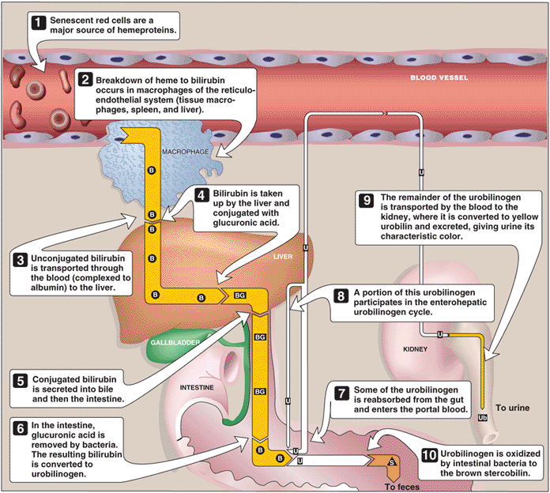
Catabolism of heme B = bilirubin; BG = bilirubin diglucuronide;
U= urobilinogen; Ub = urobilin; S = stercobilin.

Slide 22
2 - Urobilinogen:
- Normally present in trace amounts in urine
High urobilinogen is found in:
- Hemolytic anemia
- Hepatocellular damage
Nitrite :
Positive nitrite test is significant of bacteria in urine

Slide 23
Blood :
I - Hematuria: Presence of detectable amount of
blood in urine
a – Acute and chronic glomerulonephritis
b – Local disorders of kidney & genito-urinary
tract (Trauma , cystitis , renal calculi and tumors)
c – Bleeding disorders (Hemophilia)

Slide 24
II - Hemoglobinuria: Presence of hemolysed blood in urine
a – Hemoglobinopathies: 1. Sickle cell anemia
2. Thalassemia
b – Malaria (P. falciparum)
c – Transfusion reaction (Bl. Incompatibility)

Slide 25
QUESTIONS??

