Slide 1
Pathology of Kidney and the Urinary tract
Dr. Amar C. Al-Rikabi
Dr. Hala Kassouf Kfoury

Slide 2
Pathology of pyelonephritis, Nephrolithiasis and Cystitis
Lecture -2:

Slide 3
Objectives
Definition
Distinguish types of infections of urinary tract- pyelonephritis urethritis, cystitis, ureteritis
Recognize the pathophysiology of the most common infections of the kidney and urinary tract
Complications of infections of the urinary tract

Slide 4
Infections of Urinary Tract
Upper Urinary tract
Pyelonephritis-
Acute
Chronic
Lower Urinary tract
ureteritis
cystitis
urethritis

Slide 5
Route of infection
Ascending infection
This is the most common route of infection
Hematogenous infection

Slide 6
Predisposing conditions- acute pyelonephritis
Urinary tract obstruction, either congenital or acquired
Instrumentation of the urinary tract
Vesicoureteral reflux
Pregnancy..
Gender and age..
Preexisting renal lesions, causing intrarenal scarring and obstruction
Diabetes mellitus
Immunosuppression and immunodeficiency
Notes:
After the first year of life (when congenital anomalies in males commonly become evident) and up to around age 40 years, infections are much more frequent in females. With increasing age the incidence in males rises as a result of prostatic hypertrophy and instrumentation

Slide 7
Complications -acute pyelonephritis
1 Papillary necrosis
2 Pyonephrosis
3 Perinephric abscess

Slide 8
Acute on chronic pyelonephritis with numerous septic foci present in an already scarred kidney.

Slide 9
Acute pyelonephritis. There is a diffuse interstitial infiltrate with polymorphonuclear leukocytes.

Slide 10
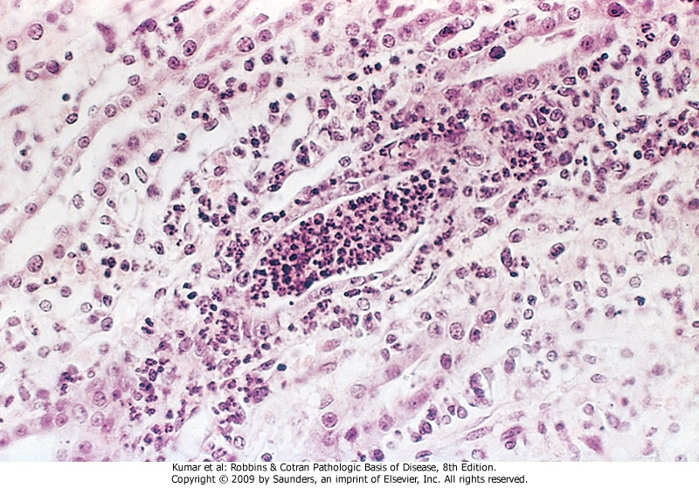
Acute pyelonephritis marked by an acute neutrophilic exudate within tubules and interstitial inflammation

Slide 11
Renal tuberculosis secondary to hematogenous spread of tubercle bacilli.

Slide 12
Staghorn calculus in pelviureteric junction.

Slide 13
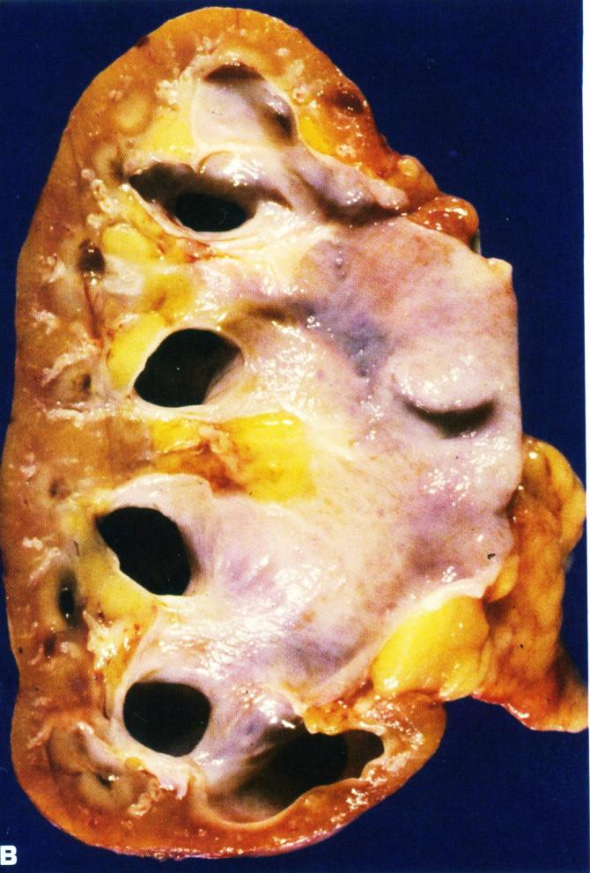
A. Bilateral hydronephrosis with acute on chronic pyelonephritis in a child due to urinary tract obstruction.
B. Hydronephrosis with thinned renal parenchyma in an adult kidney.

Slide 14
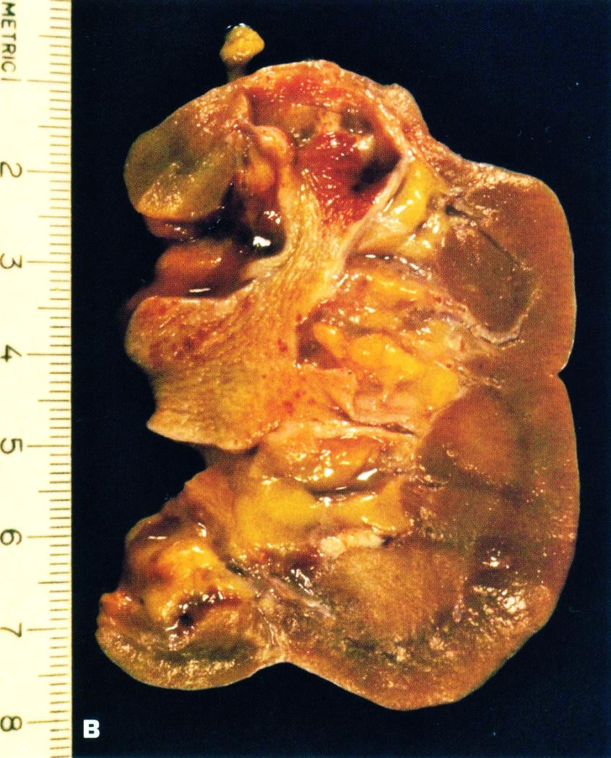
A. Board unshaped scar of healed pyelonephritis
B. Healed pyelonephritis associated with vesicoureteral reflux has produced scarring of both poles of the kidney with calyceal distortion due to infection of the peripheral compound papillae.

Slide 15
Chronic Pyelonephritis
Chronic tubulo-interstitial inflammation and renal scarring associated with pathologic involvement of the calyces and pelvis.
An important cause of end-stage kidney disease.
Divided into two forms:
* reflux-associated
* obstructive

Slide 16
Chronic pyelonephritis is a nonspecific interstitial infiltrate predominately with lymphocytes.

Slide 17
Chronic pyelonephritis.

Slide 18
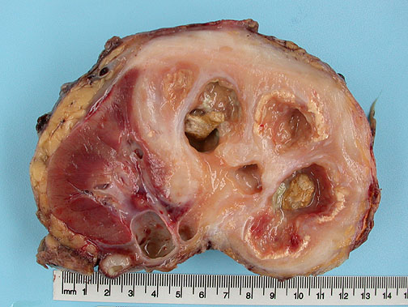
Notes:
Destruction of approximately 70% of the kidney. Numerous dilated calyces with yellow-brown calculi. The central necrotic areas are surrounded by dense fibrosis

Slide 19
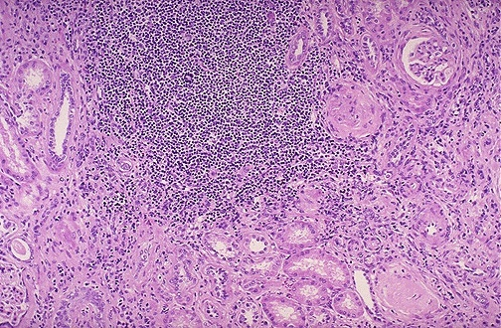
Chronic pyelonephritis: collection of chronic inflammatory cells here is in a patient with a history of multiple recurrent urinary tract infections.
Notes:
Both lymphocytes and plasma cells are seen in this case of chronic pyelonephritis. However, the plasma cells are most characteristic for chronic pyelonephritis.

Slide 20
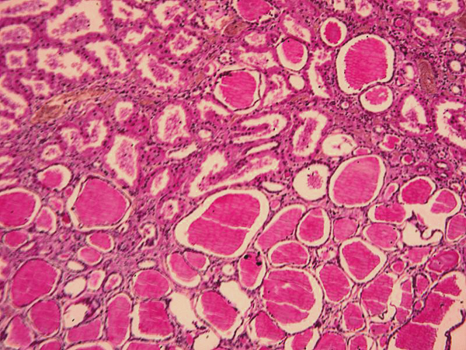

Slide 21
AIN. The mononuclear infiltrate is accompanying by abundant eosinophils and may have a granulomatous appearance.

Slide 22
AIN. Higher power of tubulitis demonstrating interstitial edema and invasion of the tubular epithelium by lymphocytes.

Slide 23
Urolithiasias
Types of stones in urinary tract
CALCIUM OXALATE and PHOSPHATE (70% )
Magnesium ammonium phosphate (15-20%)
(Struvite stone)
URIC ACID & URATE (5-10%)
CYSTINE (1-2%)

Slide 24
Definition-UTI
UTI: the finding of microorganisms in bladder urine with or without clinical symptoms and with or without renal disease
Significant bacteriuria: the number of bacteria in the voided urine exceeds the number that can be expected from contamination (i.e. ≥ 10⁵ cfu/ml)

Slide 25
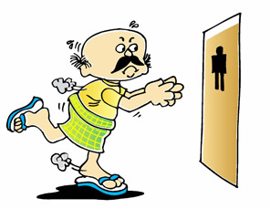
Clinical features of UTI
Cystitis
Frequency
Urgency
Dysuria – painful voiding
suprapubic Pain
Cloudy or foul-smelling
urine

Slide 26
Symptoms urolithiasis
Pain in the lower back part or in the lower abdomen, which might move to the groin. Pain may last from hours to minutes.
Nausea, vomiting
Blood in urine
Burning during urination, foul smell in urine, chills, weakness and fevers for urinary tract infection.

Slide 27
Acute and Chronic Cystitis: Etiology
Women are more likely to develop cystitis
Tuberculous cystitis is always a sequel to renal TB
Candida albicans
Schistosomiasis (Schistosoma haematobium)),
Chlamydia, and Mycoplasma may also cause cystitis.
Predisposing factors include bladder calculi, urinary obstruction, diabetes mellitus, instrumentation, and immune deficiency.
Finally, irradiation of the bladder region gives rise to radiation cystitis.

Slide 28
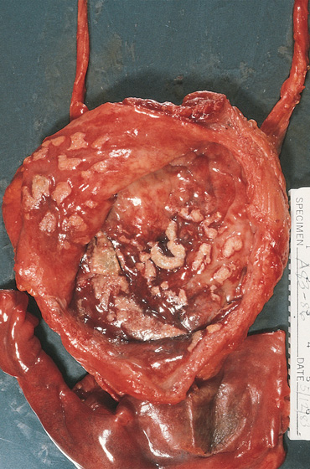
Cystitis with malakoplakia
Peculial inflammatory reaction
chacakterized by
soft, yellow,
plaques 3-4 cm in diameter
and histologically
by foamy
macrophages
Slide 22.6

Slide 29
Acute inflammation of the urinary bladder.

Slide 30
Multiple acquired diverticula (arrows) lie between hypertrophied muscular bundles in a hypertrophied bladder of the patient who had severe prostatic hyperplasia.

