Slide 1

Pathology of Kidney and the Urinary tract
Dr. Amar C. Al-Rikabi
Dr. Hala Kasouf Kfouri

Slide 2
Benign and Malignant Tumours of the Kidney and Urinary Bladder
Lecture -5

Slide 3
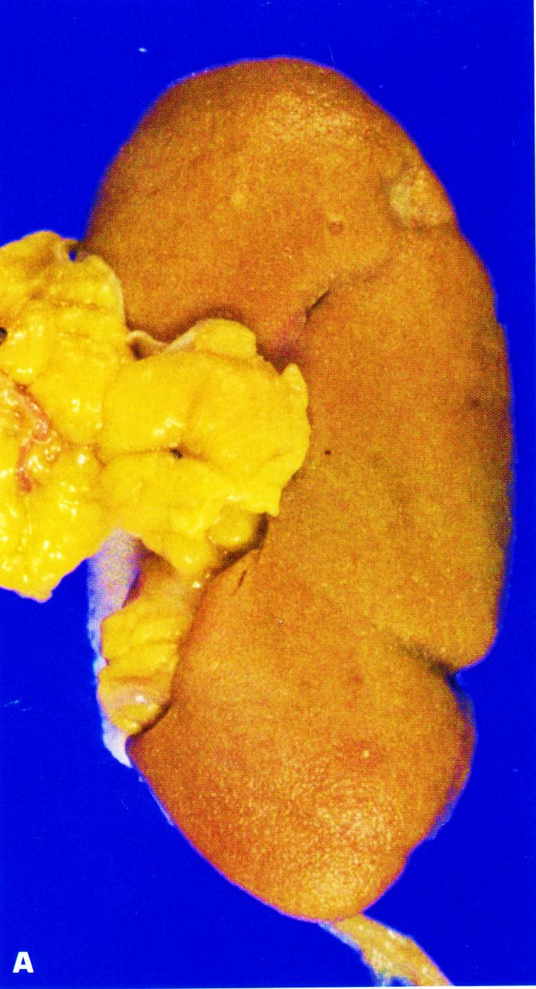
Kidney with ischemic atrophy also bears very small subcapsular adenomas near to each pole.

Slide 4
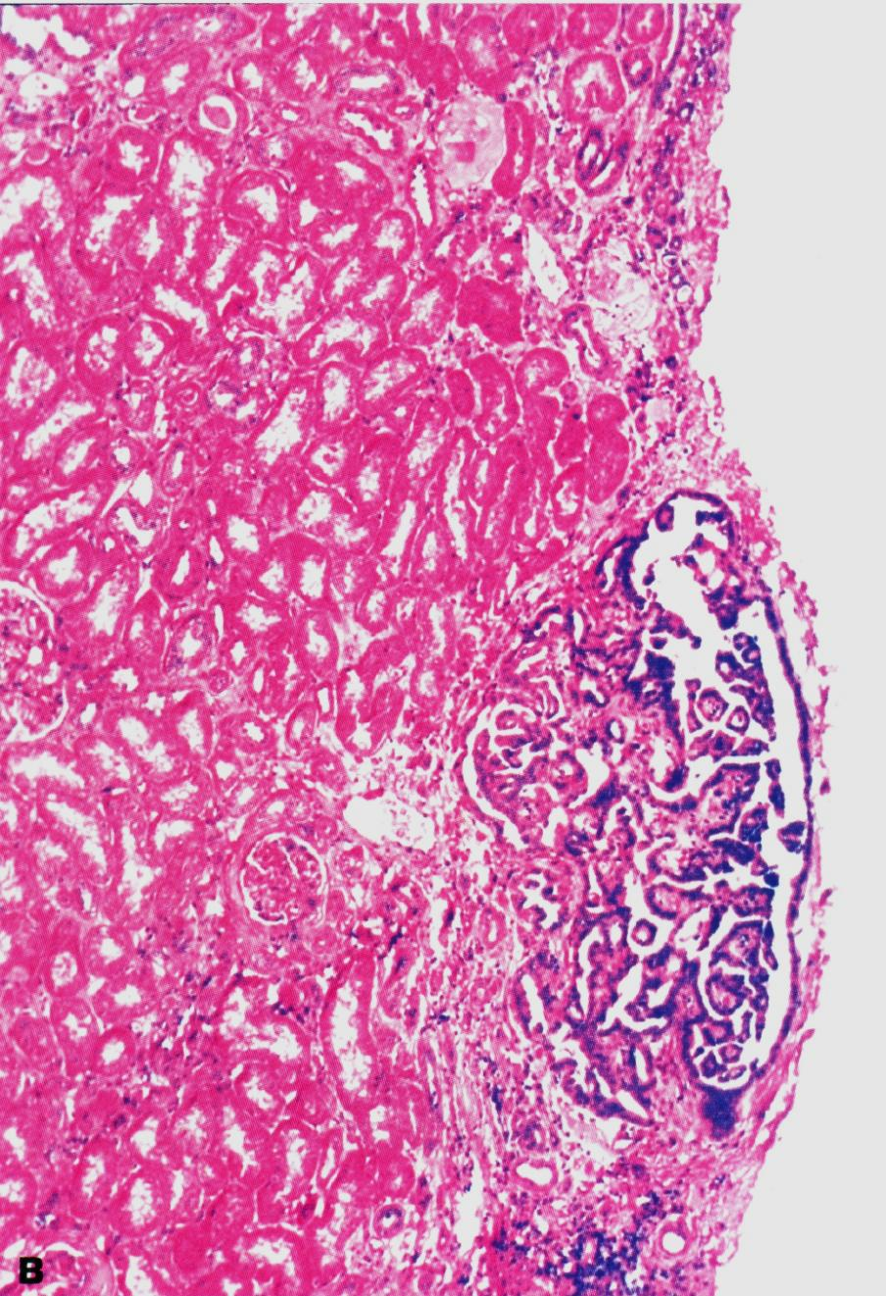
Histology of a subcapsular papillary adenoma shows tubules arranged in a papillary fashion.

Slide 5
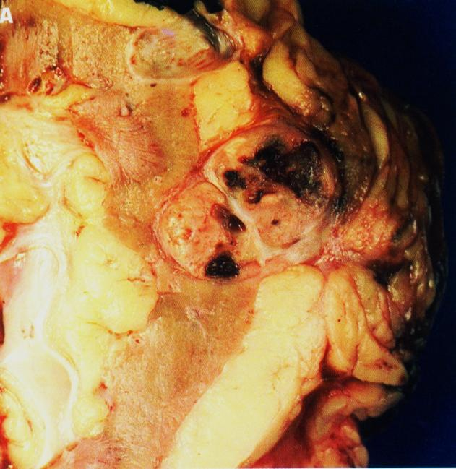
Renal cell carcinoma
Renal cell carcinoma is the most common primary renal tumor in adults and may be occult.

Slide 6
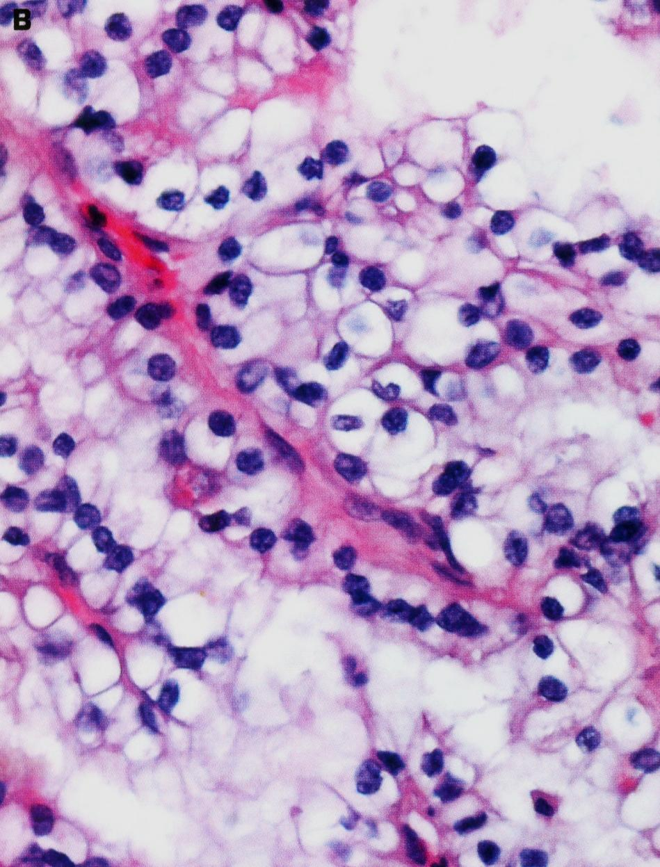
Small clear cell renal cell carcinoma (hypernephroma, Grawitz tumor) is spreading into perirenal adipose tissue.

Slide 7
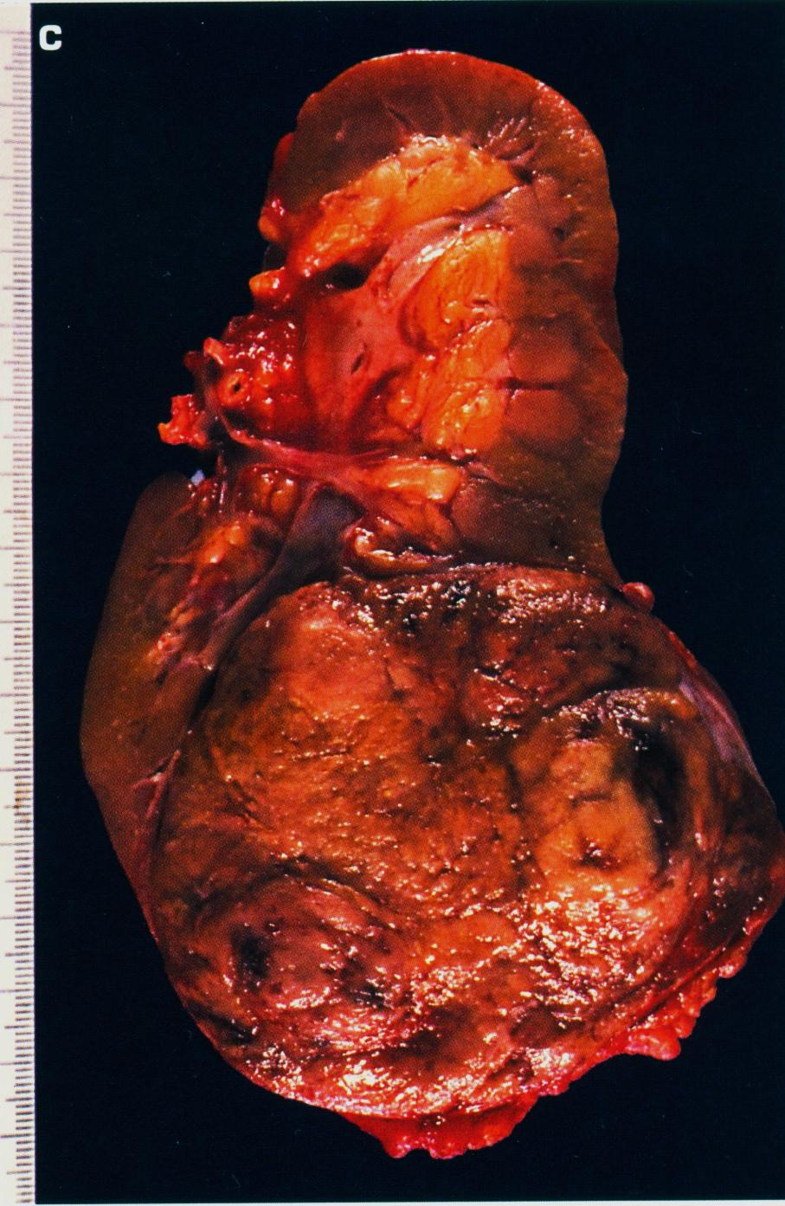
Typical lobulated, whorled, tan-colored cut surface of renal cell carcinoma.

Slide 8
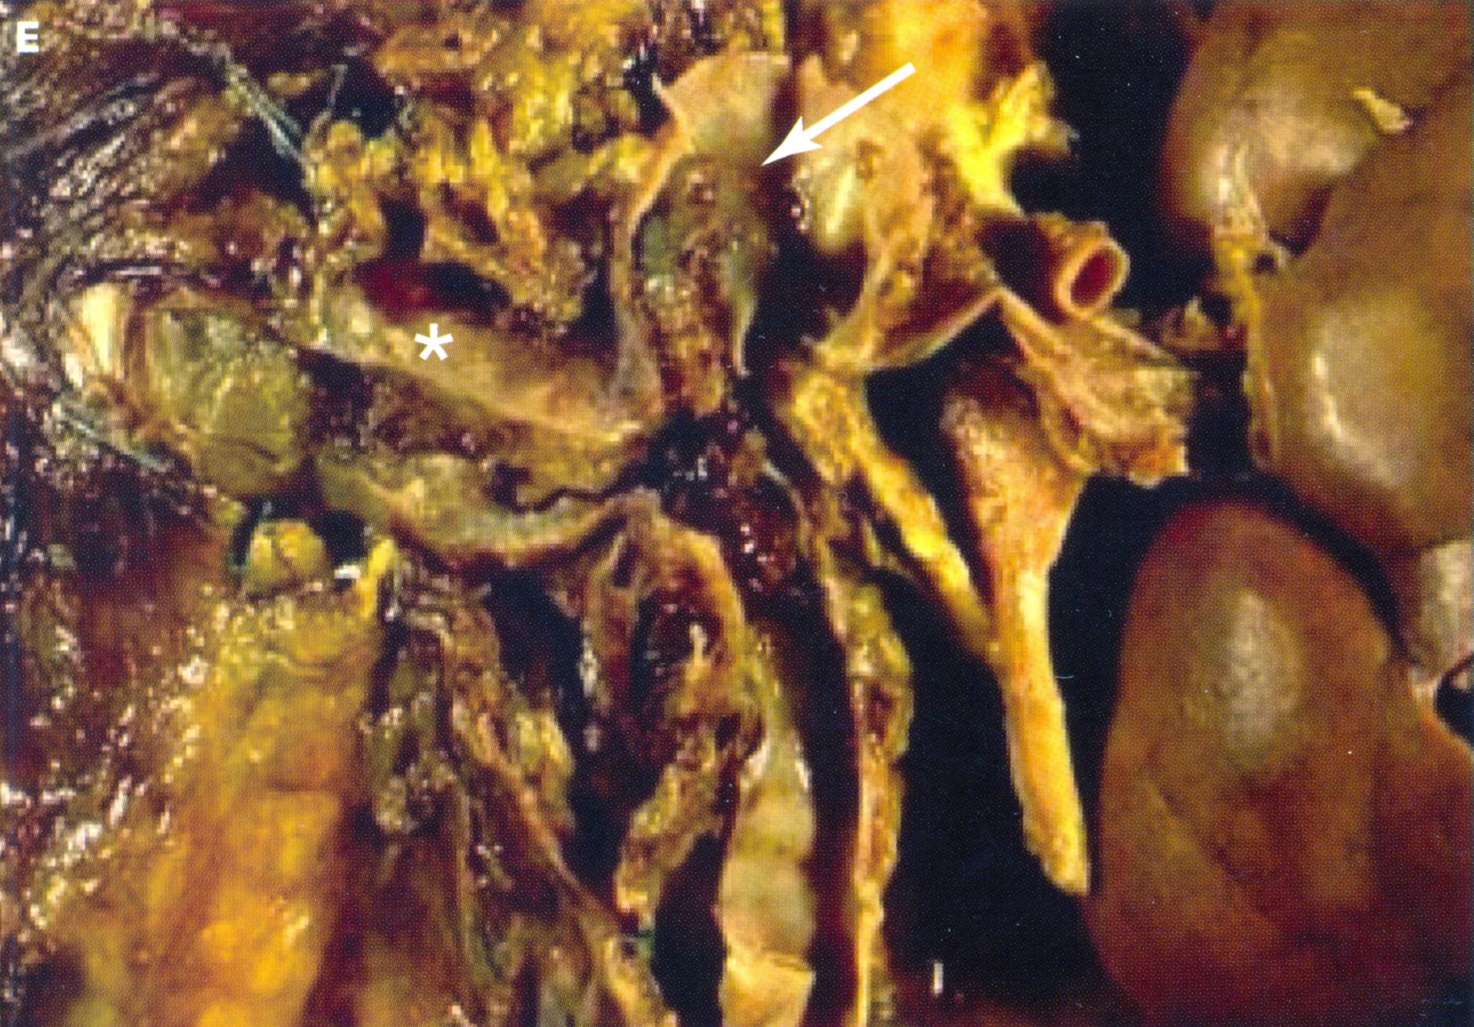
Invasion of the renal vein and inferior vena cava (arrow) by renal cell carcinoma.

Slide 9
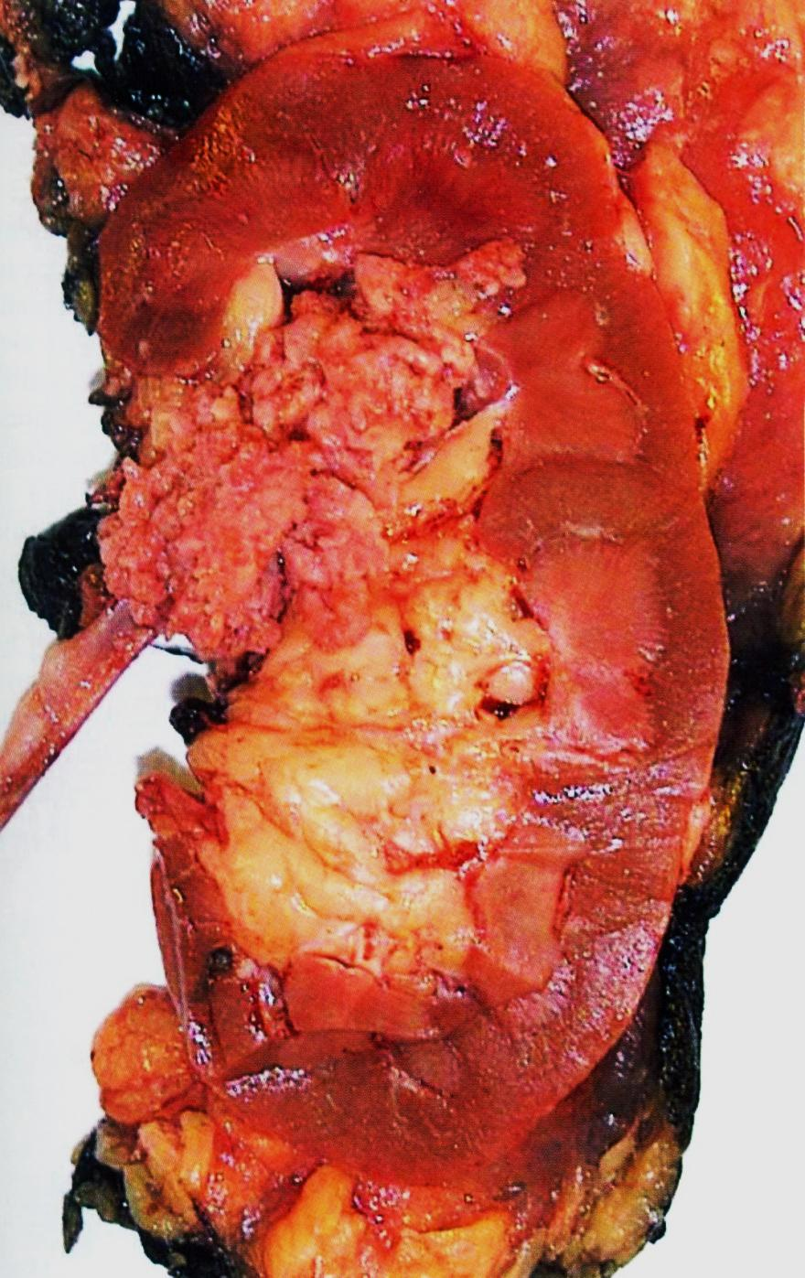
Papillary urothelial (transitional cell) carcinoma of renal pelvis. Note the exophytic, multifronded nature of the tumor.
Transitional cell carcinoma of the renal pelvis.

Slide 10
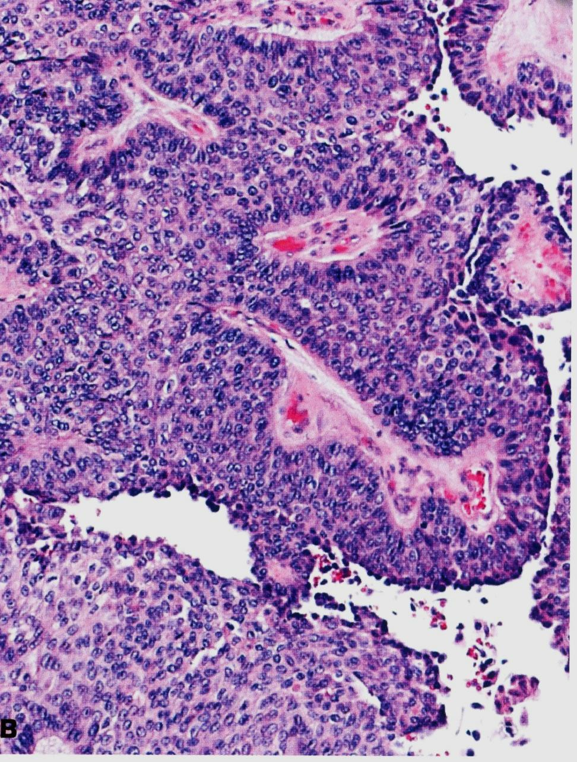
Moderately differentiated urothelial carcinoma of bladder.

Slide 11
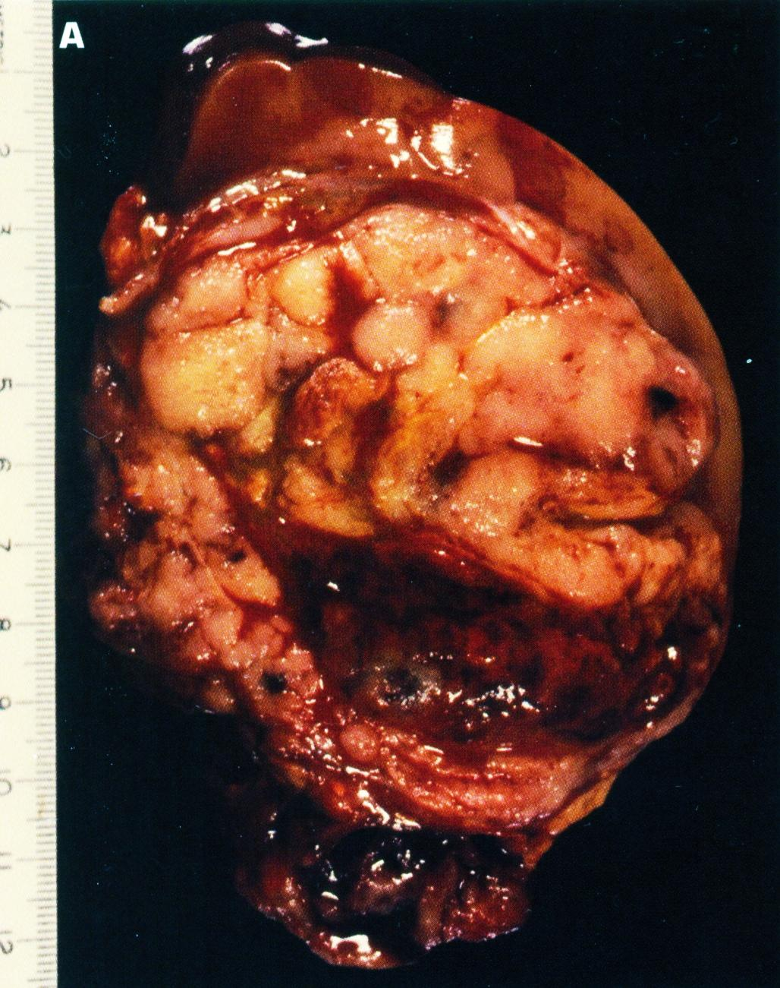
Solid, bulging, fleshy tan-white, partially necrotic tumor has replaced much of the kidney and is encompassed by a thin rim of renal tissue..
Wilms’ tumor (nephroblastoma)

Slide 12
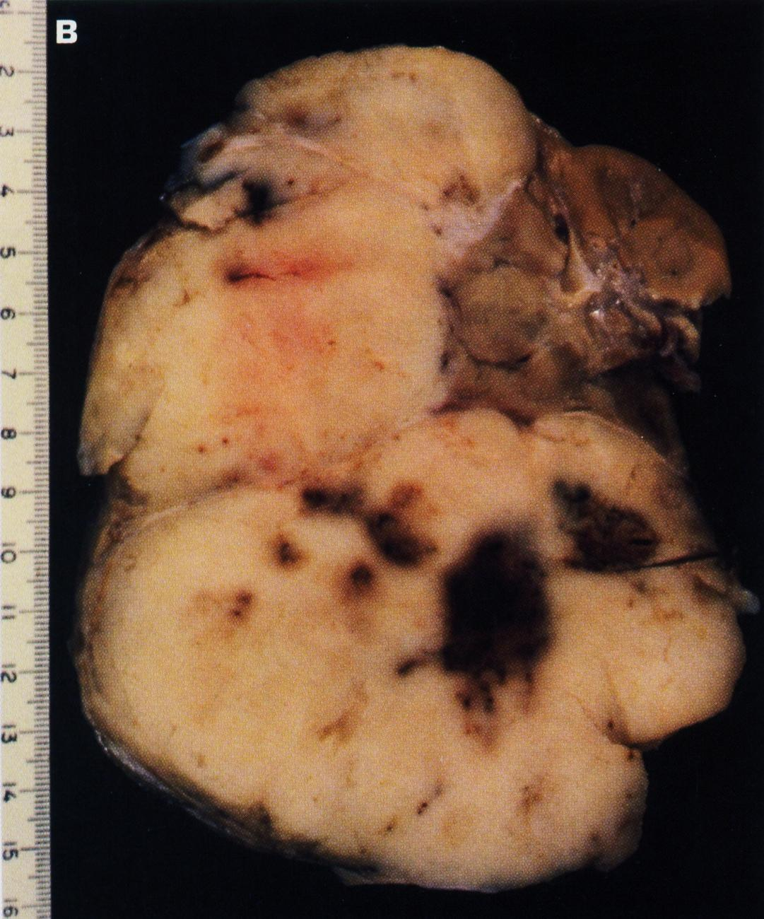
This Wilms’ tumor appears whiter due to formalin fixation and has extended beyond the confines of the kidney

Slide 13
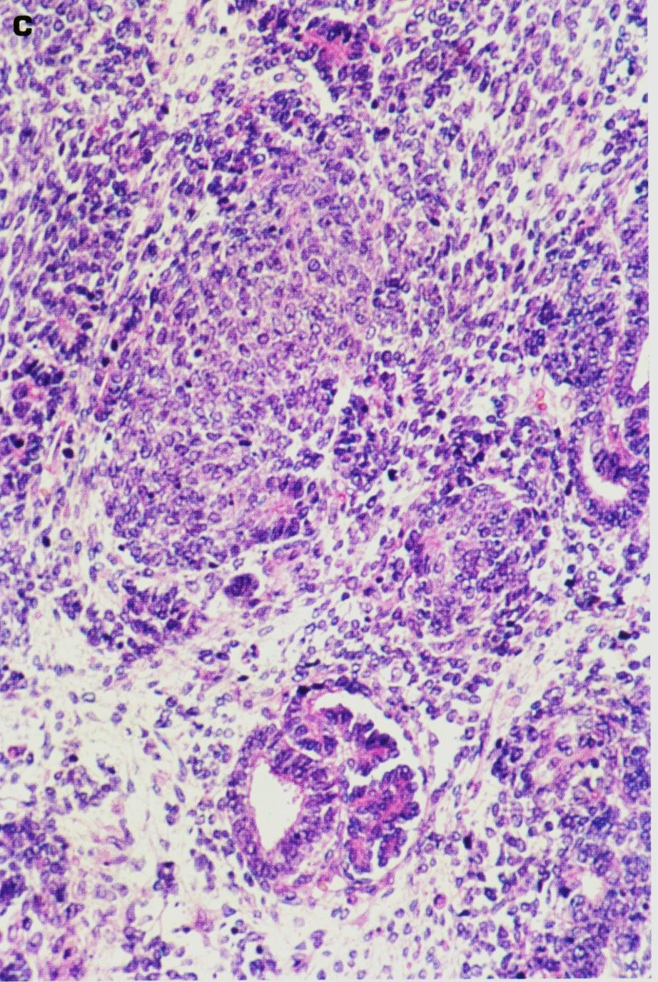
Histology shows hypercellular areas comprising undifferentiated blastema, loose stroma with undifferentiated mesglomeruloid body.
Wilms’ tumor

Slide 14
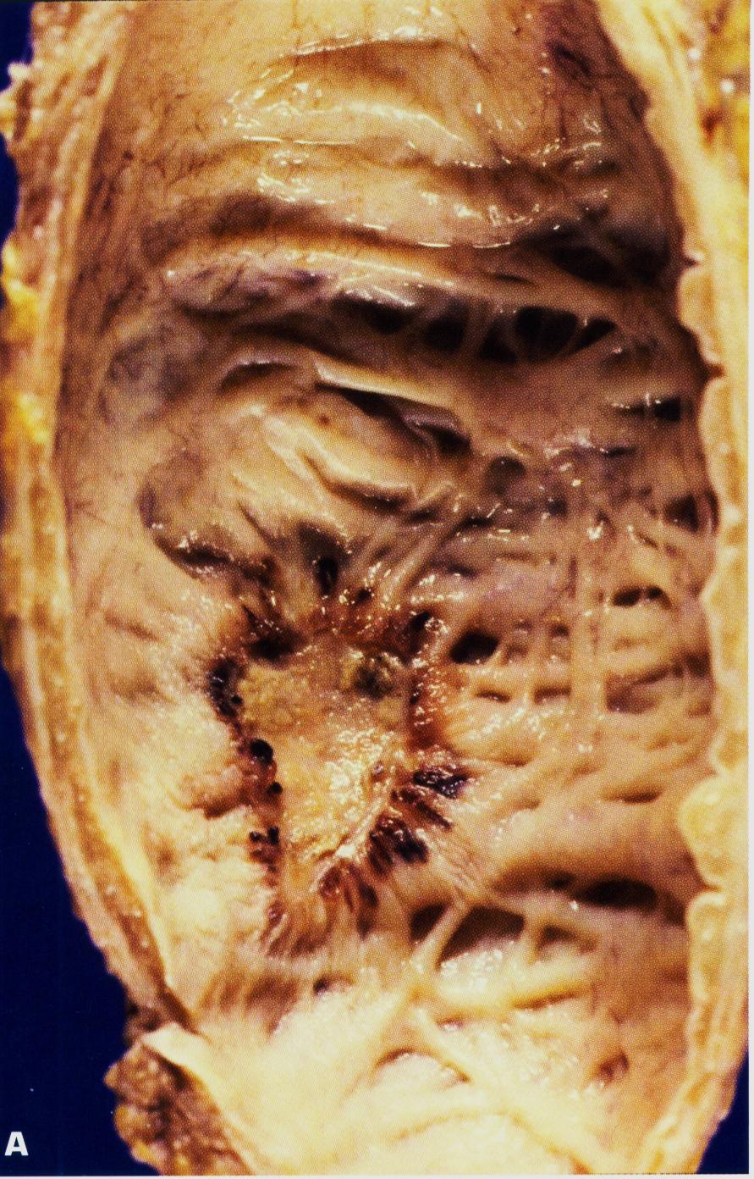
Urothelial (transitional cell) carcinoma in situ of the urinary bladder if untreated, up to 75% of cases go on to invasive cancer.

Slide 15
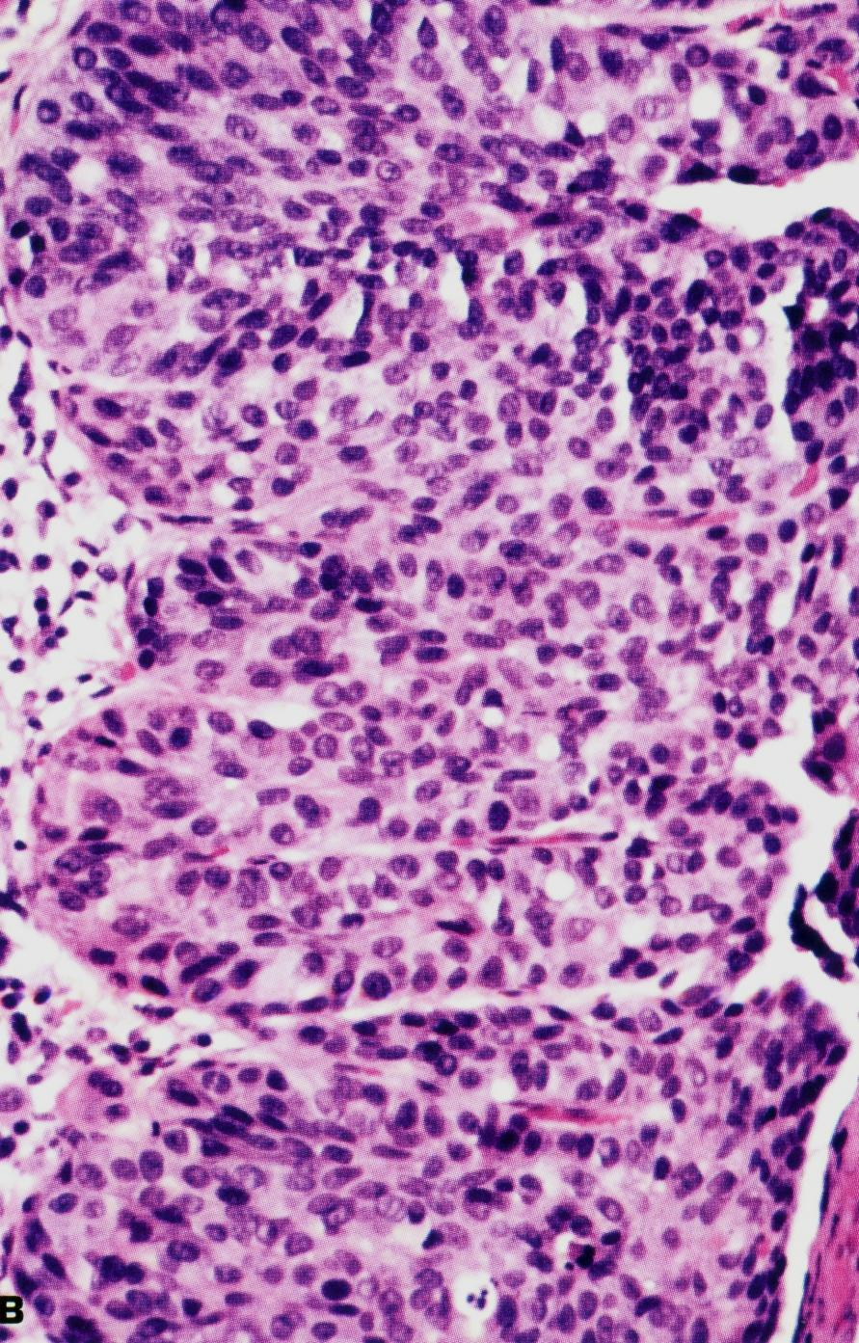
Histology of carcinoma in situ (surface is to the right).

Slide 16
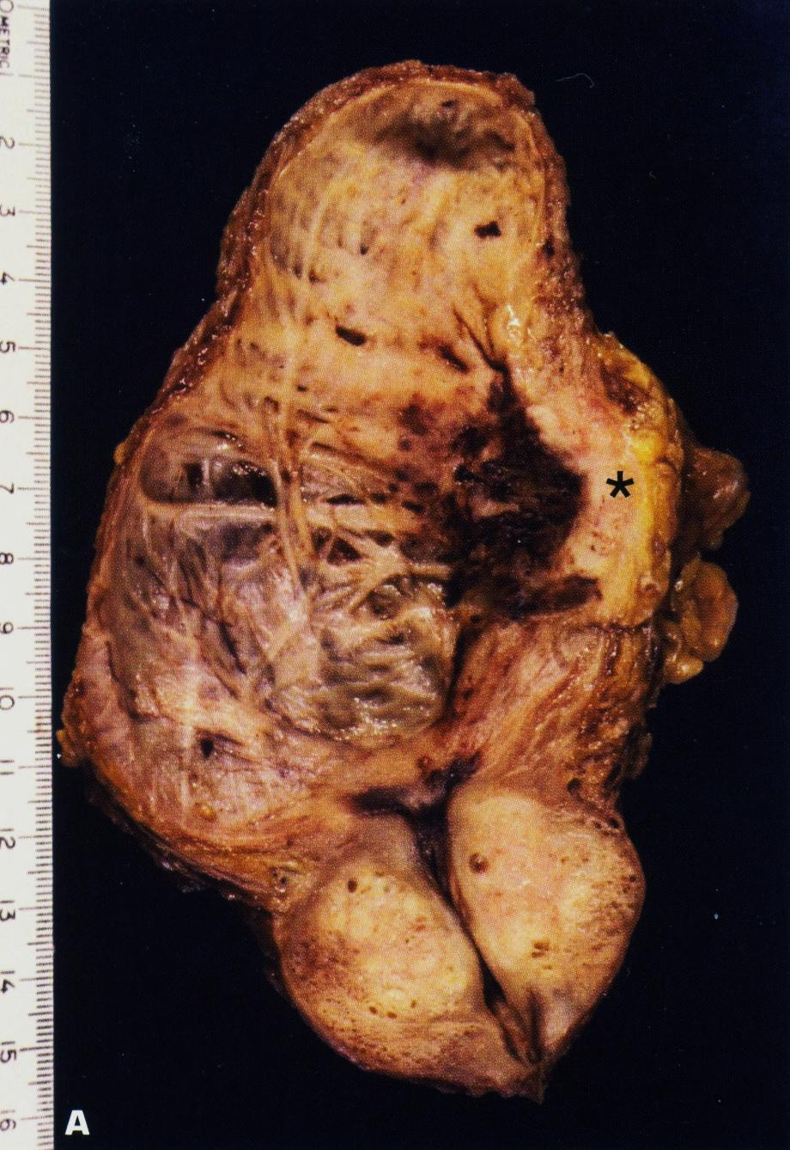
Invasive urothelial carcinoma of the bladder is invading the muscle coat on the right side of the picture.

Slide 17
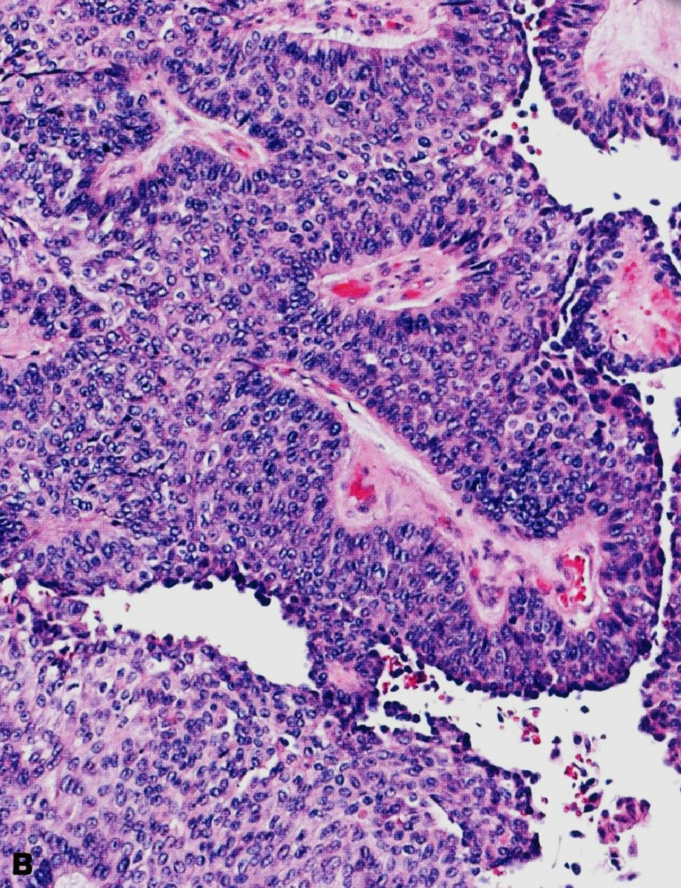
Moderately differentiated urothelial carcinoma of bladder.

Slide 18
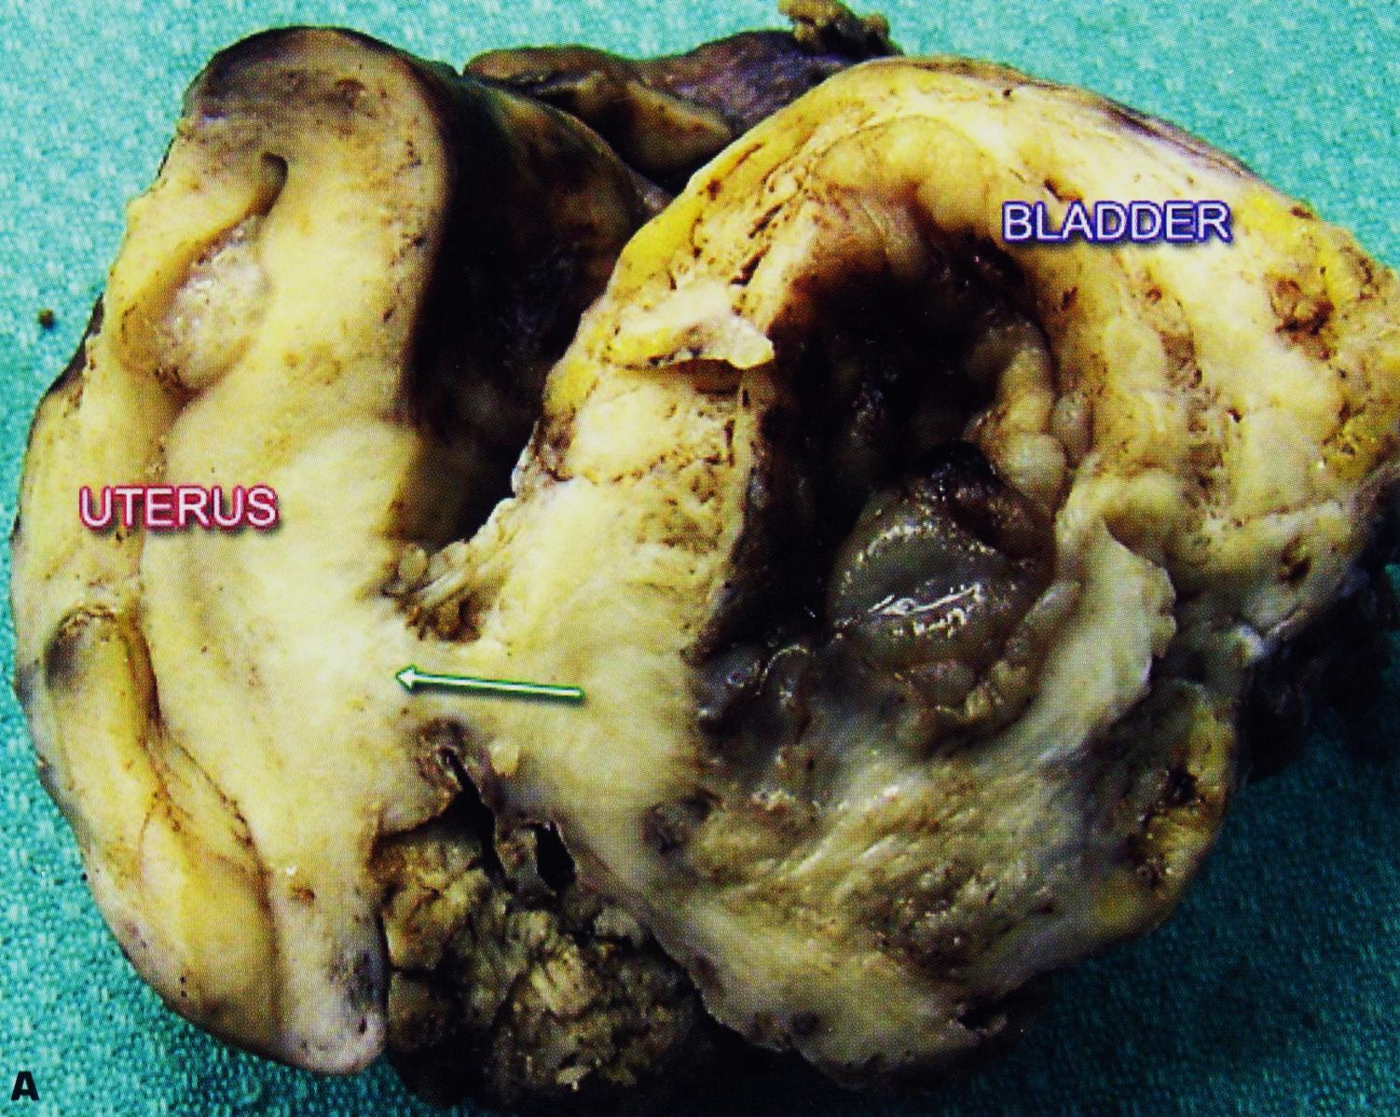
Advanced urothelial cancer of the bladder has spread posteriorly (arrow)to invade the uterus.

Slide 19
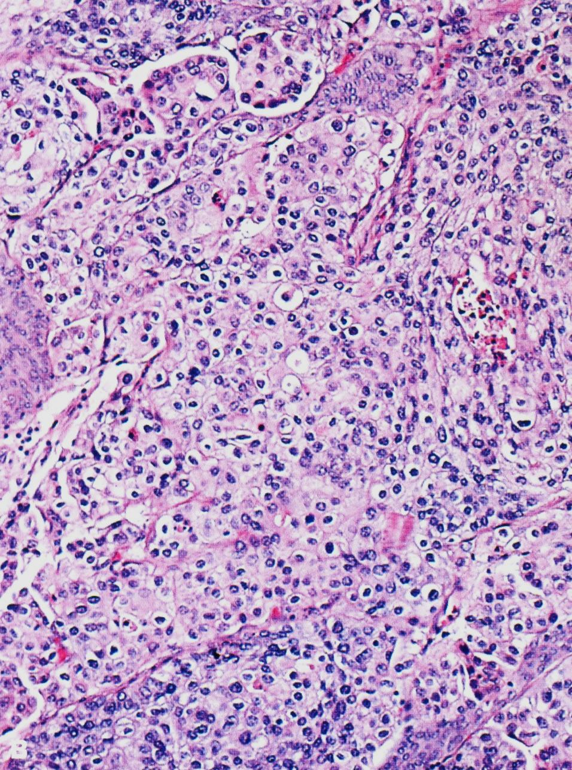
Poorly differentiated urothelial carcinoma.

