Slide 1
Pathology of Kidney and the Urinary tract
Dr. Amar C. Al-Rikabi
Dr. Hala Kasouf Kfouri

Slide 2
Pathology of pyelonephritis, Nephrolithiasis and Cystitis
Lecture -2:

Slide 3
Acute on chronic pyelonephritis with numerous septic foci present in an already scarred kidney.

Slide 4
Acute pyelonephritis. There is a diffuse interstitial infiltrate with polymorphonuclear leukocytes.

Slide 5
Acute pyelonephritis. The infiltrate of polymorphonuclear leukocytes is not only present within interstitium and in the lumen but also evidence of tubulitis is seen.

Slide 6
Renal tuberculosis secondary to hematogenous spread of tubercle bacilli.

Slide 7
Staghorn calculus in pelviureteric junction.

Slide 8
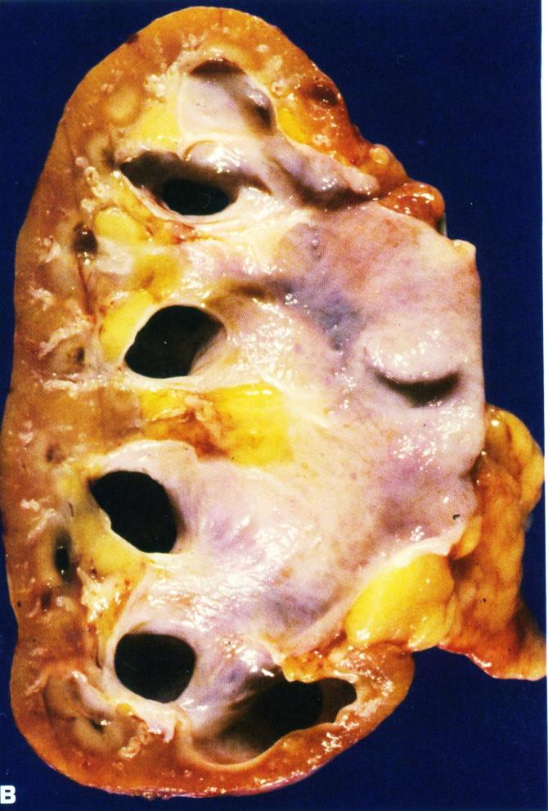
A. Bilateral hydronephrosis with acute on chronic pyelonephritis in a child due to urinary tract obstruction.
B. Hydronephrosis with thinned renal parenchyma in an adult kidney.

Slide 9
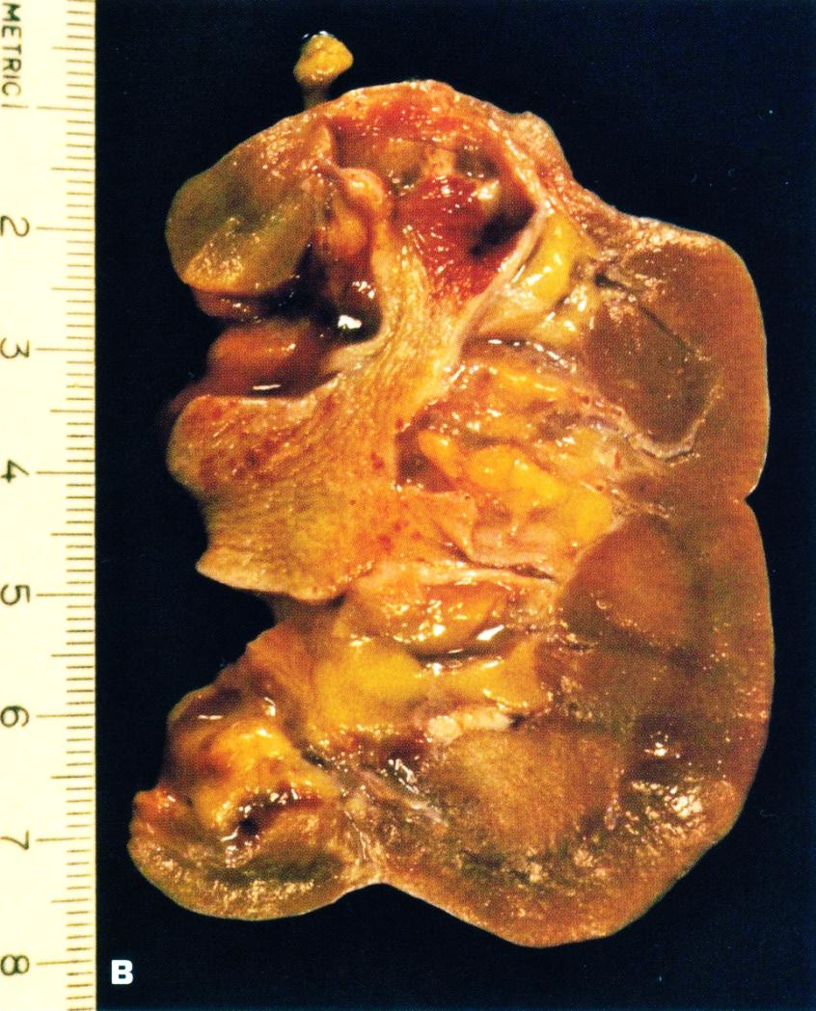
A. Board unshaped scar of healed pyelonephritis
B. Healed pyelonephritis associated with vesicoureteral reflux has produced scarring of both poles of the kidney with calyceal distortion due to infection of the peripheral compound papillae.

Slide 10
Chronic pyelonephritis is a nonspecific interstitial infiltrate predominately with lymphocytes.

Slide 11
Chronic pyelonephritis.

Slide 12
AIN. The mononuclear infiltrate is accompanying by abundant eosinophils and may have a granulomatous appearance.

Slide 13
AIN. Higher power of tubulitis demonstrating interstitial edema and invasion of the tubular epithelium by lymphocytes.

Slide 14
Acute inflammation of the urinary bladder.

Slide 15
Multiple acquired diverticula (arrows) lie between hypertrophied muscular bundles in a hypertrophied bladder of the patient who had severe prostatic hyperplasia.

